Slide 1
QFE-COD: Camouflaged Object Detection Using Quantum Frequency Enhancement with Q-WaveKAN-Based Feature Learning
BCSE498J – Project II Bachelor of Technology in Computer Science and Engineering Student: Daksheth G (Reg. No. 22BCE0905) Guide: Sathya K, Assistant Professor Sr. Grade 2, SCOPE Vellore Institute of Technology | April 2026 Mentor:Balakrishnan N , Greynuim Technologies (OneIndia)

Slide 2
Synopsis
Camouflaged Object Detection (COD) presents a unique challenge in computer vision where targets blend seamlessly with backgrounds through color, texture, and edge similarity. QFE-COD introduces a novel deep learning framework that integrates quantum-classical hybrid processing with multi-scale frequency domain analysis
CAM/NonCAM Binary Classifier - PVTv2-B2 backbone achieves 94.23% validation accuracy on COD10K-v3.
QFE-COD Segmentation Model-PVTv2-B4 + DWT + FSA + 8-qubit HQCM + FPN-Mamba + Q-WaveKAN
SINetV2 Baseline Comparison - Traditional deep learning benchmark for performance evaluation
Dataset: COD10K-v3 — 6000 train, 4000 test images Best Performance: Dice 0.7889 | IoU 0.7402 (Epoch 28

Slide 3
Introduction
COD fundamentally differs from salient object detection: targets are specifically designed to evade detection through sophisticated blending mechanisms. The field traces its roots to military aerial reconnaissance during World War I, evolving through hand-crafted features like SIFT and HOG.
WWI Era -Military aerial reconnaissance establishes camouflage detection
2020 -SINet (CVPR) + COD10K benchmark by Fan et al.
2022 -SINetV2 (IEEE TPAMI) introduces NCD and GRA modules
2024 -QFE-COD integrates quantum frequency processing
Key Insight: Camouflaged objects differ most in mid-frequency features, not gross color or structure. This motivates frequency-domain processing combined with quantum computing (VQCs via PennyLane) and the emerging KAN neural network paradigm.

Slide 4
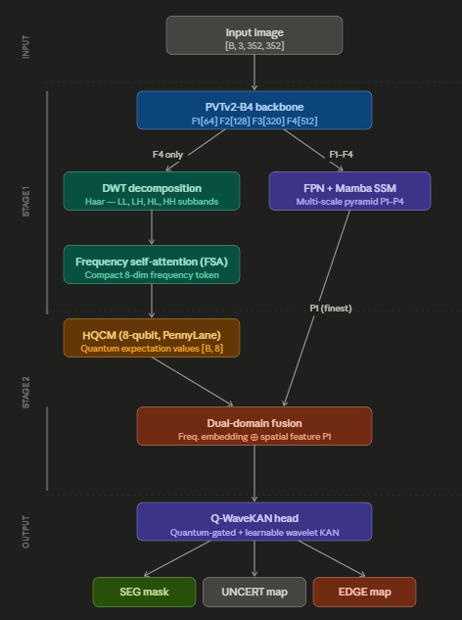
System Architecture — QFE-COD Pipeline
Overview
Three-stage end-to-end pipeline: CAM/NonCAM classification → QFE-COD segmentation → output generation
Input: RGB images resized to 352×352
Stage 1 — Backbone (PVTv2-B4)
Pyramid Vision Transformer extracts 4 hierarchical feature maps: F1[64], F2[128], F3[320], F4[512]
Captures both fine-grained and high-level semantic features
Stage 2 — Frequency Branch (Left path)
DWT Decomposition: Haar wavelet decomposes F4 into 4 subbands — LL, LH, HL, HH
FSA (Frequency Self-Attention): Pools subbands into compact 8-dimensional frequency token
HQCM (8-qubit): PennyLane quantum circuit applies angle embedding + entangling layers → quantum expectation values [B, 8]

Slide 5
System Architecture — QFE-COD Pipeline
Stage 3 — Spatial Branch (Right path)
FPN + Mamba SSM blocks process F1–F4 into multi-scale pyramid P1–P4
Mamba-inspired State Space Model captures long-range spatial dependencies
Stage 4 — Fusion & Decoding
Dual-Domain Fusion: merges quantum frequency embedding with P1 (finest spatial scale)
Q-WaveKAN Head: quantum-gated decoder with learnable wavelet-based KAN activations
Outputs
SEG mask — binary segmentation of camouflaged object
UNCERT map — pixel-level uncertainty estimation
EDGE map — boundary/edge prediction

Slide 6
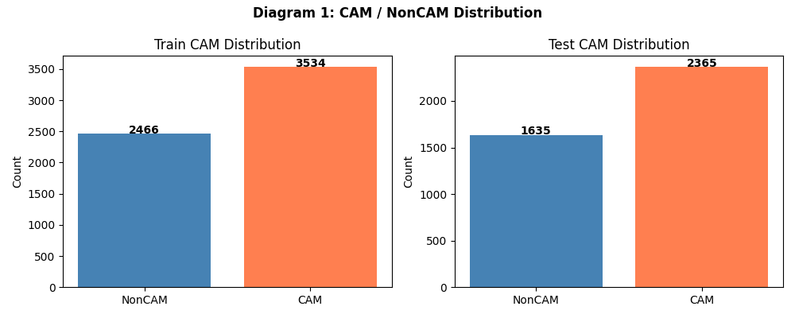
Dataset – COD10k
Overview
Largest and most comprehensive benchmark dataset for Camouflaged Object Detection
Contains 10,000 images spanning 78 camouflaged object categories
Covers both aquatic and terrestrial camouflage scenarios
Dataset Split
Train set: 6,000 images → CAM: 3,534 | NonCAM: 2,466
Test set: 4,000 images → CAM: 2,365 | NonCAM: 1,635
Class ratio approximately 59% CAM : 41% NonCAM (slight imbalance handled via binary labels)
Preprocessing & Augmentation
Images resized to 352×352 for training
Augmentation: random horizontal flip, color jitter, normalization
Binary label sanitization applied (labels mapped to {0, 1})
Dataloaders rebuilt with safe binary labels before training

Slide 7
Implementation Tools & Software
Hardware
GPU: NVIDIA CUDA-enabled (CUDA 12.8)
Framework: PyTorch 2.10.0+cu128
Platform: Kaggle cloud GPU environment
Batch size: 4 (GPU memory optimized)
Deep Learning Framework
PyTorch 2.10.0 — primary model building, training, and inference
torchvision — image transforms and preprocessing utilities
CUDA 12.8 — GPU acceleration for model training
Backbone & Baseline Models
PVTv2-B2 — Stage 1 CAM/NonCAM classifier backbone (24.98M params)
PVTv2-B4 — Stage 2 QFE-COD segmentation backbone (62.51M params)
SINetV2 — comparative baseline model (23.91M params)
Quantum Computing
PennyLane (Xanadu AI) — differentiable quantum circuit simulation
8-qubit variational quantum circuit with angle embedding
4 layers of strongly entangling operations
Seamless PyTorch integration via autograd

Slide 8
Implementation Tools & Software
Stage 1 — CAM/NonCAM Classifier Results
Total epochs trained: 20 (early stopping patience: 7)
Best validation accuracy: 94.23% (Epoch 19)
Final training accuracy: 99.23% | Final training loss: 0.0195
Validation loss stabilized around 0.28 after Epoch 11
Epoch 1: Train acc=82.98% → Val acc=91.03%
Epoch 6: Train acc=94.55% → Val acc=93.30%
Epoch 11: Train acc=97.53% → Val acc=94.10%
Epoch 19: Train acc=99.23% → Val acc=94.23% ← Best saved
Stage 2 — QFE-COD Segmentation ResultsTotal epochs trained: 28 (best checkpoint saved)
Early stopping patience: 10 epochs
QFE-COD Best Checkpoint (Epoch 28)
Dice: 0.7889 | IoU: 0.7402
QFE-COD Progression
Epoch 1: Dice=0.5788 | IoU=0.5196
Epoch 6: Dice=0.7200 | IoU=0.6654
Epoch 13: Dice=0.7501 | IoU=0.6981
Epoch 22: Dice=0.7789 | IoU=0.7288
Epoch 28: Dice=0.7889 | IoU=0.7402 ← Best saved

Slide 9
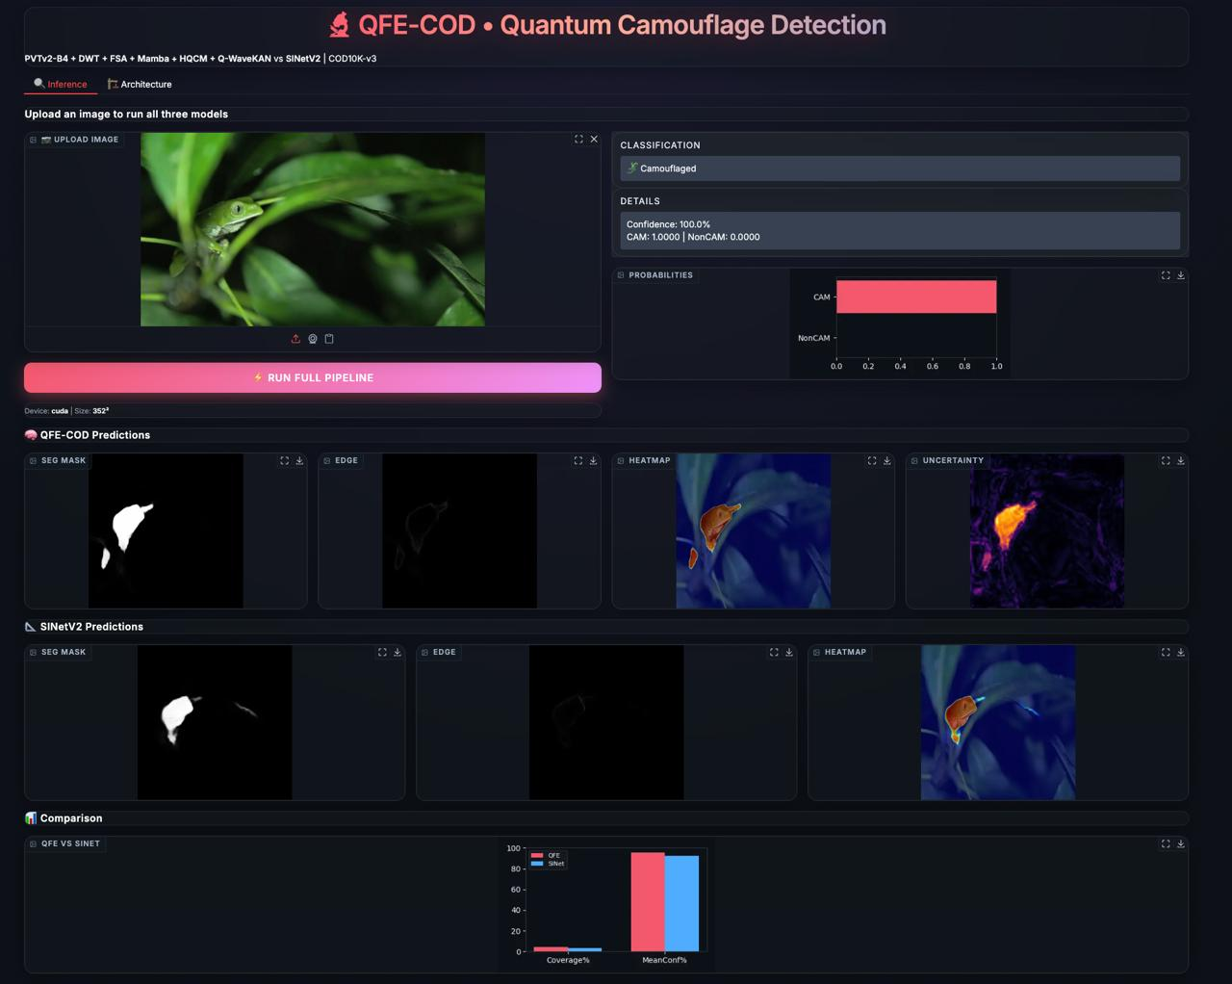
Output
Stage 1 — Classifier
Predicts CAM or NonCAM per image
Best validation accuracy: 94.23%
Confusion matrix: 1924 TP | 1849 TN | 125 FP | 102 FN
Training loss: 0.38 → 0.019 over 20 epochs
Stage 2 — Segmentation
Produces 3 outputs per image:
SEG mask — object region
UNCERT map — uncertain boundary pixels
EDGE map — object contour
Best Dice: 0.7889 | Best IoU: 0.7402 (Epoch 28)

Slide 10
Output
Stage 1 — Classifier
Predicts CAM or NonCAM per image
Best validation accuracy: 94.23%
Confusion matrix: 1924 TP | 1849 TN | 125 FP | 102 FN
Training loss: 0.38 → 0.019 over 20 epochs
Stage 2 — Segmentation
Produces 3 outputs per image:
SEG mask — object region
UNCERT map — uncertain boundary pixels
EDGE map — object contour
Best Dice: 0.7889 | Best IoU: 0.7402 (Epoch 28)

Slide 11
Conclusion
Successful Integration
QFE-COD effectively combines quantum-classical hybrid processing with frequency-domain analysis for camouflaged object detection
Modular Pipeline
Three-stage architecture (classifier → QFE segmentation → evaluation) proved robust and practical
Quantum Signal Boost
HQCM frequency embeddings provided meaningful performance improvement over purely spatial baseline (SINetV2)
Enhanced Boundaries
Q-WaveKAN head's learnable wavelet activations improved boundary delineation in texturally complex scenes
Practical Demonstration
Framework demonstrates hybrid quantum-classical models can be integrated into deep vision pipelines using PennyLane + PyTorch

Slide 12
Future Enhancement
Dataset Expansion
Evaluate on additional COD benchmarks — CAMO, CHAMELEON, NC4K
Train on larger, more diverse camouflage datasets for better generalization
Quantum Hardware
Deploy HQCM on real quantum hardware — IBM Quantum / IonQ
Currently limited to PennyLane simulation — real hardware may unlock further gains
Scale from 8-qubit to larger quantum circuits as hardware matures
Model Optimization
Apply model pruning and quantization for faster inference
TensorRT / ONNX export for edge deployment
Reduce model size from 62.51M parameters without sacrificing accuracy
Extended Applications
Medical imaging — polyp detection, lesion segmentation
Industrial defect detection under camouflage-like conditions
Military target detection in complex backgrounds

Slide 13
Outcome
Technical Outcomes
Built a functional 3-stage COD pipeline — classifier → segmentation → evaluation
Achieved Dice = 0.7889, IoU = 0.7402 on COD10K-v3 test set
Outperformed SINetV2 baseline by +0.10 Dice (~14.8% relative improvement)
Deployed interactive Gradio dashboard for real-time inference
Academic Outcomes
Demonstrated practical integration of quantum circuits in a deep vision pipeline
Validated that frequency-domain features improve camouflaged object detection
Produced comprehensive project report with ablation analysis and diagnostics

Slide 14
Outcome
Technical Outcomes
Built a functional 3-stage COD pipeline — classifier → segmentation → evaluation
Achieved Dice = 0.7889, IoU = 0.7402 on COD10K-v3 test set
Outperformed SINetV2 baseline by +0.10 Dice (~14.8% relative improvement)
Deployed interactive Gradio dashboard for real-time inference
Academic Outcomes
Demonstrated practical integration of quantum circuits in a deep vision pipeline
Validated that frequency-domain features improve camouflaged object detection
Produced comprehensive project report with ablation analysis and diagnostics

Slide 15
Outcome
Technical Outcomes
Built a functional 3-stage COD pipeline — classifier → segmentation → evaluation
Achieved Dice = 0.7889, IoU = 0.7402 on COD10K-v3 test set
Outperformed SINetV2 baseline by +0.10 Dice (~14.8% relative improvement)
Deployed interactive Gradio dashboard for real-time inference
Academic Outcomes
Demonstrated practical integration of quantum circuits in a deep vision pipeline
Validated that frequency-domain features improve camouflaged object detection
Produced comprehensive project report with ablation analysis and diagnostics

Slide 16
Outcome
Camouflaged Object Detection
Fan, D.-P. et al. — Camouflaged Object Detection — CVPR 2020
Fan, D.-P. et al. — Concealed Object Detection — IEEE TPAMI 2022
Pang, Y. et al. — ZoomNeXt: Unified Collaborative Pyramid Network for COD — IEEE TPAMI 2024
Zhou, T. et al. — Feature Aggregation and Propagation Network for COD — IEEE TIP 2022
Li, Y. et al. — FindNet: Boundary-and-Texture Enhancement for COD — IEEE TIP 2023
Backbone & Feature Extraction
Wang, W. et al. — PVTv2: Improved Baselines with Pyramid Vision Transformer — arXiv 2021 7. Lin, T.-Y. et al. — Feature Pyramid Networks for Object Detection — CVPR 2017
Quantum Machine Learning
Bergholm, V. et al. — PennyLane: Automatic Differentiation of Hybrid Quantum-Classical Computations — arXiv 2018 9. Cerezo, M. et al. — Variational Quantum Algorithms — Nature Reviews Physics 2021

Slide 17
Literature Review
SINet (CVPR 2020) — first COD framework + COD10K dataset
SINetV2 (TPAMI 2022) — added NCD + GRA modules, Dice ~0.82
FAPNet (2022) — multi-scale feature aggregation for boundary refinement
FindNet (2023) — boundary and texture enhancement network
ZoomNeXt (2024) — zoom-in/out pyramid network for multi-scale detection
Transformer-Based
PVTv2 (2021) — pyramid vision transformer, used as backbone in QFE-COD
VST (2021) — vision swin transformer for dense COD prediction
ERPNet — edge-guided recurrent positioning with transformer features
Frequency Domain
DCT-based methods — capture mid-frequency texture differences
Wavelet segmentation — Haar/Daubechies subbands highlight edge transitions
Key insight: camouflaged objects differ most in mid-frequency, not spatial domain
Boundary-Aware

Slide 18

Thank You
someone@example.com

