Slide 1

Project Based Learning Presentation –May-2025 Project-Id: P4 ALUMNI DATABASE MANAGEMENT SYSTEM
by
DAKSH GARG
Section :H1
Roll No. 19
University Roll No. 2418429
Under the mentorship of
Ms. Pallavi Semwal
Graphic Era Hill University, Dehradun

Slide 2
Introduction Educational institutions often struggle to maintain an up-to-date and well-organized record of their alumni. Traditional record-keeping methods—such as spreadsheets, paper documents, or outdated software—fail to provide the functionality required to efficiently manage, access, and communicate with former students. These methods lack scalability, searchability, and ease of use, which creates challenges in tracking alumni achievements, facilitating networking opportunities, and organizing alumni events or fundraising activities. As institufions grow, the volume of alumni data increases, making manual management not only inefficient but also prone to errors and data loss. Additionally, institutions are missing out on opportunities to engage with their alumni communities due to the absence of a centralized platform that enables interaction and collaboration.

Slide 3
working of ALUMNI DATABASE MANAGEMENT SYSTEM
An Alumni Database Management System (ADMS) is a digital platform that helps institutions manage and connect with their former students. It begins with collecting alumni data through registration or bulk uploads and storing it in a structured database. Admins and alumni can log in to update profiles, search records, and manage communications.
The system allows for easy organization of reunions, events, and mentorship programs. It also supports email notifications, donation tracking, and report generation. Overall, ADMS simplifies alumni engagement, strengthens institutional relationships, and supports future growth through data-driven insights.
.

Slide 4
working of modules
Authentication module: for verification of the user.
Menu Module: Displaying the required choice for the adding , view, and updation of the alumni.
Add record Module: for the addition of the record of the alumni.
View all records Module: This module will help us to view the data
Search by name Module: This module will display the data as per name entered.
Search by graduation year: this module will display the data as per the graduation year entered.

Slide 5
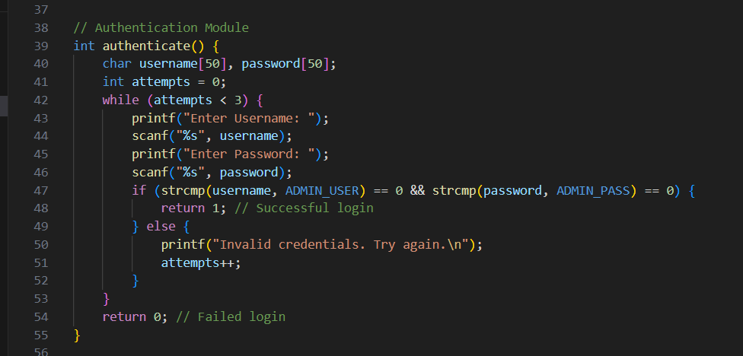
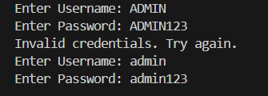
authentication module

Slide 6
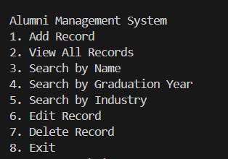
menu module and output

Slide 7
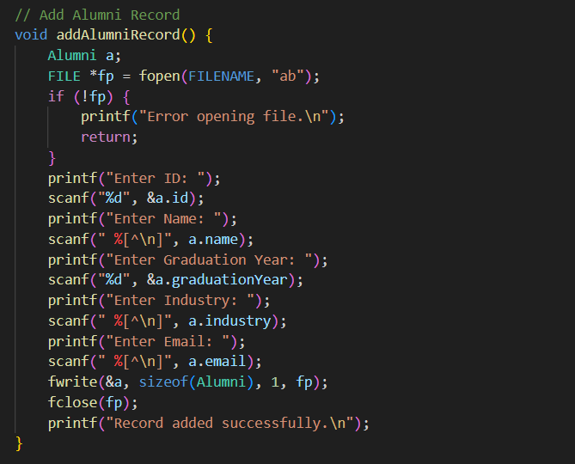
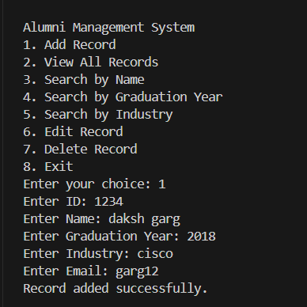
Alumni record module

Slide 8
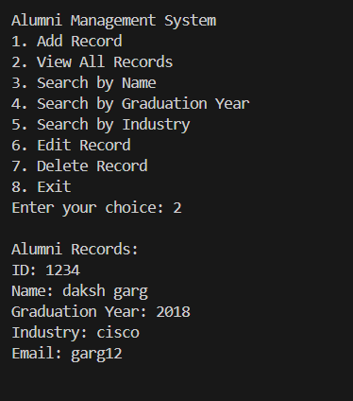
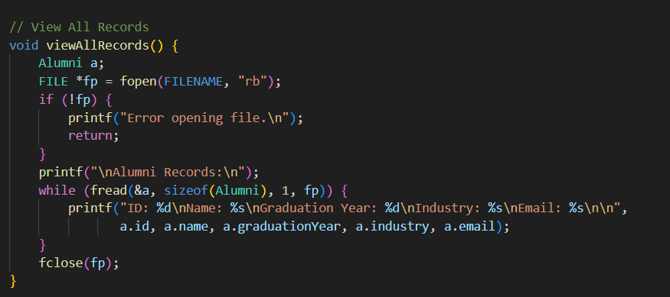
View all records module

Slide 9
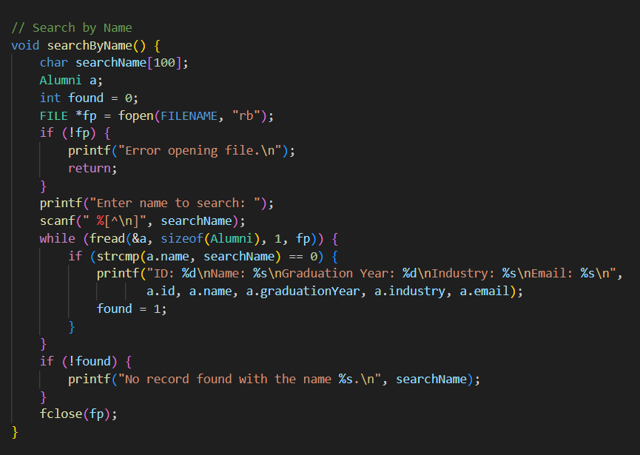
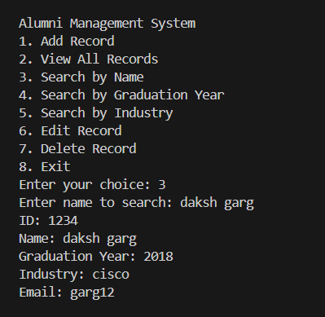
Search by name module

Slide 10
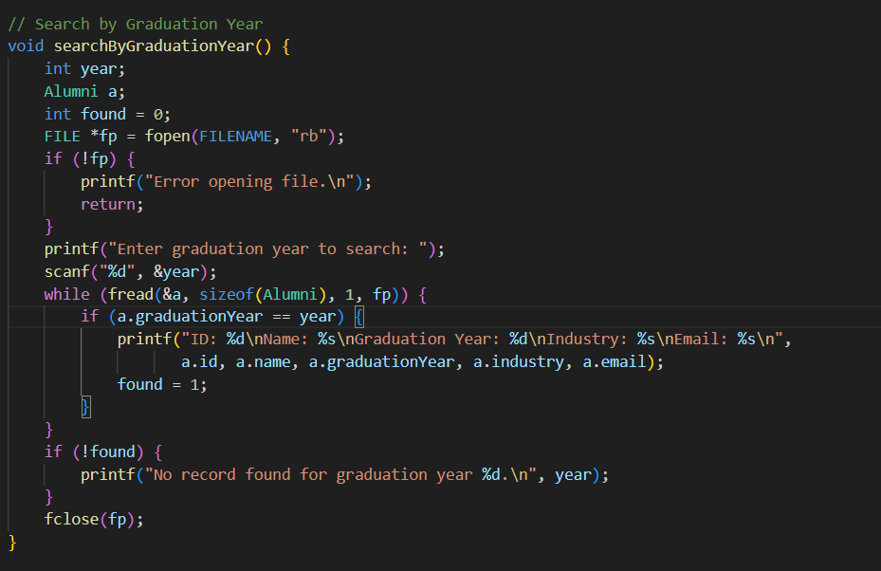
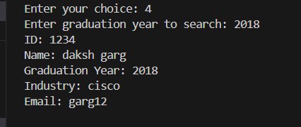
Search by graduation year module

Slide 11
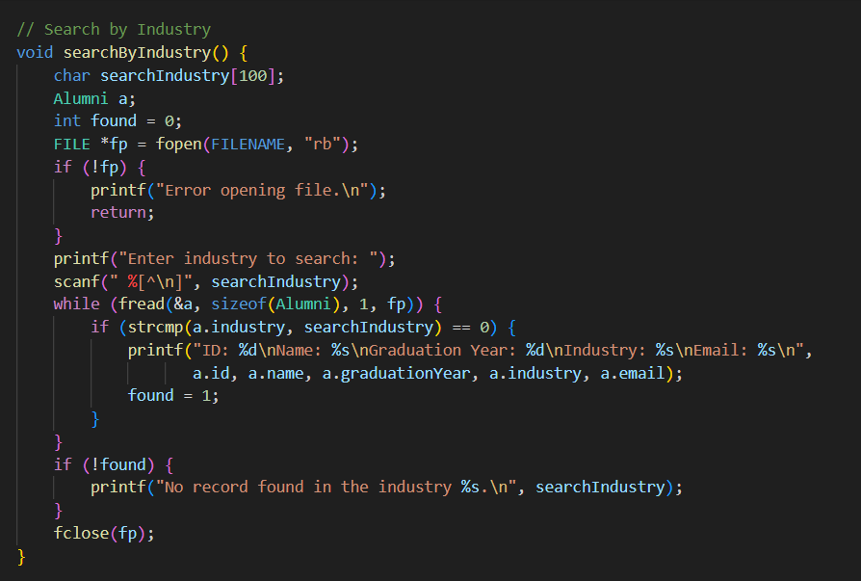
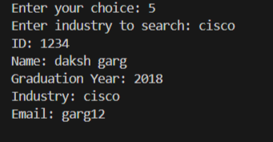
search BY INDUSTRY module

Slide 12
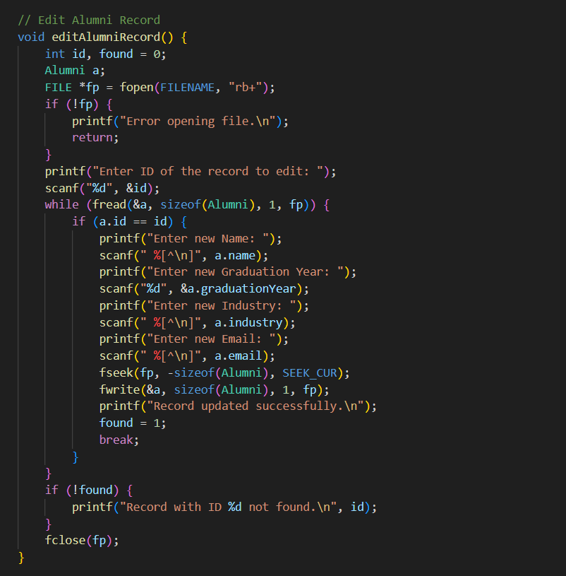
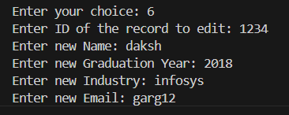
EDIT RECORD module

Slide 13
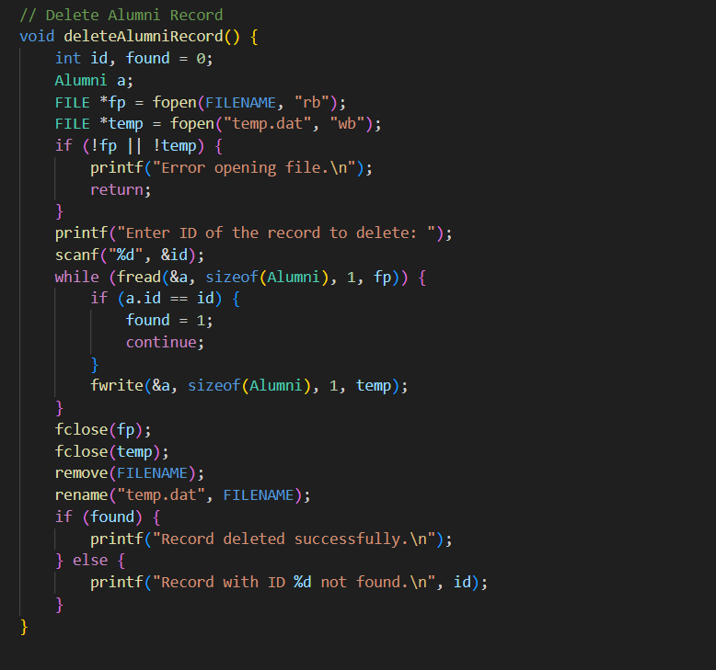
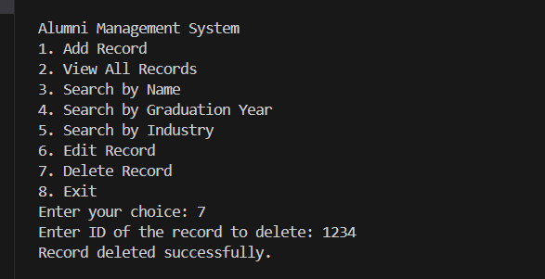
DELETE RECORD MODULE

Slide 14
Conclusion
The Alumni Database Management System (ADMS) is a vital tool for educational institutions aiming to maintain strong, lasting relationships with their former students. It streamlines the management of alumni data, fosters effective communication, and enables collaboration between alumni and the institution. By supporting activities such as event planning, mentorship, fundraising, and networking, the system enhances alumni engagement and contributes to the institution’s long-term development.
FUTURE SCOPE
-The Alumni Database Management System has great potential for future development, especially with the increasing use of digital platforms in education and networking

