Slide 1
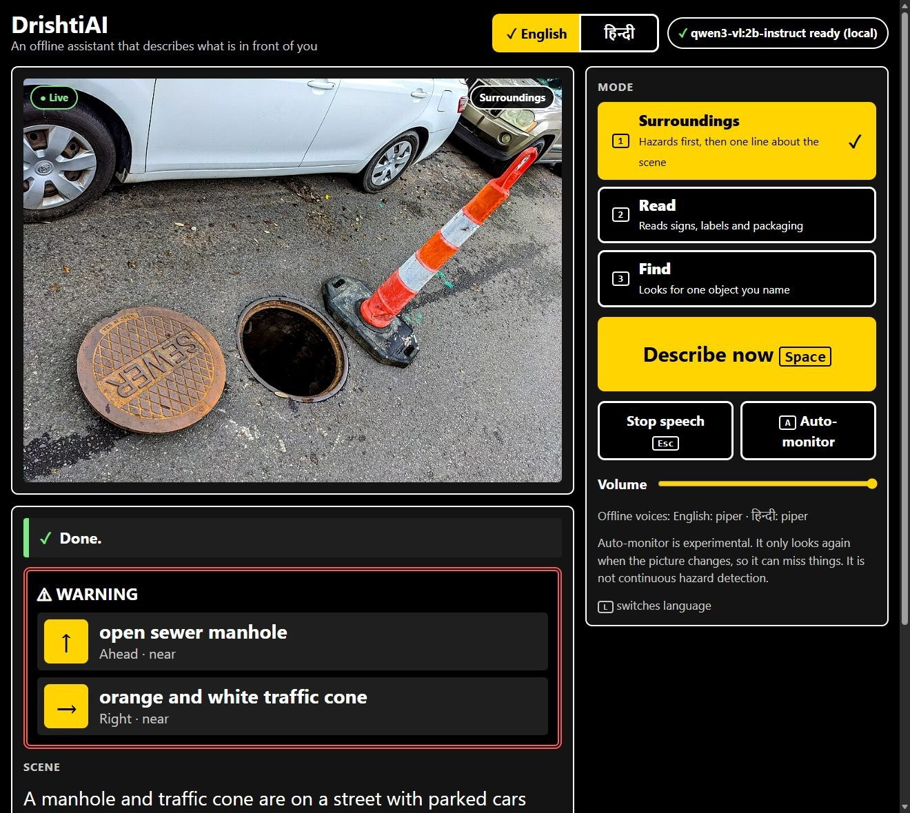
DrishtiAI
Offline eyes that speak. An open-weight vision model that warns about hazards first, in English and Hindi.
Best Open-Source AI Project · Hacktoberfest Hack Day Hamirpur x ISTE NITH · Daksh
Notes:
DrishtiAI describes what is in front of a blind or low-vision person. It runs entirely on this laptop: an open-weight vision model, no cloud. Drishti is Hindi for sight. I will show the problem, a live demo, how it works, and what the evaluation found, including what it gets wrong.

Slide 2
Describing a scene should not need the cloud
01
02
03
Privacy
Connectivity
Cost
Cloud apps upload every photo: faces, bank letters, prescriptions.
No signal in a hostel basement or a village means no description at all.
Per-image charges add up for something a person uses all day.
DrishtiAI keeps every frame on the laptop: no upload, no signal needed, no bill.
Notes:
Most scene-description apps send every camera frame to a server. That is a privacy problem, it fails without signal, and it costs money per image. The question for today: how far can a small open model on one laptop get?

Slide 3
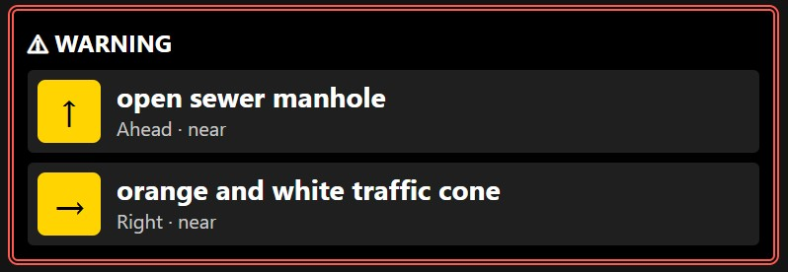
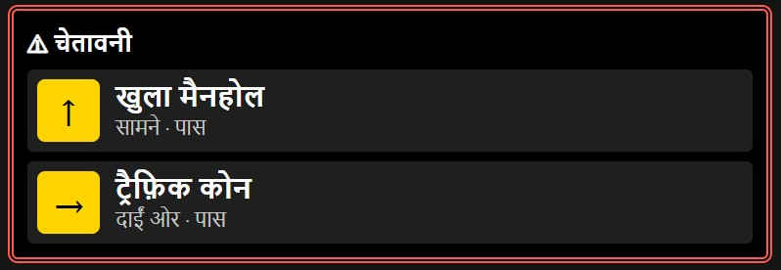
Three modes, spoken aloud, hazards first
1
Surroundings
Warns about what is in the way, then gives one line about the scene.
2
Read
Reads signs, labels and packaging, exactly as written.
3
Find
You name an object. It answers found, not found or uncertain.
Notes:
DEMO HERE. Wi-Fi is off. Press Space on a scene with something in the way: it warns first, then describes. Press 2 and hold up a printed label. Press 3, type water bottle, press Enter. Press L to hear the same answer in Hindi. The whole page works from the keyboard.

Slide 4
One local pipeline, open at every step
Webcam
FastAPI
Qwen3-VL 2B
Validation
Speech rules
Piper voice
one frame, never saved
on 127.0.0.1 only
open weights, via Ollama
strict JSON, one retry
hazards first, nearest first
offline, EN and HI
Apache‑2.0
MIT
0
6 GB
model weights
project code
cloud calls at run time
laptop GPU it runs on
The app, the evaluation and the Agent Skill all call the same function, drishti.vlm.describe().
Notes:
A frame goes to FastAPI on this machine, then to Qwen3-VL through Ollama. The model must return strict JSON. If it does not validate, it is asked once more, and after that the answer is marked as rough: hazards are never invented to fill a gap. A separate speech layer decides what is said, always hazards first. The same function is packaged as an Agent Skill.

Slide 5
Measured on 30 images: 14 of 15 hazards found
14 of 15
texts read correctly
1.5 s
median model time per image
Read this as optimistic: the prompt was tuned on these same images, and 3 of the 4 hazard-free scenes still got a warning.
Notes:
30 fixed images: 21 openly licensed photos and 9 rendered text images. Missed hazards are counted on their own because that is the dangerous failure. The first real run was poor: 9 of 15 found and 31 false alarms. After one prompt change it found 14 of 15 with 6 false alarms. Be upfront: I tuned on this same set, so this is optimistic, and it still over-warns on clear scenes. Both result files are in the repository.

Slide 6
Three things failed on the first real run
The model never answered
Switched to the instruct variant
→
The default tag was a thinking variant that spent its whole reply reasoning.
The app now detects this and names the model to pull.
It warned about stairs everywhere
List what you see, then pick hazards
→
It repeated the example hazards from the prompt, even on empty corridors.
False alarms fell from 31 to 6 on the same images.
Its Hindi was nonsense
A fixed Hindi glossary
→
A 2B model cannot translate: wet floor came back as gibberish.
About 100 common words. Unknown words stay in English.
Notes:
Nothing worked the first time, and each failure is documented. The plain model tag was a thinking variant that never produced an answer. The model then parroted my own example hazards back at me. And it cannot write Hindi, so Hindi warnings come from a fixed glossary: correct and predictable, but it drops adjectives.

Slide 7
Honest limits, and what comes next
Not yet
Next
Over-warns on clear scenes
4 to 5 seconds from key press to speech
Misreads small or curved text
Not a replacement for a cane or a guide
A held-out evaluation set
A larger multilingual model for real Hindi
Voice input for Find
A phone build
github.com/Dakshhhhh-ops/hacktober
ollama pull qwen3-vl:2b-instruct, then python -m drishti, then press Space
Notes:
It is an experimental aid, not a safety device. It over-warns, it takes four to five seconds end to end, and it misreads small text. Next I would build a held-out test set, try a larger multilingual model for real Hindi, and add voice input. Everything is in the repository: MIT code, an Apache-2.0 model, the evaluation, the tests and the Agent Skill.

