Slide 1

EDA CASE STUDY
Credit Risk
Analysis
Dakshin JV

Slide 2
Problem Stement
Two types of risks are associated with the bank’s decision:
If the applicant is likely to repay the loan, then not approving the loan results in a loss of business to the company
If the applicant is not likely to repay the loan, i.e. he/she is likely to default, then approving the loan may lead to a financial loss for the company.

Slide 3
Approach adopted in this case study
•Load the Datasets
•Inspect the data frames
•Data Cleaning ('application_data.csv')
•Identifying the data types
•Identifying the null values
•Fixing the rows and columns
•Fixing invalid values
•Removing the unwanted columns
•Finding the Categorical and Numerical columns
•Imputing/removing missing values (Univariate Analysis)
•Find the percentage of missing values of each column.
•Drop all columns having more than 50% null values
•Suggest how to impute null values in these columns

Slide 4
•Analysing outliers (Univariate Analysis)
•For numerical columns, check for outliers
•Suggest approaches to treat outliers
•Check the imbalance percentage of target variable
•Also split the data frame into two based on target variable
•Perform Univariate and Bivariate analysis on
•categorical variables and
•Numerical variables
•Perform Multivariate analysis
•Perform correlation of numerical columns
•Find the top 10 correlation for the Client with payment difficulties and all other cases (Target variable)
•Merge the two data frames application_data and previous_application
•Perform Analysis on Merged Data
•Conclusion

Slide 5
Techniques to impute the missing values
Drop the columns with null values more than 50%
Imputed Categorical Columns with Maximum Value_Counts and Mode function
Imputed Numerical Columns with Median or Mean Values
Checking the Data Correctness
Replacing the XNA Values with appropriate Values and Replacing XNA with Null Values to ease the analysis.
Correcting the Days Columns with negative values using abs()
Binning the Continuous Value
Binning of continuous variables like INCOME, AMT_CREDIT_RANGE, REGION_POPULATION_RELATIVE,POPULATION to ease the analysis

Slide 6
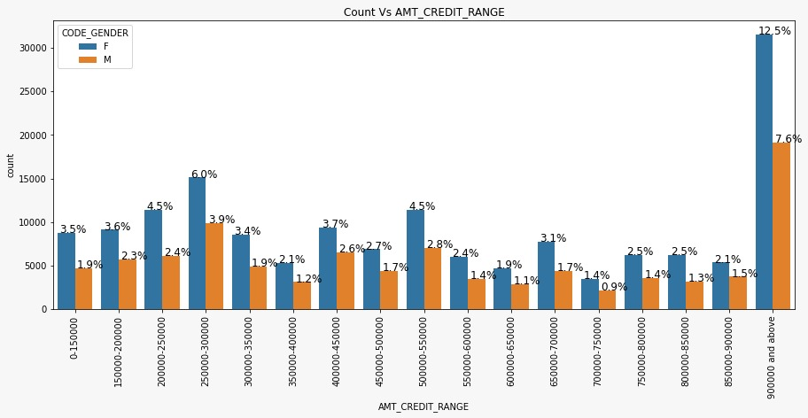
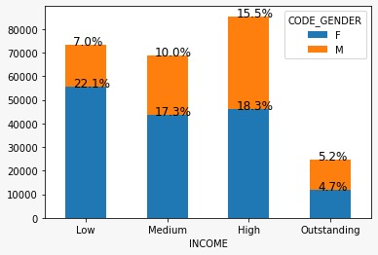
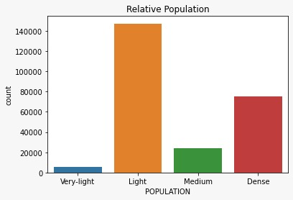
Binning of Continuous-variable

Slide 7
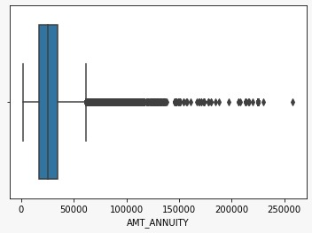
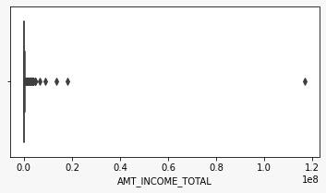
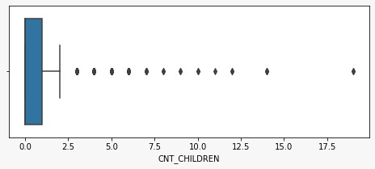
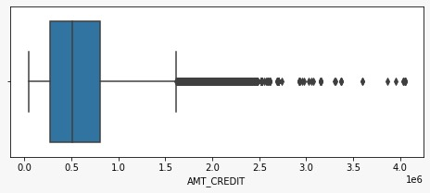
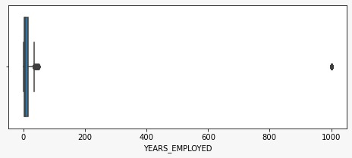
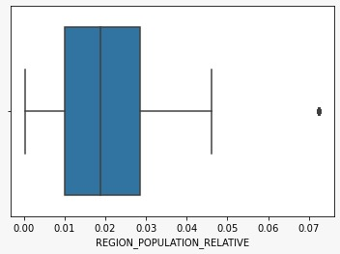
Interpretation of Outliers
• Outliers in the data affect the analysis and give biased outputs. So it has to be handled .
From descriptive statistical analysis variables with outliers - CNT_CHILDREN, AMT_INCOME_TOTAL, AMT_CREDIT, AMT_ANNUITY, YEARS_EMPLOYED,YEARS_EMPLOYED,REGION_POPULATION_RELATIVE.

Slide 8
Interpretation of Outlires
From Boxplot, client having 19 children is an exceptional scenario. Hence, it is an Outlier.
A person from Laborers occupation type and her target attribute is 1. Hence, its an outlier.
The amount credited is more than a person's total income with significantly high than other values greater than 350000.
Before the application, person with 1000 years of work experience would be a reason for outlier.
As the clients live in more populated region with highest normalized value(i.e; 0.72) is a cause for an outlier.

Slide 9
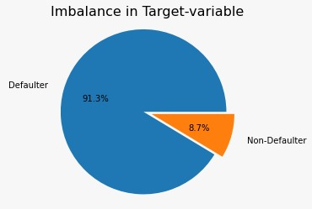
Checking Imbalance
• We have checked the dataset for Applicants with loan repaying difficulty and with No difficulty
• Ratio of Imbalance was 11.39%
• We have divided the target variable
into two subset of clients with
non-Repaying difficulty (Target0)
and Clients with repaying difficulty
(Target1)
• We observe that imbalance is high
between target variables

Slide 10
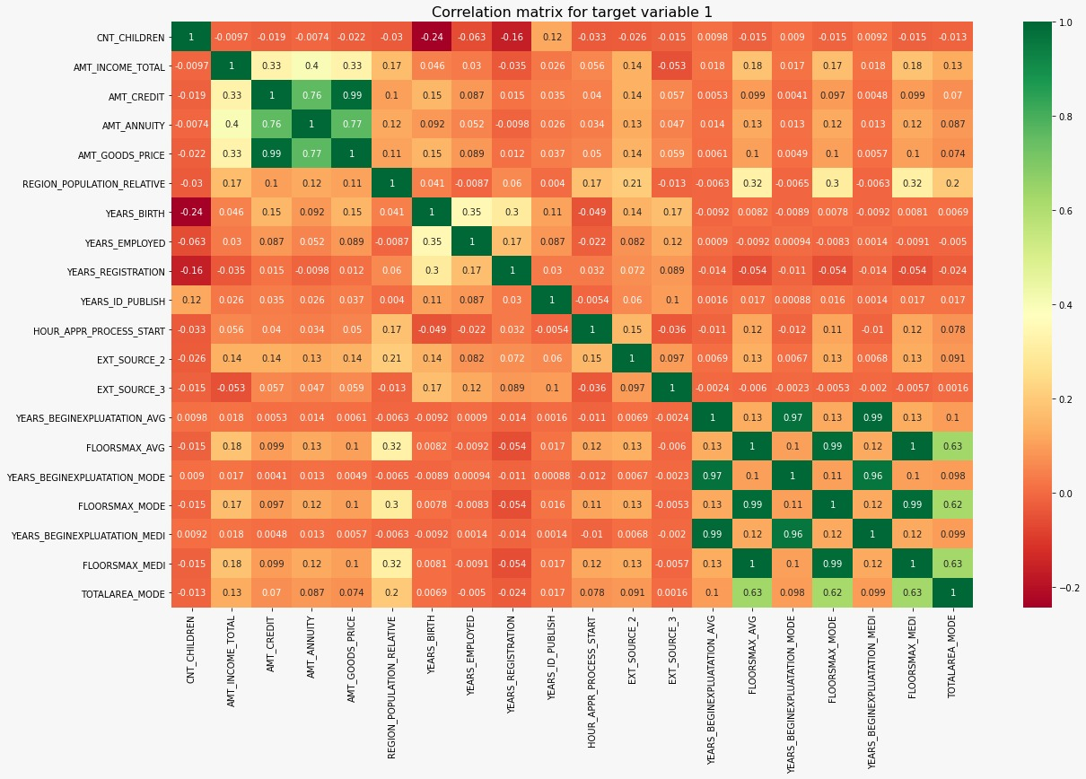
Correlation checks for Defaulters
This heat map for Target 1
is also having quite a same
observation just like Target 0.
But for few points are
different. They are listed
below.
The client's permanent
address does not match
contact address are having
less children and vice-versa
The client's permanent
address does not match
work address are having
less children and vice-versa

Slide 11

Correlation checks for Non-Defaulters
Credit amount is inversely proportional to the Years of birth, which means Credit amount is higher for low age and vice-versa.
Credit amount is
inversely proportional to
the number of children
client have, means Credit
amount is higher for less
children count client have
and vice-versa.
Income amount is
inversely proportional to
the number of children
client have, means more
income for less children
client have and vice-versa.
Client with less
children located in densely
populated area.

Slide 12
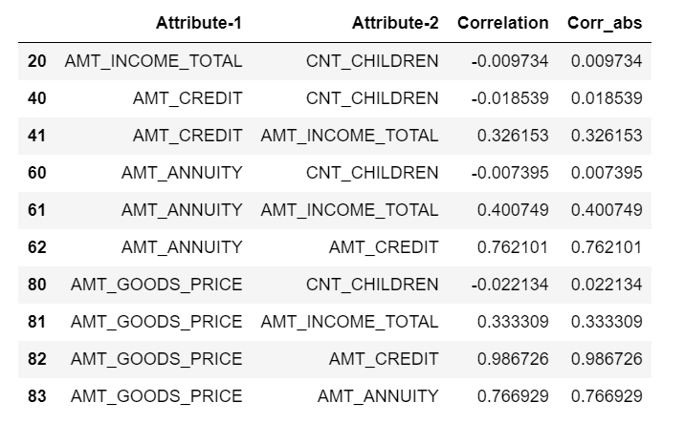
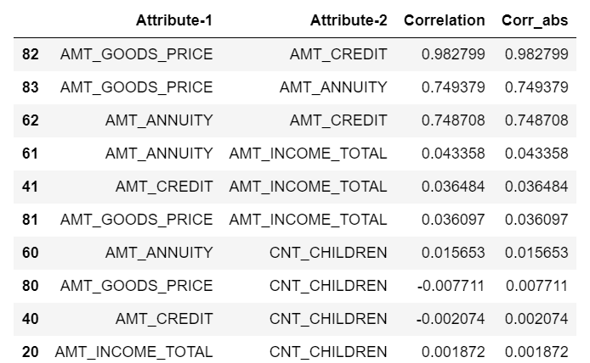
Top 10 Correlation for clients as Defaulters and Non-Defaulters.
Defaulters
Non-Defaulters

Slide 13
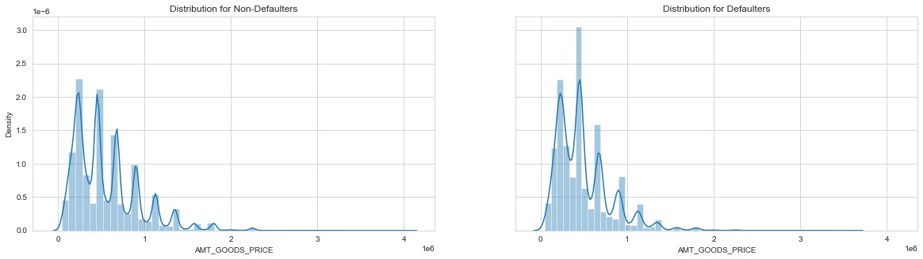
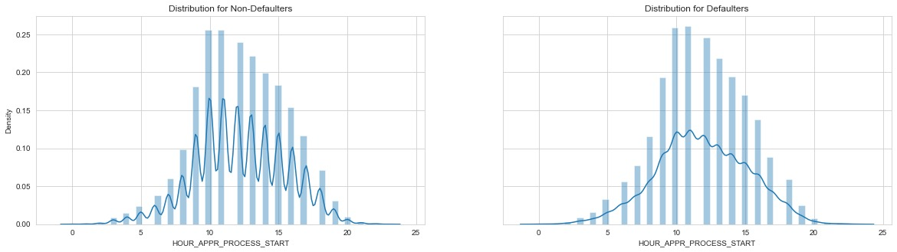
Segmented Univariate Analysis
AMT_GOODS_PRICE
On Comparing the Defaulters and Non Defaulters, Defaulters purchases or loan credited is high in range of 0 to 50,000.
HOUR_APPR_PROCESS_START
In peak-time(10AM - 12:30PM),many defaulters prefer this timing for loan application.

Slide 14
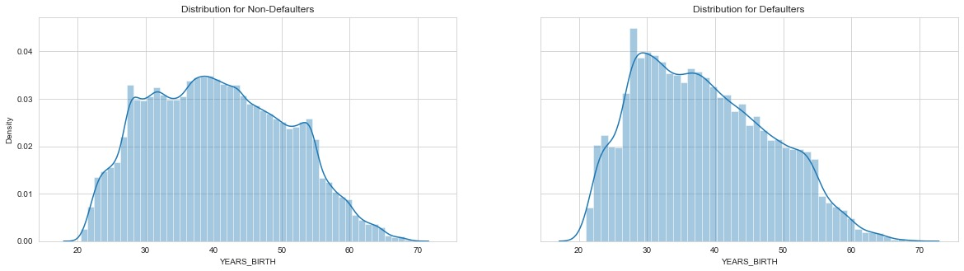
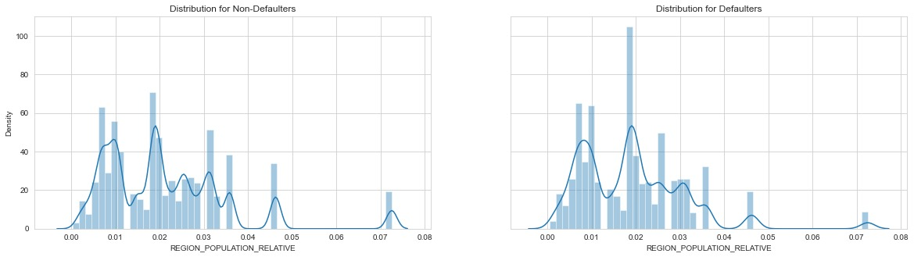
Segmented Univariate Analysis
YEARS_BIRTH
From the distributed plot, we can note that customer without payment difficulties having year in between 34 to 54 years , And customer with payment difficulties having in between 31 to 50 years.
REGION_POPULATION_RELATIVE
People living in higher density areas having least defaulters.

Slide 15
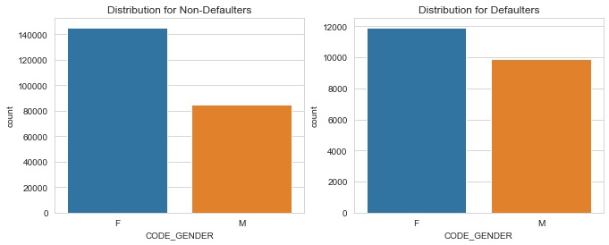
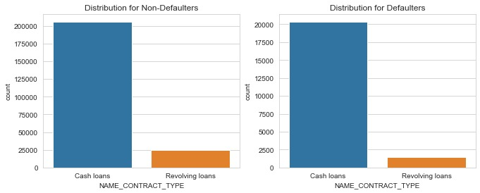
Univariate Analysis on Categorical variable(unordered).
CODE_GENDER
Both follow same pattern, so cannot decide much on basis of gender as defaulters and non defaulters.
NAME_CONTRACT_TYPE
Many customers took cash loans.

Slide 16
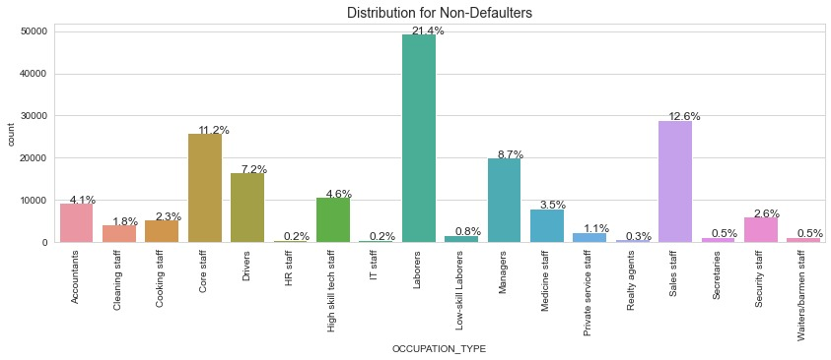
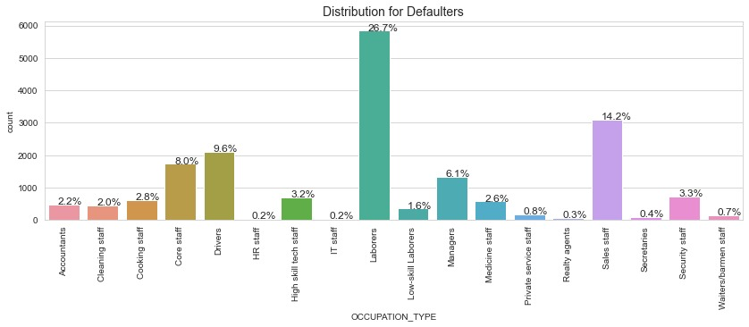
Univariate Analysis on Categorical variable(unordered).
OCCUPATION_TYPE
About 26.7% of Labours are having payment difficulties.

Slide 17
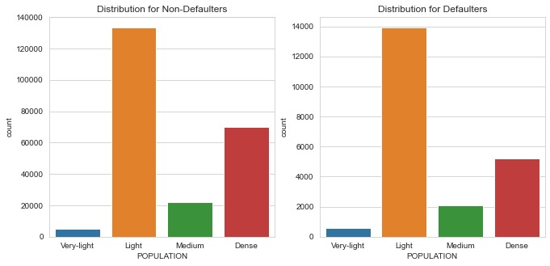
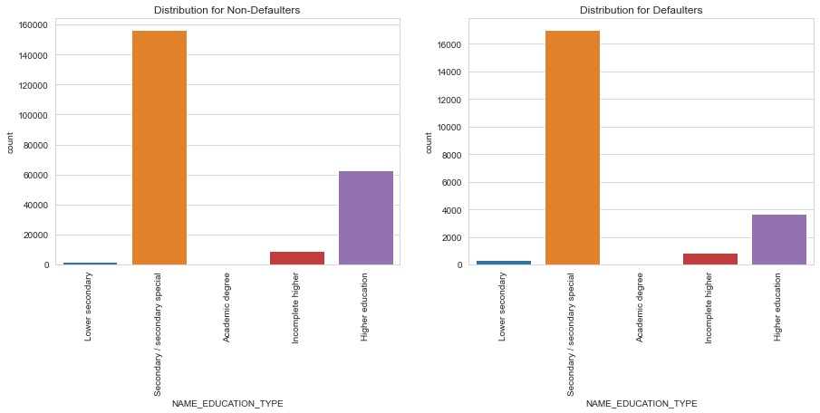
Univariate Analysis on Categorical variable(unordered).
POPULATION
From both the cases, customers from moderately populated region are more likey able to manage income and payback their loans.
NAME_EDUCATION_TYPE
In both the cases, clients are having payment difficulties in secondary/ secondary special category.

Slide 18
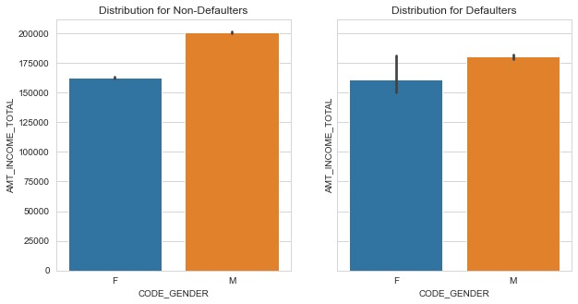
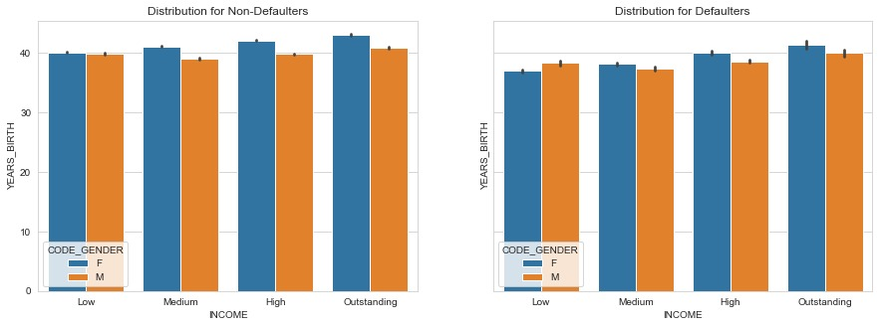
Bivariate Analysis
On an average male defaulters do have less income compared to non-defaulters.
We can observe that, there are more number of male defaulters with low income and all male defaulters have age around 38-42.

Slide 19
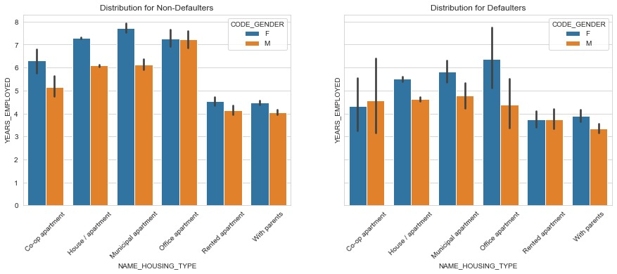
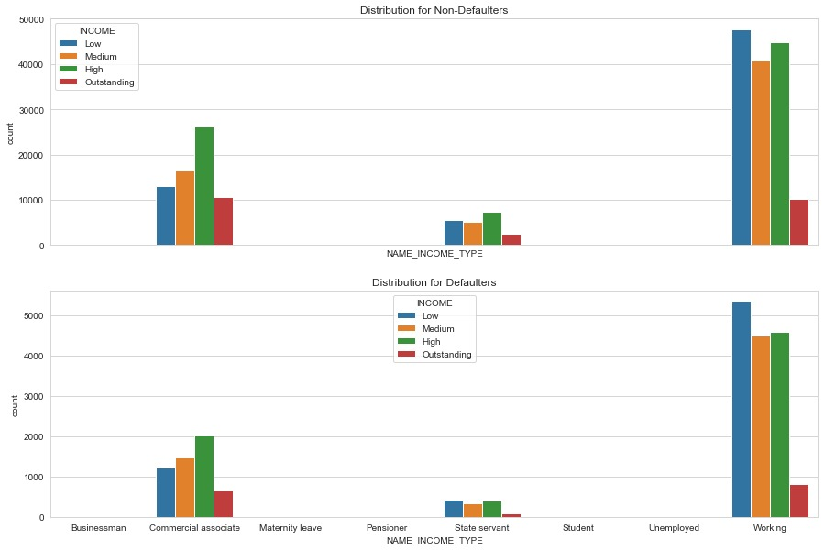
Bivariate Analysis
Defaulters prefers to say in Municipal apartment, where as Non-defaulters prefers to stay in House/Apartment.
Working Professionals are more likely to br placed in defaulters as well as Non-defaulters. Hence, with the help of this we can't decide the defaulters.

Slide 20
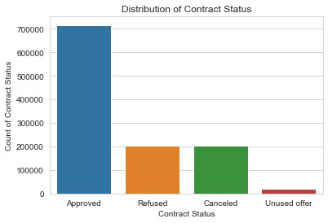
Analysis based on Loan-Status

Slide 21
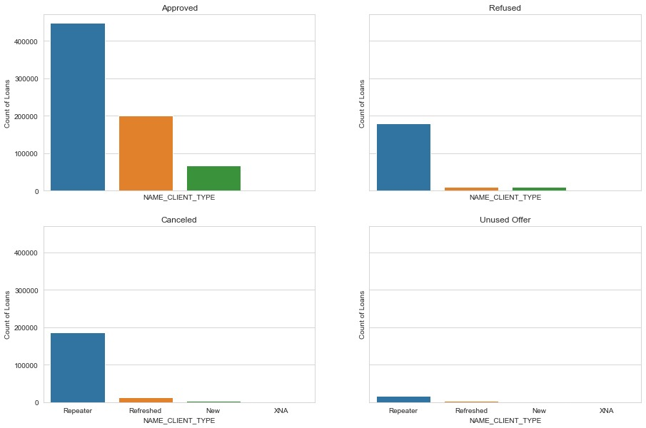
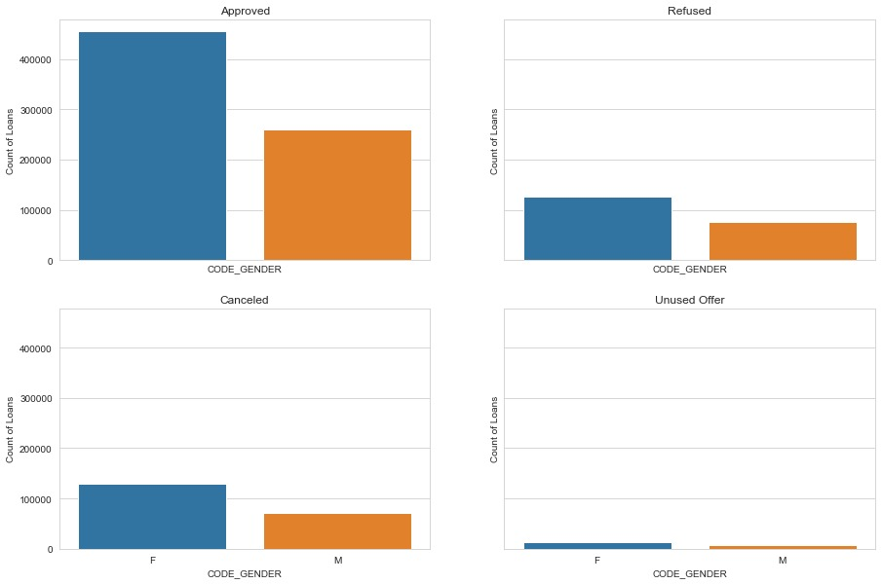
Analysis based on Loan-Status
Here we can see that the Repeater is getting more Refused but also we can see that the it also getting more apporved and even that it is getting more canceled and more used
Here we can see that Female is getting more Refused more approved more canceled more unused but in case of male it is having average in every category

Slide 22
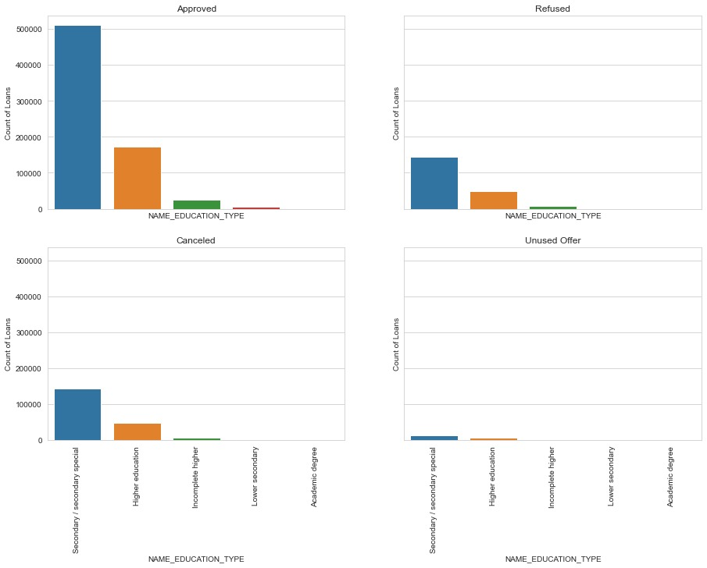
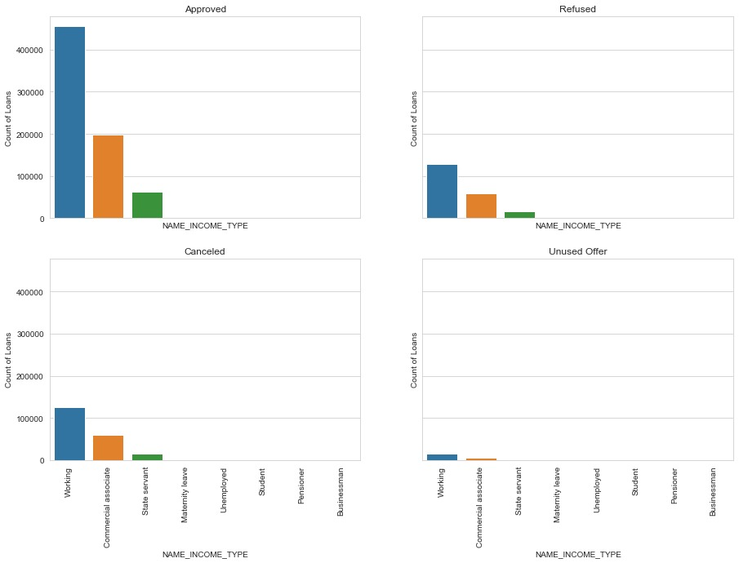
Analysis based on Loan-Status
The most accepting loan is Cash X-sell: low And most canceled loan is Cash and Most Unused loan is POS mobile with interest.
Here we can see that the working type people are applying more loans as compare to others and also Commercial associates people are taking more loans.

Slide 23
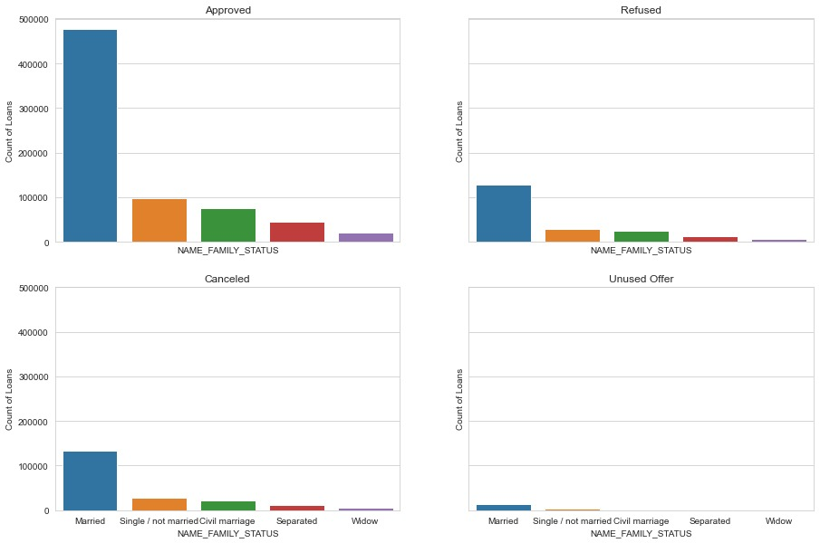
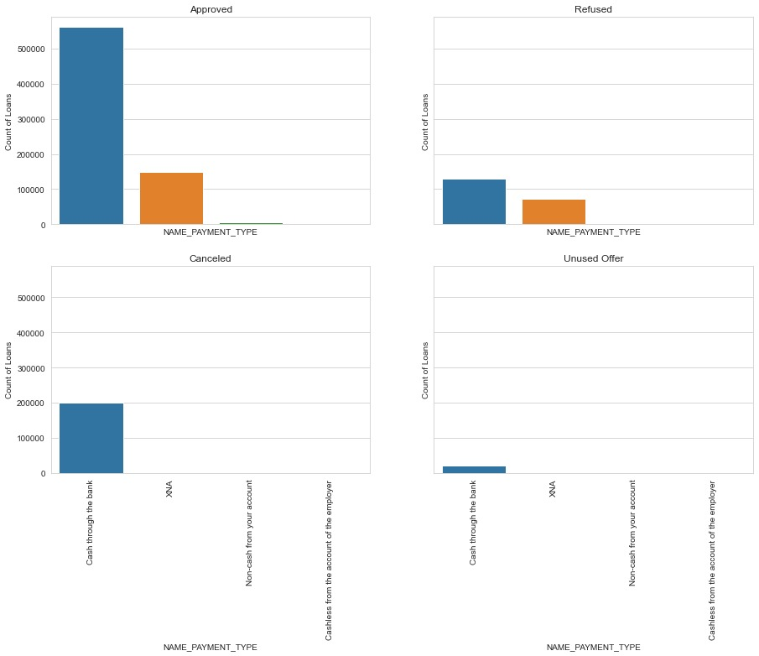
Analysis based on Loan-Status
Here we can see that the Married people are applying and taking loans more than the others.
Here we can see that the people are taking more loan in format of cash through the bank

Slide 24
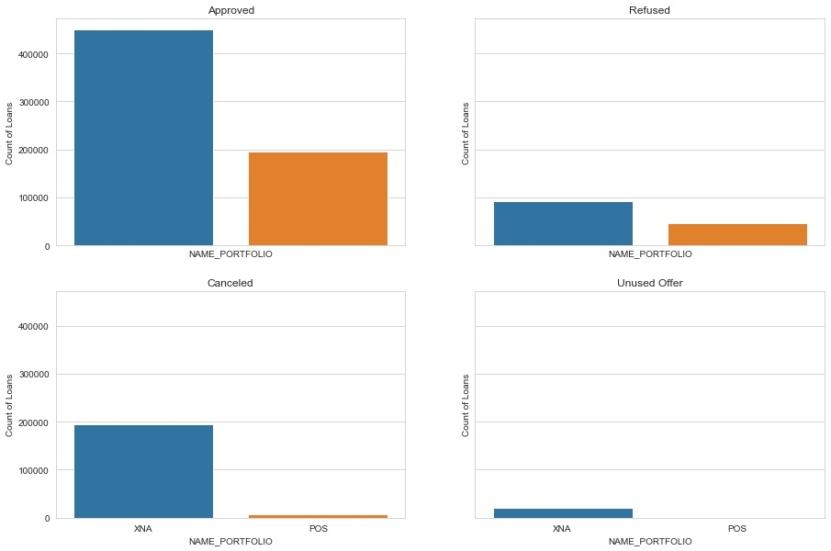
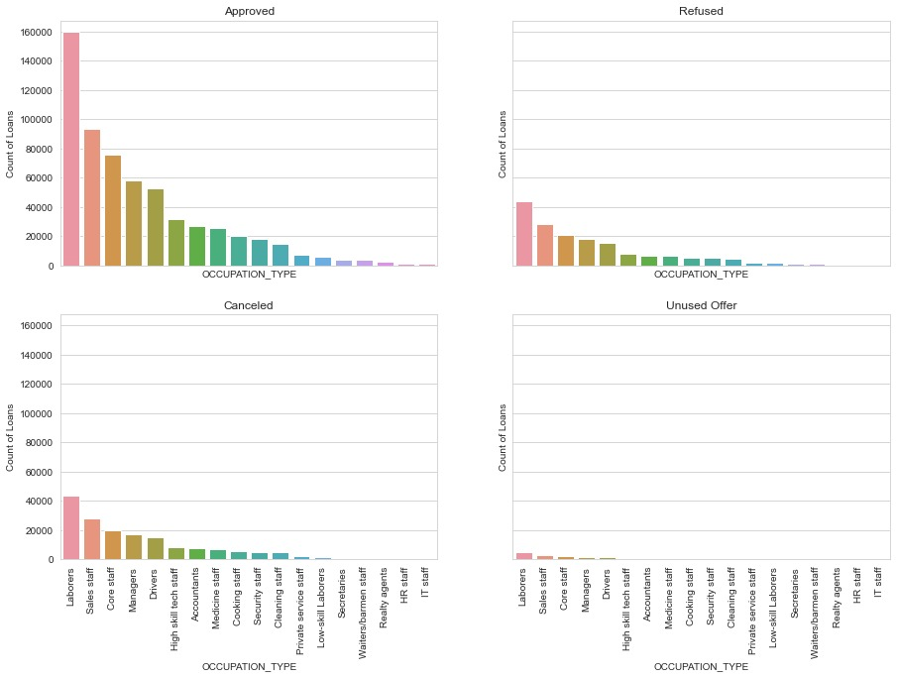
Analysis based on Loan-Status
Here most approved loan were through POS and Most refused loans were in cash.
Here laborers are getting most refused and most approved loans. And aslo Sales staff is also getting the second most refused and approved loans.

Slide 25
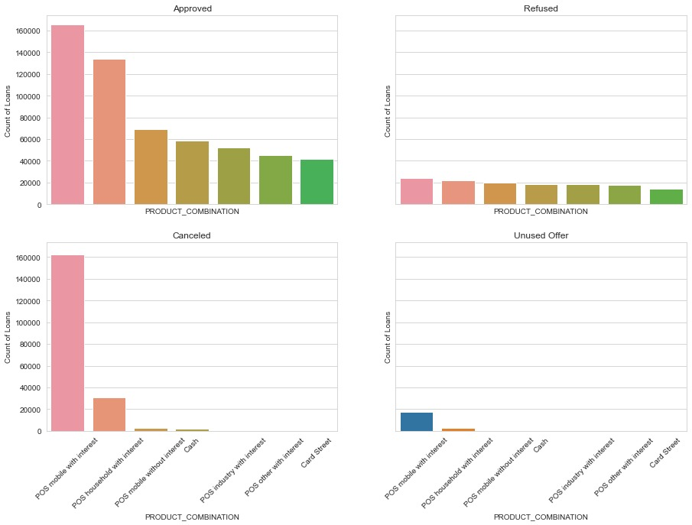
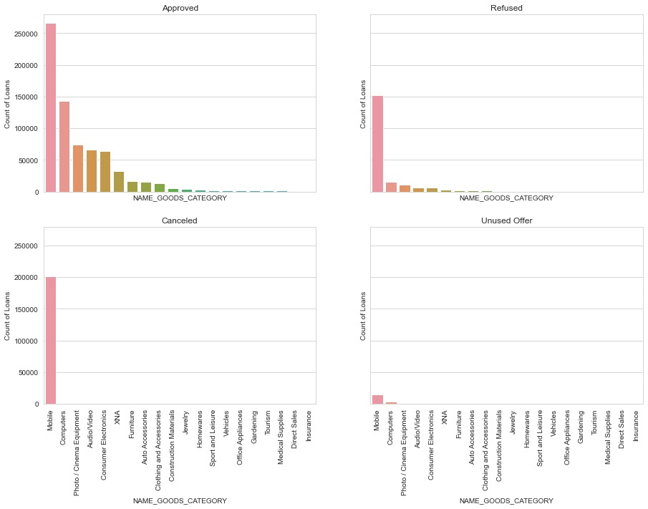
Analysis based on Loan-Status
The most accepting loan is Cash X-sell: low And most canceled loan is Cash and Most Unused loan is POS mobile with interest.
Here Most Refused loan is of Mobile and most approved loan is Mobile

Slide 26
Conclusions
EDA for the banking data set revealed that:
Banks should focus more on contract type ‘Student’ ,’pensioner’ and ‘Businessman’ with housing ‘type other than ‘Co-op apartment’ for successful payments.
Banks should focus less on income type ‘Working’ as they are having most number of unsuccessful payments.Also with loan purpose ‘Repair’ is having higher number of unsuccessful payments on time.
‘Revolving Loans’ in ‘NAME_CONTRACT_TYPE’ has maximum percentage of payment difficulties. Hence, client with contract type as ‘Revolving loans’ in previous application are the driving factors for Loan Defaulters.
Get as much as clients from housing type ‘With parents’ as they are having least number of unsuccessful payments.
Banks should focus more on new applicants those who belong to IT staff, Accountants, Medicine Staff or Private Service Staff group since the loan statuses(approved, refused, cancelled) are stable for such groups.

