Slide 1
Custom Training Day 14 – 19/09/2023
Learnt advanced concepts of python
Knowledge about List Comprehensions and Lambda Functions
Introduction to Panda Data Frame
Understanding Positional and Keyword Arguments

Slide 2
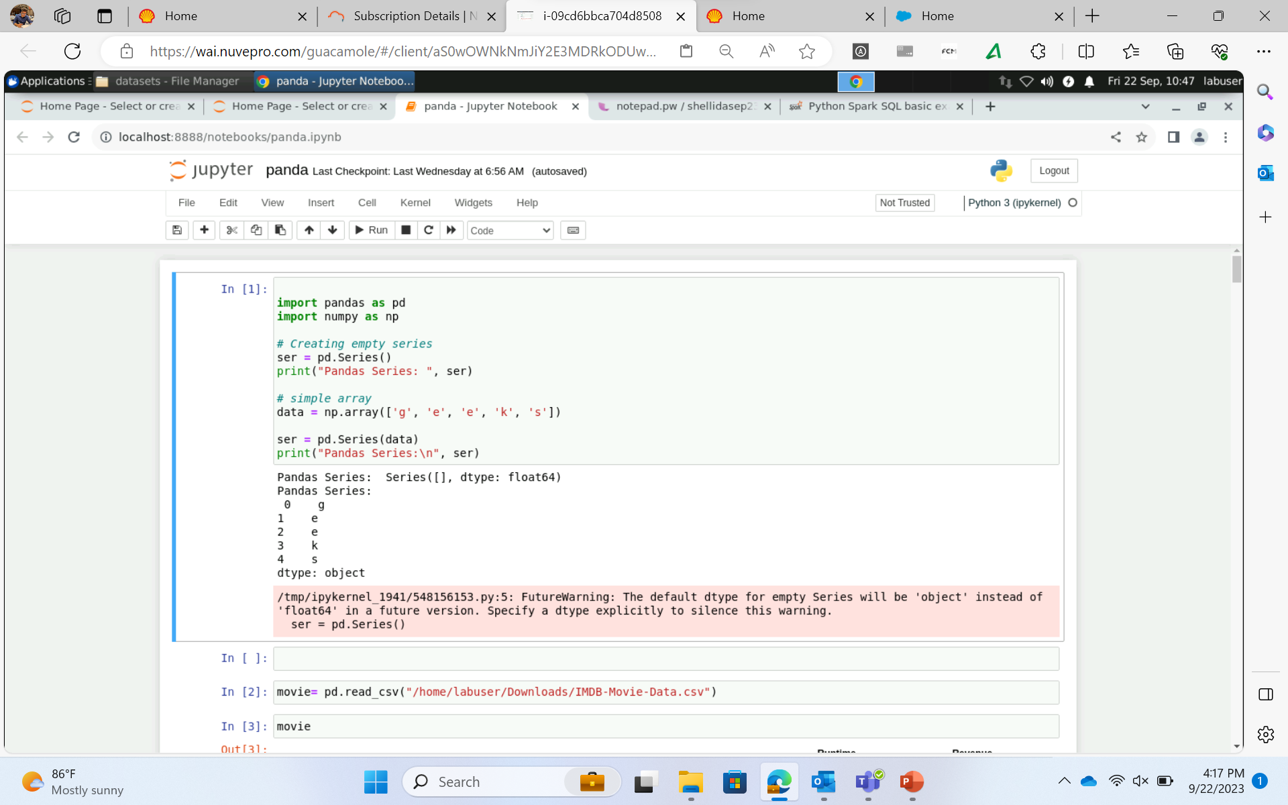

Slide 3
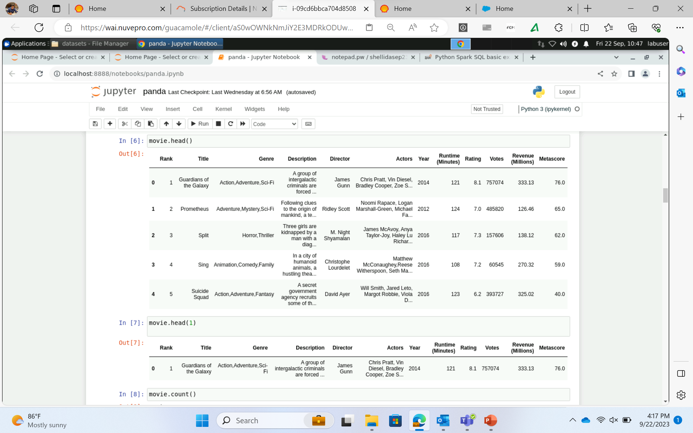

Slide 4
Custom Training Day 15 – 20/09/2023
NumPy Array
A review on Dictionaries, Sets, Tuples and Map
Visualizing dataset using Matplotlib and Pandas

Slide 5
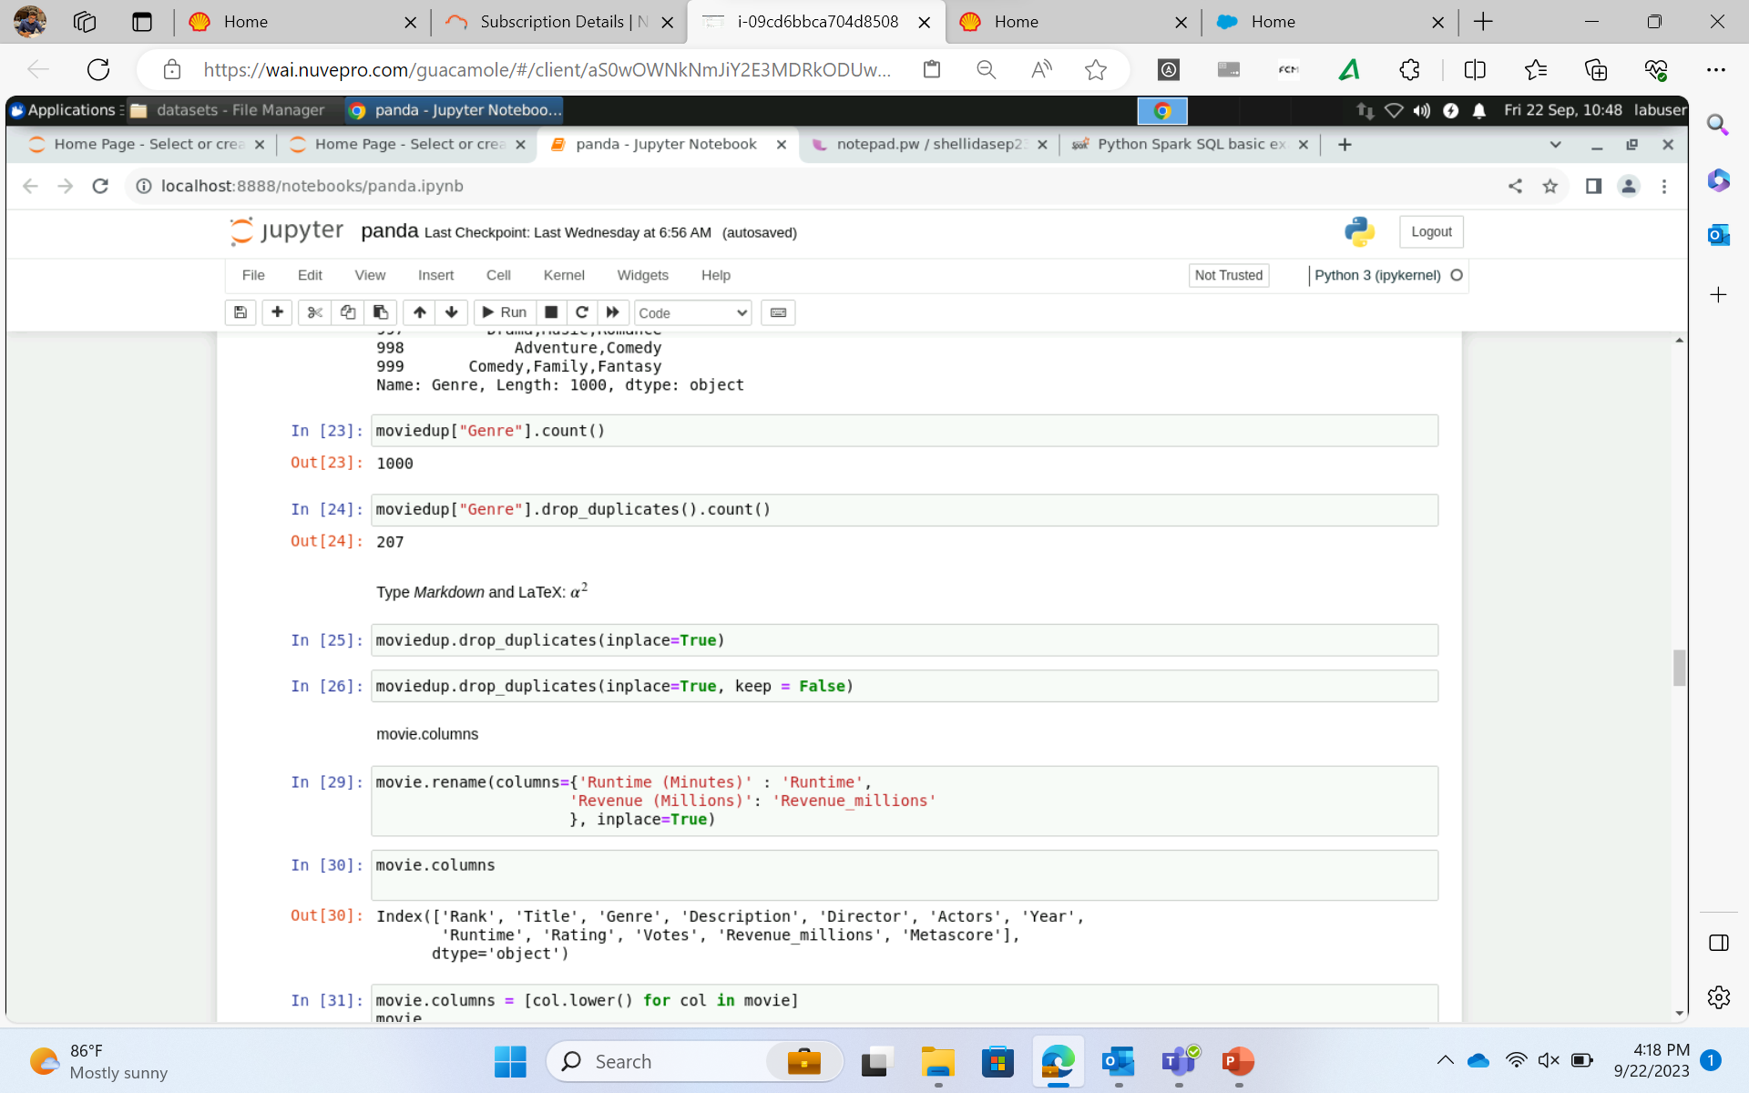

Slide 6
Custom Training Day 16 – 21/09/2023
Introduction to PySpark
Spark Architecture
Introduction to PySpark shell
RDD concepts overview

Slide 7
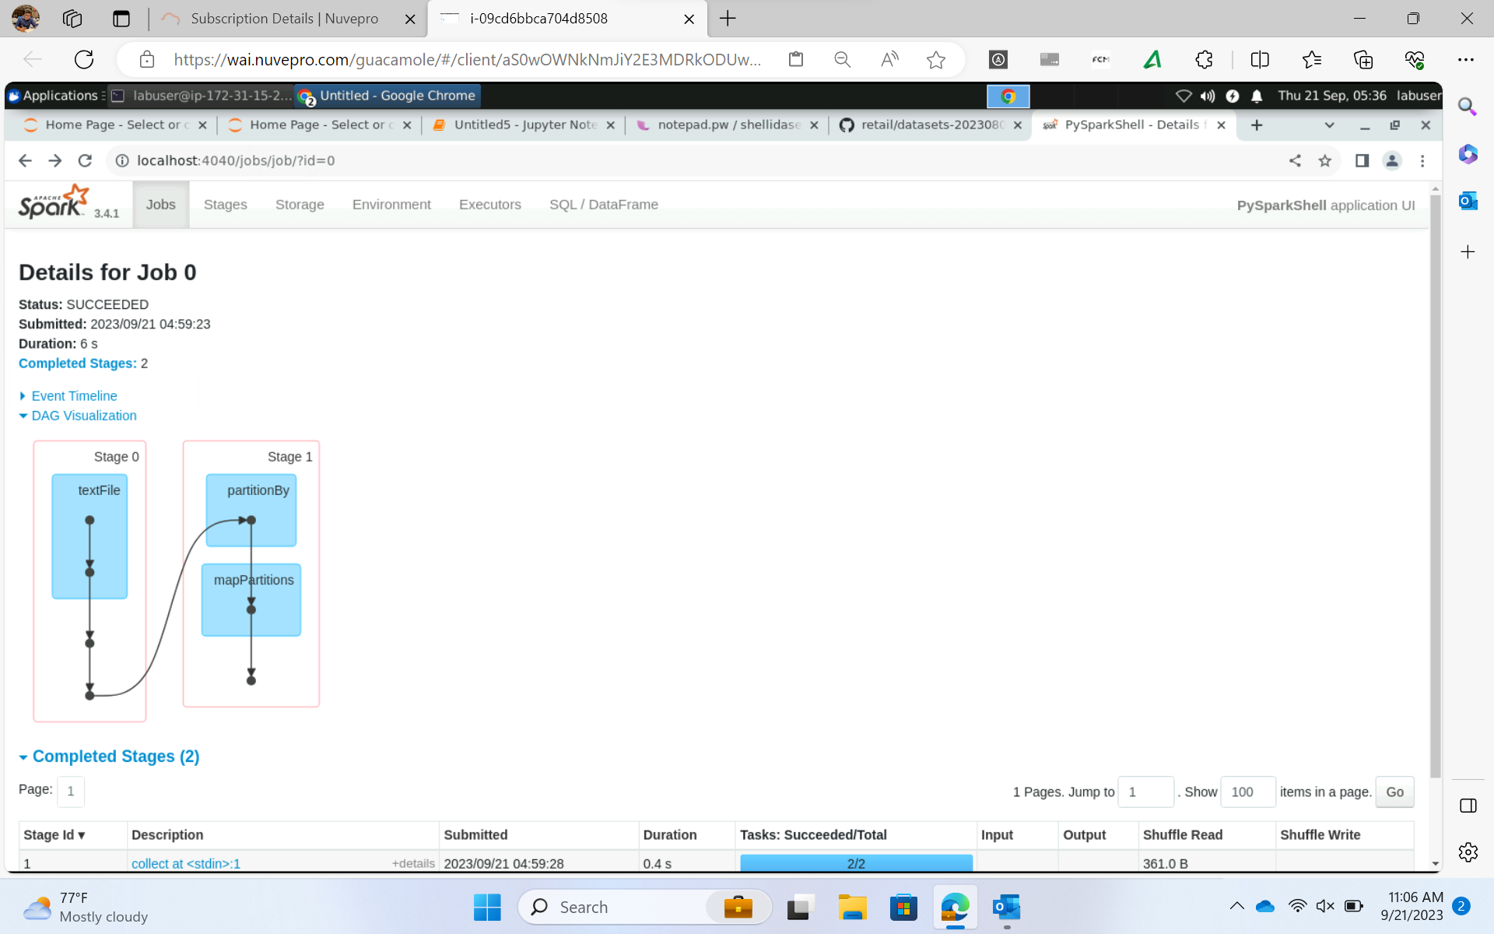

Slide 8
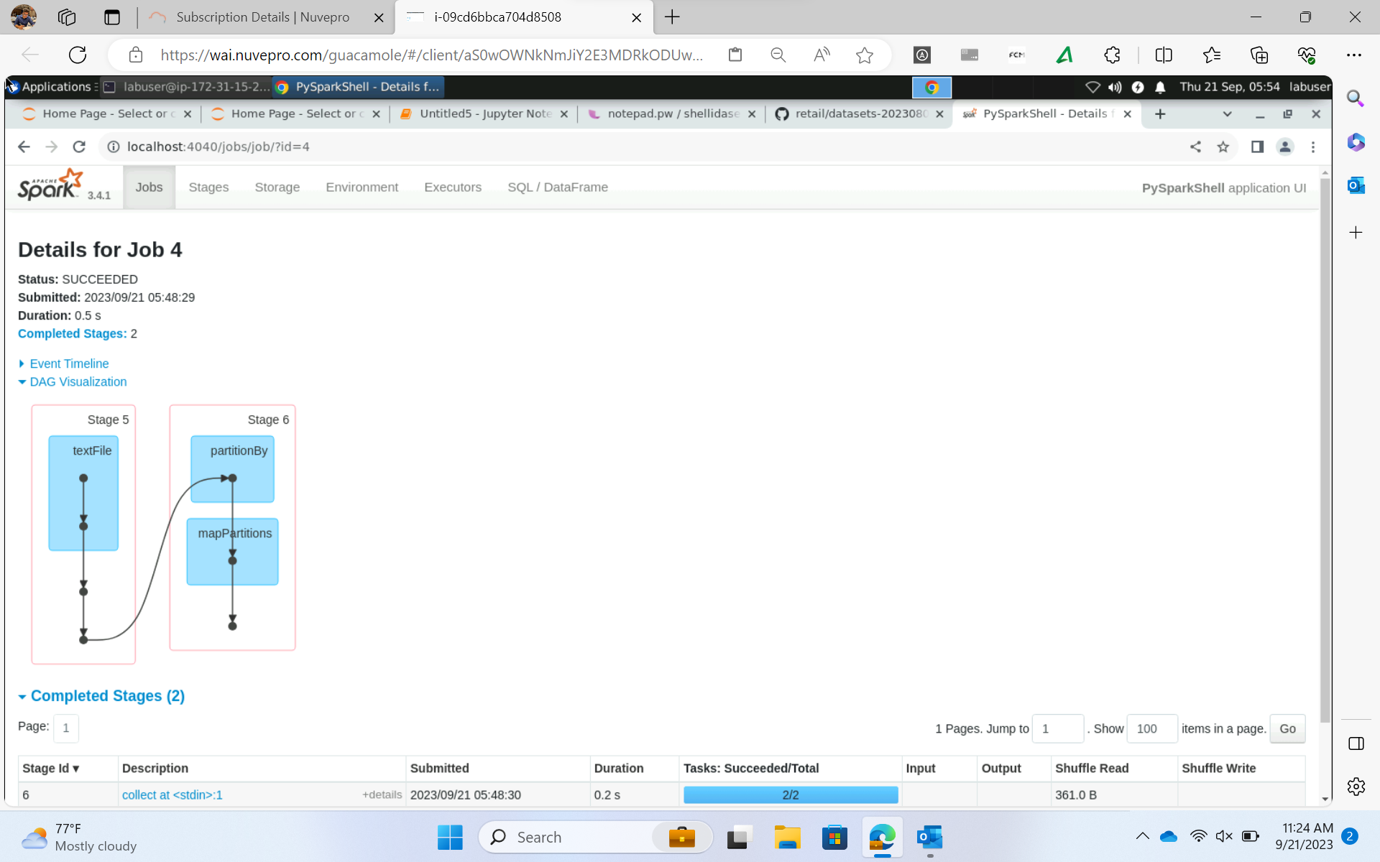

Slide 9
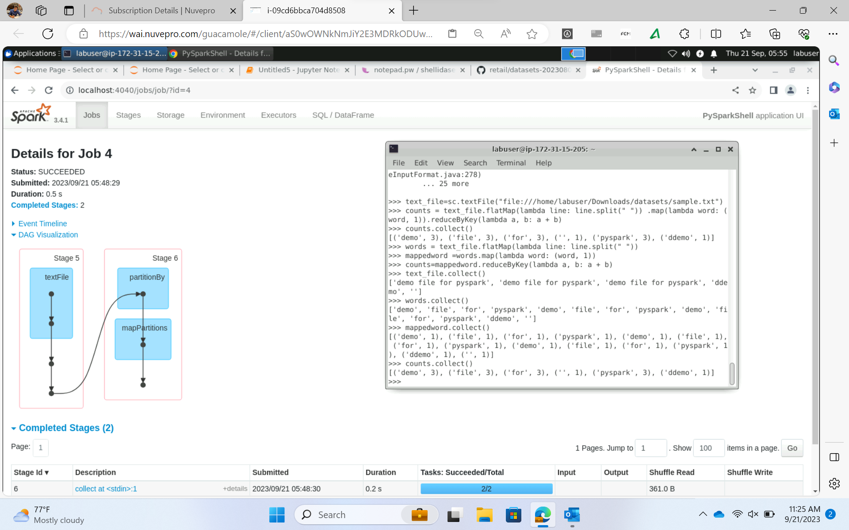

Slide 10
Custom Training Day 17 – 22/09/2023
Spark Caching
Spark and Fault Tolerance
RDD to Data frame

