Slide 1
Project Management System
created by :-
Thakkar Divy(21004500210183)
Shah Daksh(21004500210144)
Sakshi Jani(21004500210052)

Slide 2
Introduction
Project Management System is Created for IT Students and Employee.
It Provides many functionality like:
Assign Project
Review Project
Requirement Gathering
Upload Project

Slide 3
Main Objectives
Project Management Systems help in project management by allowing Employee to share information and work on allocated tasks. These tools can help improve communication and coordination among employee and project leader, making tracking progress and deadlines easy.

Slide 4
Project Profile
Project Title | Project Management System
Front-end | HTML5, CSS3, Bootstrap4
Back End | My SQL ,Django
Server | Apache (Tomcat 9.0)
Other Tools | Power Point, MS Word - 2019
Diagram Builder | Dia.de,draw.io

Slide 5
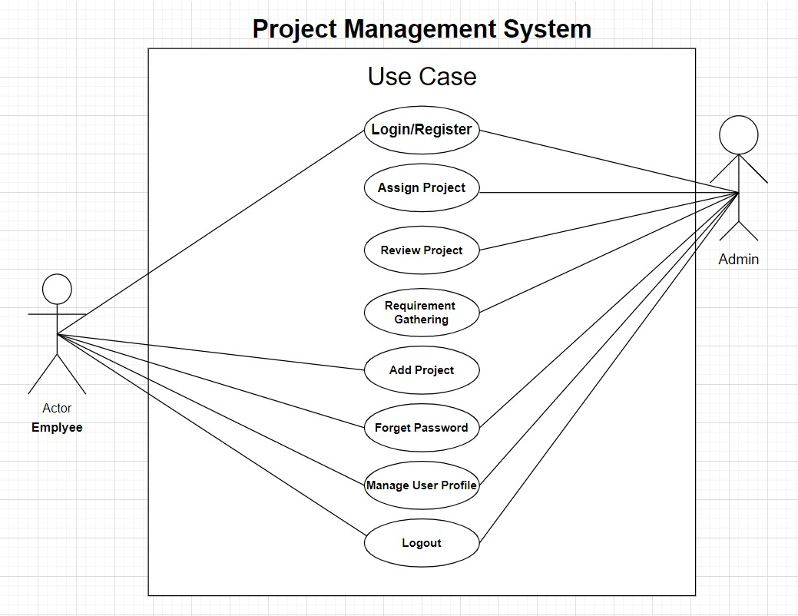
Use Case Diagram

Slide 6
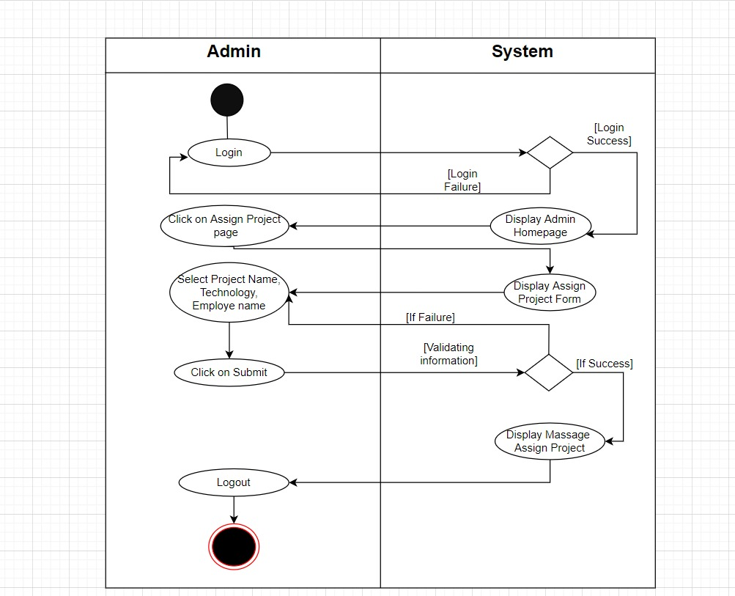
“An activity diagram for Assigning Project By Admin ”

Slide 7
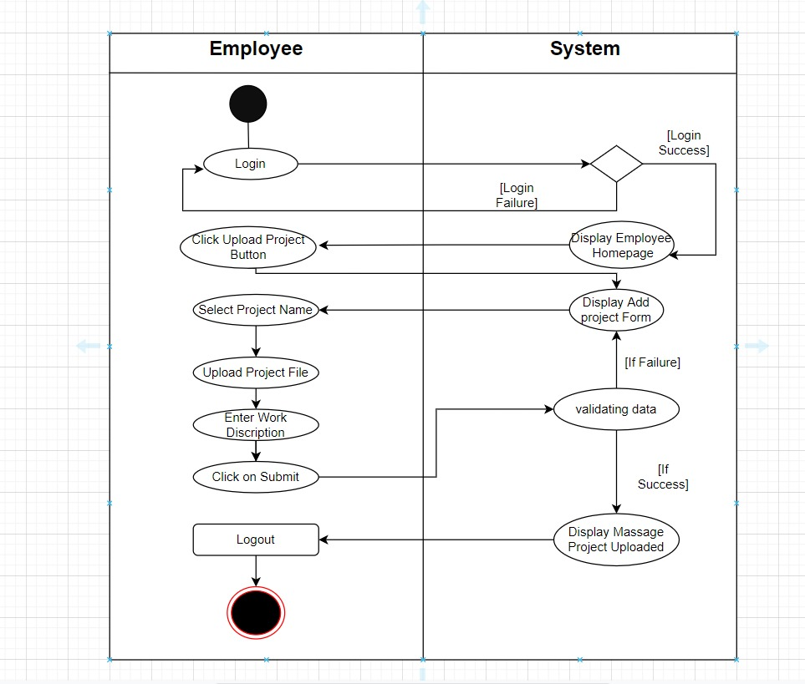
“An activity diagram Add Project By Employee”

Slide 8
Targeted Users
Students
Teacher
I.T. Companies
Employee
Project leaders

Slide 9
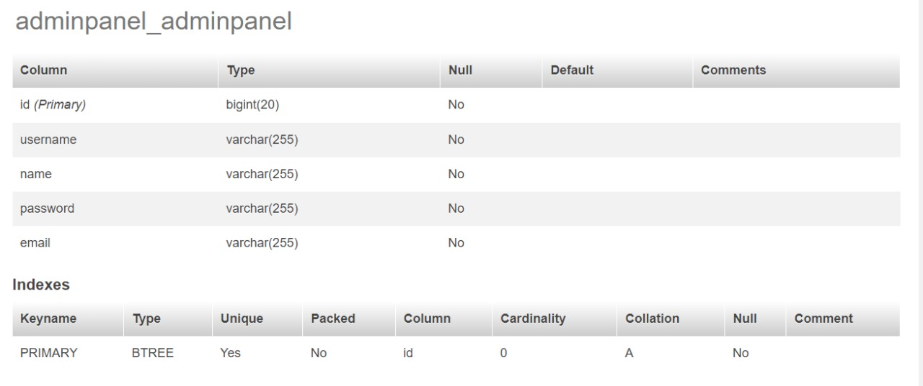
Data Dictionary
“Admin_Login”

Slide 10
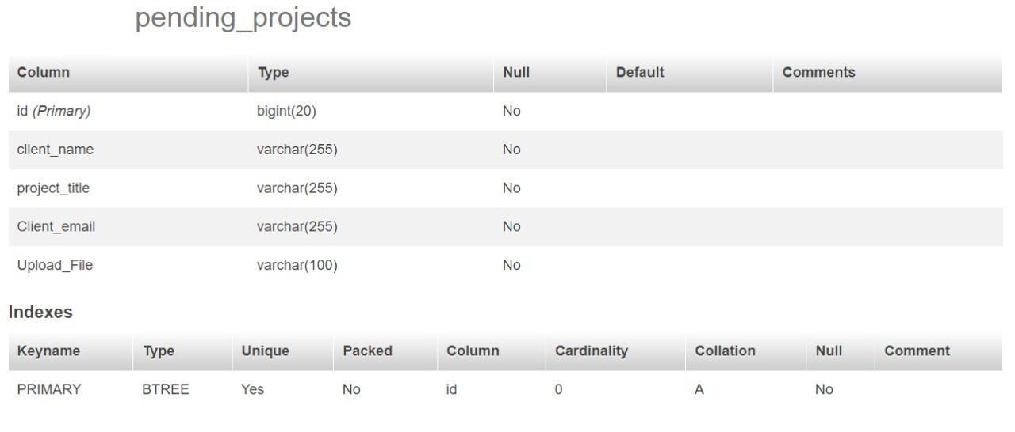
“Pending_Projects”

Slide 11
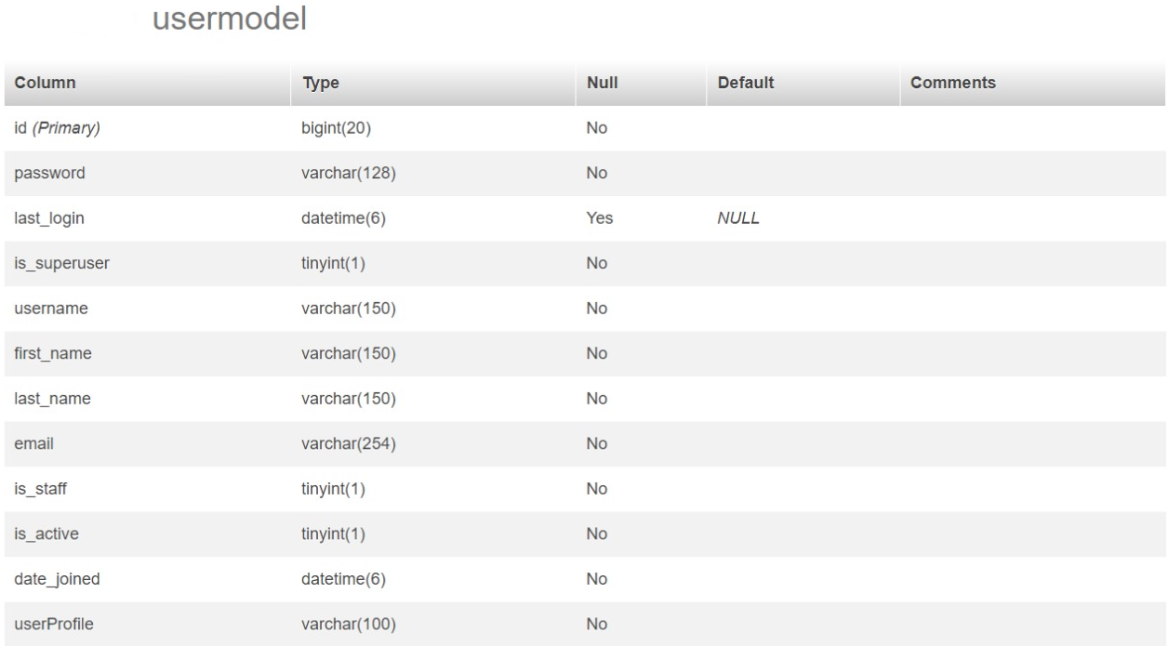
“UserModel”

Slide 12
CONCLUSION
Project Management System is a very effective application which can be used to a great extent. It have many advantages over the traditional system. Some of these advantages are centralized data, up-to-date status reporting, ease of use, backups etc. It also provides a good interface which is easy to understand by the users and helps in adapting to the use of this web application.

Slide 13
Thank You

