Slide 1
STAYZE RENT PREDICTION
TEAM
Hackatoons

Slide 2
PROBLEM STATEMENT
The stakeholders with the help of the available data want to know the ideal prices at which the properties can be rented, as it will help them decide upon the ideal investment to be done.
To understand the customers’ and the providers’(Host) behaviour and performance on the Stayze Platform, guiding new marketing initiatives, and implementation of innovative additional services.

Slide 3
POTENTIAL BUSINESS PROBLEM
To predict the ideal prices at which the properties can be rented.
Investment for the stakeholder depending upon the location and room type in demand.
Number of hosts listing(34226) their properties and their commercial behaviour.
Availability of the house.
Stakeholder –
CXO
Sales, Public Relation Manager, Hosts and Marketing Team.
Finance Planning and Analysis Department.
Operations Team

Slide 4
OUR APPROACH
01
02
03
DATA WRANGLING
DATA EXPLORATION
ML MODEL IMPLEMENTATION
Cleaning the raw data and making it useful for further analysis.
Gaining insights from the data to find correlated features.
Trying different ML models & selecting the best performing model.

Slide 5
DATA
NUMERICAL VARIABLES | CATEGORICAL VARIABLES
id | name
host_id | host_name
latitude / longitude | neighbourhood_group
minimum_nights | neighbourhood
number_of_reviews | room_type
reviews_per_month
calculated_host_listing_count
availability_365
Target Variable
price

Slide 6
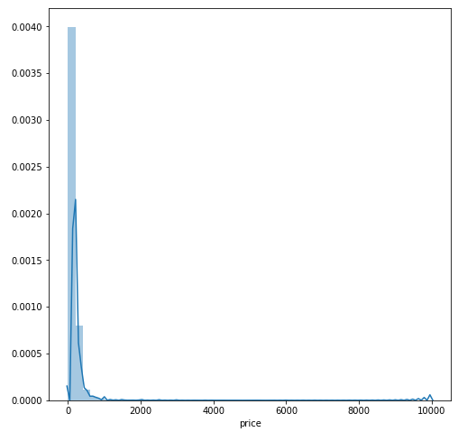
EXPLORATORY DATA ANALYSIS
Price Insights -
The plot is skewed towards the left, which indicates that our dataset mostly consists of Budget Rental Homes.
Only 2376 houses(i.e. 7%) are priced above $300
Only 143 houses(i.e. 0.4%) are priced above $1000
Price Distribution of all Listings

Slide 7
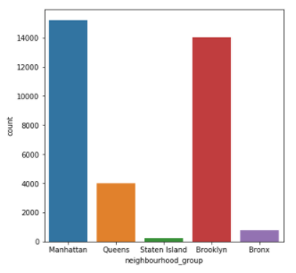
EXPLORATORY DATA ANALYSIS
Neighbourhood Group Insights:
Listings being scattered across the New York City and are distributed mainly in the high density areas such as Manhattan and Brooklyn.

Slide 8
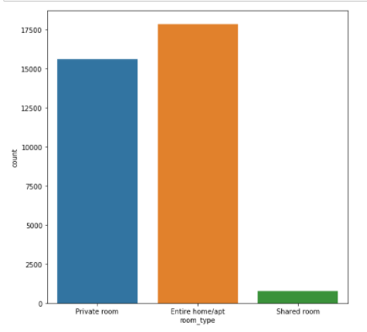
EXPLORATORY DATA ANALYSIS
Room Type – Insights:
There are higher number of Entire home/apt followed by private rooms. Shared rooms are only 2.3% of the dataset(803 houses).

Slide 9
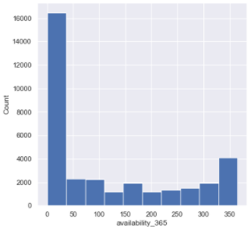
EXPLORATORY DATA ANALYSIS
Availability in 365 days – Insights:
There are more number of houses available for 10 to 50 days.
The availability_365 column has minimum value 0 - those properties which are rented out/ not available for rent anymore

Slide 10
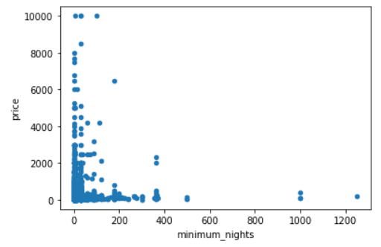
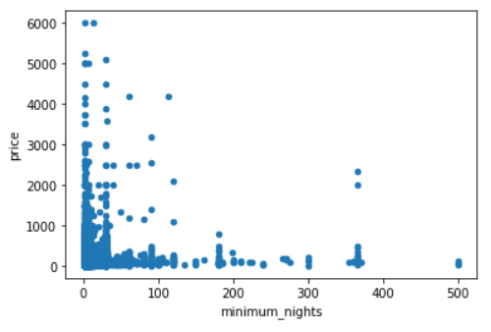
EXPLORATORY DATA ANALYSIS
Minimum Nights – Insights:
33833 houses(i.e. approx 99% of the dataset) lie in the range of 1-31 minimum nights. It is observed that the constraint of min nights leads to less occupancy of the listings

Slide 11
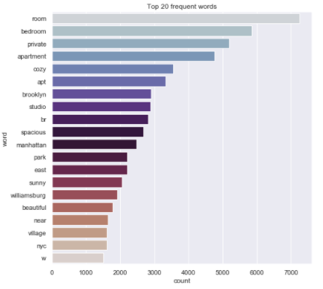
EXPLORATORY DATA ANALYSIS
Frequent Words (dataset)-Insights:
The 5 most frequently used words (room, bedroom, private, apartment, cozy) could help us understand the type of room and the number of bedrooms/ area of the room, whether it is private or shared room, whether it is an apartment or a studio, the comfort level of the house.

Slide 12
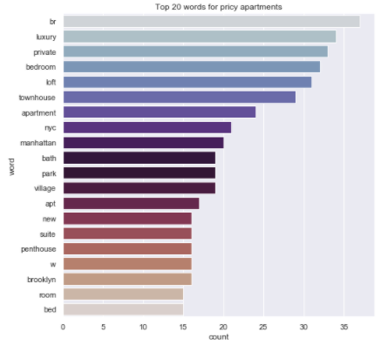
EXPLORATORY DATA ANALYSIS
Frequent words
(houses above $800) – Insights:
since our dataset has more houses in 10-600 range we consider houses above 800 as expensive
294 houses are expensive
only 20% descriptions have the word luxury.
9.5% are townhouses.
NYC > Manhattan > Brooklyn

Slide 13
PIPELINE
Dropping rows with null values for reviews_per_month column would mean losing 20% of our data, but dropping the columns would be a loss of a possibly important predictor. Therefore, replace the null values in the reviews_per_month with 0 and drop the last_review column.
Replacing Null values in host_name with “Unknown”
There are few rows with price = 0, hence dropped(houses cannot be rented for free). It might mean that the property is occupied or sold out and not available for future rental purposes.
The minimum nights has a supposed correlation with price. There are 3 rows with minimum_nights having outlier i.e 1250 and 999 value. Hence, dropped
We cannot drop rows with availability_365 = 0 since in the scatterplot for those datapoints the price lies between 0-2000 which also forms the part of budget homes.
The neighbourhood_group and the room_type columns are one-hot-encoded as the price is dependent on these variables.

Slide 14
PIPELINE
We perform NLP on the name column to find its correlation with price but we realize that there is not much information that can be extracted from the column and it is scattered. Hence, the name column can be dropped.
The dataset is split into 5 folds using KFold method for training and testing purposes.
We implement 4 ML models: Linear Regression, Random Forest, Decision Trees, and XGBoost.
After finding their RMSE values it is concluded that XGBoost model gives the least RMSE value. Hence, XGBoost model is trained.
The Test dataset is pre-processed and modifications are made similar to the modifications made in the Train dataset to make it suitable for the XGBoost model.
A blend of XGBoost(20%) and Catboost(80%) model is applied on the dataset.
The final submission csv file with the ‘predicted prices’ for the corresponding ‘id’ is extracted.

Slide 15
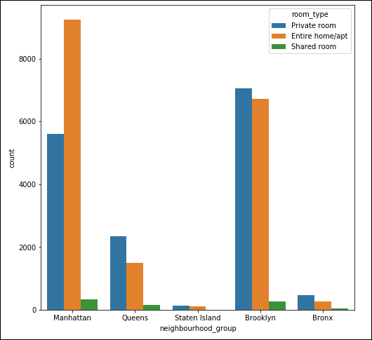
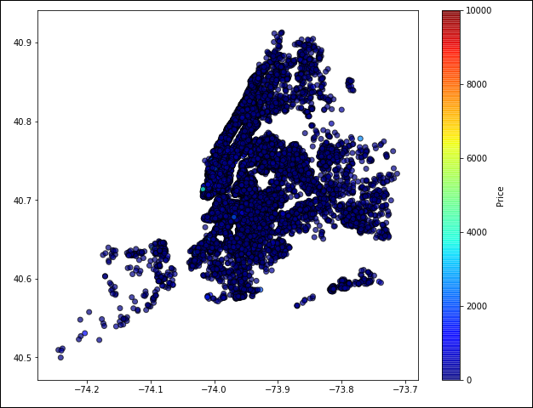
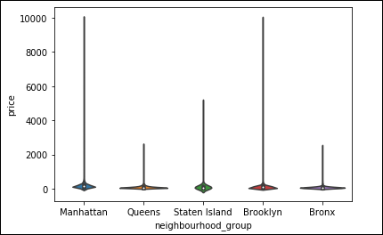
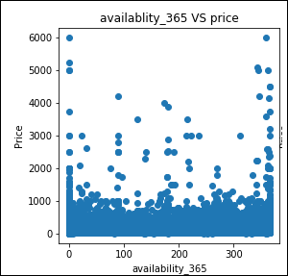
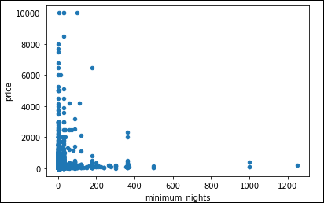
MAIN FEATURES
neighbourhood_group
latitude, longitude
room_type
availability_365
Minimum_nights

Slide 16
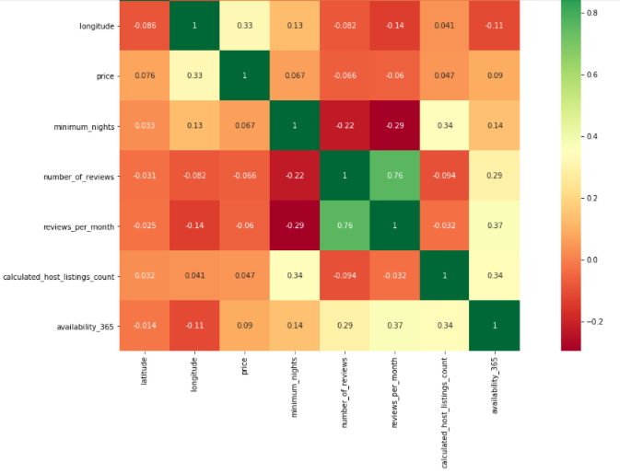
ANALYSIS

Slide 17
ANALYSIS
Observations on price:
price seems to be positively correlated with longitude meaning - Manhattan most expensive
latitude seems to have lesser effect on the price - higher prices located in the northern parts of the city
price is slightly positively correlated with - increasing availability, the fact that the property is rented by a host who lists other properties - increasing number of minimum nights
price is negatively correlated with number of reviews and reviews per month - possible that the prior reviews could reduce the prices to some extent
Other interesting observations:
calculated host lisiting count is positively correlated with minimum nights and availability_365 indicating that hosts who list more than one property may be more strategic about their rentals. That may attempt to maximize the amount of time a single renter stays at their property to minimize turnover cost.

Slide 18
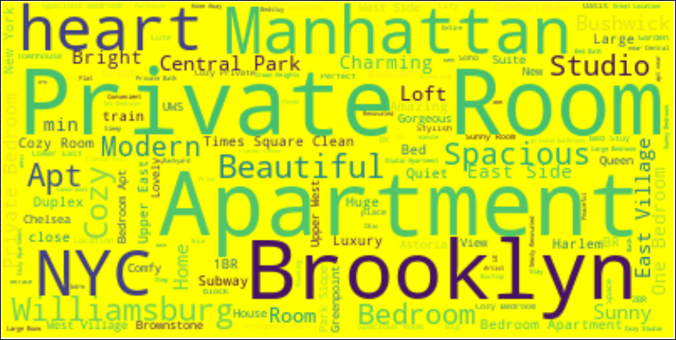
THE STAYZE WORDS

Slide 19
APPROACHED MODELS AND EVALUATION SCORES
Decision Tree
CatBoost
Random Forest
XGBoost
RMSE – 165.65
RMSE – 151.65
RMSE – 180.37
RMSE – 151.14

Slide 20
DECISION
Favourable places for house renting – Brooklyn and Manhattan
Investors should invest more into Private rooms and Entire House/Apt
Areas adjacent to Brooklyn and Manhattan should be considered for Investment
To attract customers, discount and campaigns should be implemented on Rooms in outskirts. This approach can also be used in Non-seasonal months.
Mainly rooms are in Manhattan, i.e, It is the business hub and tourism centre of NYC and other three being residential to a good extent.
NEXT STEPS
If additional details would have been given – Number of Bedrooms, number of Restrooms, plot size, Furnished/Not Furnished, Number of Times Listing was booked, Room Listing Date.
These data would be used to be more accurate and exact with Host and Customer behaviour.

Slide 21
OUR TEAM MATES
MANPREET KAUR DAKSH WAHI BHAVISHYA GARG KHUSBU VERMA

Slide 22
THANKS
Do you have any questions?

Slide 23
RESOURCES
https://towardsdatascience.com/exploratory-data-analysis-eda-a-practical-guide-and-template-for-structured-data-abfbf3ee3bd9
https://www.kaggle.com/amidala/nlp-what-s-in-a-name-predict-prices-by-title

