Slide 1


Daksh Agravat - 202211062
Ganesh Epili - 202211022
Under Guidance of
Our Beloved Guruji
Shri Dr. Tapas Kumar Maiti

Slide 2
Tech Stack
Back End
FastApi (Python Framework)
REST architecture
JSON schema - open API
Swagges / ReDoc
OAuth2.0 (JWT Tokens)
Pydantic Schema
Database
NoSql (Mongo db) / GraphQL (Prisma)
Front End
React.js
Tailwindcss
Few other npm packages
axios
react-motion
redux
react-router
Tools & Platforms
AWS lambda
Vercel
Postman
Version Control Platform - Github
Databse - Atlas
UI / UX - Figma

Slide 3
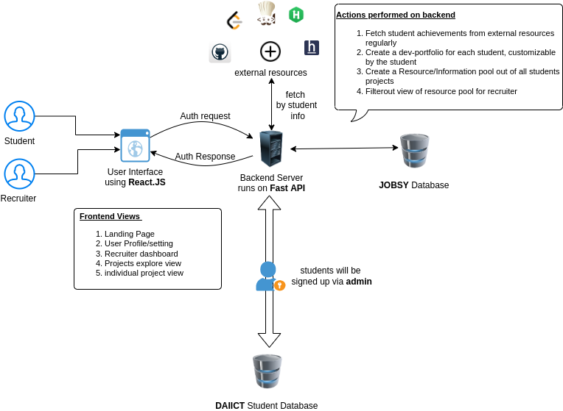
DFD & Usecase Diagrams

Slide 4
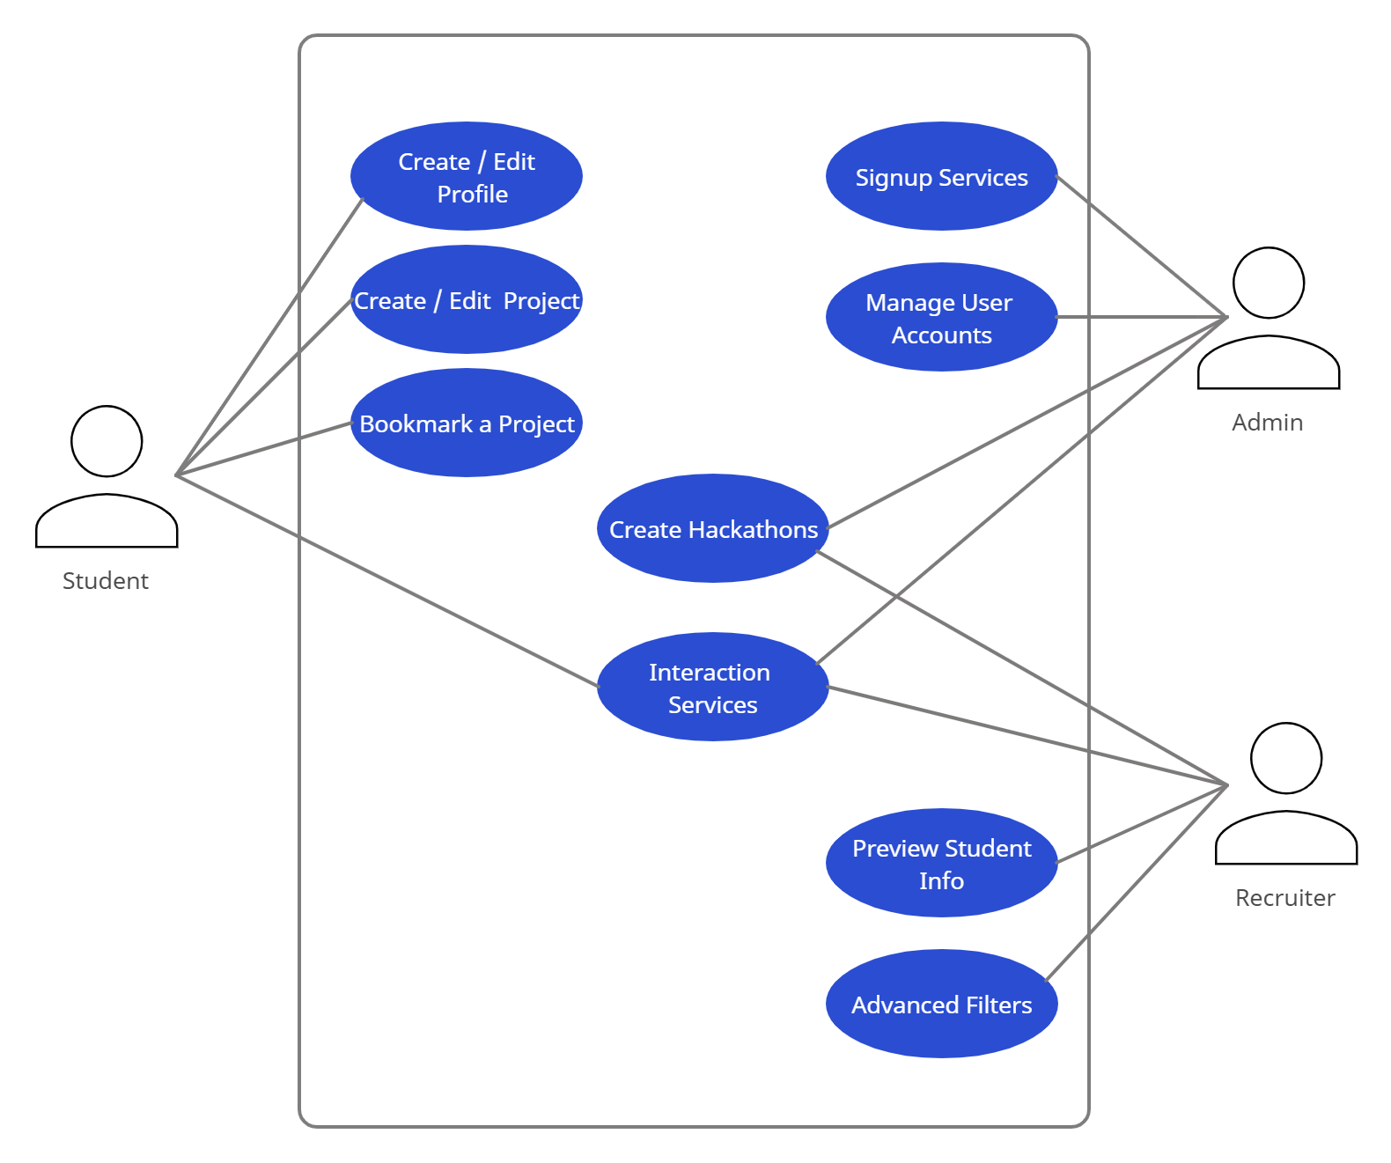
DFD & Usecase Diagrams

Slide 5
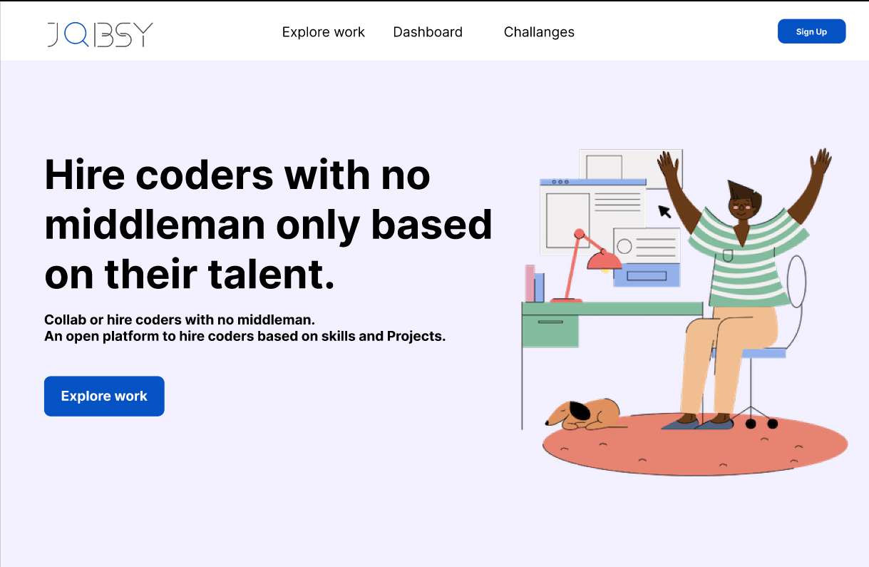
Figma Design - Landing Page

Slide 6
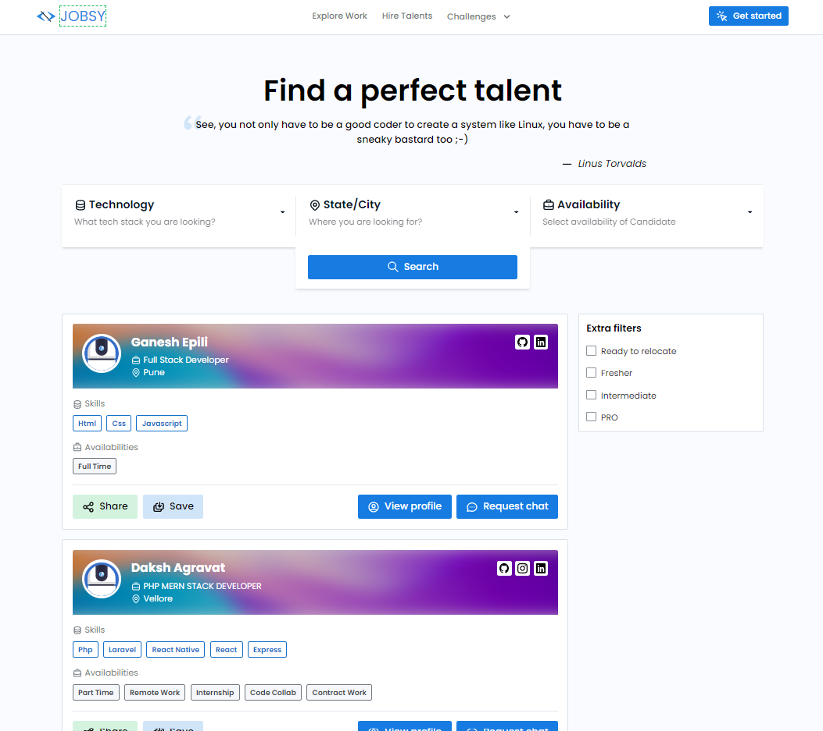
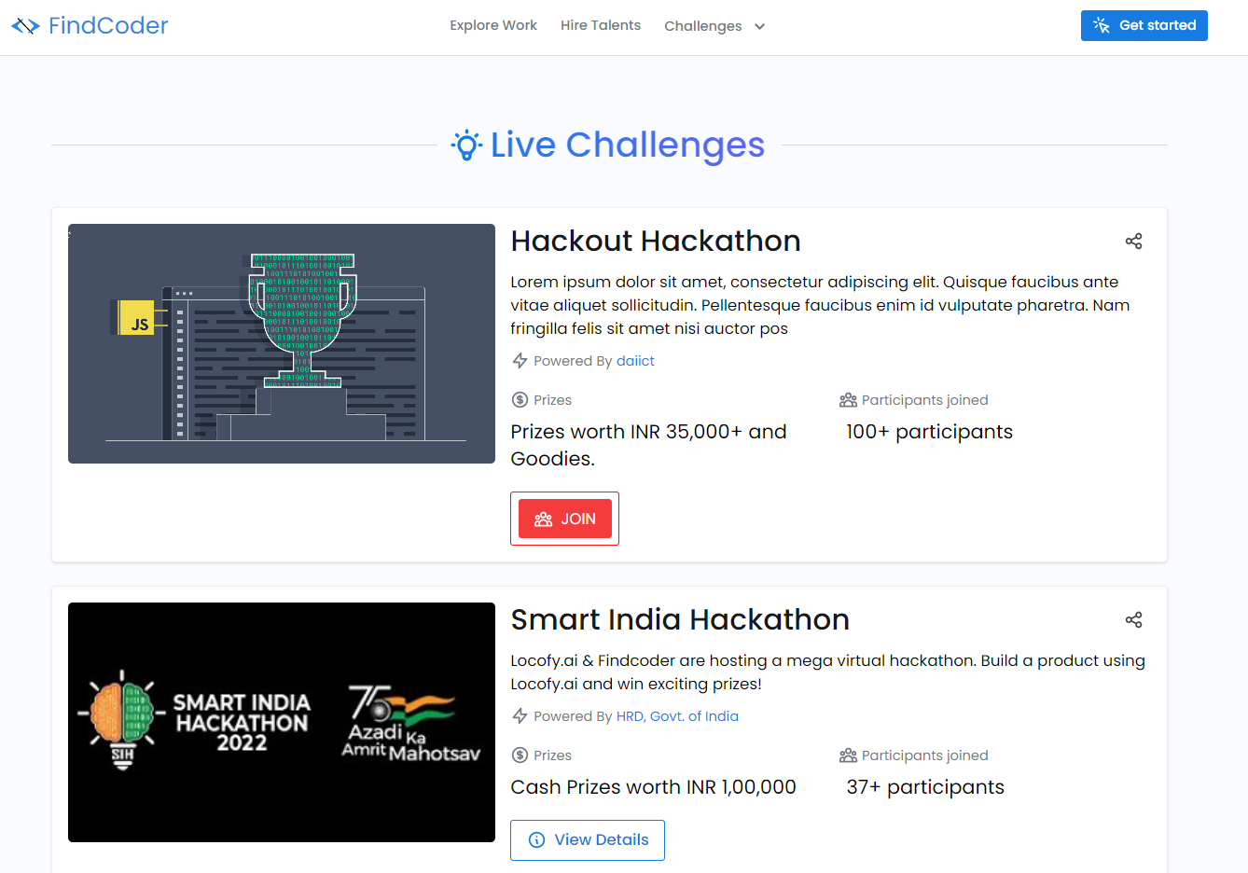
Figma Design - Explore Students

Slide 7
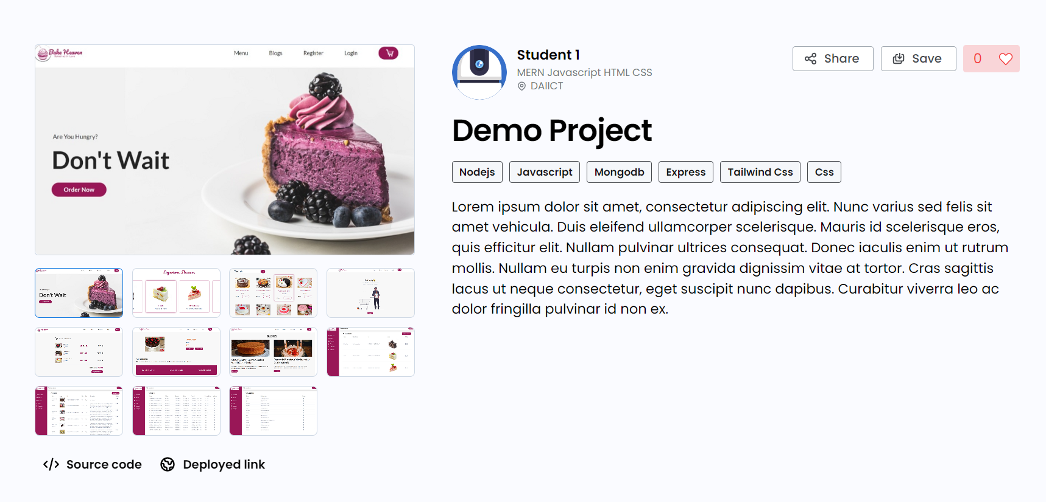
Figma Design - Project Page

Slide 8
Future Work and Time Line
Stage-2 Presentation
Development of wireframes presented in Stage-1 of the submission
Development of APIs
Integration of front-end & back-end
Stage-3 Presentation
Adding additional functionalities to enhance User Experience
Working on responsiveness of the website
Adding animations for a great User Experience
Optimizing the performance of the website

Slide 9

References
https://fastapi.tiangolo.com/
https://reactjs.org/docs/getting-started.html
https://redux.js.org/
https://tailwindui.com/documentation
https://www.prisma.io/docs/
https://www.mongodb.com/docs/
Thank You

