Slide 1
Azure Database Benchmark — Game OLTP Workload
Exp B: MySQL Flexible Server Premium SSD v1 vs v2 | Exp A: PostgreSQL Flexible Server vs HorizonDB Gate-validated open-loop measurements · 2026-08-25 UTC · Euson Internal Subscription

Slide 2
Executive summary
what was measured, what passed validation, what it means
• Exp B C1 @ 5,000/s: v2 vs v1 p99 +2.8% (CI [-44.7%, +156.4%]), p50 -28.6%; usable pairs 3/3
• Exp B C3 @ 5,000/s: v2 vs v1 p99 +41.9% (CI [+14.2%, +64.1%]), p50 -32.1%; usable pairs 3/3
• Exp B C5 @ 5,000/s: v2 vs v1 p99 +21.6% (CI [-11.3%, +118.6%]), p50 -34.0%; usable pairs 5/5
• Exp B C5 @ 3,000/s: v2 vs v1 p99 -55.2% (CI [-62.5%, -43.7%]), p50 -17.9%; usable pairs 3/3
• Exp B C5 @ 2,000/s: v2 vs v1 p99 -8.6% (CI [-10.0%, -7.7%]), p50 -27.0%; usable pairs 3/3
• Exp B C7 @ 5,000/s: v2 vs v1 p99 +30.0% (CI [+26.6%, +32.7%]), p50 -33.7%; usable pairs 3/3
• Exp B C7 @ 3,000/s: v2 vs v1 p99 -33.4% (CI [-35.9%, -28.9%]), p50 -19.2%; usable pairs 3/3
• Exp A C1 @ 5,500/s: HorizonDB vs PG p99 -89.8% (CI [-95.2%, -84.0%]); usable pairs 3/3
• Exp A C5 @ 5,500/s: HorizonDB vs PG p99 -87.1% (CI [-93.3%, -75.2%]); usable pairs 2/5
• Exp A C5 @ 3,300/s: HorizonDB vs PG p99 - (CI None); usable pairs 0/3
• Exp A C5 @ 2,200/s: HorizonDB vs PG p99 -94.5% (CI [-99.7%, -71.8%]); usable pairs 3/3
• Exp A C7 @ 5,500/s: HorizonDB vs PG p99 -75.0% (CI [-94.0%, -46.4%]); usable pairs 3/3
• Exp A C7 @ 5,501/s: HorizonDB vs PG p99 - (CI None); usable pairs 0/3
• Exp A C7 @ 3,300/s: HorizonDB vs PG p99 -76.8% (CI [-87.5%, -56.9%]); usable pairs 2/3
• All reported numbers come only from runs that passed the hard validity gates (dataset ≥ 2× buffer pool, physical reads > 0, client CPU < 60%, errors < 1%, steady state, server metrics aligned to the UTC window).
• 3 repetitions per cell (protocol baseline is 5) — CIs are wide; treat effects as directional unless the CI excludes 0.
• Exp A: HorizonDB's buffer cache (45 GB at 8 vCore, 90 GB at 16 vCore) exceeds the dataset — G1/G2 are soft-failed for HorizonDB; the comparison is 'storage-bound PG (P15 disk at 100% IOPS) vs cache-resident HorizonDB' at the same offered load. In C5, PG Flexible showed multi-second stalls in 2 of 3 reps (queue/latency gates failed → excluded), HorizonDB none.
• Exp A S2 (write-heavy, 3,300/s): HorizonDB p99 ≈ 4 ms in all 3 reps; PG Flexible (P15 disk, IOPS 100%) stalled for seconds in every rep (p99 0.4–20 s, G4/G5 fail) → no usable pair, but the failure itself is the finding. Exp A C7 (No-HA, warm): PG p99 7–8 ms vs HorizonDB 3.7 ms (−75% [−94%, −46%]).
• Exp B: MySQL is storage-bound in both cases (16 vCore did not raise the knee); v2's median latency is consistently lower, but v2 showed a tail-latency degradation episode in the 3rd repetition of both C1 and C5 (dirty pages ↑, threads_running spikes) — root cause not established; needs a longer soak.

Slide 3
Method — how validity was enforced
traditional load-testing protocol + automated gates; pilots/smoke never appear in result tables
• Workload: game OLTP schema (accounts/inventory/sessions/ledger/matches/leaderboard/guilds), random incompressible payloads; S1 mix = 65% read / 35% write (profile 30, inventory 20, leaderboard 10, guild 5, session upsert 10, inventory update 12, match result 8, purchase 5).
• Key model: 20% of ops on a 50k-account hot set, 80% uniform over 2.5M accounts (top-1 key share ≈ 0.0004%).
• Load: closed-loop staircase finds the knee → open-loop Poisson-ish arrivals at ≈65% of the lower arm's knee; latency measured from scheduled arrival (no coordinated omission); HDR histogram (µs); errors counted separately.
• Concurrency: 256 dedicated connections per arm; queue pickup delay p99 gated < 5 ms (no pool wait).
• Warm-up until last-120 s throughput CV < 5%, then 10-minute measurement; both arms run in the same wall-clock window; 3 repetitions.
• Server evidence inside every run: SHOW GLOBAL STATUS / pg_stat_* every 5 s → read/write IOPS, buffer hit ratio; Azure Monitor sliced to the run window; Telegraf→InfluxDB→Grafana for live view.
• Statistics: paired log-ratio per repetition → geometric-mean Δ%, seeded bootstrap 95% CI, per-arm CV; gate-failed runs excluded and listed.
Gate | Rule
G1 | dataset ≥ 2× buffer pool
G2 | read IOPS > 0 and hit ratio < 99%
G3 | client CPU < 60%, NIC < 50% (measured)
G4 | queue pickup p99 < 5 ms
G5 | errors < 1%, timeouts < 0.5%, drops < 0.1%
G6 | ≥3 server samples, 0 errors, UTC-aligned; Azure Monitor non-empty
G7 | steady state CV < 5% before measuring
G9 | app invariants (ledger = spent, no negatives)
G10 | ≥ 95% of planned duration

Slide 4
Exp B environment & confound table
MySQL Flexible Server 8.4.9, Korea Central, Same-zone HA, storage 128 GiB, both arms 5,000 provisioned IOPS (same-IOPS cell)
Item | v1 (Premium SSD v1) | v2 (Premium SSD v2) | Controlled?
Compute | Standard_E8ds_v5 (8 vCore / 64 GiB) → C5: E16ds_v5 | Standard_E8ds_v6 (8 vCore / 64 GiB) → C5: E16ds_v6 | Generation differs (platform forces v6 for SSD v2) — confound
Storage | Premium_LRS 128 GiB, 5,000 IOPS (paid additional IOPS) | PremiumV2_LRS 128 GiB, 5,000 IOPS / 125 MB/s | IOPS matched
innodb_buffer_pool_size | 8 GiB (pinned) | 8 GiB (pinned) | controlled (pre-registered; default would be 48 GiB)
innodb_doublewrite | OFF (platform read-only) | ON (platform read-only) | cannot control — confound
Dataset | 24.4 GiB (3.05× buffer pool) | 23.7 GiB (2.96× buffer pool) | same generator/seed
HA / zone | SameZone / zone 1 | SameZone / zone 1 | controlled
Network | public endpoint + TLS from bench VM (D16ds_v5, same region) | same | controlled

Slide 5
Exp B (MySQL SSD v1 vs v2) — overview across cases
arms: v1 = Premium SSD v1, v2 = Premium SSD v2 (same-IOPS 5,000) | medians of gate-passing repetitions; Δ = geometric-mean paired change of second arm vs first with 95% bootstrap CI
Cell | Rate/s | pairs | p50 A→B | p95 A→B | p99 A→B | p99.9 A→B | Δ p50 [CI] | Δ p99 [CI] | read IOPS A/B | hit A/B
C1/S1 | 5,000 | 3/3 | 3.5 ms → 2.3 ms | 19.4 ms → 15.3 ms | 25.2 ms → 18.5 ms | 43.1 ms → 26.3 ms | -29% [-39, -14] | +3% [-45, +156] | 2,225 → 1,519 | 0.9752 → 0.9791
C3/S1 | 5,000 | 3/3 | 3.7 ms → 2.6 ms | 20.8 ms → 28.8 ms | 27.5 ms → 40.6 ms | 79.7 ms → 55.2 ms | -32% [-36, -29] | +42% [+14, +64] | 1,721 → 1,731 | 0.9766 → 0.9765
C5/S1 | 5,000 | 5/5 | 3.6 ms → 2.3 ms | 19.5 ms → 17.9 ms | 24.6 ms → 23.6 ms | 56.9 ms → 29.8 ms | -34% [-37, -30] | +22% [-11, +119] | 1,556 → 1,542 | 0.9790 → 0.9789
C5/S2 | 3,000 | 3/3 | 15.0 ms → 12.5 ms | 22.5 ms → 17.7 ms | 54.1 ms → 23.0 ms | 115.5 ms → 42.1 ms | -18% [-20, -17] | -55% [-62, -44] | 810 → 815 | 0.9889 → 0.9887
C5/S3 | 2,000 | 3/3 | 17.3 ms → 12.5 ms | 4,284.4 ms → 3,919.9 ms | 4,390.9 ms → 4,032.5 ms | 4,481.0 ms → 4,126.7 ms | -27% [-29, -25] | -9% [-10, -8] | 1,641 → 1,707 | 0.9745 → 0.9742
C7/S1 | 5,000 | 3/3 | 3.6 ms → 2.4 ms | 19.9 ms → 23.4 ms | 24.8 ms → 32.6 ms | 56.6 ms → 43.7 ms | -34% [-35, -33] | +30% [+27, +33] | 1,638 → 1,647 | 0.9781 → 0.9778
C7/S4 | 3,000 | 3/3 | 15.0 ms → 12.1 ms | 22.1 ms → 16.1 ms | 28.6 ms → 18.6 ms | 88.3 ms → 28.4 ms | -19% [-20, -18] | -33% [-36, -29] | 521 → 524 | 0.9960 → 0.9958
A = first arm, B = second arm (v1→v2 / postgres→horizon). C1 = 8 vCore + Same-zone HA, C5 = 16 vCore + Same-zone HA; same dataset, same offered load, same client.
Read as: negative Δ latency = B faster. CIs from 3 repetitions are wide; a CI that excludes 0 is a directional finding, not a precise magnitude.

Slide 6
Exp B (MySQL SSD v1 vs v2) — C1 / S1 @ 5,000/s
8 vCore / Same-zone HA · S1 normal play (65% read) | arms: v1 = Premium SSD v1, v2 = Premium SSD v2 (same-IOPS 5,000) | usable pairs 3/3 (10-min open-loop, arms concurrent)
Outcome | v1 (median) | v2 (median) | Δ% v2 vs v1 | 95% CI (bootstrap) | n pairs | Reading
Throughput (TPS) | 5,000 | 5,000 | -0.0% | [-0.0%, +0.0%] | 3 | CI includes 0
p50 | 3.5 ms | 2.3 ms | -28.6% | [-39.4%, -13.5%] | 3 | v2 lower (better)
p95 | 19.4 ms | 15.3 ms | +11.3% | [-25.2%, +133.0%] | 3 | CI includes 0
p99 | 25.2 ms | 18.5 ms | +2.8% | [-44.7%, +156.4%] | 3 | CI includes 0
p99.9 | 43.1 ms | 26.3 ms | -32.9% | [-79.3%, +108.6%] | 3 | CI includes 0
Error rate | 0.000% | 0.000% | - | - | 3 | insufficient pairs for effect/CI
Dropped arrivals | 0.000% | 0.000% | - | - | 3 | insufficient pairs for effect/CI
Burst recovery (s) | - | - | - | - | 0 | insufficient pairs for effect/CI
Server read IOPS | 2,225 | 1,519 | - | - | 3
Server write IOPS | 2,183 | 3,299 | - | - | 3
Buffer hit ratio | 0.9752 | 0.9791 | - | - | 3
Gate status per repetition (G1 dataset≥2×buffer, G2 storage used, G3 client headroom, G4 queue, G5 errors, G6 metrics, G7 steady state, G10 duration; azmon=Azure Monitor slice; inv=invariants):
rep 1: v1: PASS tps=5000 p99=23.2ms | v2: PASS tps=5000 p99=17.8ms
rep 2: v1: PASS tps=5000 p99=33.5ms | v2: PASS tps=5000 p99=18.5ms
rep 3: v1: PASS tps=5000 p99=25.2ms | v2: PASS tps=5000 p99=64.6ms

Slide 7
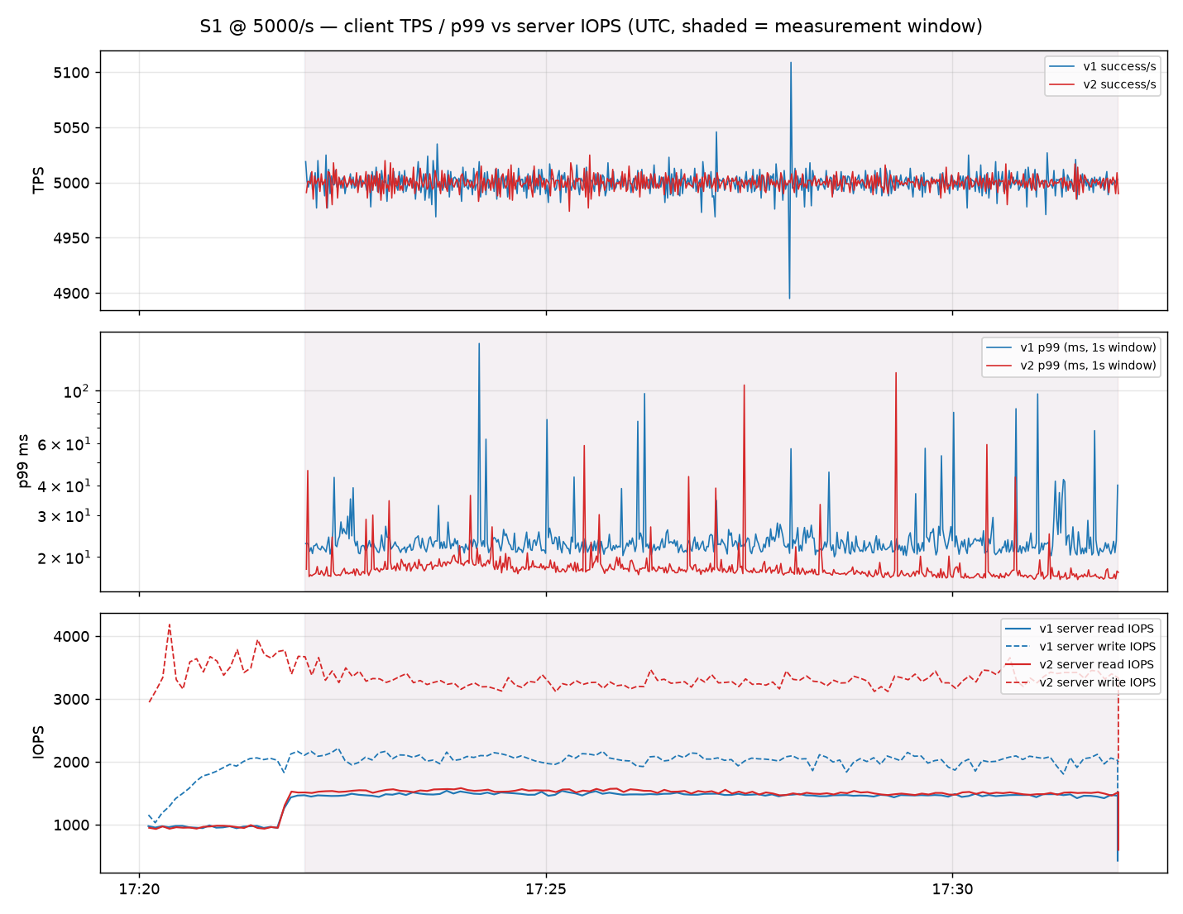
Exp B (MySQL SSD v1 vs v2) — C1 time series (client TPS / p99 vs server IOPS, same UTC axis)
shaded = 10-minute measurement window; server IOPS from in-run status sampling (SHOW GLOBAL STATUS / pg_stat)

Slide 8
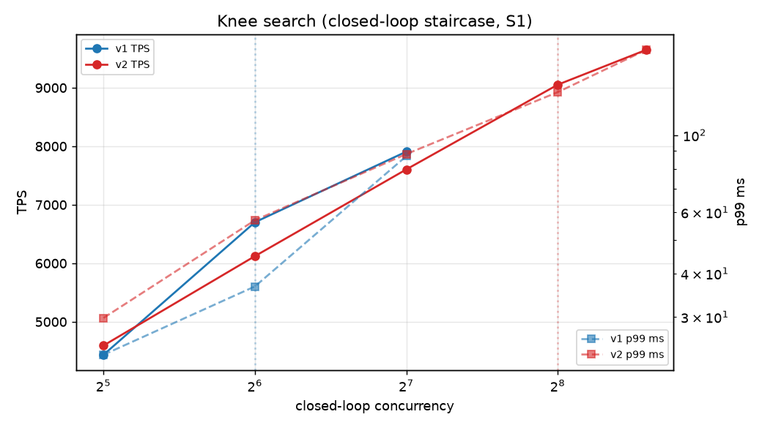
Exp B (MySQL SSD v1 vs v2) — C1 knee search (closed-loop staircase)
used only to pick the open-loop measurement rate (≈65% of the lower arm's knee); not a result table

Slide 9
Exp B (MySQL SSD v1 vs v2) — C3 / S1 @ 5,000/s
8 vCore / No-HA · S1 normal play (65% read) | arms: v1 = Premium SSD v1, v2 = Premium SSD v2 (same-IOPS 5,000) | usable pairs 3/3 (10-min open-loop, arms concurrent)
Outcome | v1 (median) | v2 (median) | Δ% v2 vs v1 | 95% CI (bootstrap) | n pairs | Reading
Throughput (TPS) | 5,000 | 5,000 | +0.0% | [-0.0%, +0.0%] | 3 | CI includes 0
p50 | 3.7 ms | 2.6 ms | -32.1% | [-36.2%, -29.2%] | 3 | v2 lower (better)
p95 | 20.8 ms | 28.8 ms | +30.2% | [+8.7%, +42.5%] | 3 | v2 higher (worse)
p99 | 27.5 ms | 40.6 ms | +41.9% | [+14.2%, +64.1%] | 3 | v2 higher (worse)
p99.9 | 79.7 ms | 55.2 ms | -44.6% | [-72.2%, +9.8%] | 3 | CI includes 0
Error rate | 0.000% | 0.000% | - | - | 3 | insufficient pairs for effect/CI
Dropped arrivals | 0.000% | 0.000% | - | - | 3 | insufficient pairs for effect/CI
Burst recovery (s) | - | - | - | - | 0 | insufficient pairs for effect/CI
Server read IOPS | 1,721 | 1,731 | - | - | 3
Server write IOPS | 2,347 | 3,095 | - | - | 3
Buffer hit ratio | 0.9766 | 0.9765 | - | - | 3
Gate status per repetition (G1 dataset≥2×buffer, G2 storage used, G3 client headroom, G4 queue, G5 errors, G6 metrics, G7 steady state, G10 duration; azmon=Azure Monitor slice; inv=invariants):
rep 1: v1: PASS tps=5000 p99=28.1ms | v2: PASS tps=5000 p99=32.1ms
rep 2: v1: PASS tps=5000 p99=24.8ms | v2: PASS tps=5000 p99=40.6ms
rep 3: v1: PASS tps=5000 p99=27.5ms | v2: PASS tps=5000 p99=41.9ms

Slide 10
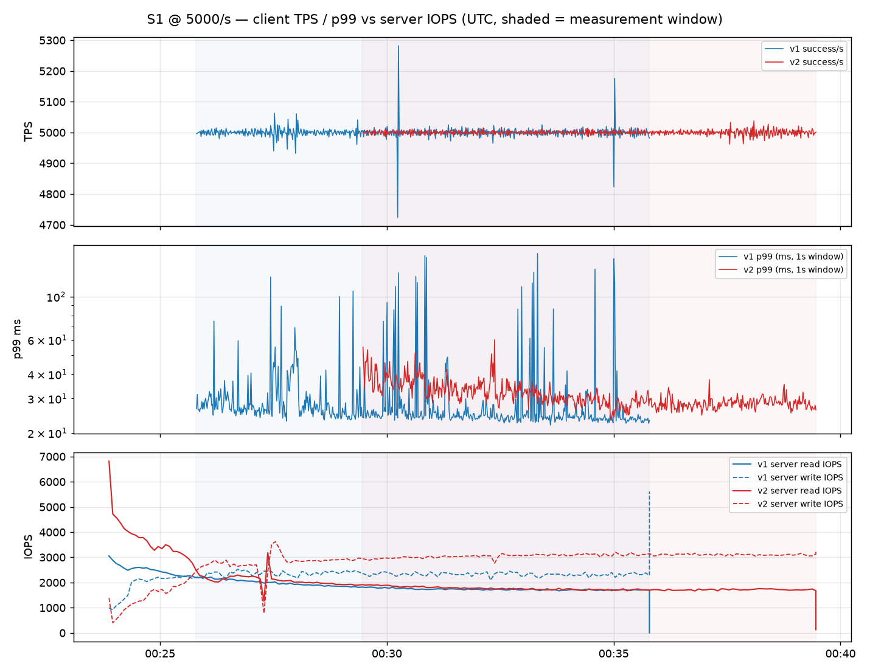
Exp B (MySQL SSD v1 vs v2) — C3 time series (client TPS / p99 vs server IOPS, same UTC axis)
shaded = 10-minute measurement window; server IOPS from in-run status sampling (SHOW GLOBAL STATUS / pg_stat)

Slide 11
Exp B (MySQL SSD v1 vs v2) — C5 / S1 @ 5,000/s
16 vCore / Same-zone HA · S1 normal play (65% read) | arms: v1 = Premium SSD v1, v2 = Premium SSD v2 (same-IOPS 5,000) | usable pairs 5/5 (10-min open-loop, arms concurrent)
Outcome | v1 (median) | v2 (median) | Δ% v2 vs v1 | 95% CI (bootstrap) | n pairs | Reading
Throughput (TPS) | 5,000 | 5,000 | +0.0% | [-0.0%, +0.0%] | 5 | CI includes 0
p50 | 3.6 ms | 2.3 ms | -34.0% | [-37.5%, -29.8%] | 5 | v2 lower (better)
p95 | 19.5 ms | 17.9 ms | +13.5% | [-11.6%, +80.4%] | 5 | CI includes 0
p99 | 24.6 ms | 23.6 ms | +21.6% | [-11.3%, +118.6%] | 5 | CI includes 0
p99.9 | 56.9 ms | 29.8 ms | -65.2% | [-89.1%, +10.8%] | 5 | CI includes 0
Error rate | 0.000% | 0.000% | - | - | 5 | insufficient pairs for effect/CI
Dropped arrivals | 0.000% | 0.000% | - | - | 5 | insufficient pairs for effect/CI
Burst recovery (s) | - | - | - | - | 0 | insufficient pairs for effect/CI
Server read IOPS | 1,556 | 1,542 | - | - | 5
Server write IOPS | 2,168 | 3,236 | - | - | 5
Buffer hit ratio | 0.9790 | 0.9789 | - | - | 5
Gate status per repetition (G1 dataset≥2×buffer, G2 storage used, G3 client headroom, G4 queue, G5 errors, G6 metrics, G7 steady state, G10 duration; azmon=Azure Monitor slice; inv=invariants):
rep 1: v1: PASS tps=5000 p99=23.3ms | v2: PASS tps=5000 p99=21.5ms
rep 2: v1: PASS tps=5000 p99=25.3ms | v2: PASS tps=5000 p99=22.2ms
rep 3: v1: PASS tps=5000 p99=24.2ms | v2: PASS tps=5000 p99=94.1ms
rep 4: v1: PASS tps=5000 p99=24.6ms | v2: PASS tps=5000 p99=23.6ms
rep 5: v1: PASS tps=5000 p99=29.0ms | v2: PASS tps=5000 p99=25.5ms

Slide 12
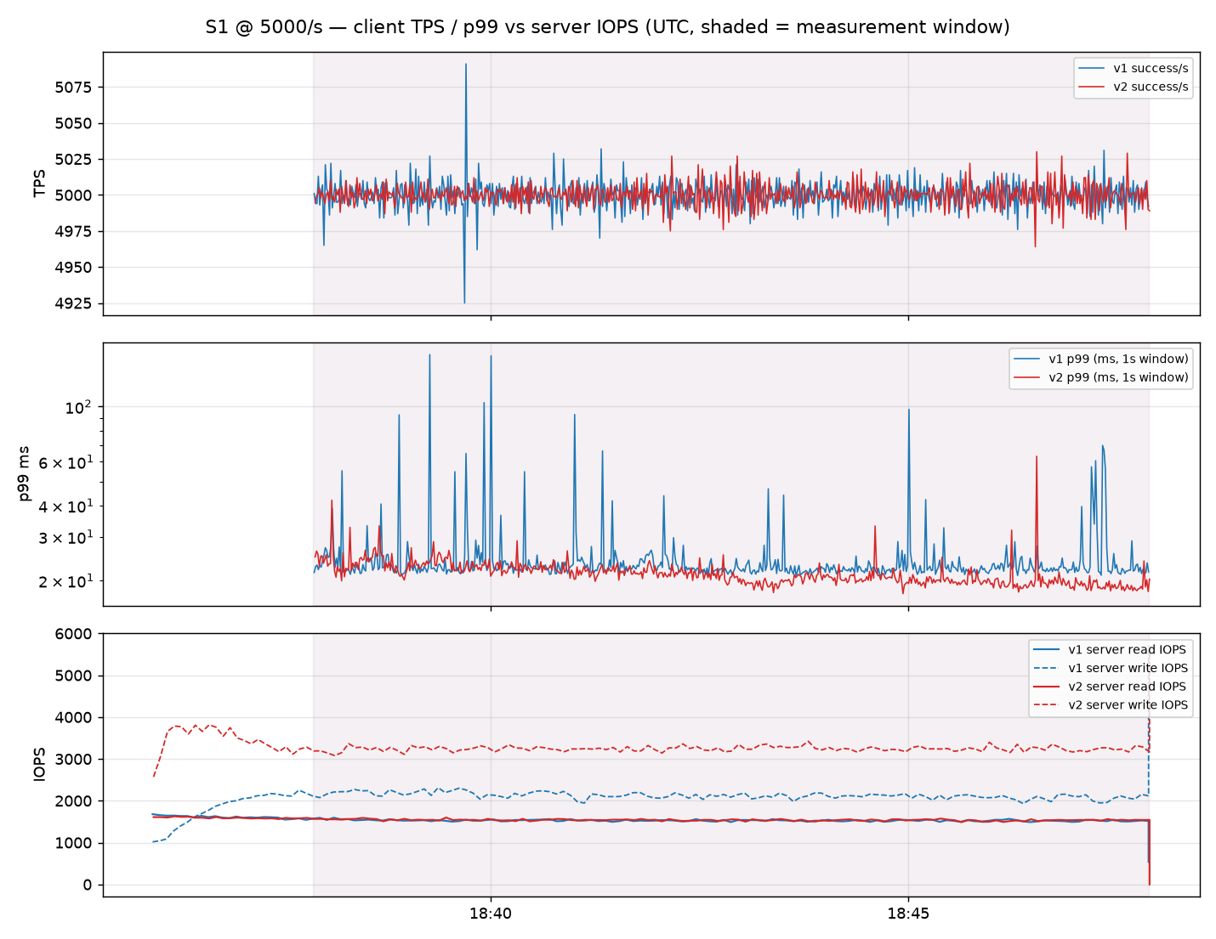
Exp B (MySQL SSD v1 vs v2) — C5 time series (client TPS / p99 vs server IOPS, same UTC axis)
shaded = 10-minute measurement window; server IOPS from in-run status sampling (SHOW GLOBAL STATUS / pg_stat)

Slide 13
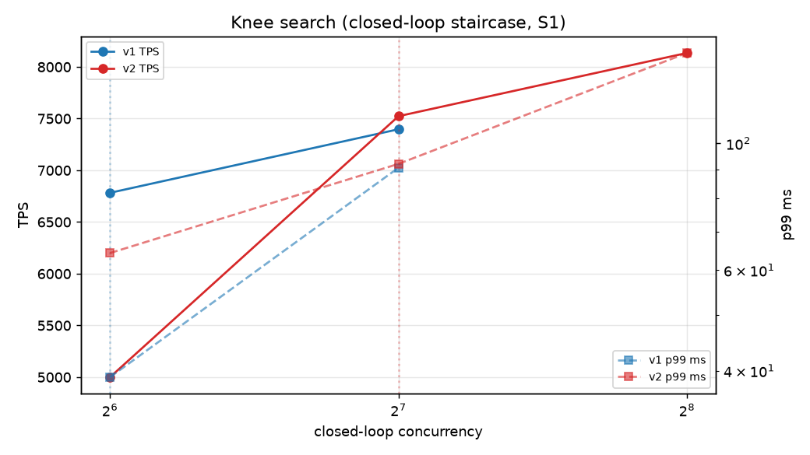
Exp B (MySQL SSD v1 vs v2) — C5 knee search (closed-loop staircase)
used only to pick the open-loop measurement rate (≈65% of the lower arm's knee); not a result table

Slide 14
Exp B (MySQL SSD v1 vs v2) — C5 / S2 @ 3,000/s
16 vCore / Same-zone HA · S2 write-heavy (80% write) | arms: v1 = Premium SSD v1, v2 = Premium SSD v2 (same-IOPS 5,000) | usable pairs 3/3 (10-min open-loop, arms concurrent)
Outcome | v1 (median) | v2 (median) | Δ% v2 vs v1 | 95% CI (bootstrap) | n pairs | Reading
Throughput (TPS) | 3,000 | 3,000 | -0.0% | [-0.0%, +0.0%] | 3 | CI includes 0
p50 | 15.0 ms | 12.5 ms | -17.9% | [-20.0%, -16.7%] | 3 | v2 lower (better)
p95 | 22.5 ms | 17.7 ms | -22.5% | [-28.6%, -17.4%] | 3 | v2 lower (better)
p99 | 54.1 ms | 23.0 ms | -55.2% | [-62.5%, -43.7%] | 3 | v2 lower (better)
p99.9 | 115.5 ms | 42.1 ms | -61.7% | [-65.6%, -54.4%] | 3 | v2 lower (better)
Error rate | 0.000% | 0.000% | - | - | 3 | insufficient pairs for effect/CI
Dropped arrivals | 0.000% | 0.000% | - | - | 3 | insufficient pairs for effect/CI
Burst recovery (s) | - | - | - | - | 0 | insufficient pairs for effect/CI
Server read IOPS | 810 | 815 | - | - | 3
Server write IOPS | 2,843 | 11,929 | - | - | 3
Buffer hit ratio | 0.9889 | 0.9887 | - | - | 3
Gate status per repetition (G1 dataset≥2×buffer, G2 storage used, G3 client headroom, G4 queue, G5 errors, G6 metrics, G7 steady state, G10 duration; azmon=Azure Monitor slice; inv=invariants):
rep 1: v1: PASS tps=3000 p99=56.0ms | v2: PASS tps=3000 p99=21.0ms
rep 2: v1: PASS tps=3000 p99=42.4ms | v2: PASS tps=3000 p99=23.9ms
rep 3: v1: PASS tps=3000 p99=54.1ms | v2: PASS tps=3000 p99=23.0ms

Slide 15
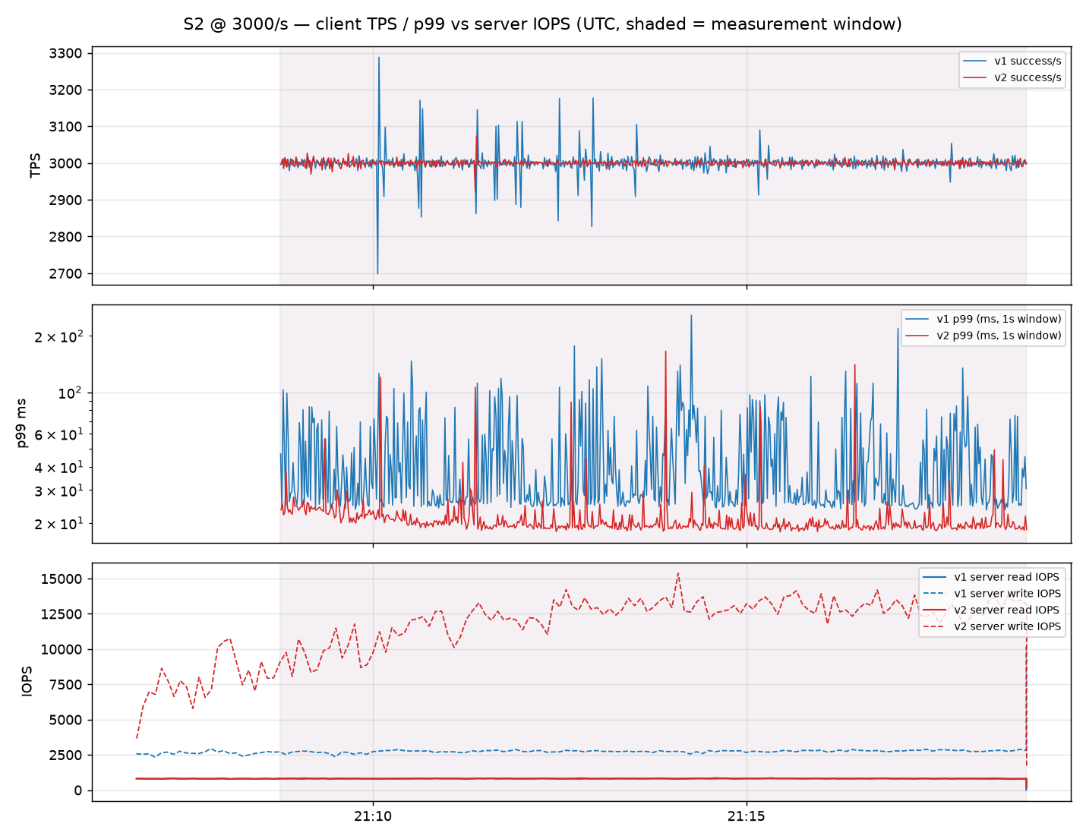
Exp B (MySQL SSD v1 vs v2) — C5 time series (client TPS / p99 vs server IOPS, same UTC axis)
shaded = 10-minute measurement window; server IOPS from in-run status sampling (SHOW GLOBAL STATUS / pg_stat)

Slide 16
Exp B (MySQL SSD v1 vs v2) — C5 knee search (closed-loop staircase)
used only to pick the open-loop measurement rate (≈65% of the lower arm's knee); not a result table

Slide 17
Exp B (MySQL SSD v1 vs v2) — C5 / S3 @ 2,000/s
16 vCore / Same-zone HA · S3 login burst: base rate ×3 for 120 s at t+240 s | arms: v1 = Premium SSD v1, v2 = Premium SSD v2 (same-IOPS 5,000) | usable pairs 3/3 (10-min open-loop, arms concurrent)
Outcome | v1 (median) | v2 (median) | Δ% v2 vs v1 | 95% CI (bootstrap) | n pairs | Reading
Throughput (TPS) | 2,614 | 2,694 | +3.2% | [+2.8%, +3.9%] | 3 | v2 higher (better)
p50 | 17.3 ms | 12.5 ms | -27.0% | [-29.0%, -24.6%] | 3 | v2 lower (better)
p95 | 4,284.4 ms | 3,919.9 ms | -8.8% | [-10.2%, -7.9%] | 3 | v2 lower (better)
p99 | 4,390.9 ms | 4,032.5 ms | -8.6% | [-10.0%, -7.7%] | 3 | v2 lower (better)
p99.9 | 4,481.0 ms | 4,126.7 ms | -8.0% | [-10.2%, -5.8%] | 3 | v2 lower (better)
Error rate | 0.000% | 0.000% | - | - | 3 | insufficient pairs for effect/CI
Dropped arrivals | 6.638% | 3.800% | -44.3% | [-50.8%, -40.6%] | 3 | v2 lower (better)
Burst recovery (s) | 8 | 7 | -13.1% | [-25.0%, +0.0%] | 3 | CI includes 0
Server read IOPS | 1,641 | 1,707 | - | - | 3
Server write IOPS | 1,591 | 2,461 | - | - | 3
Buffer hit ratio | 0.9745 | 0.9742 | - | - | 3
Gate status per repetition (G1 dataset≥2×buffer, G2 storage used, G3 client headroom, G4 queue, G5 errors, G6 metrics, G7 steady state, G10 duration; azmon=Azure Monitor slice; inv=invariants):
rep 1: v1: PASS tps=2598 p99=4464.6ms soft-warn=['G4', 'G5'] | v2: PASS tps=2701 p99=4020.2ms soft-warn=['G4', 'G5']
rep 2: v1: PASS tps=2620 p99=4370.4ms soft-warn=['G4', 'G5'] | v2: PASS tps=2694 p99=4032.5ms soft-warn=['G4', 'G5']
rep 3: v1: PASS tps=2614 p99=4390.9ms soft-warn=['G4', 'G5'] | v2: PASS tps=2690 p99=4038.7ms soft-warn=['G4', 'G5']

Slide 18
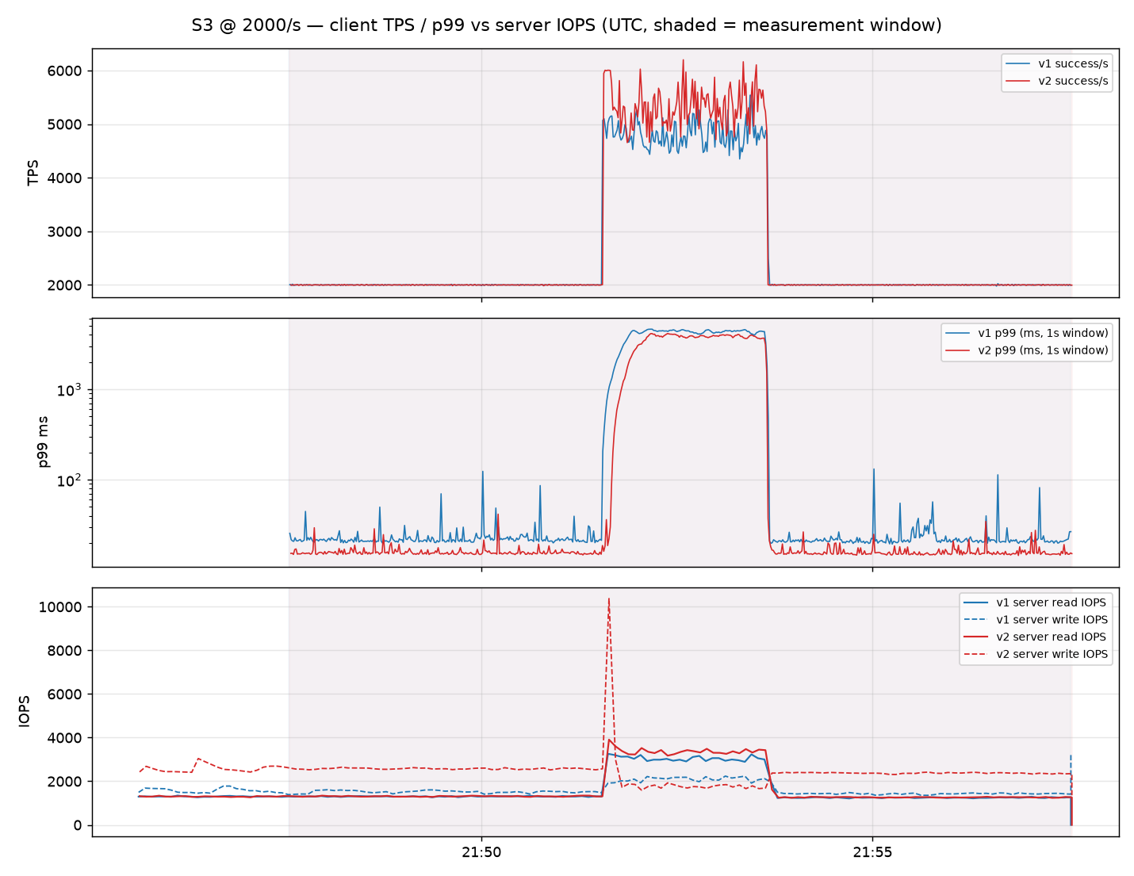
Exp B (MySQL SSD v1 vs v2) — C5 time series (client TPS / p99 vs server IOPS, same UTC axis)
shaded = 10-minute measurement window; server IOPS from in-run status sampling (SHOW GLOBAL STATUS / pg_stat)

Slide 19
Exp B (MySQL SSD v1 vs v2) — C5 knee search (closed-loop staircase)
used only to pick the open-loop measurement rate (≈65% of the lower arm's knee); not a result table

Slide 20
Exp B (MySQL SSD v1 vs v2) — C7 / S1 @ 5,000/s
16 vCore / No-HA (HorizonDB keeps replicaCount 1 — minimum allowed) · S1 normal play (65% read) | arms: v1 = Premium SSD v1, v2 = Premium SSD v2 (same-IOPS 5,000) | usable pairs 3/3 (10-min open-loop, arms concurrent)
Outcome | v1 (median) | v2 (median) | Δ% v2 vs v1 | 95% CI (bootstrap) | n pairs | Reading
Throughput (TPS) | 5,000 | 5,000 | +0.0% | [-0.0%, +0.0%] | 3 | CI includes 0
p50 | 3.6 ms | 2.4 ms | -33.7% | [-34.7%, -33.1%] | 3 | v2 lower (better)
p95 | 19.9 ms | 23.4 ms | +17.7% | [+16.9%, +18.8%] | 3 | v2 higher (worse)
p99 | 24.8 ms | 32.6 ms | +30.0% | [+26.6%, +32.7%] | 3 | v2 higher (worse)
p99.9 | 56.6 ms | 43.7 ms | -29.9% | [-46.0%, -19.7%] | 3 | v2 lower (better)
Error rate | 0.000% | 0.000% | - | - | 3 | insufficient pairs for effect/CI
Dropped arrivals | 0.000% | 0.000% | - | - | 3 | insufficient pairs for effect/CI
Burst recovery (s) | - | - | - | - | 0 | insufficient pairs for effect/CI
Server read IOPS | 1,638 | 1,647 | - | - | 3
Server write IOPS | 2,271 | 3,201 | - | - | 3
Buffer hit ratio | 0.9781 | 0.9778 | - | - | 3
Gate status per repetition (G1 dataset≥2×buffer, G2 storage used, G3 client headroom, G4 queue, G5 errors, G6 metrics, G7 steady state, G10 duration; azmon=Azure Monitor slice; inv=invariants):
rep 1: v1: PASS tps=5000 p99=24.6ms | v2: PASS tps=5000 p99=32.6ms
rep 2: v1: PASS tps=5000 p99=24.8ms | v2: PASS tps=5000 p99=32.4ms
rep 3: v1: PASS tps=5000 p99=26.0ms | v2: PASS tps=5000 p99=32.9ms

Slide 21
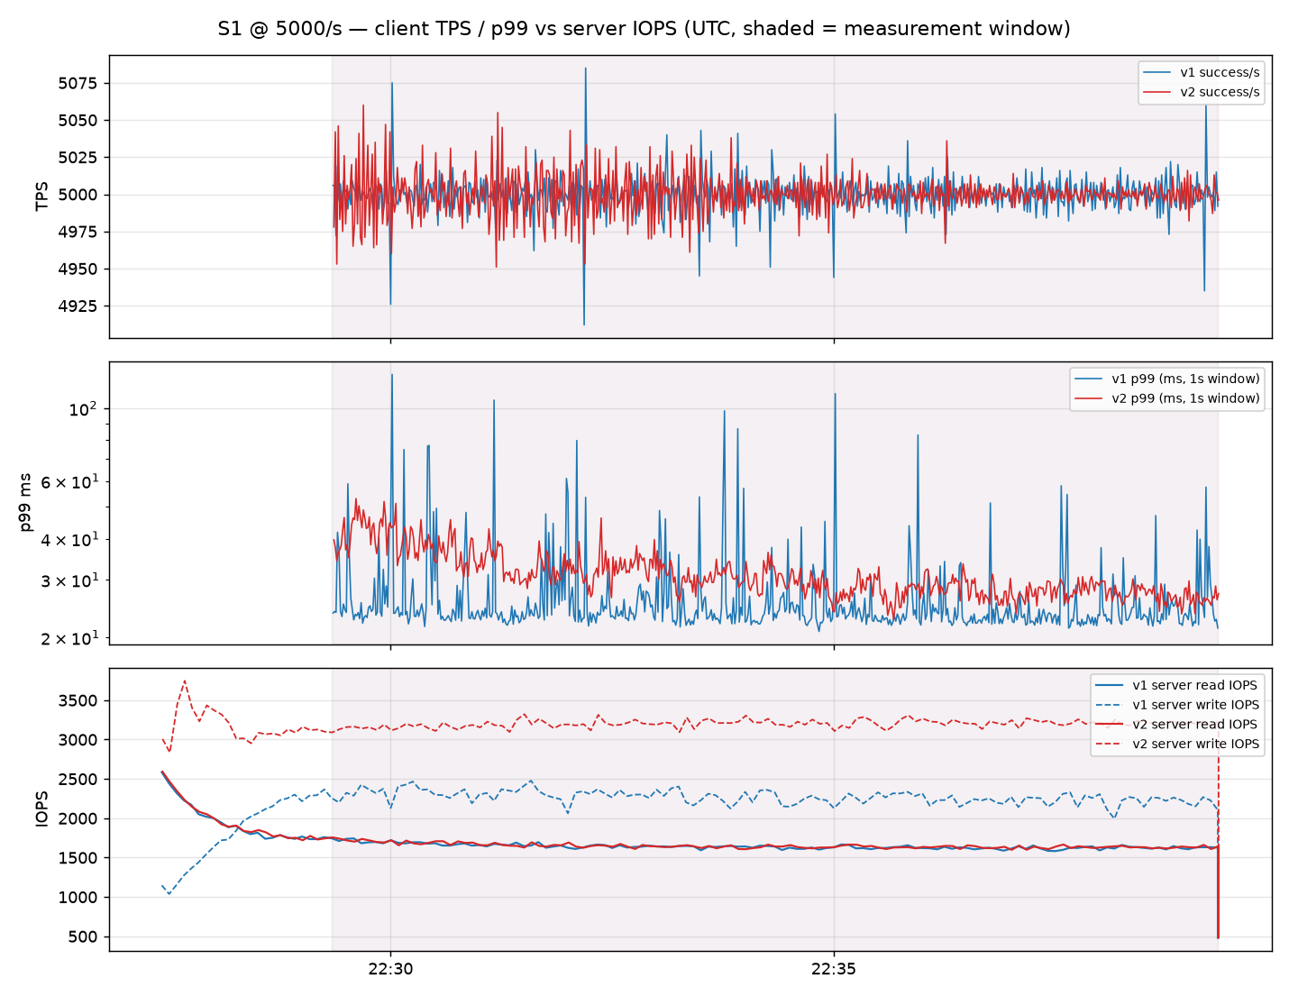
Exp B (MySQL SSD v1 vs v2) — C7 time series (client TPS / p99 vs server IOPS, same UTC axis)
shaded = 10-minute measurement window; server IOPS from in-run status sampling (SHOW GLOBAL STATUS / pg_stat)

Slide 22
Exp B (MySQL SSD v1 vs v2) — C7 / S4 @ 3,000/s
16 vCore / No-HA (HorizonDB keeps replicaCount 1 — minimum allowed) · S4 hotspot: 50% of ops on 1,000 hot accounts (write-heavy mix); G2 soft (hit ratio > 99% by design) | arms: v1 = Premium SSD v1, v2 = Premium SSD v2 (same-IOPS 5,000) | usable pairs 3/3 (10-min open-loop, arms concurrent)
Outcome | v1 (median) | v2 (median) | Δ% v2 vs v1 | 95% CI (bootstrap) | n pairs | Reading
Throughput (TPS) | 3,000 | 3,000 | +0.0% | [+0.0%, +0.0%] | 3 | v2 higher (better)
p50 | 15.0 ms | 12.1 ms | -19.2% | [-20.0%, -18.1%] | 3 | v2 lower (better)
p95 | 22.1 ms | 16.1 ms | -26.4% | [-27.8%, -24.4%] | 3 | v2 lower (better)
p99 | 28.6 ms | 18.6 ms | -33.4% | [-35.9%, -28.9%] | 3 | v2 lower (better)
p99.9 | 88.3 ms | 28.4 ms | -79.1% | [-92.5%, -61.1%] | 3 | v2 lower (better)
Error rate | 0.000% | 0.000% | - | - | 3 | insufficient pairs for effect/CI
Dropped arrivals | 0.000% | 0.000% | - | - | 3 | insufficient pairs for effect/CI
Burst recovery (s) | - | - | - | - | 0 | insufficient pairs for effect/CI
Server read IOPS | 521 | 524 | - | - | 3
Server write IOPS | 2,295 | 14,426 | - | - | 3
Buffer hit ratio | 0.9960 | 0.9958 | - | - | 3
Gate status per repetition (G1 dataset≥2×buffer, G2 storage used, G3 client headroom, G4 queue, G5 errors, G6 metrics, G7 steady state, G10 duration; azmon=Azure Monitor slice; inv=invariants):
rep 1: v1: PASS tps=3000 p99=28.8ms soft-warn=['G2'] | v2: PASS tps=3000 p99=18.5ms soft-warn=['G2']
rep 2: v1: PASS tps=3000 p99=28.6ms soft-warn=['G2'] | v2: PASS tps=3000 p99=18.6ms soft-warn=['G2']
rep 3: v1: PASS tps=3000 p99=26.3ms soft-warn=['G2'] | v2: PASS tps=3000 p99=18.7ms soft-warn=['G2']

Slide 23
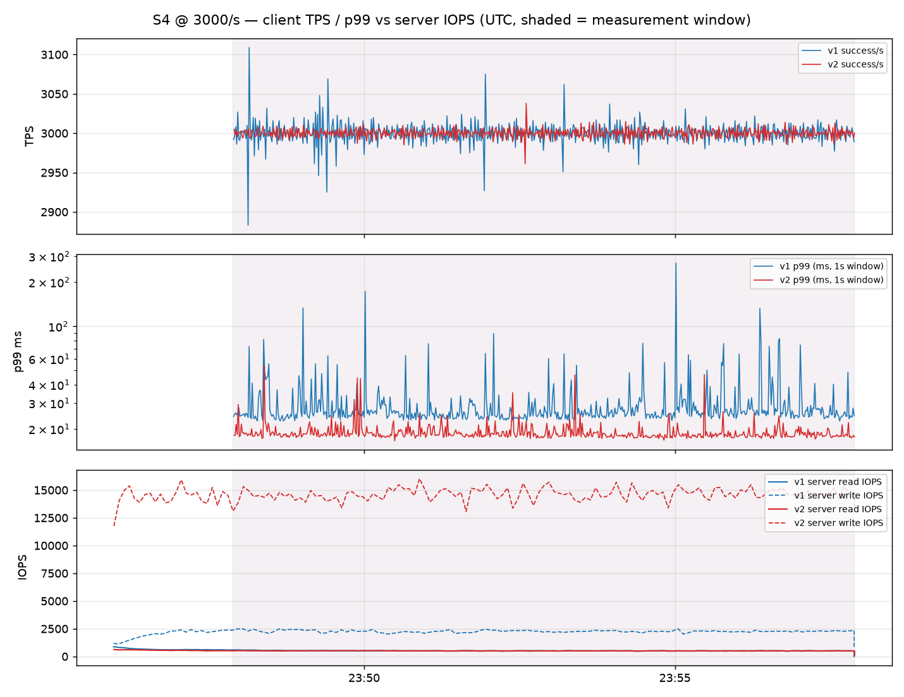
Exp B (MySQL SSD v1 vs v2) — C7 time series (client TPS / p99 vs server IOPS, same UTC axis)
shaded = 10-minute measurement window; server IOPS from in-run status sampling (SHOW GLOBAL STATUS / pg_stat)

Slide 24
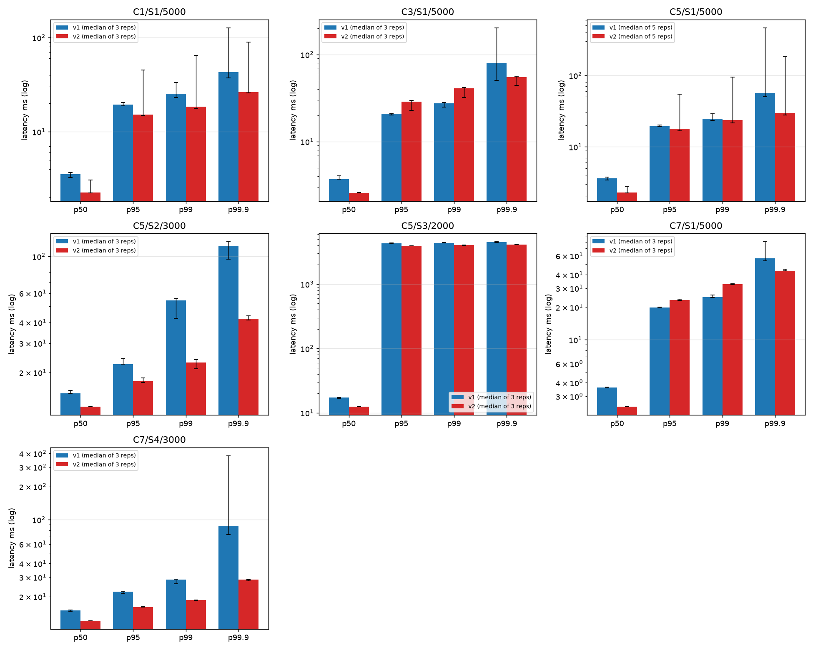
Exp B (MySQL SSD v1 vs v2) — latency percentiles by cell (median of ALL reps incl. gate-failed ones, whiskers = min/max)
log scale; lower is better; use the per-cell tables (gate-passing pairs only) for the estimates

Slide 25
Exp A environment & confound table
Australia East; PostgreSQL 17; both public endpoint + TLS from bench VM (D16ds_v5, same region)
Item | postgres (Flexible Server) | horizon (HorizonDB) | Controlled?
Compute | Standard_D8ds_v5 GeneralPurpose (8 vCore / 32 GiB) → C5: D16ds_v5 | vCores 8 → C5: 16 (memory not exposed; shared_buffers 45,058 MB observed) | vCores matched only — memory differs
Storage | Premium SSD P15 256 GiB (1,100 IOPS baseline, burstable) | HorizonDB managed storage (IOPS not exposed) | not comparable — confound
HA / replica | SameZone HA, no read replica | replicaCount 1 (read-only endpoint exists, unused by workload) | best-effort mapping
shared_buffers | 8 GB | 45,058 MB | dataset (23 GiB) < HZ cache → G1/G2 soft-fail for HZ
Version | 17.10 | 17.9 (Azure HorizonDB) | -
Price | list price per vCore-hour differs; see cost note |  | report cost-normalised metric when billing data is available

Slide 26
Exp A (PostgreSQL vs HorizonDB) — overview across cases
arms: postgres = Flexible Server, horizon = HorizonDB | medians of gate-passing repetitions; Δ = geometric-mean paired change of second arm vs first with 95% bootstrap CI
Cell | Rate/s | pairs | p50 A→B | p95 A→B | p99 A→B | p99.9 A→B | Δ p50 [CI] | Δ p99 [CI] | read IOPS A/B | hit A/B
C1/S1 | 5,500 | 3/3 | 0.7 ms → 0.6 ms | 14.2 ms → 3.6 ms | 31.9 ms → 4.4 ms | 142.5 ms → 9.8 ms | -24% [-25, -24] | -90% [-95, -84] | 3,088 → 0 | 0.9730 → 1.0000
C5/S1 | 5,500 | 2/5 | 0.6 ms → 0.5 ms | 12.8 ms → 3.3 ms | 35.0 ms → 3.7 ms | 73.8 ms → 4.3 ms | -17% [-18, -16] | -87% [-93, -75] | 1,288 → 0 | 0.9883 → 1.0000
C5/S2 | 3,300 | 0/3 | - → - | - → - | - → - | - → - | - | - | - → - | - → -
C5/S3 | 2,200 | 3/3 | 6.1 ms → 2.4 ms | 10.7 ms → 3.4 ms | 16.8 ms → 3.8 ms | 303.6 ms → 4.4 ms | -61% [-62, -59] | -94% [-100, -72] | 1,557 → 0 | 0.9624 → 1.0000
C7/S1 | 5,500 | 3/3 | 0.6 ms → 0.5 ms | 5.5 ms → 3.3 ms | 7.7 ms → 3.7 ms | 19.5 ms → 4.3 ms | -15% [-15, -15] | -75% [-94, -46] | 1,375 → 0 | 0.9874 → 1.0000
C7/S1 | 5,501 | 0/3 | - → - | - → - | - → - | - → - | - | - | - → - | - → -
C7/S4 | 3,300 | 2/3 | 3.8 ms → 2.6 ms | 7.0 ms → 3.6 ms | 20.4 ms → 4.0 ms | 48.8 ms → 5.2 ms | -31% [-31, -31] | -77% [-87, -57] | 359 → 0 | 0.9945 → 1.0000
A = first arm, B = second arm (v1→v2 / postgres→horizon). C1 = 8 vCore + Same-zone HA, C5 = 16 vCore + Same-zone HA; same dataset, same offered load, same client.
Read as: negative Δ latency = B faster. CIs from 3 repetitions are wide; a CI that excludes 0 is a directional finding, not a precise magnitude.

Slide 27
Exp A (PostgreSQL vs HorizonDB) — C1 / S1 @ 5,500/s
8 vCore / Same-zone HA · S1 normal play (65% read) | arms: postgres = Flexible Server, horizon = HorizonDB | usable pairs 3/3 (10-min open-loop, arms concurrent)
Outcome | postgres (median) | horizon (median) | Δ% horizon vs postgres | 95% CI (bootstrap) | n pairs | Reading
Throughput (TPS) | 5,500 | 5,500 | +0.0% | [+0.0%, +0.0%] | 3 | horizon higher (better)
p50 | 0.7 ms | 0.6 ms | -24.5% | [-25.3%, -23.9%] | 3 | horizon lower (better)
p95 | 14.2 ms | 3.6 ms | -79.0% | [-86.4%, -73.1%] | 3 | horizon lower (better)
p99 | 31.9 ms | 4.4 ms | -89.8% | [-95.2%, -84.0%] | 3 | horizon lower (better)
p99.9 | 142.5 ms | 9.8 ms | -92.8% | [-96.2%, -85.7%] | 3 | horizon lower (better)
Error rate | 0.000% | 0.000% | - | - | 3 | insufficient pairs for effect/CI
Dropped arrivals | 0.000% | 0.000% | - | - | 3 | insufficient pairs for effect/CI
Burst recovery (s) | - | - | - | - | 0 | insufficient pairs for effect/CI
Server read IOPS | 3,088 | 0 | - | - | 3
Server write IOPS | 1,490 | 2,640 | - | - | 3
Buffer hit ratio | 0.9730 | 1.0000 | - | - | 3
Gate status per repetition (G1 dataset≥2×buffer, G2 storage used, G3 client headroom, G4 queue, G5 errors, G6 metrics, G7 steady state, G10 duration; azmon=Azure Monitor slice; inv=invariants):
rep 1: postgres: PASS tps=5500 p99=27.4ms | horizon: PASS tps=5500 p99=4.4ms soft-warn=['G1', 'G2']
rep 2: postgres: PASS tps=5500 p99=31.9ms | horizon: PASS tps=5500 p99=4.4ms soft-warn=['G1', 'G2']
rep 3: postgres: PASS tps=5500 p99=87.9ms | horizon: PASS tps=5500 p99=4.2ms soft-warn=['G1', 'G2']

Slide 28
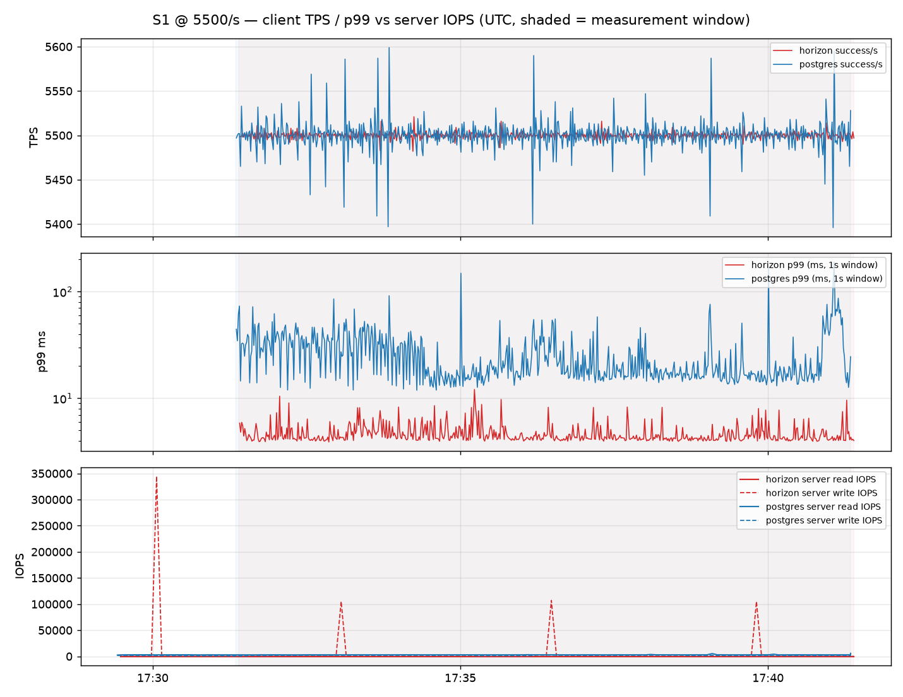
Exp A (PostgreSQL vs HorizonDB) — C1 time series (client TPS / p99 vs server IOPS, same UTC axis)
shaded = 10-minute measurement window; server IOPS from in-run status sampling (SHOW GLOBAL STATUS / pg_stat)

Slide 29
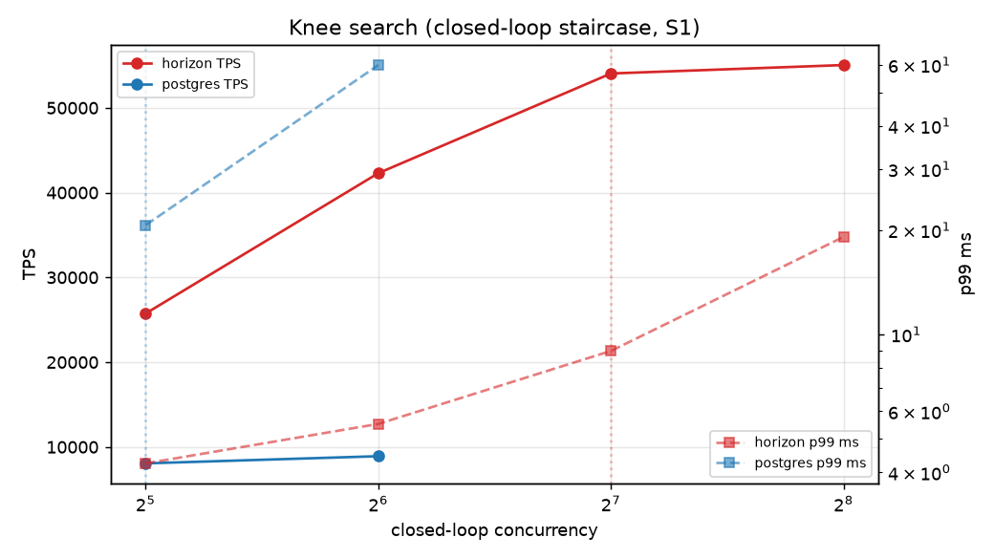
Exp A (PostgreSQL vs HorizonDB) — C1 knee search (closed-loop staircase)
used only to pick the open-loop measurement rate (≈65% of the lower arm's knee); not a result table

Slide 30
Exp A (PostgreSQL vs HorizonDB) — C5 / S1 @ 5,500/s
16 vCore / Same-zone HA · S1 normal play (65% read) | arms: postgres = Flexible Server, horizon = HorizonDB | usable pairs 2/5 (10-min open-loop, arms concurrent)
Outcome | postgres (median) | horizon (median) | Δ% horizon vs postgres | 95% CI (bootstrap) | n pairs | Reading
Throughput (TPS) | 5,500 | 5,500 | -0.0% | [-0.0%, -0.0%] | 2 | horizon lower (worse)
p50 | 0.6 ms | 0.5 ms | -16.9% | [-17.9%, -15.9%] | 2 | horizon lower (better)
p95 | 12.8 ms | 3.3 ms | -73.7% | [-78.4%, -68.0%] | 2 | horizon lower (better)
p99 | 35.0 ms | 3.7 ms | -87.1% | [-93.3%, -75.2%] | 2 | horizon lower (better)
p99.9 | 73.8 ms | 4.3 ms | -93.5% | [-96.0%, -89.5%] | 2 | horizon lower (better)
Error rate | 0.000% | 0.000% | - | - | 2 | insufficient pairs for effect/CI
Dropped arrivals | 0.000% | 0.000% | - | - | 2 | insufficient pairs for effect/CI
Burst recovery (s) | - | - | - | - | 0 | insufficient pairs for effect/CI
Server read IOPS | 1,288 | 0 | - | - | 2
Server write IOPS | 1,156 | 2,206 | - | - | 2
Buffer hit ratio | 0.9883 | 1.0000 | - | - | 2
Gate status per repetition (G1 dataset≥2×buffer, G2 storage used, G3 client headroom, G4 queue, G5 errors, G6 metrics, G7 steady state, G10 duration; azmon=Azure Monitor slice; inv=invariants):
rep 1: postgres: PASS tps=5500 p99=55.0ms soft-warn=['G1'] | horizon: PASS tps=5500 p99=3.7ms soft-warn=['G1', 'G2']
rep 2: postgres: EXCLUDED tps=5405 p99=15614.0ms fail=['G1', 'G4', 'G5'] soft-warn=['G1'] | horizon: PASS tps=5500 p99=3.7ms soft-warn=['G1', 'G2']
rep 3: postgres: EXCLUDED tps=5500 p99=3864.6ms fail=['G1', 'G4'] soft-warn=['G1'] | horizon: PASS tps=5500 p99=3.7ms soft-warn=['G1', 'G2']
rep 4: postgres: PASS tps=5500 p99=14.9ms soft-warn=['G1'] | horizon: PASS tps=5500 p99=3.7ms soft-warn=['G1', 'G2']
rep 5: postgres: EXCLUDED tps=5500 p99=1354.8ms fail=['G1', 'G4'] soft-warn=['G1'] | horizon: PASS tps=5500 p99=3.7ms soft-warn=['G1', 'G2']

Slide 31
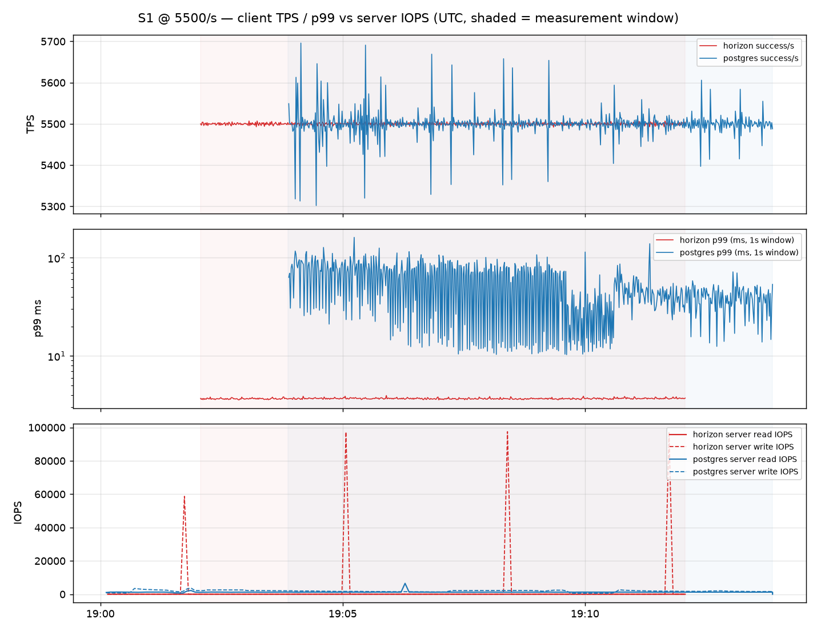
Exp A (PostgreSQL vs HorizonDB) — C5 time series (client TPS / p99 vs server IOPS, same UTC axis)
shaded = 10-minute measurement window; server IOPS from in-run status sampling (SHOW GLOBAL STATUS / pg_stat)

Slide 32
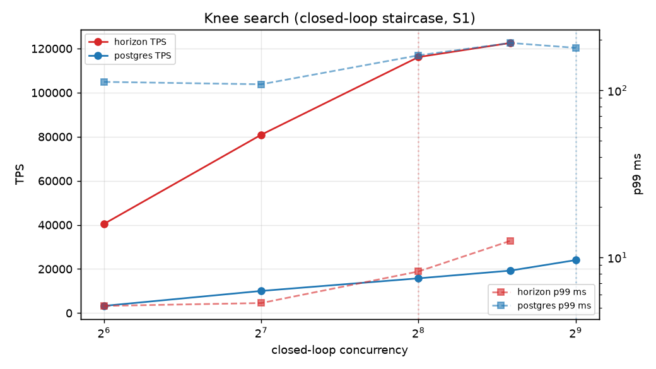
Exp A (PostgreSQL vs HorizonDB) — C5 knee search (closed-loop staircase)
used only to pick the open-loop measurement rate (≈65% of the lower arm's knee); not a result table

Slide 33
Exp A (PostgreSQL vs HorizonDB) — C5 / S2 @ 3,300/s
16 vCore / Same-zone HA · S2 write-heavy (80% write) | arms: postgres = Flexible Server, horizon = HorizonDB | usable pairs 0/3 (10-min open-loop, arms concurrent)
Outcome | postgres (median) | horizon (median) | Δ% horizon vs postgres | 95% CI (bootstrap) | n pairs | Reading
Throughput (TPS) | - | - | - | - | 0 | insufficient pairs for effect/CI
p50 | - | - | - | - | 0 | insufficient pairs for effect/CI
p95 | - | - | - | - | 0 | insufficient pairs for effect/CI
p99 | - | - | - | - | 0 | insufficient pairs for effect/CI
p99.9 | - | - | - | - | 0 | insufficient pairs for effect/CI
Error rate | - | - | - | - | 0 | insufficient pairs for effect/CI
Dropped arrivals | - | - | - | - | 0 | insufficient pairs for effect/CI
Burst recovery (s) | - | - | - | - | 0 | insufficient pairs for effect/CI
Server read IOPS | - | - | - | - | 0
Server write IOPS | - | - | - | - | 0
Buffer hit ratio | - | - | - | - | 0
Gate status per repetition (G1 dataset≥2×buffer, G2 storage used, G3 client headroom, G4 queue, G5 errors, G6 metrics, G7 steady state, G10 duration; azmon=Azure Monitor slice; inv=invariants):
rep 1: postgres: EXCLUDED tps=3300 p99=371.7ms fail=['G1', 'G2', 'G4'] soft-warn=['G1', 'G2'] | horizon: PASS tps=3300 p99=4.0ms soft-warn=['G1', 'G2']
rep 2: postgres: EXCLUDED tps=3263 p99=11665.4ms fail=['G1', 'G2', 'G4', 'G5'] soft-warn=['G1', 'G2'] | horizon: PASS tps=3300 p99=4.0ms soft-warn=['G1', 'G2']
rep 3: postgres: EXCLUDED tps=3194 p99=20299.8ms fail=['G1', 'G2', 'G4', 'G5'] soft-warn=['G1', 'G2'] | horizon: PASS tps=3300 p99=4.0ms soft-warn=['G1', 'G2']

Slide 34
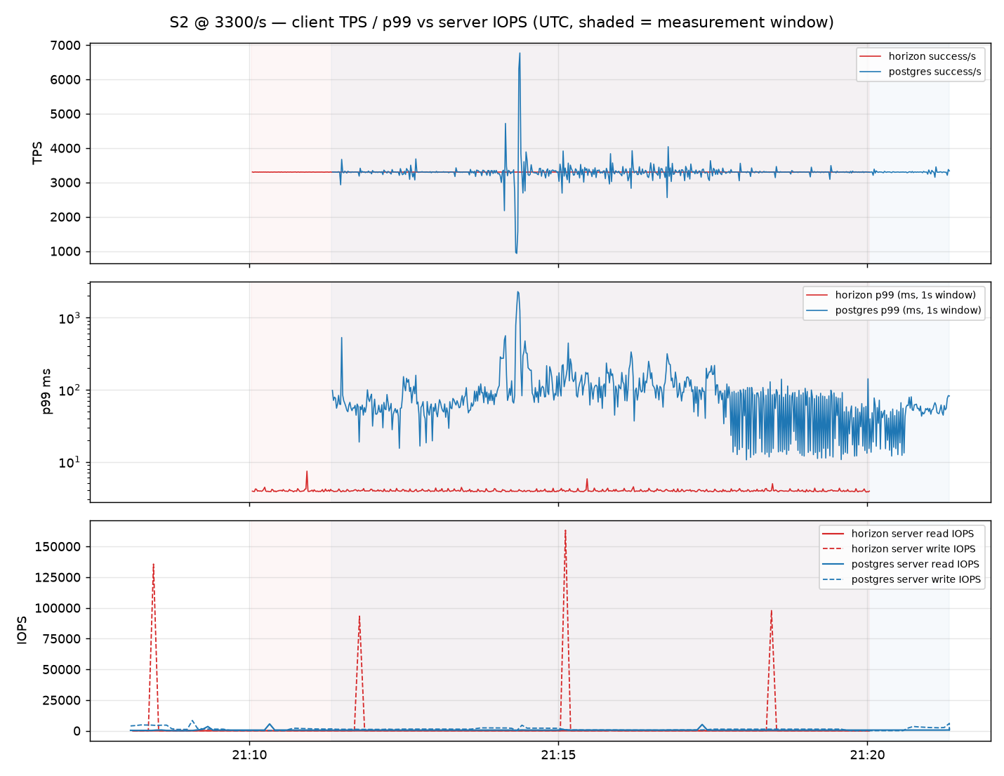
Exp A (PostgreSQL vs HorizonDB) — C5 time series (client TPS / p99 vs server IOPS, same UTC axis)
shaded = 10-minute measurement window; server IOPS from in-run status sampling (SHOW GLOBAL STATUS / pg_stat)

Slide 35
Exp A (PostgreSQL vs HorizonDB) — C5 knee search (closed-loop staircase)
used only to pick the open-loop measurement rate (≈65% of the lower arm's knee); not a result table

Slide 36
Exp A (PostgreSQL vs HorizonDB) — C5 / S3 @ 2,200/s
16 vCore / Same-zone HA · S3 login burst: base rate ×3 for 120 s at t+240 s | arms: postgres = Flexible Server, horizon = HorizonDB | usable pairs 3/3 (10-min open-loop, arms concurrent)
Outcome | postgres (median) | horizon (median) | Δ% horizon vs postgres | 95% CI (bootstrap) | n pairs | Reading
Throughput (TPS) | 3,080 | 3,080 | +0.0% | [+0.0%, +0.0%] | 3 | horizon higher (better)
p50 | 6.1 ms | 2.4 ms | -60.5% | [-62.1%, -58.9%] | 3 | horizon lower (better)
p95 | 10.7 ms | 3.4 ms | -73.1% | [-83.1%, -63.7%] | 3 | horizon lower (better)
p99 | 16.8 ms | 3.8 ms | -94.5% | [-99.7%, -71.8%] | 3 | horizon lower (better)
p99.9 | 303.6 ms | 4.4 ms | -98.8% | [-99.8%, -93.4%] | 3 | horizon lower (better)
Error rate | 0.000% | 0.000% | - | - | 3 | insufficient pairs for effect/CI
Dropped arrivals | 0.000% | 0.000% | - | - | 3 | insufficient pairs for effect/CI
Burst recovery (s) | 0 | 0 | - | - | 3 | insufficient pairs for effect/CI
Server read IOPS | 1,557 | 0 | - | - | 3
Server write IOPS | 587 | 1,026 | - | - | 3
Buffer hit ratio | 0.9624 | 1.0000 | - | - | 3
Gate status per repetition (G1 dataset≥2×buffer, G2 storage used, G3 client headroom, G4 queue, G5 errors, G6 metrics, G7 steady state, G10 duration; azmon=Azure Monitor slice; inv=invariants):
rep 1: postgres: PASS tps=3080 p99=1450.0ms soft-warn=['G1', 'G4'] | horizon: PASS tps=3080 p99=3.8ms soft-warn=['G1', 'G2']
rep 2: postgres: PASS tps=3080 p99=16.8ms soft-warn=['G1'] | horizon: PASS tps=3080 p99=3.8ms soft-warn=['G1', 'G2']
rep 3: postgres: PASS tps=3080 p99=13.5ms soft-warn=['G1'] | horizon: PASS tps=3080 p99=3.8ms soft-warn=['G1', 'G2']

Slide 37
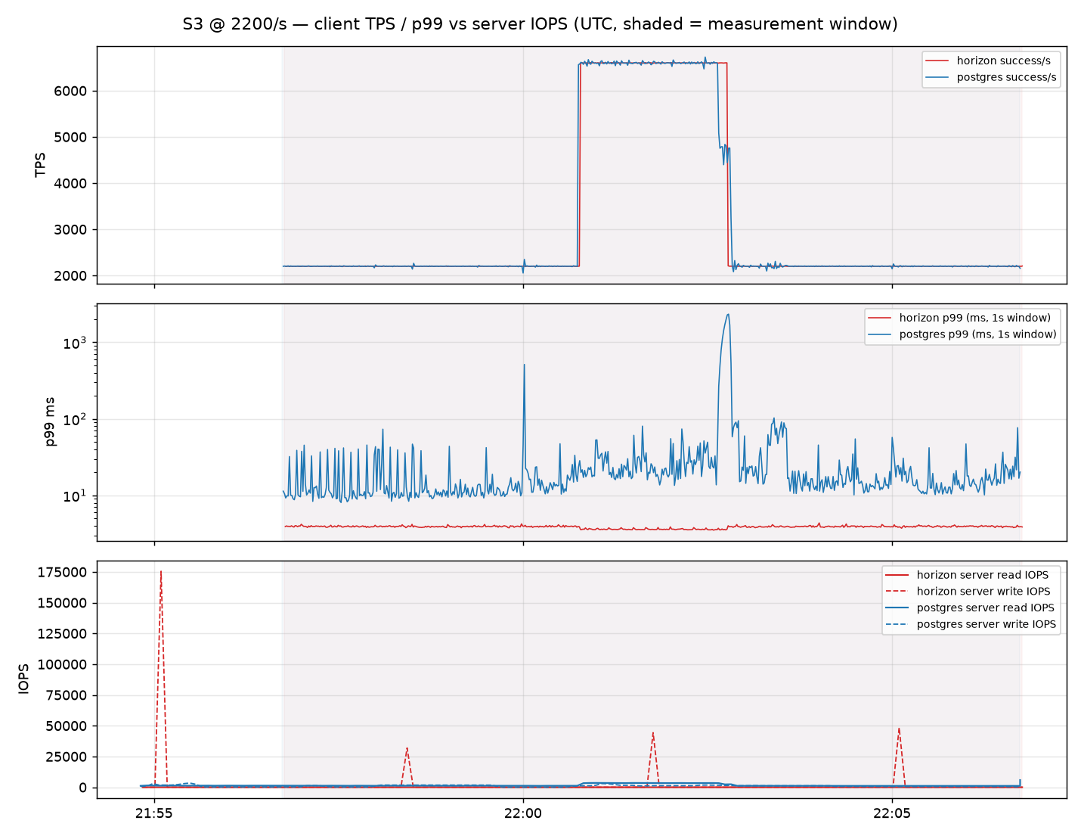
Exp A (PostgreSQL vs HorizonDB) — C5 time series (client TPS / p99 vs server IOPS, same UTC axis)
shaded = 10-minute measurement window; server IOPS from in-run status sampling (SHOW GLOBAL STATUS / pg_stat)

Slide 38
Exp A (PostgreSQL vs HorizonDB) — C5 knee search (closed-loop staircase)
used only to pick the open-loop measurement rate (≈65% of the lower arm's knee); not a result table

Slide 39
Exp A (PostgreSQL vs HorizonDB) — C7 / S1 @ 5,500/s
16 vCore / No-HA (HorizonDB keeps replicaCount 1 — minimum allowed) · S1 normal play (65% read) | arms: postgres = Flexible Server, horizon = HorizonDB | usable pairs 3/3 (10-min open-loop, arms concurrent)
Outcome | postgres (median) | horizon (median) | Δ% horizon vs postgres | 95% CI (bootstrap) | n pairs | Reading
Throughput (TPS) | 5,500 | 5,500 | +0.0% | [+0.0%, +0.0%] | 3 | horizon higher (better)
p50 | 0.6 ms | 0.5 ms | -14.9% | [-15.5%, -14.5%] | 3 | horizon lower (better)
p95 | 5.5 ms | 3.3 ms | -39.3% | [-43.5%, -35.4%] | 3 | horizon lower (better)
p99 | 7.7 ms | 3.7 ms | -75.0% | [-94.0%, -46.4%] | 3 | horizon lower (better)
p99.9 | 19.5 ms | 4.3 ms | -88.4% | [-97.6%, -70.7%] | 3 | horizon lower (better)
Error rate | 0.000% | 0.000% | - | - | 3 | insufficient pairs for effect/CI
Dropped arrivals | 0.000% | 0.000% | - | - | 3 | insufficient pairs for effect/CI
Burst recovery (s) | - | - | - | - | 0 | insufficient pairs for effect/CI
Server read IOPS | 1,375 | 0 | - | - | 3
Server write IOPS | 1,103 | 2,064 | - | - | 3
Buffer hit ratio | 0.9874 | 1.0000 | - | - | 3
Gate status per repetition (G1 dataset≥2×buffer, G2 storage used, G3 client headroom, G4 queue, G5 errors, G6 metrics, G7 steady state, G10 duration; azmon=Azure Monitor slice; inv=invariants):
rep 1: postgres: PASS tps=5500 p99=6.9ms soft-warn=['G1'] | horizon: PASS tps=5500 p99=3.7ms soft-warn=['G1', 'G2']
rep 2: postgres: PASS tps=5500 p99=7.7ms soft-warn=['G1'] | horizon: PASS tps=5500 p99=3.7ms soft-warn=['G1', 'G2']
rep 3: postgres: PASS tps=5500 p99=62.5ms soft-warn=['G1'] | horizon: PASS tps=5500 p99=3.7ms soft-warn=['G1', 'G2']

Slide 40
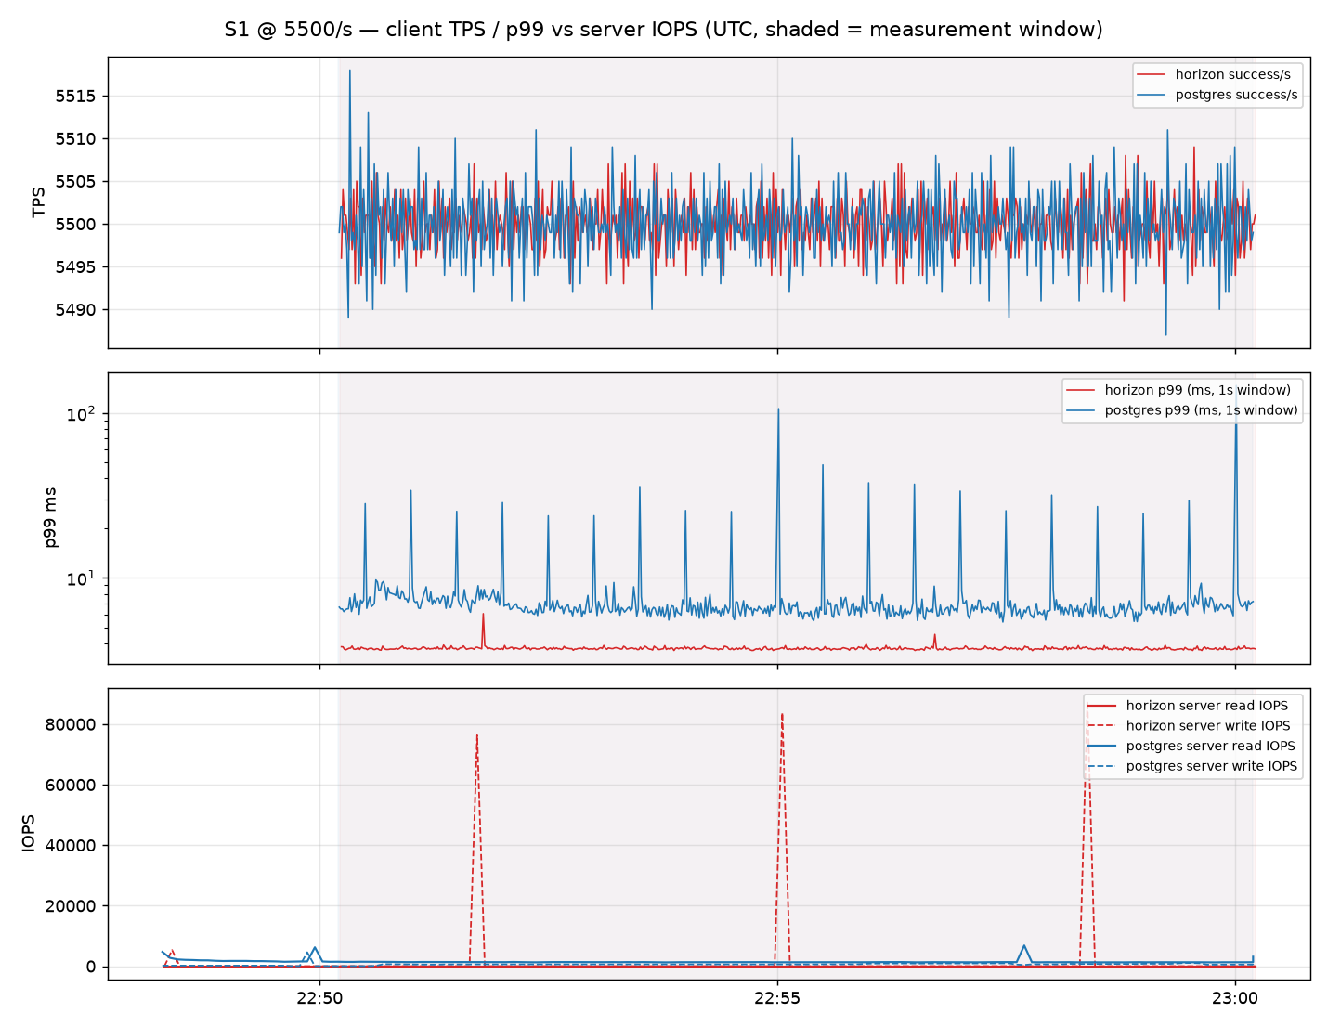
Exp A (PostgreSQL vs HorizonDB) — C7 time series (client TPS / p99 vs server IOPS, same UTC axis)
shaded = 10-minute measurement window; server IOPS from in-run status sampling (SHOW GLOBAL STATUS / pg_stat)

Slide 41
Exp A (PostgreSQL vs HorizonDB) — C7 / S1 @ 5,501/s
16 vCore / No-HA (HorizonDB keeps replicaCount 1 — minimum allowed) · S1 normal play (65% read) | arms: postgres = Flexible Server, horizon = HorizonDB | usable pairs 0/3 (10-min open-loop, arms concurrent)
Outcome | postgres (median) | horizon (median) | Δ% horizon vs postgres | 95% CI (bootstrap) | n pairs | Reading
Throughput (TPS) | - | - | - | - | 0 | insufficient pairs for effect/CI
p50 | - | - | - | - | 0 | insufficient pairs for effect/CI
p95 | - | - | - | - | 0 | insufficient pairs for effect/CI
p99 | - | - | - | - | 0 | insufficient pairs for effect/CI
p99.9 | - | - | - | - | 0 | insufficient pairs for effect/CI
Error rate | - | - | - | - | 0 | insufficient pairs for effect/CI
Dropped arrivals | - | - | - | - | 0 | insufficient pairs for effect/CI
Burst recovery (s) | - | - | - | - | 0 | insufficient pairs for effect/CI
Server read IOPS | - | - | - | - | 0
Server write IOPS | - | - | - | - | 0
Buffer hit ratio | - | - | - | - | 0
Gate status per repetition (G1 dataset≥2×buffer, G2 storage used, G3 client headroom, G4 queue, G5 errors, G6 metrics, G7 steady state, G10 duration; azmon=Azure Monitor slice; inv=invariants):
rep 1: postgres: EXCLUDED tps=3567 p99=35160.1ms fail=['G4', 'G5', 'G7'] | horizon: PASS tps=5501 p99=3.9ms soft-warn=['G1', 'G2']
rep 2: postgres: EXCLUDED tps=5087 p99=16924.7ms fail=['G4', 'G5'] | horizon: PASS tps=5501 p99=3.9ms soft-warn=['G1', 'G2']
rep 3: postgres: EXCLUDED tps=5409 p99=8896.5ms fail=['G4', 'G5'] | horizon: PASS tps=5501 p99=4.0ms soft-warn=['G1', 'G2']

Slide 42
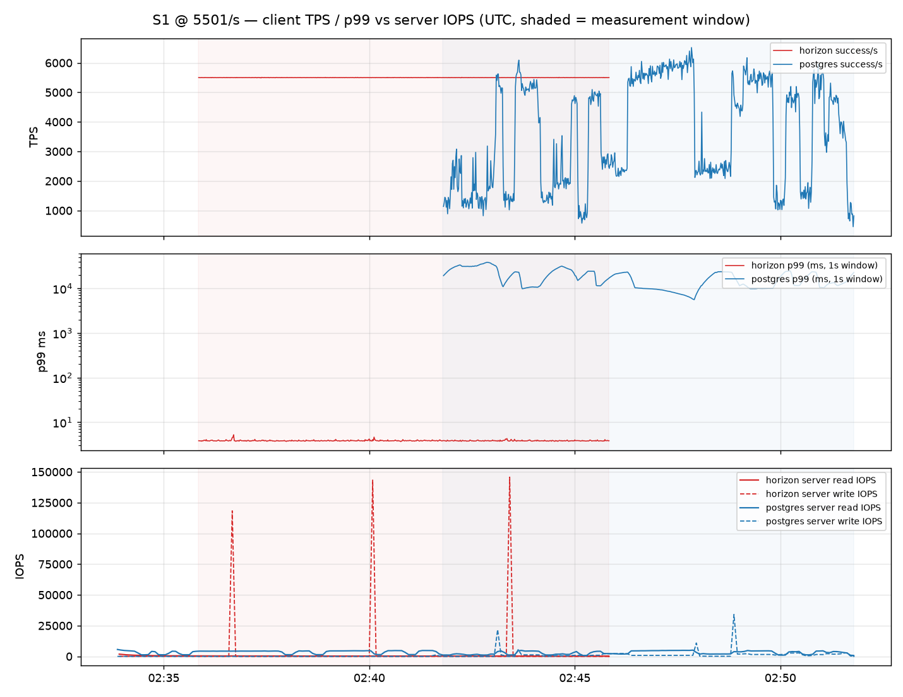
Exp A (PostgreSQL vs HorizonDB) — C7 time series (client TPS / p99 vs server IOPS, same UTC axis)
shaded = 10-minute measurement window; server IOPS from in-run status sampling (SHOW GLOBAL STATUS / pg_stat)

Slide 43
Exp A (PostgreSQL vs HorizonDB) — C7 / S4 @ 3,300/s
16 vCore / No-HA (HorizonDB keeps replicaCount 1 — minimum allowed) · S4 hotspot: 50% of ops on 1,000 hot accounts (write-heavy mix); G2 soft (hit ratio > 99% by design) | arms: postgres = Flexible Server, horizon = HorizonDB | usable pairs 2/3 (10-min open-loop, arms concurrent)
Outcome | postgres (median) | horizon (median) | Δ% horizon vs postgres | 95% CI (bootstrap) | n pairs | Reading
Throughput (TPS) | 3,300 | 3,300 | +0.0% | [+0.0%, +0.0%] | 2 | horizon higher (better)
p50 | 3.8 ms | 2.6 ms | -31.0% | [-31.3%, -30.8%] | 2 | horizon lower (better)
p95 | 7.0 ms | 3.6 ms | -48.5% | [-52.5%, -44.0%] | 2 | horizon lower (better)
p99 | 20.4 ms | 4.0 ms | -76.8% | [-87.5%, -56.9%] | 2 | horizon lower (better)
p99.9 | 48.8 ms | 5.2 ms | -88.1% | [-92.8%, -80.5%] | 2 | horizon lower (better)
Error rate | 0.000% | 0.000% | - | - | 2 | insufficient pairs for effect/CI
Dropped arrivals | 0.000% | 0.000% | - | - | 2 | insufficient pairs for effect/CI
Burst recovery (s) | - | - | - | - | 0 | insufficient pairs for effect/CI
Server read IOPS | 359 | 0 | - | - | 2
Server write IOPS | 837 | 1,642 | - | - | 2
Buffer hit ratio | 0.9945 | 1.0000 | - | - | 2
Gate status per repetition (G1 dataset≥2×buffer, G2 storage used, G3 client headroom, G4 queue, G5 errors, G6 metrics, G7 steady state, G10 duration; azmon=Azure Monitor slice; inv=invariants):
rep 1: postgres: PASS tps=3300 p99=31.6ms soft-warn=['G1', 'G2'] | horizon: PASS tps=3300 p99=4.0ms soft-warn=['G1', 'G2']
rep 2: postgres: PASS tps=3300 p99=9.2ms soft-warn=['G1', 'G2'] | horizon: PASS tps=3300 p99=4.0ms soft-warn=['G1', 'G2']
rep 3: postgres: EXCLUDED tps=3300 p99=3463.2ms fail=['G1', 'G2', 'G4'] soft-warn=['G1', 'G2'] | horizon: PASS tps=3300 p99=4.0ms soft-warn=['G1', 'G2']

Slide 44
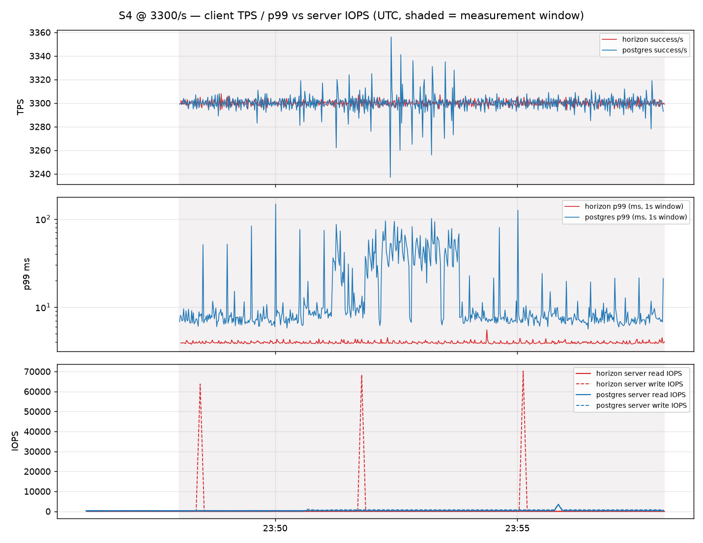
Exp A (PostgreSQL vs HorizonDB) — C7 time series (client TPS / p99 vs server IOPS, same UTC axis)
shaded = 10-minute measurement window; server IOPS from in-run status sampling (SHOW GLOBAL STATUS / pg_stat)

Slide 45
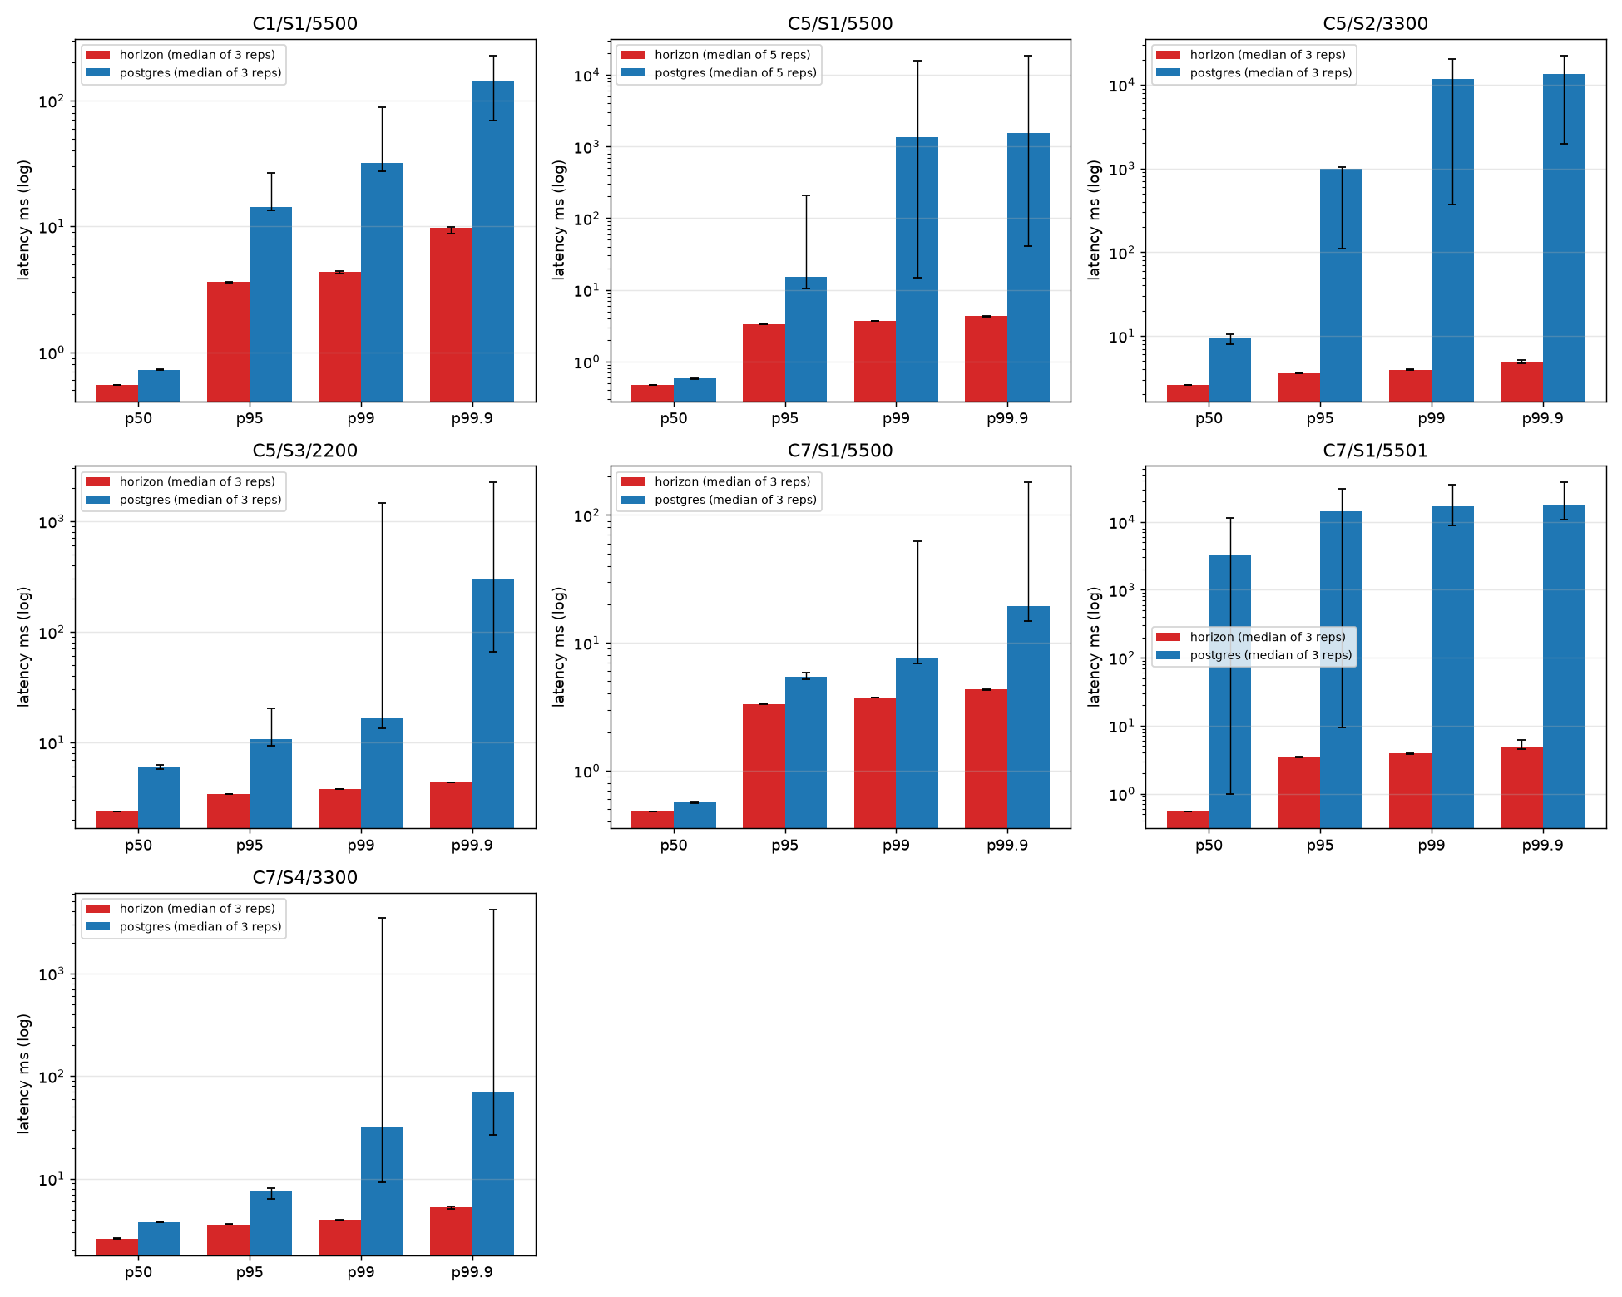
Exp A (PostgreSQL vs HorizonDB) — latency percentiles by cell (median of ALL reps incl. gate-failed ones, whiskers = min/max)
log scale; lower is better; use the per-cell tables (gate-passing pairs only) for the estimates

Slide 46
Limitations & next steps
• Cases run: C1 (8 vCore/HA), C5 (16 vCore/HA), C7 (16 vCore/No-HA); scenarios S1 (C1: 3 reps, C5: 5 reps, C7: 3 reps), S2 and S3 at C5 (3 reps). Not run: C3 and the read-replica cases C2/C4/C6/C8 (client replica routing not implemented/validated in this time box). HorizonDB cannot be configured with 0 replicas (API minimum 1), so 'No-HA' has no exact HorizonDB counterpart.
• S3 (login burst ×3): MySQL arms could not absorb 6,000/s bursts (queue overflow, 4–7% dropped arrivals → G5 fail on both; reported as burst behaviour, not excluded from the burst slide). PG/HorizonDB absorbed the 6,600/s burst with 0 drops.
• Exp B confounds that cannot be removed on the platform: compute generation (v5 vs v6) and innodb_doublewrite (OFF vs ON). Effects should be read as 'SSD v1 product configuration vs SSD v2 product configuration'.
• Exp A: HorizonDB exposes far more cache than the Flexible Server SKU with the same vCores; the dataset would need to exceed ~90 GiB to make HorizonDB storage-bound. HorizonDB storage IOPS/memory are not exposed by the preview API.
• Buffer pool was pinned to 8 GiB on MySQL to make the storage tier observable within budget; production defaults (48 GiB) would keep more of a 24 GiB dataset in memory.
• Same-IOPS cell only (5,000 IOPS on both). The 'as-provisioned' cell (v1 default free IOPS) was not run.
• Cost: actual billing not yet available; cost-normalised comparisons to be added when Cost Management ingests usage.
• All raw run JSON (client histograms, per-second series, server status series, Azure Monitor slices, gate verdicts) is in results/; analysis is reproducible with scripts/analyze.py.

