Slide 1












Standard Architecture Deployed by AWS QuickStart
AWS Account
Virtual Private Cloud (VPC)
us-east-1a
Cloudtrail
NAT
DMZ Subnet
Private Subnet
Private Subnet
CloudWatch Alarms
Proxies
RDS DB
AWS Config
Bastion
Private Subnet
Private Subnet
Proxies
RDS DB
us-east-1b
Archive Logs Bucket
S3 Lifecycle Policies to Glacier

Slide 2
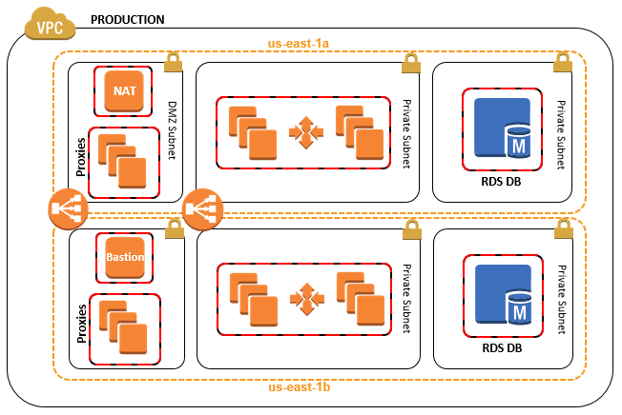



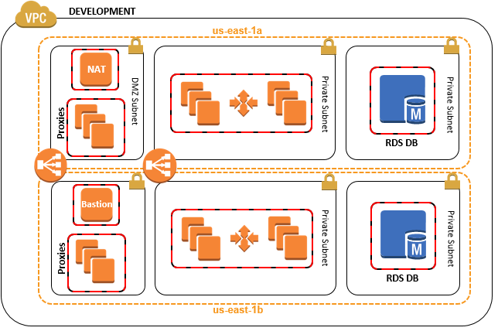
Example Design w/Management & Dev VPCs (Notional)
Archive Logs Bucket
S3 Lifecycle Policies to Glacier
Users
10.12.0.0/16
Management
VPC Peer
NAT
DSM
DSM
US-East-1b
RDP
VPC Peer
US-East-1c
NOTIONAL
AWS Config Rules
Cloudtrail
CloudWatch Alarms

Slide 3








https://aws.amazon.com/architecture/icons/
EC2 Instance
S3 Bucket
Internet Gateway
Security Group
RDS DB master
Elastic Load Balancer (ELB)
Availability Zone
IAM
RDS DB standby
Autoscaling Group
Security Groups
DynamoDB
CloudWatch
VPN Gateway
Route Table
SQS Queue

