Slide 1
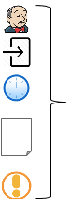
Stage N
...
Bake
Deploy
Post-deploy
Jenkins
Triggers
Pipeline
Time
Parameters
Notifications

Slide 2





client
Internet
Bastion Host
Spinnaker
VPC Public subnet
VPC Private Subnet
Virtual Private Cloud
AWS Cloud

