Slide 1
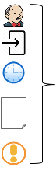
Stage N
...
Bake
Deploy
Post-deploy
Jenkins
Triggers
Pipeline
Time
Parameters
Notifications

