Slide 1









Slide 5
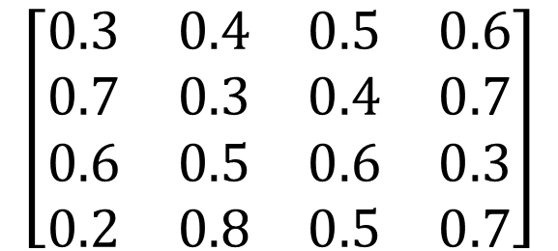
A B C D
$$\left[\begin{matrix}0.3 & 0.4 & 0.5 & 0.6 \\ 0.7 & 0.3 & 0.4 & 0.7 \\ 0.6 & 0.5 & 0.6 & 0.3 \\ 0.2 & 0.8 & 0.5 & 0.7\end{matrix}\right]$$
1
A
2
B
3
C
4
D

Slide 6
1
A
1
A
1
A
2
B
2
B
2
B
3
C
3
C
3
C
4
D
4
D
4
D
1
A
1
A
1
A
2
B
2
B
2
B
3
C
3
C
3
C
4
D
4
D
4
D
4-A-1-b-2-c

