Slide 1
helps Golden Shoe

Slide 2
Why you’re speaking with us
Golden Shoe has seen a steady decline in revenue over the last couple of years.
It’s a bricks and mortar company with an online presence. The flagship store is in London, however this is next to their main competitors, who seem much busier.
The eCommerce platform is around 9 years old. Conversion rate online has decreased rapidly and the dropout rates in mobile and iPad devices have increased dramatically. There is no mobile app.
Golden Shoe releases quarterly which works well, though it is impossible to get any small changes in quicker than this. They are aware of the benefits of agile but concerned on how they can up-skill their current loyal workforce and convince the leadership team.
Top 3 reasons for contacting Customer Services
Returns Process
Not showing items out of stock and can still checkout
Delivery Date and Time
Top reasons for returning items
Incorrect shoe size – 38%
Didn’t like the style – 35%
How to? – 19%
Other – 8%

Slide 3
Problems and Symptoms
The website may perform poorly compared to other websites
Let’s ask why, to uncover pains and anxieties
Why?
It didn’t look as expected, when the item arrived
The item may be a gift or purchased for someone else
Online conversion has decreased
Why?
Why?
Customers are not happy with the style of shoe after they purchase
Customers are returning items because they have the wrong size
It didn’t go with any outfits they had
Why?
It might be difficult to know what their size is in a particular brand or style
Why?
They may not be available at certain dates and times
Customers phone us to ask about delivery dates and times
Mobile and tablet dropout rates have increased
Why?
Why?
The website might provide a frustrating experience for the user
Why?
Customers phone us to ask about our return process
Customers have been ordering out-of-stock items
Their item hasn’t arrived within a week
Why?
They didn’t know when to expect delivery
Why?
Why?
Why?
They are scared of getting it wrong
The process isn’t articulated on the website
The website is allowing checkout with unavailable items
We need to treat the problem, not the symptom!

Slide 4
What problem are we solving and why?
The problem statement should be short (a couple of sentences).
Make sure we are confident that we are treating the problem and not the symptom!
What pains and anxieties do people encounter when facing the problem?
Job Stories (Jobs-To-Be-Done)
What do users want to do and what are they trying to achieve?
Try to think from first principles.
This helps define scope.
What is the size of the impact and how will we measure success?
Where in the customer journey people encounter the problem?
As a general rule, stick to using the same medium of where you found the problem and compare to the current method they have “hire” to do the job.

Slide 5


Getting to our North Star
Let’s combine our ideas to solve problems into releases
Release 3: 3 weeks
Release 5: 3 weeks
Release 1: 2 weeks
Release 2: 4 weeks
Release 4: 4 weeks

Slide 6
What problem are we solving and why?
Problem statement: Customers are able to order items that not currently in-stock.
Customer expectations are damaged when the order can not be fulfilled.
Customer service phone lines are taken up by queries about this type of issue.
Job Stories (Jobs-To-Be-Done)
When I am about to order a pair of shoes, I want to know if my size and colour are in stock, so that I can be confident that I can secure my purchase.
When I am checking out the details on a pair of shoes, I want to know what the stock levels are, so that I figure out how quickly I need to make my purchasing decision.
What is the size of the impact and how will we measure success?
This should impact: The customer’s confidence in Golden Shoe and the amount of time (?) saved for staff needing to handle refunds. Lost customer confidence could be a key factor in the decrease of conversions.
To measure success we will see what the percentage difference in number of phone calls, if we haven’t already tackled one of the other top reasons. If we have, then let’s measure the absolute number of phone calls.

Slide 7
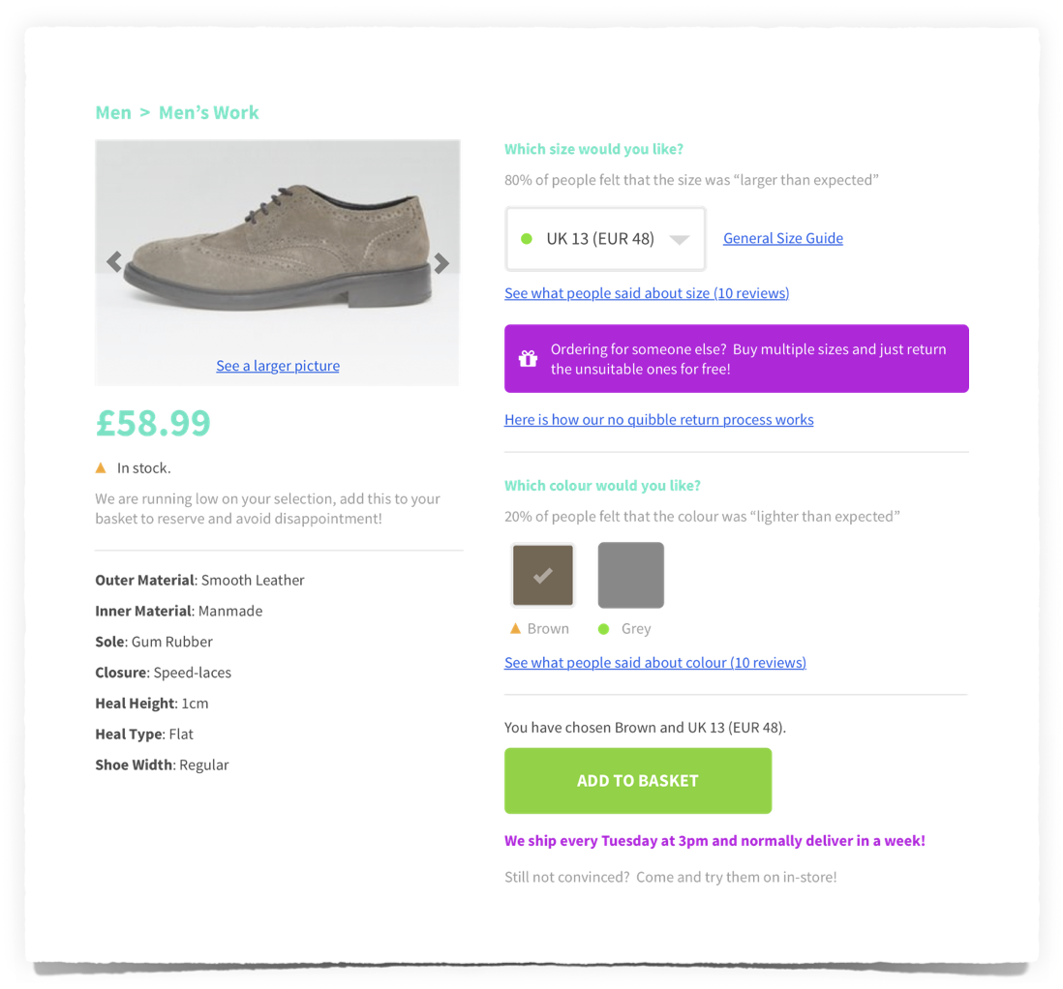






Our North Star
It might be difficult to know what their size is in a particular brand or style
The item may be a gift or purchased for someone else
The process isn’t articulated on the website
The website is allowing checkout with unavailable items
They didn’t know when to expect delivery

Slide 8
Other recommendations
Self-service help
These are dedicated pages for the most FAQs by customers, that have the same answer. For example, explaining the returns process.
Adopting the “one service, many doors” mindset
Golden Shoe sells shoes. People can walk through the front door or visit your website or use your catalogue. Whichever way they interact with your service, the experience should be the rich.
Learn why your customers come to your “door”, then be the best
There will be things about your service that people love and prefer over others. Figure out what these are and strive to keep being loved for what you do.
Embrace SoMo
Your competitors are taking in potential customers coming from Social and Mobile (SoMo) channels, you need to be there to take your position.

Slide 9
Together, we are one team
We help clients design, setup and improve the kind of digital function and teams they need to win in the marketplace
We blend our people amongst the clients own people to create skilled teams and deliver products and features fast
We up-skill the clients team members and executives to better at doing digital as core ongoing capability

