Slide 1
UI
Cartes
schedule
…
Timetable view
Csv parser
… parser
Controller
Route view
Data Importer
Map view
Route calculator
Transport Map
Geo Map
GPS calculator

Slide 2
Initially need to create:
walkGraph : Map< Node, Set<WalkSegment> >
Node :
StartPoint
MetroStation
EndPoint
Segment :
MetroSegment
WalkSegment

Slide 3


To calculate the track need to add segments of actual schedule (include possible repair works, delays due to accidents etc. – changings arrived from controller) to walkGraph
keep all the walkSegments, or replace those for which there is a better time (thanks to the metroSegments available)
repair works on red line
delay 30 minutes on
black line

Slide 4
Launch Dijkstra on this obtained (multi)graph
repair works on red line
delay 30 minutes on
black line

Slide 5
Add start and finish points
Calculate distances to nearest stations of obtained (multi)graph on some radius
Launch Dijkstra for this (multi)graph
repair works on red line
delay 30 minutes on
black line

Slide 6
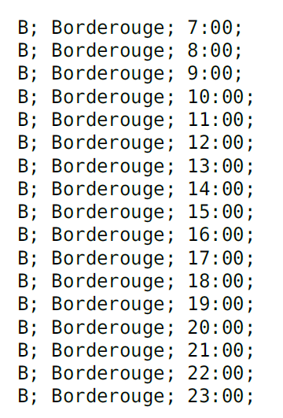
Dijkstra : how to apply according schedules ?
Initial schedule
We work only with copy + delays/annulations possibles
30;
30;
30;
30;
30;
30;
30;
30;
30;
30;
30;
30;
30;
30;
30;
but how to apply it to Dijkstra?

Slide 7
Dijkstra (details)
6:15 ( =22500s )
next train 7:00 ( =25200s )
Y
300s
500s
200s
450s
1000s
900s
250s
270s
300s
450s
300s
3050s
250s
X
330s
250s

Slide 8
Dijkstra (details)
6:15 ( =22500s )
repair works on red line
next train 7:00 ( =25200s )
300s
2950s
450s
1000s
900s
250s
270s
300s
450s
3050s
X + 1800s
330s
delay 30 minutes on black line

Slide 10
Future problems and solutions:
Time is counted from 00:00:00 (0 seconds) of one day and ends at
23:59:59 (86399 seconds) of the same day.
If the route involves the passage of midnight, then we need to subtract 86399,
convert to hh:mm:ss format and specify +1 day (arrival the next day at calculated time).

