Slide 1
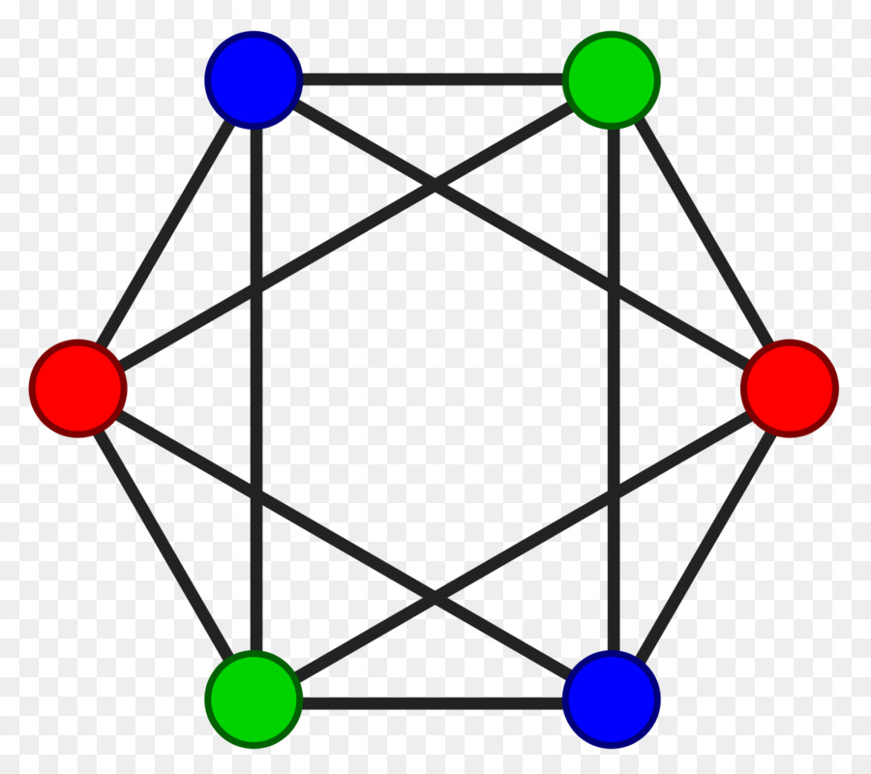
Graph Colouring Algorithms
By Vimal Vinod

Slide 2

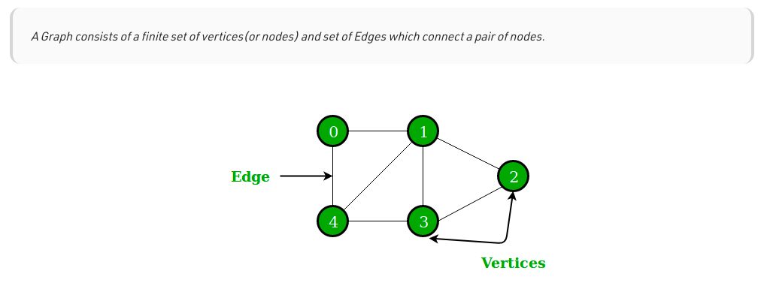

Slide 3

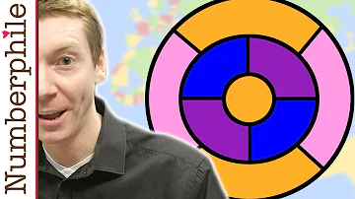
https://youtu.be/NgbK43jB4rQ

Slide 4
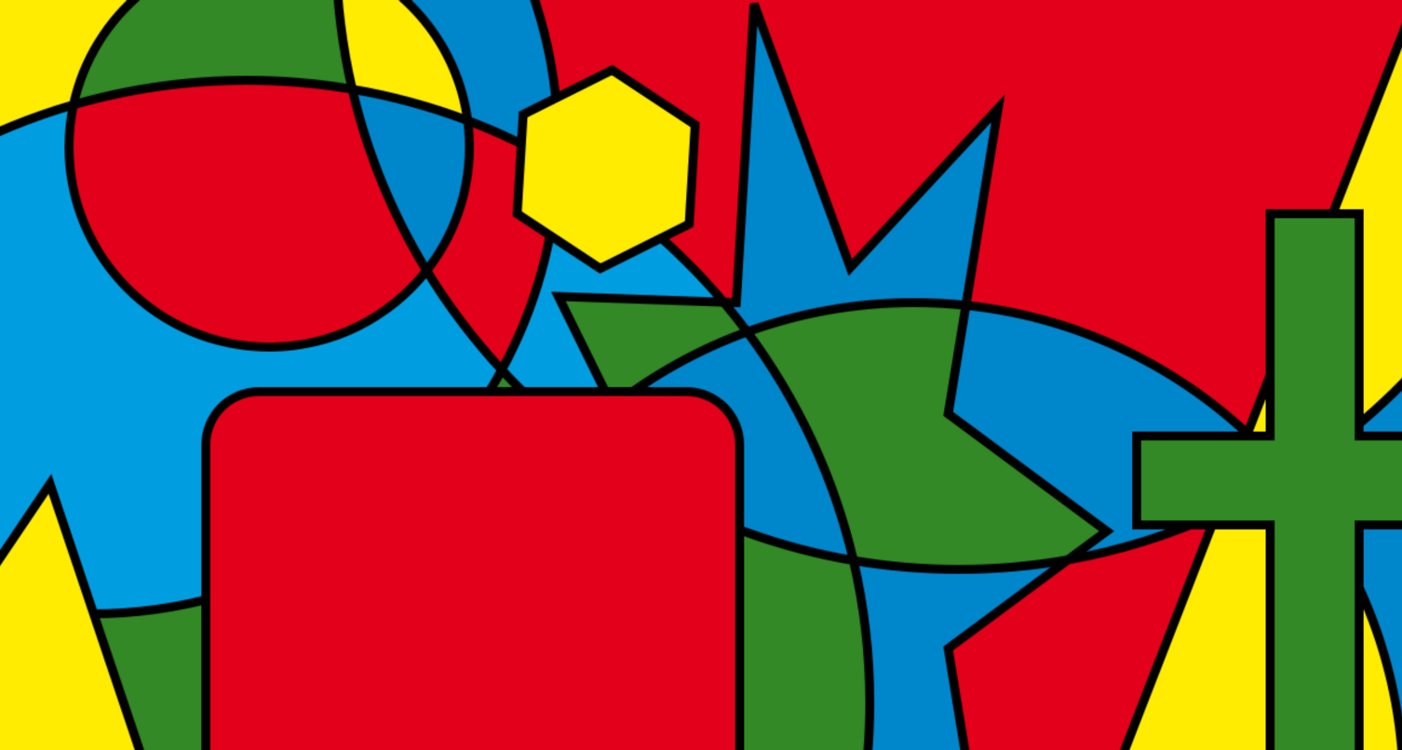
The Four Colour Theorem

Slide 5
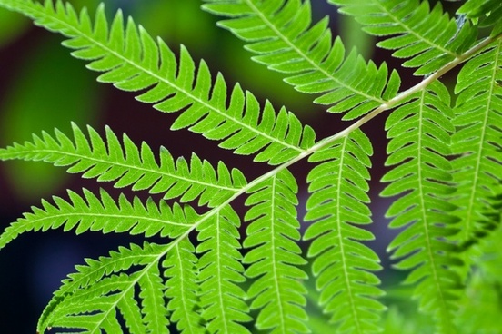
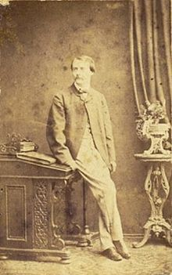
Francis Guthrie

Slide 6
Algorithms
Greedy
DSatur
Recursive Largest First
Backtracking

Slide 7
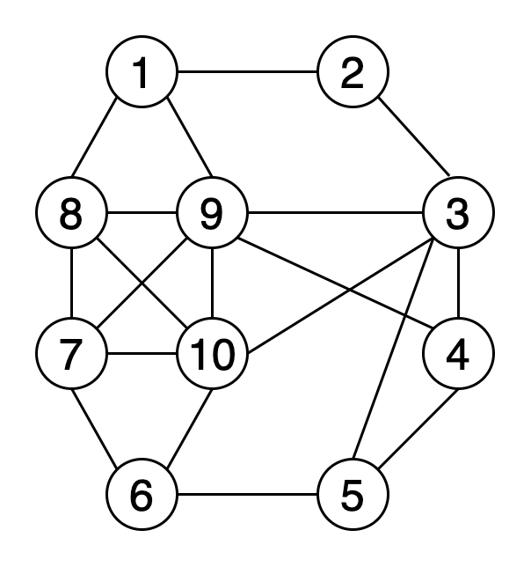
Greedy

Slide 8
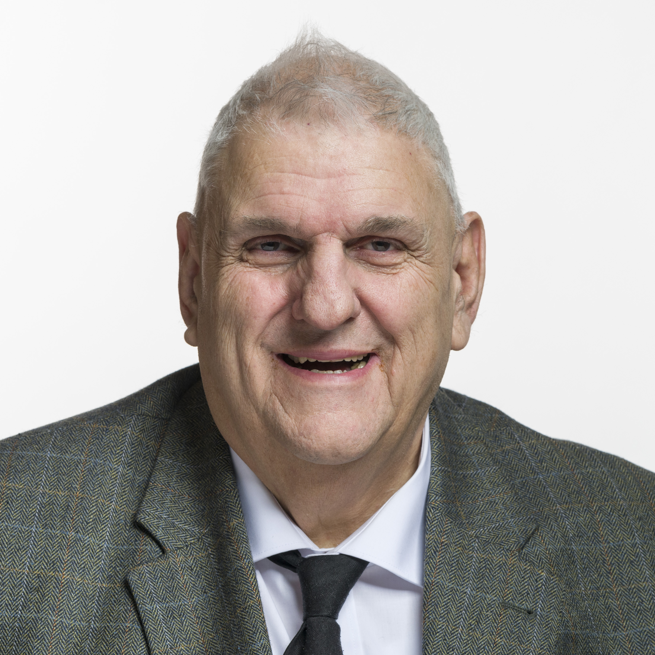
DSatur
Daniel Brélaz
By http://www.parlament.ch, Attribution, https://commons.wikimedia.org/w/index.php?curid=86351445

Slide 9
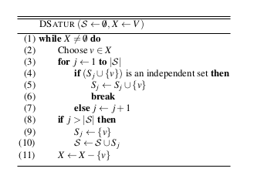
The DSatur Algorithm

Slide 10
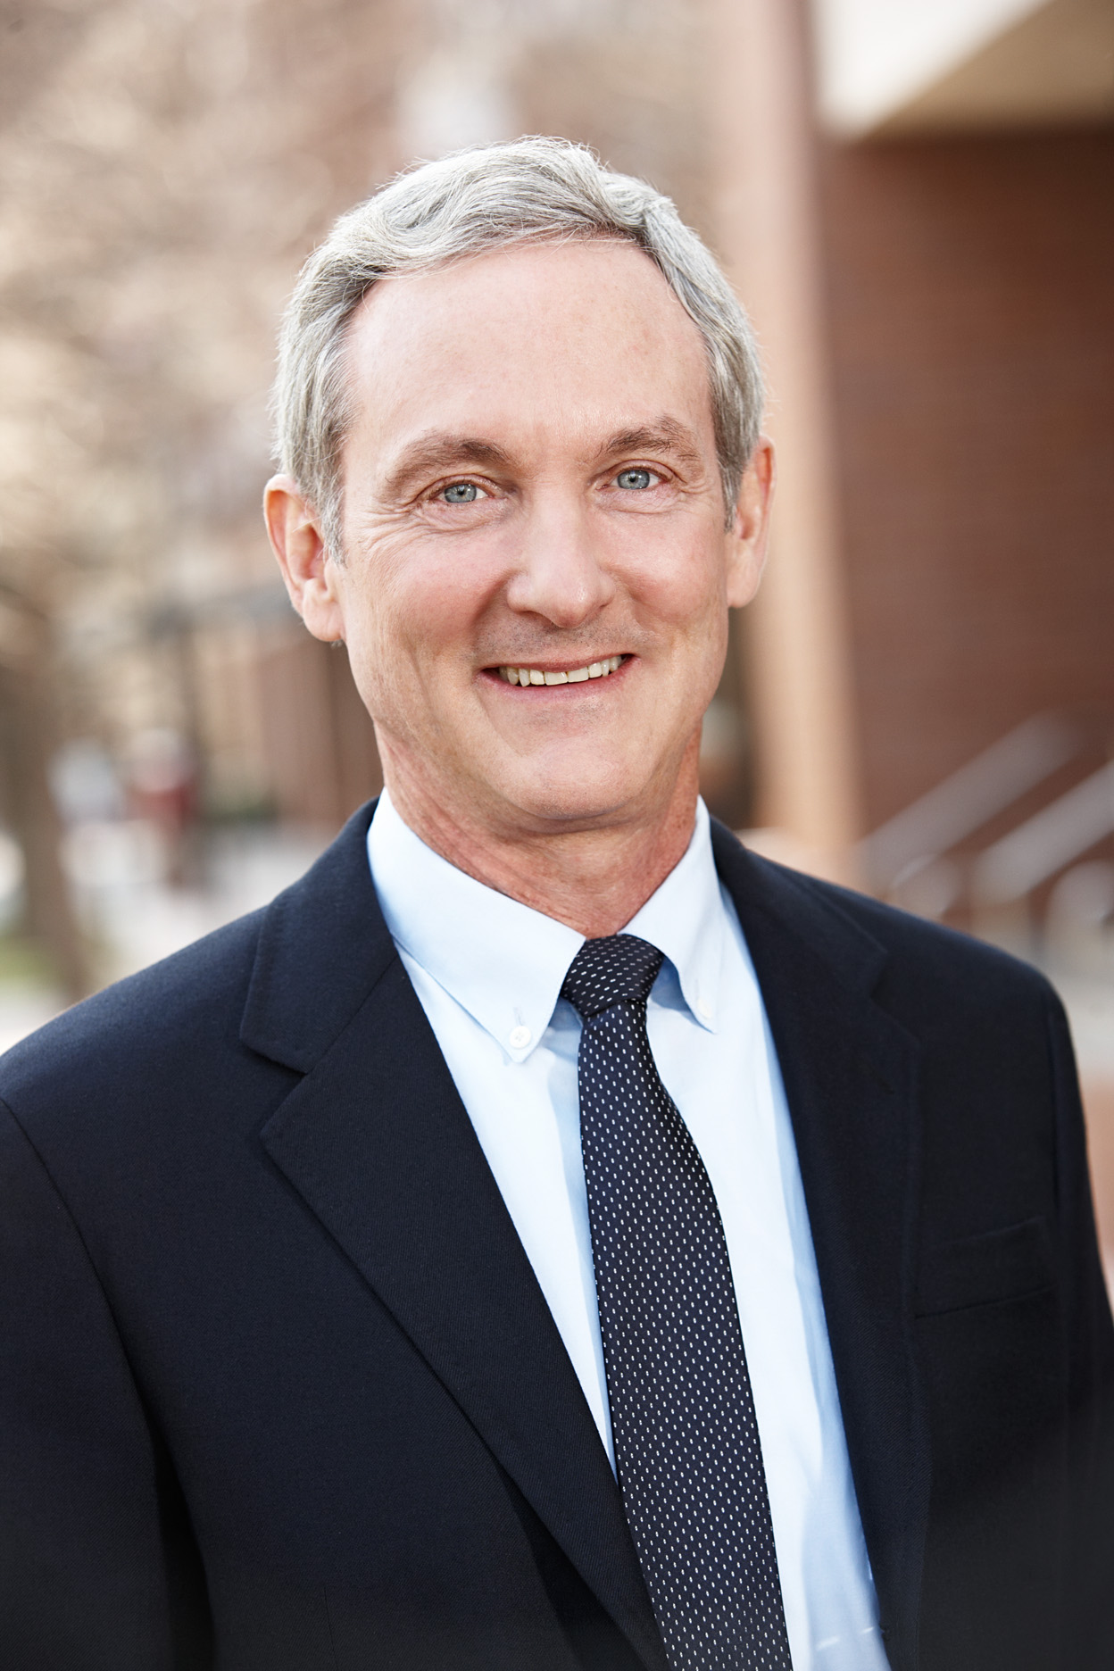
Recursive Largest First
Frank Thomson "Tom" Leighton
By Beannyc924 - Template:Akamai Technologies, CC BY-SA 4.0, https://commons.wikimedia.org/w/index.php?curid=50121219

Slide 11
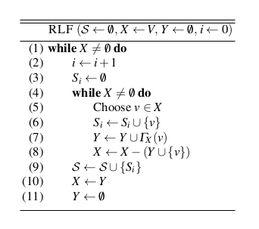
RLF Algorithm
A Guide to Graph Colouring: Algorithms and Applications

Slide 12
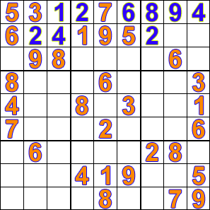
Sudoku solved by Backtracking

Slide 13
Applications
Designing Seating Plans
Designing Timetables

Slide 14
Designing Seating Plans

Slide 15
Designing Timetables

Slide 16
Open Problems
Reed’s conjecture (1998)
Hadwiger conjecture
Erdős–Faber–Lovász conjecture
Albertson conjecture

Slide 17
Conclusion

