Slide 1
How can we improve Graph Colouring Algorithms?
By Vimal Vinod

Slide 2
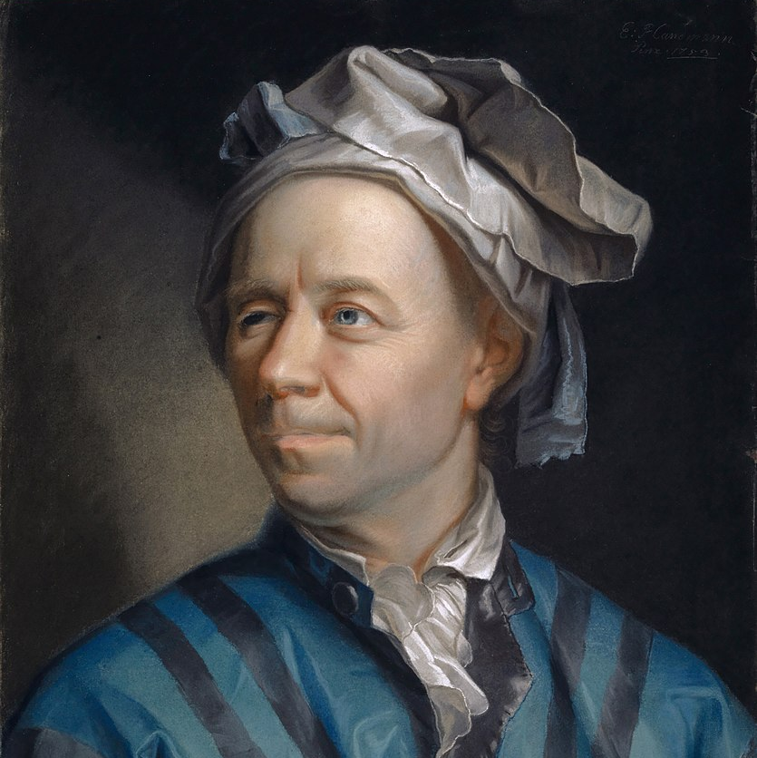
Leonard Euler
One of the most productive Mathematicians of all time.
Discovered the Field of Graph Theory.
Notes:
Picture of A Painting of Euler
By Jakob Emanuel Handmann - Kunstmuseum Basel, Public Domain, https://commons.wikimedia.org/w/index.php?curid=893656

Slide 3
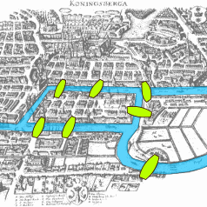
The Seven Bridges of Königsberg
Notes:
The Seven Bridges of Königsberg
Find a route through the town of Königsberg that crosses each of its seven bridges exactly once.
Königsberg Bridges
By Bogdan Giuşcă - Public domain (PD),based on the image, CC BY-SA 3.0, https://commons.wikimedia.org/w/index.php?curid=112920

Slide 4
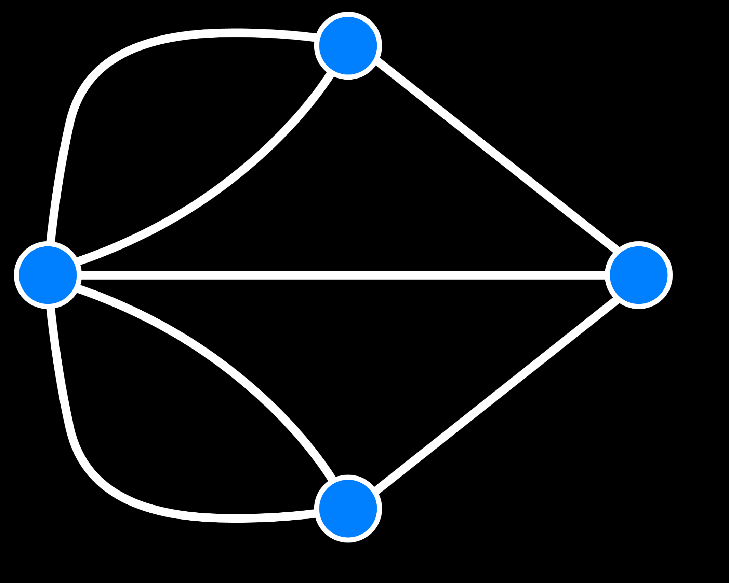
Königsberg as a Graph
Notes:
Bridges of Königsberg Graph
CC BY-SA 3.0, https://commons.wikimedia.org/w/index.php?curid=851840

