Slide 1
How can we improve Graph Colouring Algorithms?
By Vimal Vinod

Slide 2
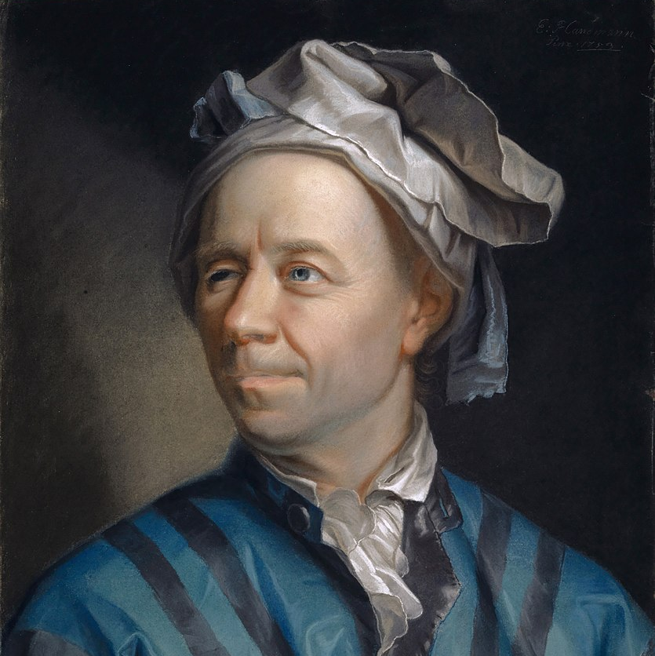
Leonard Euler
One of the most productive Mathematicians of all time.
Discovered the Field of Graph Theory.
Notes:
Graph Theory
What is graph theory exactly?
Euler called it the “Geometry of Position”. It later turned out to be part of a branch of mathematics called Topology (the study of spaces).
It can be a useful tool for studying relationships.
Picture of A Painting of Euler
By Jakob Emanuel Handmann - Kunstmuseum Basel, Public Domain, https://commons.wikimedia.org/w/index.php?curid=893656

Slide 3
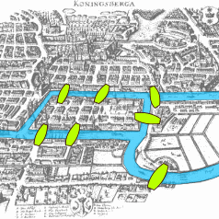
The Seven Bridges of Königsberg
Find a route that crosses each of the islands exactly once.
Notes:
The Seven Bridges of Königsberg
In 1736, Euler showed that a route like that, an Eulerian trail (yes, seriously), only happens in certain types of graphs.
Königsberg Bridges
By Bogdan Giuşcă - Public domain (PD),based on the image, CC BY-SA 3.0, https://commons.wikimedia.org/w/index.php?curid=112920

Slide 4
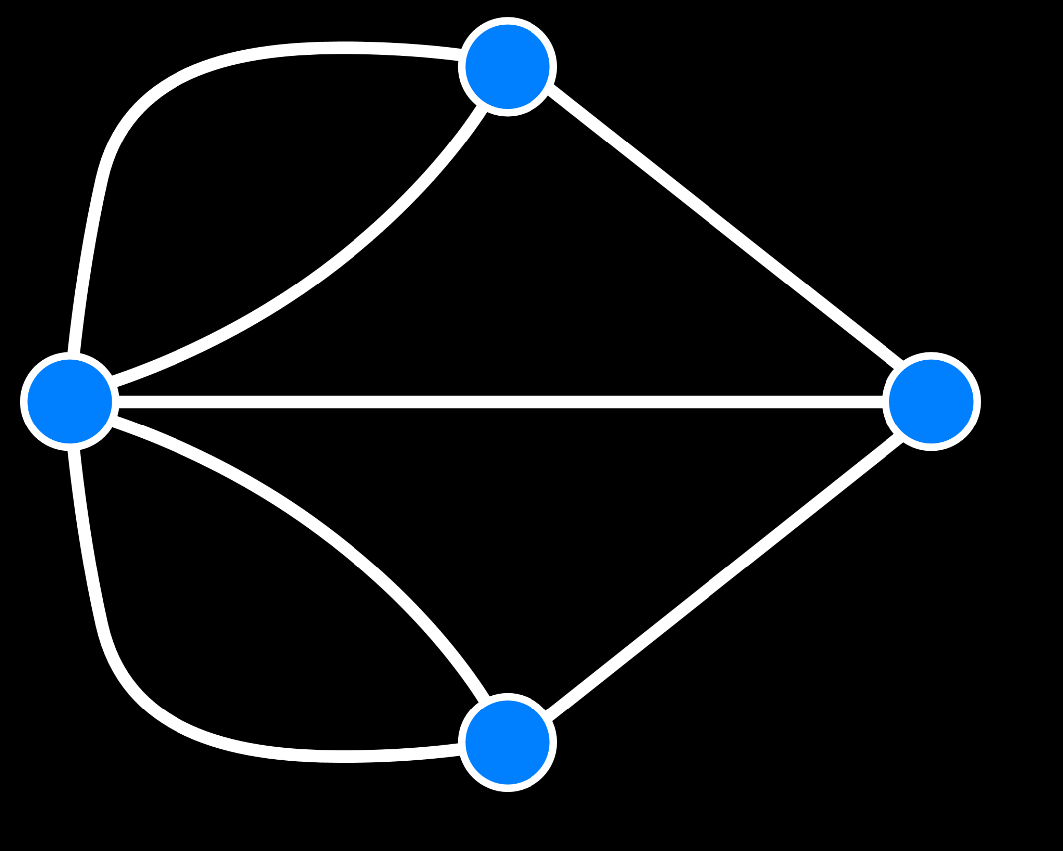
A Graph of Königsberg
Notes:
Graphs simplify the problem by abstracting away unnecessary details of the map.
Bridges of Königsberg Graph
CC BY-SA 3.0, https://commons.wikimedia.org/w/index.php?curid=851840

Slide 5
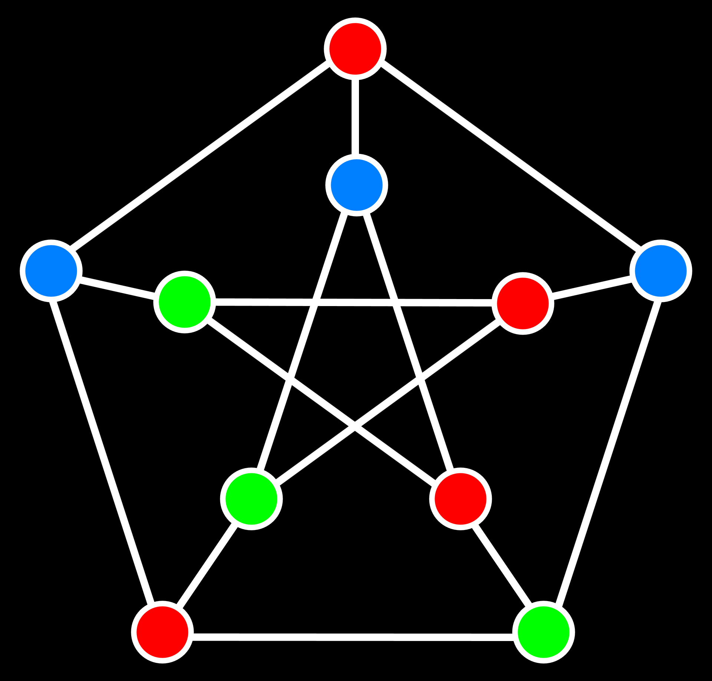
Graph Colouring
Adjacent vertices must not share the same colour.
Notes:
Graph Colouring
You colour a graph by assigning a colour to its vertices.
A colouring is complete if each vertex is coloured, else it’s partial.
Proper vertex colouring of the Peterson Graph
Public Domain, https://commons.wikimedia.org/w/index.php?curid=1386753

Slide 6
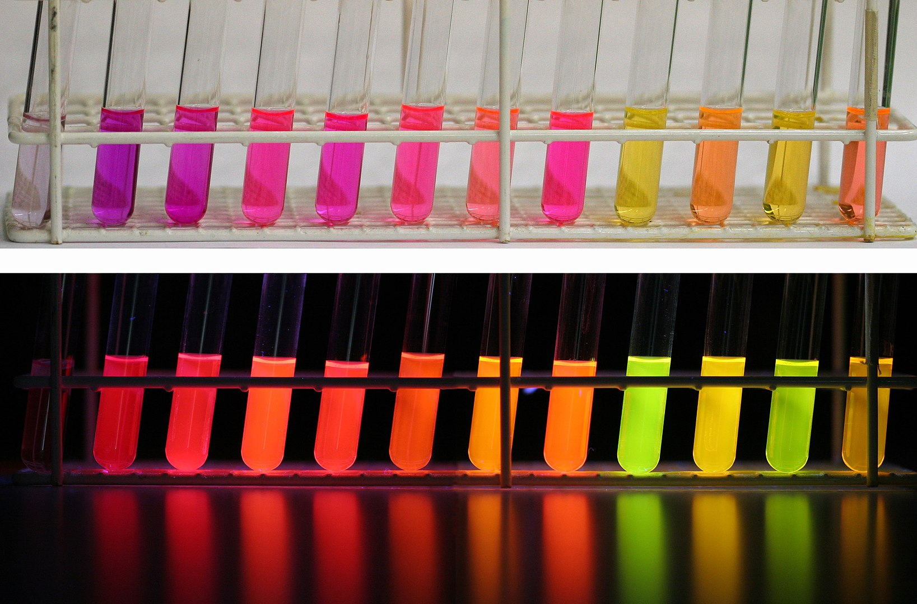
Chemicals
Must be stored in coolers.
Certain pairs should be kept separate.
Notes:
Storing Reactive Substances
One application of graph colouring is to separate chemicals into groups that do not react with each other so that they can be safely stored.
Notice that this easy to do if we put each chemical in a separate container, but this could be very convenient and expensive. It would be best to use as few containers as possible.
Colours of Nile Red under different solvents
By Kuebi = Armin Kübelbeck - Own work, CC BY-SA 3.0, https://commons.wikimedia.org/w/index.php?curid=6000765

Slide 7
Adjacency Table
Chemical | Reacts With
1 | 2, 4, 5
2 | 1, 3
3 | 2, 5
4 | 1
5 | 1, 3
Notes:
Adjacency Tables are one of the simplest ways of representing a graph without actually drawing it. The left side of the table gives you a the vertex and the right side gives you all the vertices it is connected to.
This slide has an example adjacency table where the numbers represent chemicals. Note you could have also used actual names of chemicals, but that seemed like too much effort.

Slide 8
Colouring Algorithms
The Backtracking Sequential Colouring Algorithm
The Greedy Colouring Algorithm
The Degree of Saturation Algorithm
The Recursive Largest First Algorithm
Notes:
An Algorithm is a of instructions that does something. The purpose of a colouring algorithm, as you may have guessed, is to colour graphs that are too big for humans.
A good graph colouring algorithm should have a low time complexity and use as few colours as possible.

Slide 9
BSC
Notes:
The Backtracking Sequential Colouring Algorithm
This algorithm finds all the proper colourings of a graph using Depth First Search. It has a time complexity of $m^{n}$ where $m$ is the number of colours that can be used and $n$ is the number of nodes in the graph.
Improvements that can be made
Classical algorithms such as BSC, whose purpose is to map out the solution space, cannot be greatly improved in terms of time complexity.

Slide 10

State-Space Trees
Notes:
State-Space Trees
A state-space you can think off as all the different configurations of a system. And a State Space Tree shows how that configuration can be reached by using certain actions.
Tic Tac Toe Game Tree
By Traced by User:Stannered, original by en:User:Gdr - Traced from en:Image:Tic-tac-toe-game-tree.png, CC BY-SA 3.0, https://commons.wikimedia.org/w/index.php?curid=1877696

Slide 11
Depth First Search

Slide 12
Greedy
Notes:
This is the simplest and most fundamental heuristic graph colouring algorithm.

Slide 13
Vertex Ordering
Notes:
Vertex Orderings can have a significant impact on the number of colours used by heuristic algorithms. It is proven that there is at least one ordering, for any graph, that, when fed into the greedy colouring algorithm, will produce an optimal colouring.
In this way graph colouring problems can also be considered vertex ordering problems.
There are two main ways to statically Order Vertices:
Largest First (LF)
Smallest Last (SL)
There are also ways to dynamically reorder vertices like Interchange (I) which swaps colours of nodes every now and then according to some rules.
Smallest Last Interchange has been experimentally to be the best combination in most cases.

Slide 14
The Degree of a Vertex
Notes:
The degree of a vertex is the number of edges adjacent to it.

Slide 15
Largest First

Slide 16
Smallest Last

Slide 17
DSatur
Notes:
DSatur was first proposed by Daniel Brélaz in 1979.

Slide 18
The Degree of Saturation
Notes:
The Degree of Saturation of a vertex is the number of coloured vertices adjacent to it.

Slide 19
RLF
Notes:
This algorithm was proposed by Frank Thomas Leighton in his 1979 paper on “A Graph Coloring Algorithm for Large Scheduling Problems”.

Slide 20
End of Slides

