Slide 1


FitPhone: Better Sleep - Project Update & Feasibility Evaluation

Slide 2
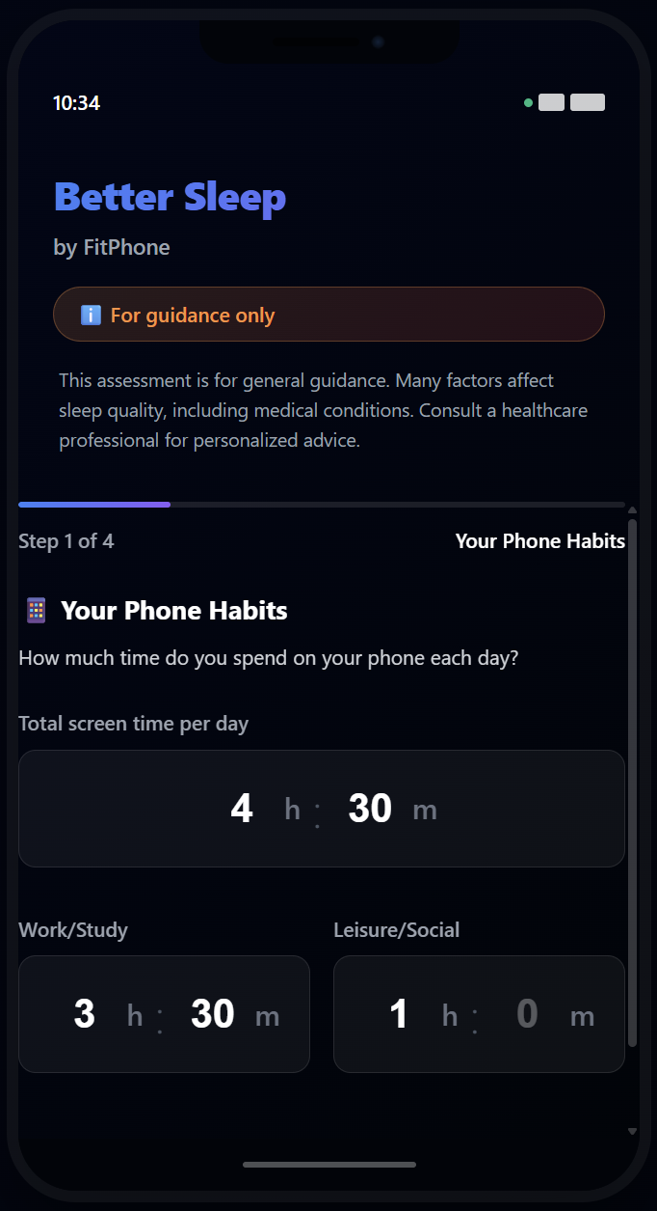
Project Context
What was the original challenge?
Build a machine-learning model that predicts daily sleep quality from smartphone behaviour.
Use self-reported behavioural data (screen time, stress, wellness index, etc.).
Deliver an actionable model for consumers to improve their sleep.

Slide 3
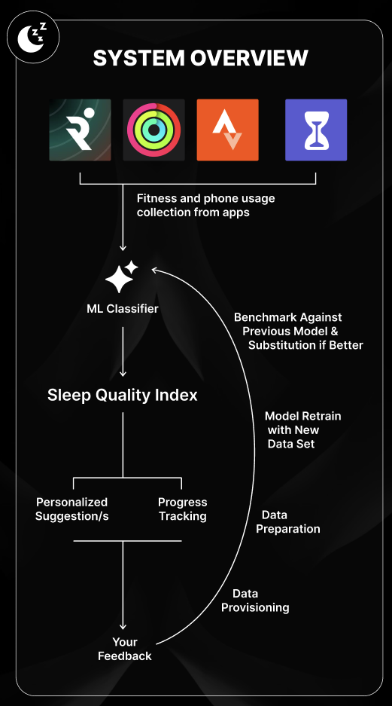
Previous Project Goals
Create a predictive model that:
Estimates next-day Sleep Quality Index (SQI)
Gives reliable recommendations
Works for all types of people → diversity, fairness, inclusivity

Slide 4
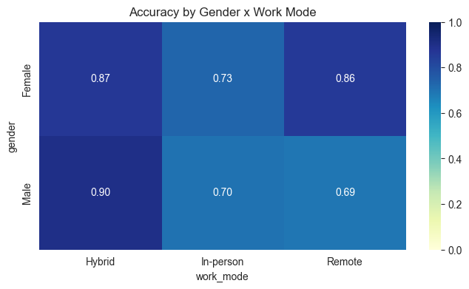
Fairness & Ethical Risks
Sleep patterns and cognitive performance can vary significantly across cultures
Unreliable for underrepresented groups = systemic bias
Users may adopt harmful behaviors based on incorrect or oversimplified recommendations
Generalize findings to individuals without considering personal or contextual factors

Slide 5
Where we are
No interactive model on website
Feasability document → done
Blueprint document (for future semesters) → polishing it
Team final retrospective → for next week
Current Project Goals

Slide 6
Meeting(s) outcome
After discussing stakeholder’s wishes with teachers:
Wish: a tangible model to show on the website that works
Final Decision: we won’t make a model for FitPhone to display
Reasoning: Ethical risks, outcomes not reliable, data limitations, bias → Not ideal for health-related problems

Slide 7
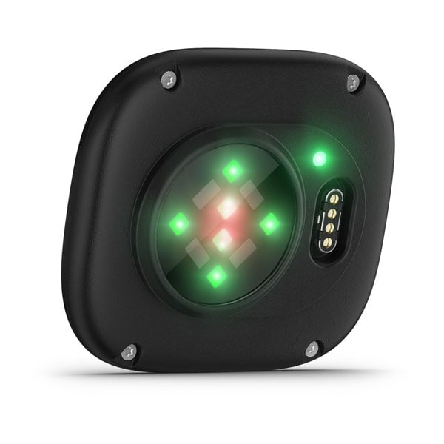
What Data Is Actually Needed
To make this project feasible:
Multi-week wearable sleep tracking (HRV, movement, stages)
Diverse participant groups (age, gender, lifestyle, disorders)
Behaviour logs (caffeine, exercise, meals, stress, light exposure)
Consistent expert-reviewed labels
Large sample size per subgroup
Essentially a full longitudinal sleep study

Slide 8

Blueprint for Next Groups
What we will deliver:
Feasibility report + failure analysis
Clear description of what data must be collected
Proposal for a structured multi-week study
Ethical guidelines & risk considerations
Recommendations for future ML modelling setup
Our work becomes the foundation for future teams to build a scientifically valid dataset.

Slide 9

Questions

