Slide 1
Autonomous Sailboat
Thomas Gwynne-Timothy
&
JULIA SARTY

Slide 2
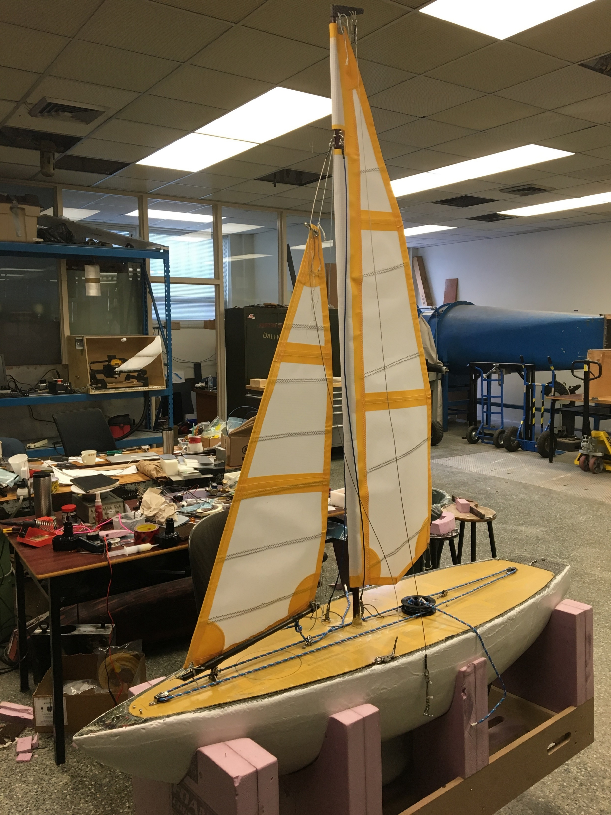
Overview
Background
Goals & Responsibilities
Hardware Architecture
Software Architecture
I/O Layer
Task Layer
Control Layer
Future Work
Summary

Slide 3
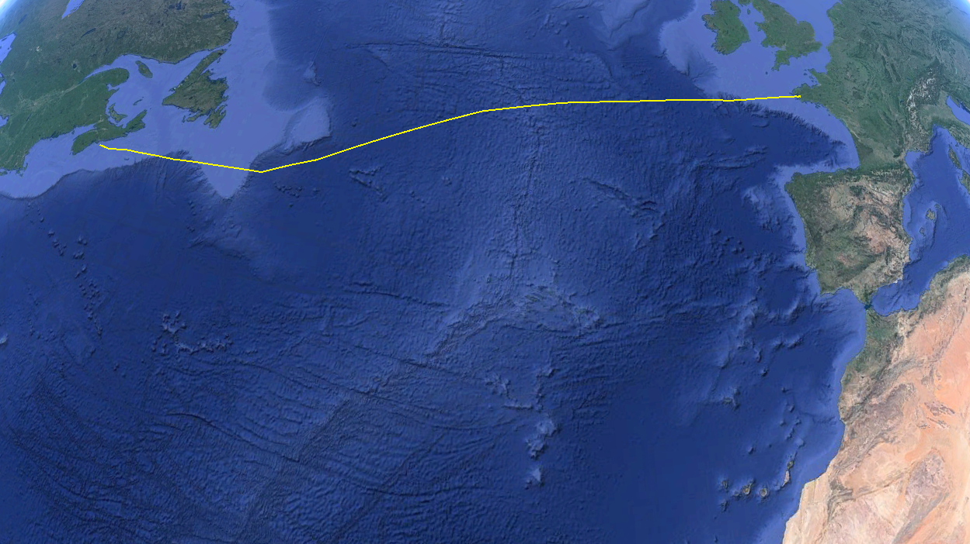
Background
“The Microtransat Challenge is a transatlantic race for autonomous boats. The race aims to stimulate the development of autonomous boats through friendly competition.”

Slide 4
Goals & Responsibilities
Project Goals
UW-Stream Team Responsibilities
Complete the Microtransat challenge
Improve boat performance and reliability
Improve data logging and system status feedback
Transfer control from PIC to ARM
Restructure source code for improved maintainability and reliability
Develop communication system for data logging and remote control

Slide 5
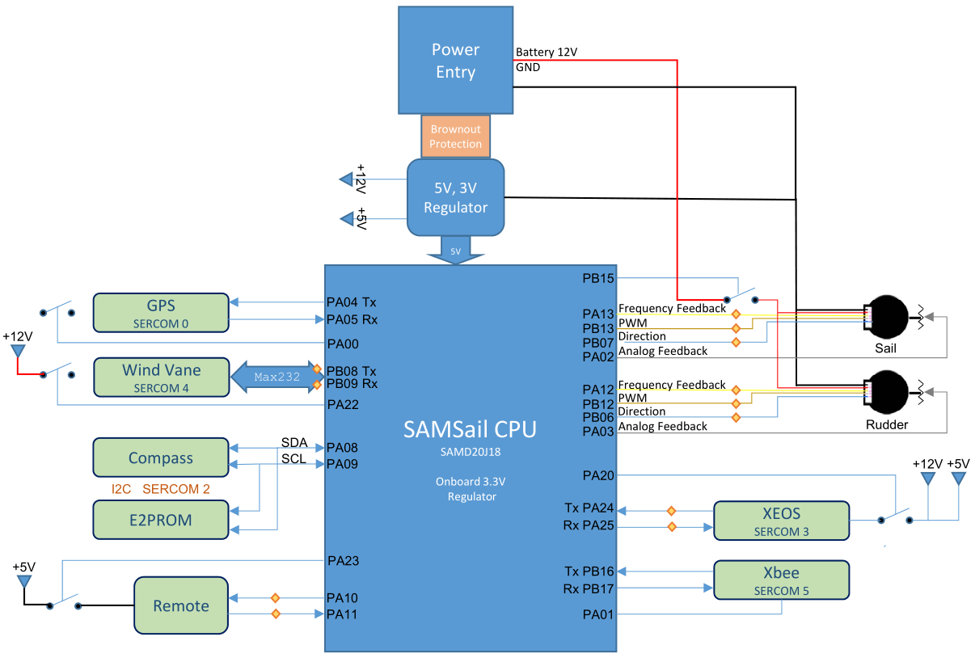
Hardware Architecture
UART
GPS
Wind
XBee
Xeos
I²C
Compass
EEPROM
Motors
ADC
PWM

Slide 6
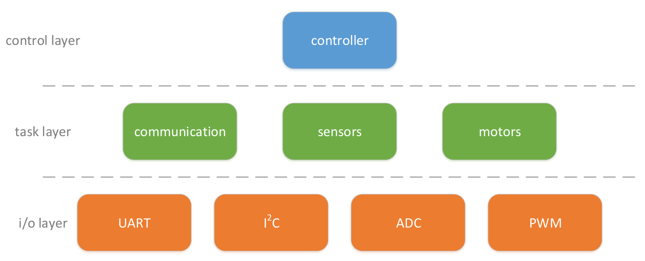
Software Architecture

Slide 7
I/O Layer – UART & I²C
Allows communication to/from peripherals
UART (Universal Asynchronous Receiver Transmitter)
4 channels
Interrupt-driven (non-blocking) interface
FIFO buffers for each channel
I²C (Inter-Integrated Circuit)
2 slave devices
Blocking interface

Slide 8
I/O Layer – ADC & PWM
Allows control over motors
ADC (Analog-to-Digital Converter)
2 channels for winch potentiometer and rudder potentiometer
12-bit resolution
Blocking interface
PWM (Pulse-Width Modulation)
2 channels for winch motor and rudder motor
500 Hz frequency
250 duty cycle settings

Slide 9
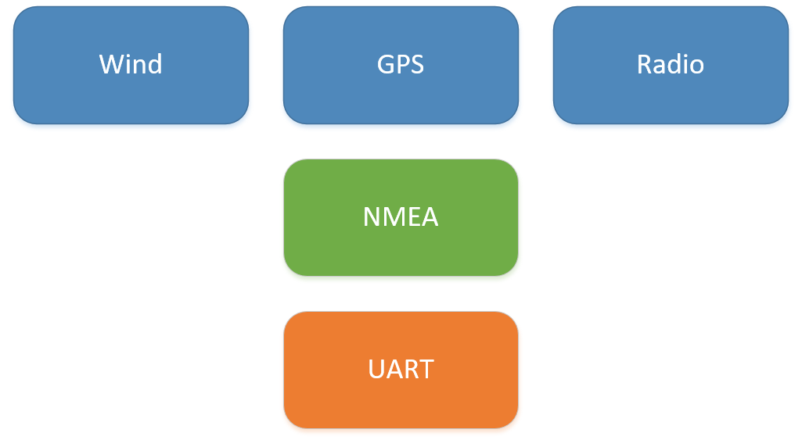
Task Layer – Communication
3-layer communication stack
Application layer
Data-link layer
Physical layer
NMEA 0183
Links application layer to physical layer
Adds header, footer, and checksum

Slide 10
Task Layer – Communication
Custom NMEA 0183 format
$DALSAIL,<type>,<arg1>,…,<argn>*checksum\r\n
Message types include:
Data logging
Remote control
Way point mission loading
Message acknowledgment

Slide 11
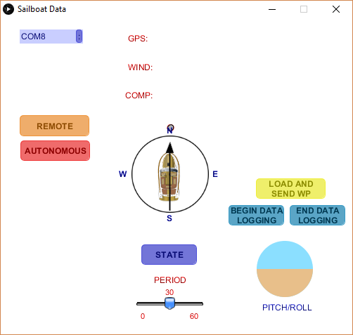
Sailboat Dashboard

Slide 12
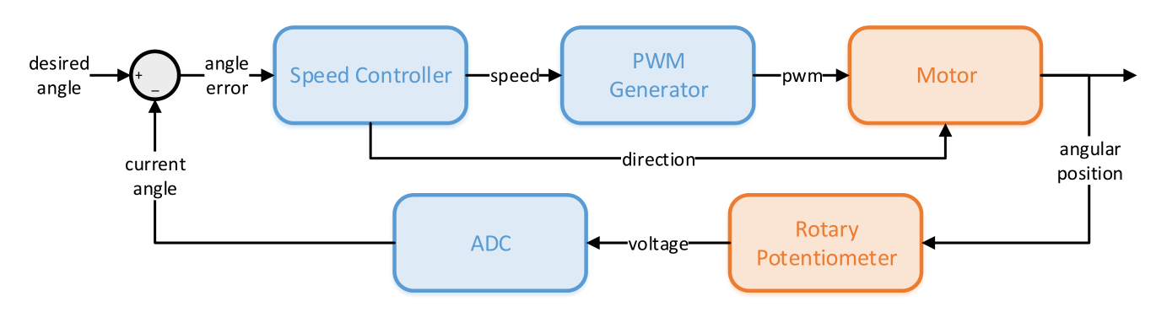
Task Layer – Motors
Proportional control with closed-loop feedback

Slide 13
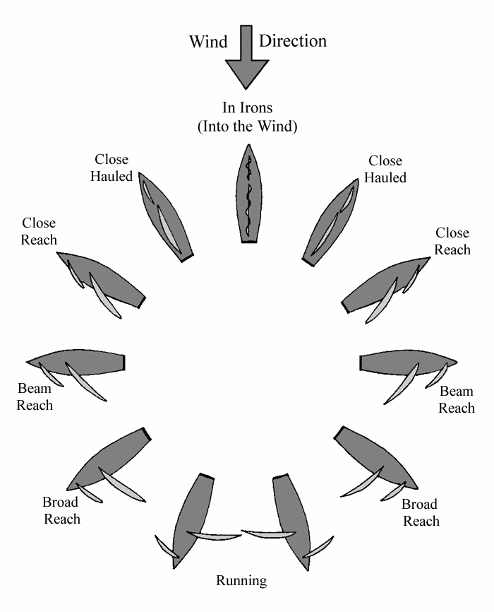
Control Layer – Navigation
Update sailboat course
Use way point, GPS location, boat heading, and wind direction to set a course
Avoid dead zone with tacking
Avoid running with jibing
Set sail angle with pre-set positions
Maintain sailboat course
Adjust rudder to maintain course

Slide 14
Control Layer – Task Management
static void ControlTimerTick(void)
{
// Update the system clock
t_ms += dt_ms;
// Iterate through tasks
for (int i = 0; i < CTRL_NUM_TASKS; i++) {
// Check if it is time to run the task
if (t_ms >= task_stamps_ms[i]) {
// Run the task
(*tasks[i])();
// Update the time stamp
task_stamps_ms[i] += task_periods_ms[i];
}
}
// Reset the watchdog
PetWatchDoge();
}
Tasks initiated with a control timer
Time stamps used to control timing between tasks
Watchdog timer used to prevent deadlock

Slide 15
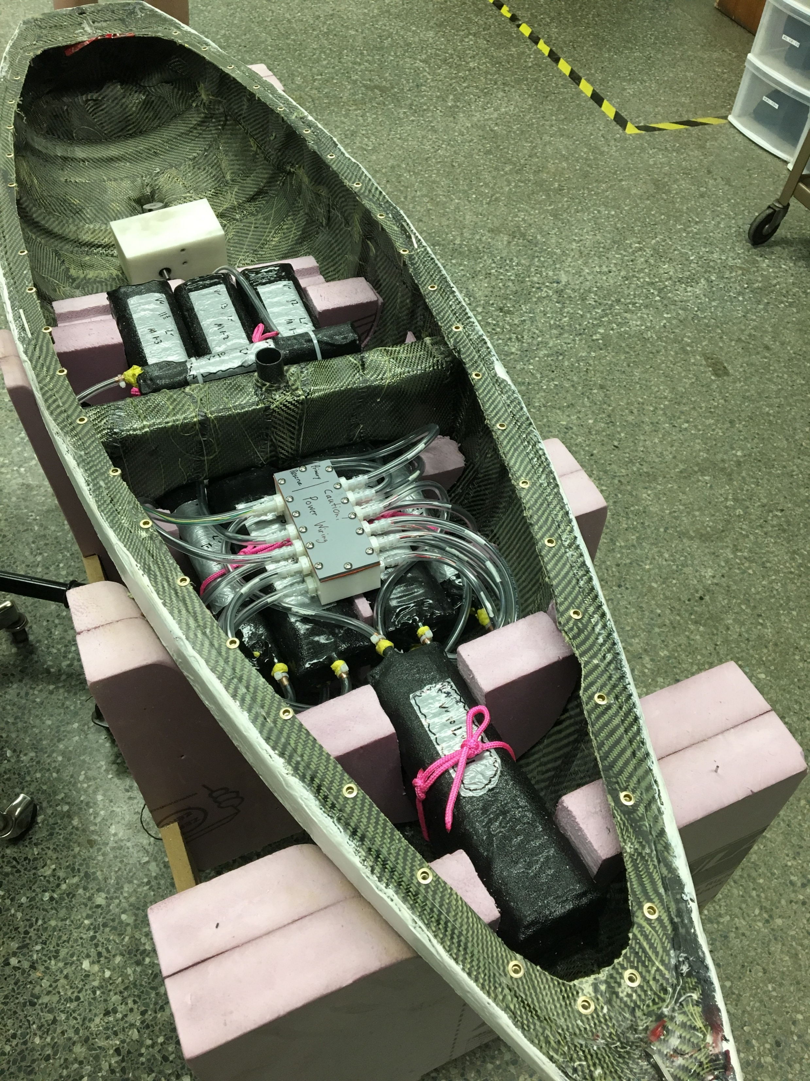
Future Work
Ocean testing
Navigation tuning
Sea-state detection
Launch!

Slide 16
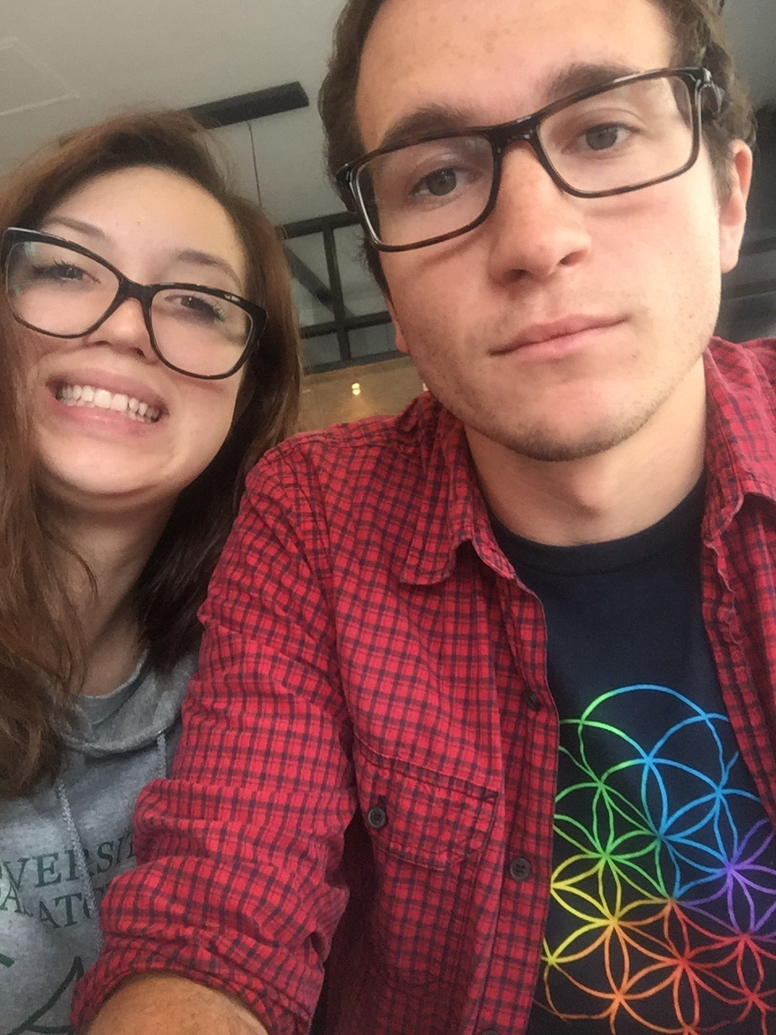
Summary
Transfer control from PIC to ARM
Restructure source code for improved maintainability and reliability
Develop communication system for data logging and remote control

