Slide 1
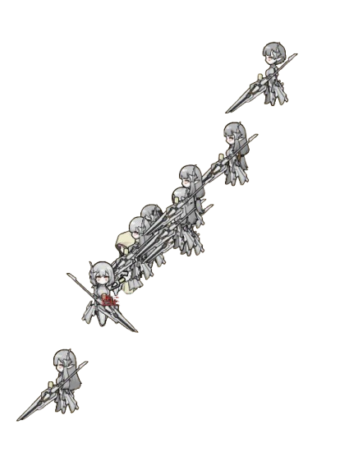




Better Milira Fallen Angel

