Slide 1

Open or closed?
ID5616001 2022 Sem 2
Dali Hoffman

Slide 2

What is Linux ?
Linux is an operating system which is kernel distributed and operated under an open source license
The founder Linus Torvalds was a young bright computer science student who was working for UNIX OS at the time. After his ideas were rejected he decided to implement the kernel himself!
Fun fact: Linux is run on over 90% of the worlds super computers

Slide 3
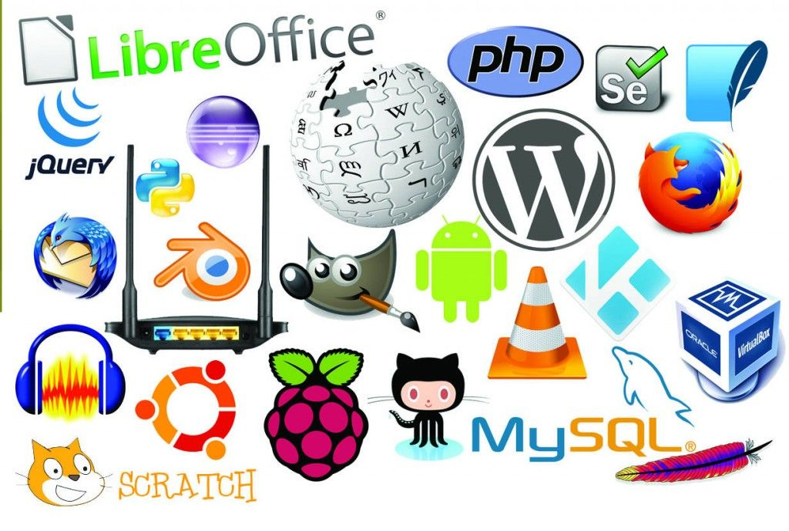
Linux is Open Source
Linux is open source meaning everyone is able to use it without having to pay a licensing fee.
Why is Linux open source?
What could this mean for the world. Is it a net positive that such open source software exists?
Fun fact: The first ever Linux kernel just occupied only 65 KB of storage space .

Slide 4
What are the benefits?
Cost efficiency… Well Obviously as its free!
Security
No spying on their users
Customization- Suitable for programmers.
Performance
Not so fun fact: Tik Tok recently gave itself the power to collect US citizens biometric data of its users.

Slide 5
What are the negatives?
Support
Some software may not be supported by the Linux operating system
Learning curve
Fun fact: This slide was a lot harder to fill

Slide 6
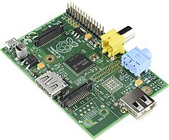
The Raspberry Pi
What is it?
The operating system it runs on?
Hard to argue with the results
Fun fact: This slide was a lot harder to fill

Slide 7
References
Limited, A. (n.d.). Linus torvalds Hi-res stock photography and images. Alamy. https://www.alamy.com/stock-photo/linus-torvalds.html
What is Linux operating system? Introduction to Linux OS. (2022, August 6). Guru99. https://www.guru99.com/introduction-linux.html
Figure 4 Photo Ref- Photo by Mati Mango from Pexels
Ref 2- Ghappour, Ahmed (2017-01-01). "Tallinn, Hacking, and Customary International Law". AJIL Unbound. 111: 224–228. doi:10.1017/aju.2017.59. S2CID 158071009.
Ref 3- Young, A.; M. Yung (1996). Cryptovirology: extortion-based security threats and countermeasures. IEEE Symposium on Security and Privacy. pp. 129–140. doi:10.1109/SECPRI.1996.502676. ISBN 0-8186-7417-2.
Ref 4- "Understanding Denial-of-Service Attacks". US-CERT. 6 February 2013. Retrieved
Ref 5- Griffin, Slade E.; Rackley, Casey C. (2008). "Vishing". Proceedings of the 5th Annual Conference on Information Security Curriculum Development - InfoSecCD '08: 33.
Figure 5 Photo Ref- Flavia Dzodan December 31, 2017
Figure 6 Photo Ref – League of Legends Official Website

