Slide 1
Phase 1 Data Science Project: Aviation Accident Analysis
Business Recommendations for Aircraft Purchases
Presented by: Filda Kiarie
Moringa School
DSF-PT08

Slide 2

Project Overview
Objective:
Purpose: Provide a business-focused analysis to guide the selection of aircraft for commercial and private enterprises.
Goal: Use aviation accident data to identify trends and recommend aircraft models that align with safety and reliability considerations

Slide 3

Overview
Data Source: (NTSB) Aviation Accident Data
Key Variables: Aircraft Damage, Make, Injury Severity, Total number of Injured, Year of events, Weather conditions, Broad phase of flights, etc
Approach: Data cleaning, Exploritory Data Ananlysis, Trend Visualizations, to guide recommendations
Business Understanding
Our goal is to select aircraft models based on safety data and historical trends.
We are to provide actionable insights to improve safety and reliability in aircraft purchases

Slide 4
Data Understanding
Cleaning: Address missing, and null values, standardize data entries, and any inconsistencies in the data
Exploration and Preparation: Explore, simplify, and extract data categories for analysis
Data Analysis
EDA(Exploratory Data Analysis): Assess distribution and relationships between data columns
Identify trends and analyze yearly changes in these Aircraft events

Slide 5
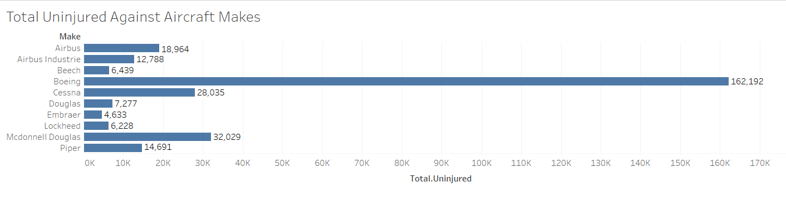
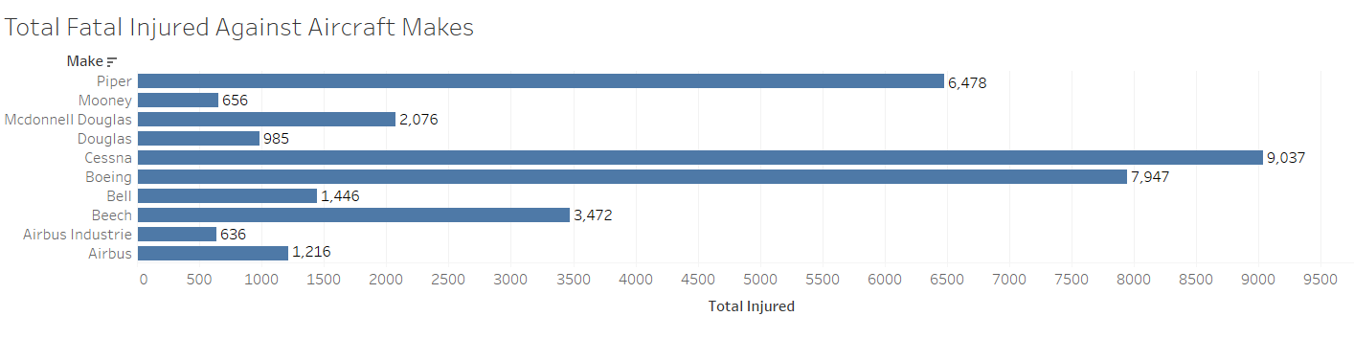
Recommendations
Based on this graph, Boeing has the highest number of uninjured people
Based on this graph, Cessna has the highest number of fatal injuries, compared to the rest
Looking at the two graphs, it’s safe to say that despite Boeing being 2nd in place in the most fatally injured people, it’s number here, compared to the number it has under total uninjured people, Boeing still takes the lead in Aircraft safety

Slide 6
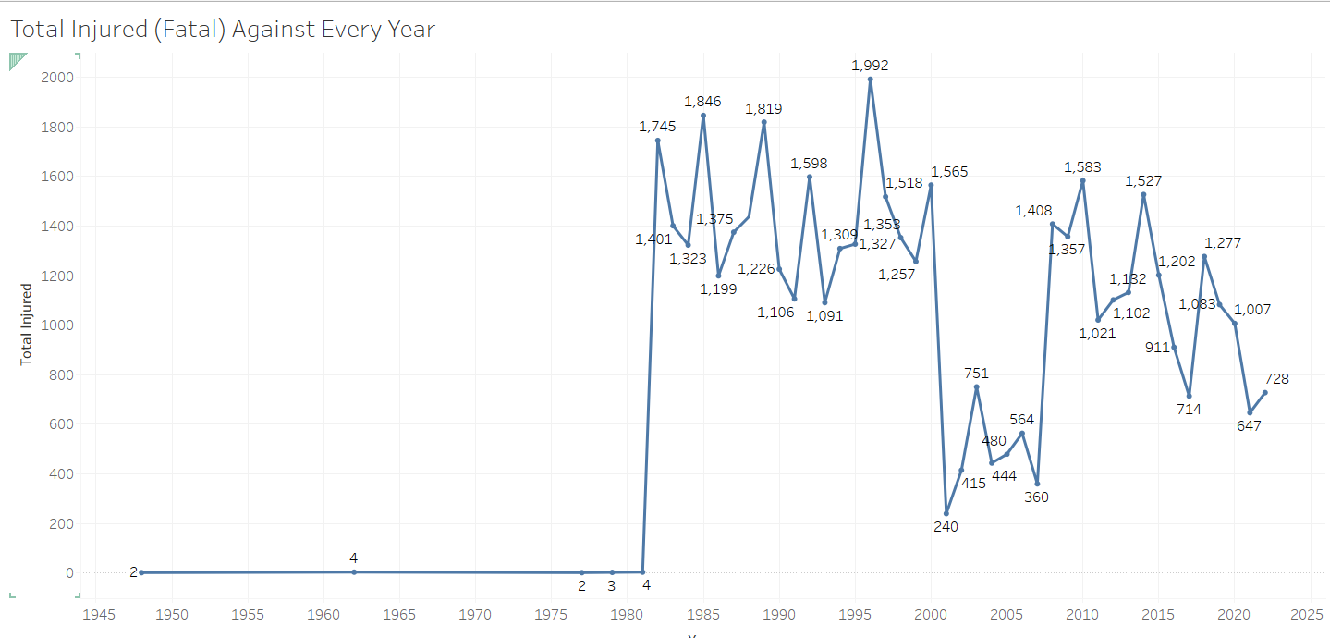
Recommendations
Due to the rise in air travel since the mid 90’s, it’s understandable that the number of injuries increased, after 1980. However, as technology and safety measures are being improved, the number of injuries has drastically reduced in the last 15 years, and the trend seems to continue on the downtrend.
This makes investment in air travel less risky as people have more faith in travelling by air.

Slide 7
Next steps
Integrate the recommendations from this analysis into the procurement strategy.
Conduct deeper analysis to explore other factors that may influence aircraft safety.
Gather feedback on the recommendations and the analysis to identify areas that need to be improved.

Slide 8
Thank you!
Thank you for your time and attention. Contact me if you have any questions or need further clarification
Name: Filda Kiarie
LinkedIn: www.linkedin.com/in/fildakiarie

