Slide 1
Activities We Give Up When We’re Online
Measuring the Crowd Out Effect of Online Leisure Activity

Slide 2
Background
Since the dot-com revolution, the internet has become an integral part of our life.
Some activities, like reading the newspaper or watching movies, are now being done through the internet
Other activities, like surfing the web for personal interest or checking Twitter, Facebook, Instagram, are new activities that have emerged with the dot-com revolution
How valuable are the activities we do online as opposed to offline ones?

Slide 3
Literature Wallsten, Scott. What are we not doing when we're online. No. w19549. National Bureau of Economic Research, 2013.
“Estimating the value of the Internet is difficult in part not just because many online activities do not require monetary payment, but also because these activities may crowd out other, offline, activities.”
This paper “estimates the opportunity cost of online leisure time. The analysis suggests that the opportunity cost of online leisure is less time spent on a variety of activities, including leisure, sleep, and work. “
Opportunity Cost of Online Leisure Time = Time Foregone on Other Activity
CROWD-OUT EFFECT

Slide 4
Wallsten’s Dataset: ATUS
The American Time Use Survey interviews respondents about:
how they spent their time on the previous day
where they were
whom they were with
The goal is to measure how people divide their time among life’s activities.
Individuals are randomly selected from a subset of households previously interviewed in the Current Population Survey (CPS).

Slide 5
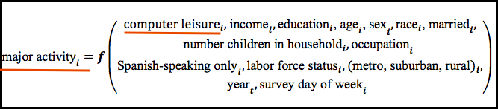
Wallsten’s Methodology
Using ATUS dataset for years 2003-2011, he estimates 18 versions of equations (one for each major activity and one for an unknown activity)
He uses the coefficient (and t-statistic) on the computer leisure variable from each regression as a measurement of the crowd-out effect of computer leisure on each major category

Slide 6
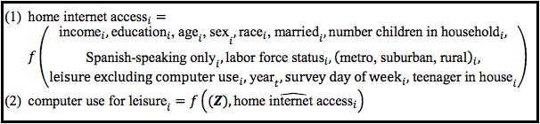
Challenge – ‘Who Has Internet?’
“While I know the ages of all household members, the data do not indicate whether a household has Internet access.”
However, I can identify some households that have access. In particular, any ATUS respondent who spends any time at home involved in computer leisure, e- mail, or using a computer for volunteer work must have home Internet access. Following Goldfarb and Prince, I estimate the following two simultaneous equations using two-stage least squares:

Slide 7
‘Who Has Internet?’ - Implications
His method implied that only 17 percent of households had access to the internet in 2010, when the US Census estimated that more than 70 percent actually had access.
For that reason, we will be taking a different approach for estimating the internet access variable on the ATUS dataset.
However, “The fitted propensity to have access increases by about 70 percent while actual home Internet access increased by about 78 percent* during that same time period.”
* As per PEW RESEARCH data

Slide 8
‘Who has Internet?’ – My Approach: Building a Decision Tree Classifier
The ATUS dataset is in fact a subsample of a larger dataset: CPS (Current Population Survey).
Unlike the ATUS dataset, the CPS dataset includes a variable that indicates whether a subject has internet access or not.
As such, we will be using similar type of variables as the one used in Wallsten's regression, and will look at the common variables found in both the ATUS and CPS datasets in order to construct a decision tree algorithm, classifiying our records into: subject has internet access or subject does not have internet access.

Slide 9
CPS Dataset – Computer and Internet Use Survey
The Current Population Survey (CPS) interviews around 56,000 households monthly, scientifically selected on the basis of area of residence to represent the nation as a whole, individual states, and other specified areas.
The main purpose of the survey is to collect information on the employment situation, as well as other information on demographic characteristics such as age, sex, race, marital status, educational attainment, family relationship, occupation and industry etc.
Starting 2011, CPS has included the optional Computer and Internet Use Survey. This was done for the years 2011, 2013, 2015. We will be using the aforestated datasets.

Slide 10
My Methodology vs. Wallsten’s
 | Wallsten | My Methodology
Datasets | ATUS | ATUS and CPS
Internet Prediction | Two Stage Regression | Decision Tree Classifier
Crowd Out Effect Measure | Linear Regression and Coefficient Analysis | Linear Regression and Coefficient Analysis

Slide 11
Variables
Variables Related To | ATUS Variables CODE | CPS Variables CODE
Income | Weekly earnings TRERNWA | Weekly earnings PRERNWA
Education | Highest level of school completed PEEDUCA | Highest level of school completed PEEDUCA
Age | Age PEAGE | Age PEAGE
Sex | Sex PESEX | Sex PESEX
Married | Presence of Spouse in the household TRSPRES | Presence of Spouse in the household TRSPRES
Number of Children in the Household and Age of Youngest Child | Number of household children TRCHILDNUM | Number of household children TRCHILDNUM
 | Age of Youngest Child TRYHHCHILD | Age of youngest child PRCHLD
Spanish-Speaking | Are you Spanish, Hispanic or Latino? PEHSPNON | Are you Spanish, Hispanic or Latino? PEHSPNON
Labor Force Status | Total hours worked per week TEHRUSLT | Total hours worked per week PEHRUSLT
 | Do you have more than one job? TEMJOT | Do you have more than one job? PEMJOT
 | Labor force status (Employed, Unemployed etc.) TELFS | Labor Force Status PEMLR
Metropolitan Status (Metro, Suburban, Rural) | Metropolitan Status (2000 and 2010 definitions) GTMETSA | Metropolitan Status (2000 and 2010 definitions) GTMETSA

Slide 12
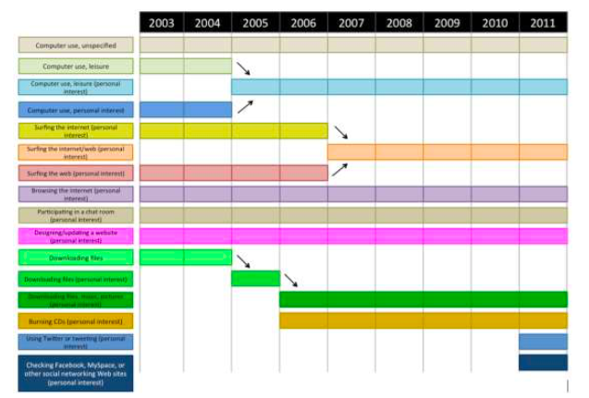
Variables Years 2011 to 2015
Smaller Sample than Wallsten’s sample. Two Reasons:
Limited Open Source Access to the CPS dataset (data used to build DT)
Since 2011 only, the ATUS question for leisure computer time spent has changed to include: Facebook, Instagram, Twitter and other– The most commonly used online platforms. Programming and designing/updating website (personal interest) has also been included.

Slide 13
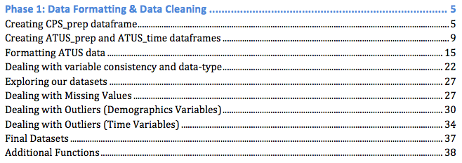
Technical Report – Phase 1 Data Formatting and Data Cleaning
Table of Content
Technical Steps – R, SQL (RMySQL, sqldf)
Creating CPS Dataframe
Formatting ATUS data
Data Consistency
Missing Values
Outliers
Final Datasets

Slide 14
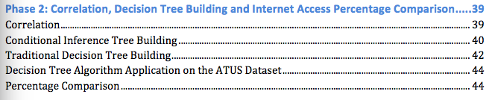
Technical Report – Phase 2 Correlation, Decision Tree Building and Internet Access Percentage Comparison
Table of content
Technical Steps – R (rpart and ctree)
Investigating the Correlation
Conditional Inference Tree Building
Traditional Decision Tree Building
Decision Tree Algorithm Application on ATUS Dataset
Percentage Comparison

Slide 15
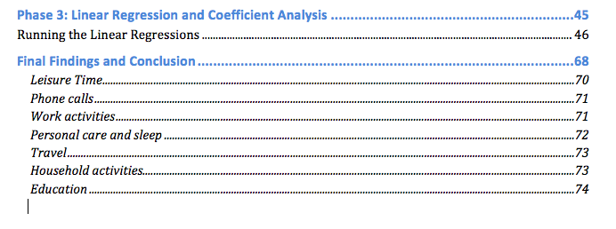
Technical Report – Phase 3 Linear Regression and Coefficient Analysis
Table of Content
Technical Steps – R and Tableau
Running the Linear Regressions
Findings

Slide 16
PHASE 1

Slide 17
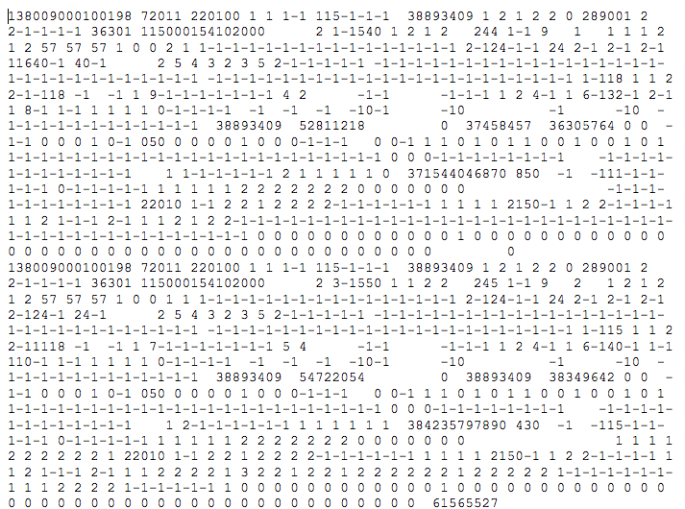
Phase 1 - Step 1 CPS Dataframe
Dat file read in a single line

Slide 18


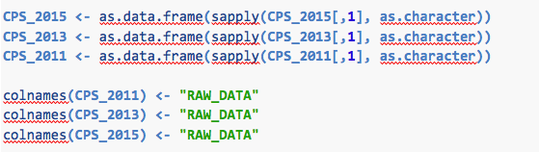
Phase 1 - Step 1 CPS Dataframe
To read it in a datframe in R:

Slide 19
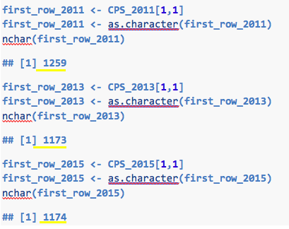
Phase 1 - Step 1 CPS Dataframe

Slide 20
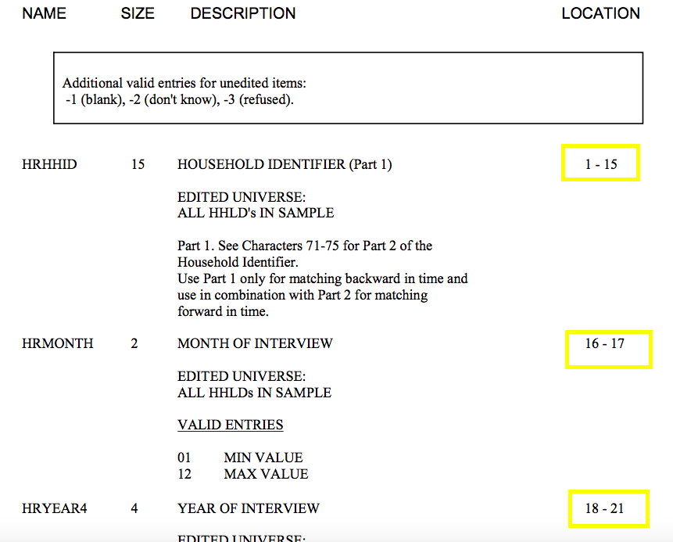
Phase 1 - Step 1 CPS Dataframe
Each row contains has a length 1259. These represent the answers of the subjects on more than 100 questions. To know which answer corresponds to which question, we need to check the CPS codebook.
The location of the answers are highlighted in the codebook.
Example shown in the picture.

Slide 21
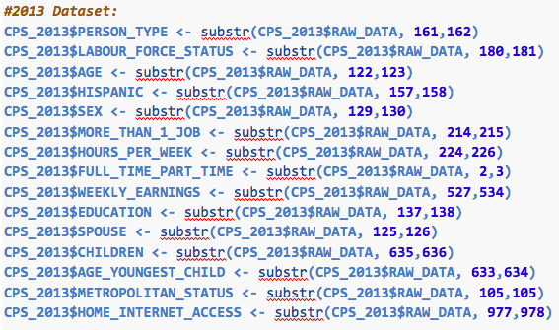
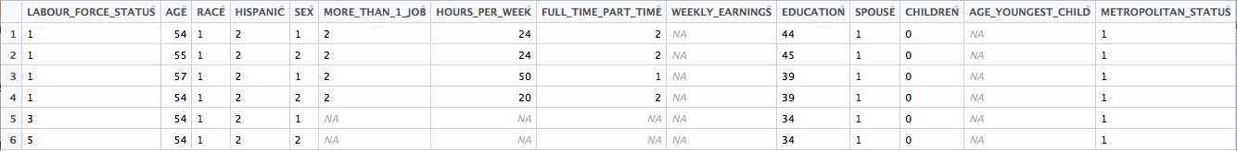

Phase 1 - Step 1 CPS Dataframe
Structuring 2011, 2013, 2015 dataset into dataframe
View End Result

Slide 22
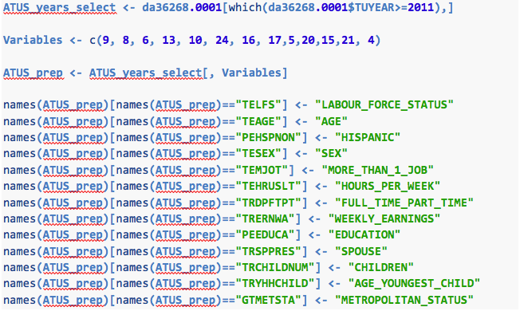
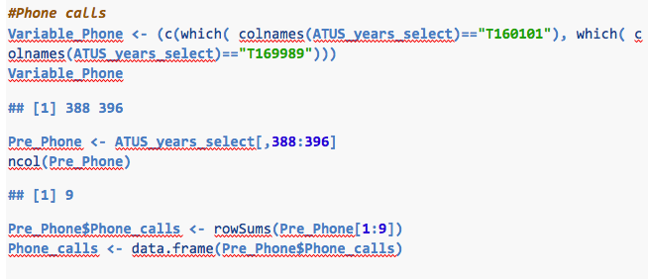
Phase 1 - Step 2 ATUS Dataframe
Selecting Demographic Variables
Selecting Time Variables (An example)

Slide 23
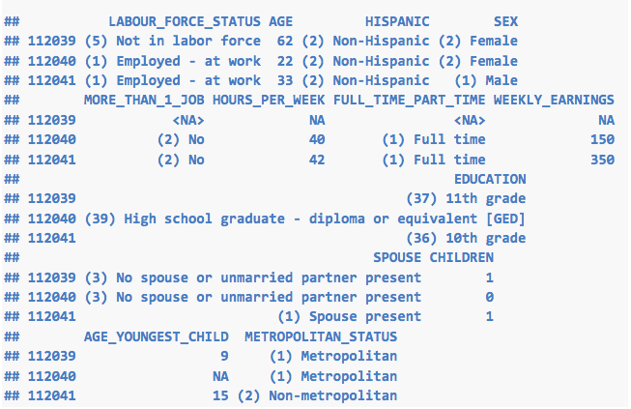
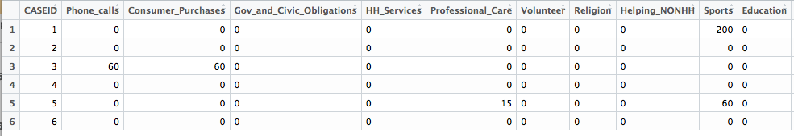
Phase 1 - Step 2 ATUS Dataframe
View Demographic Variables
View Time Variables (An example)

Slide 24
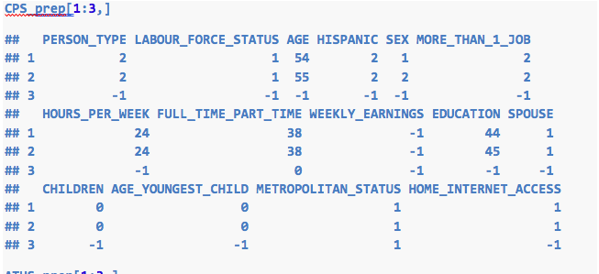
Phase 1 – Step 3 Data Consistency CPS vs. ATUS Demographics
CPS
ATUS

Slide 25
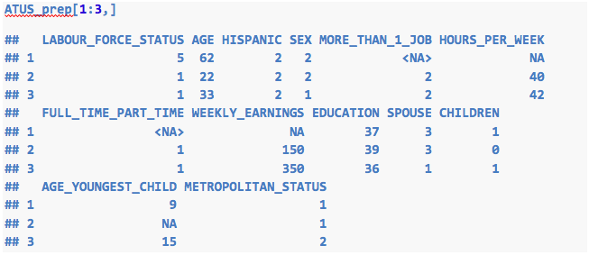
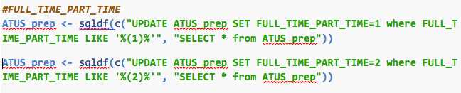
Phase 1 – Step 3 Data Consistency CPS vs. ATUS Demographics
ATUS Update Example
ATUS Result

Slide 26
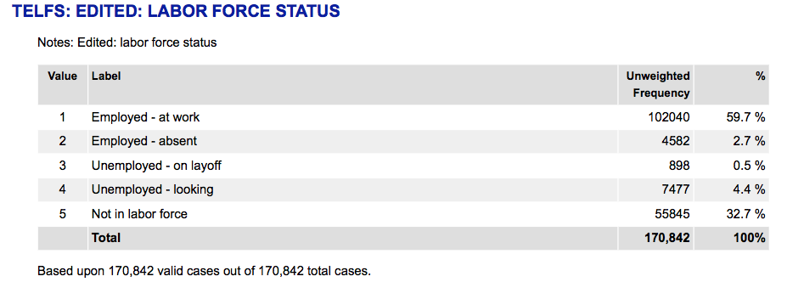
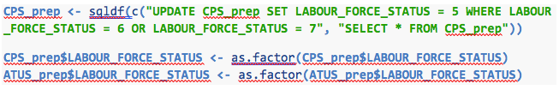
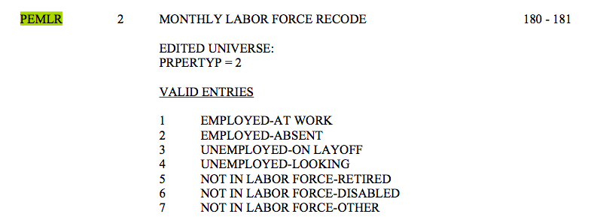
Phase 1 – Step 3 Data Consistency CPS vs. ATUS Demographics
Example: Labour Force Status
R code

Slide 27
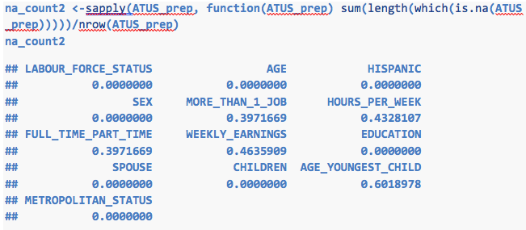
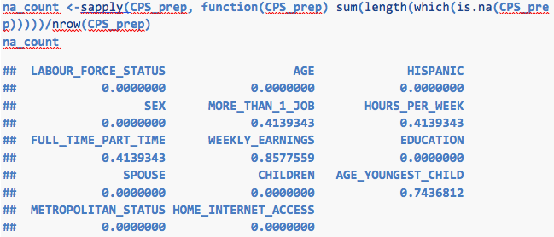
Phase 1 – Step 4 Dealing With Missing Values
NAs in ATUS
NAs in CPS
NAs in ATUS

Slide 28
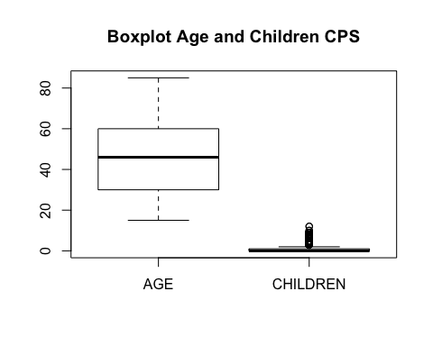
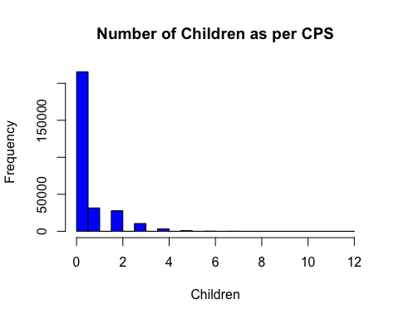
Phase 1 – Step 5 Dealing Outliers
CPS Demographics
Children

Slide 29
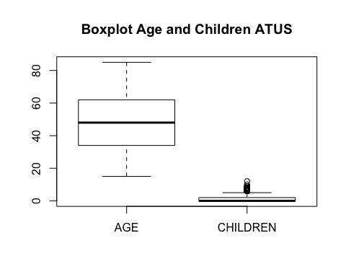
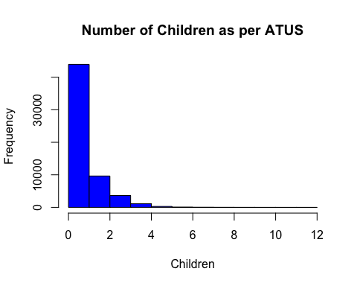
Phase 1 – Step 5 Dealing Outliers
ATUS Demographics
Children

Slide 30
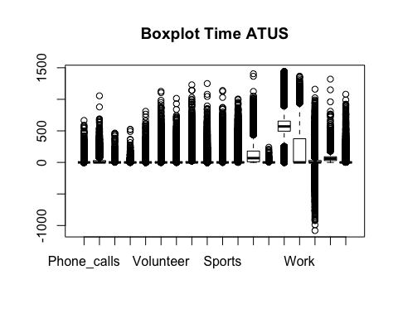
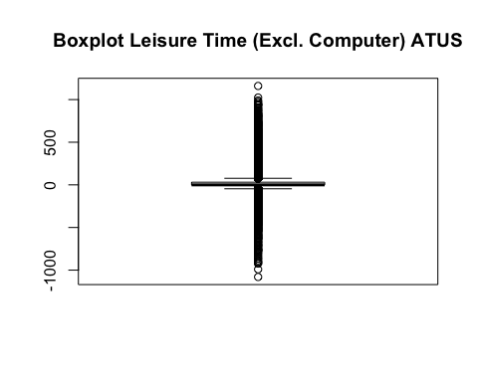
Phase 1 – Step 5 Dealing Outliers
ATUS Time Variables
Leisure Time

Slide 31
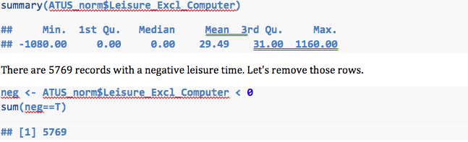
Phase 1 – Step 5 Dealing Outliers

Slide 32
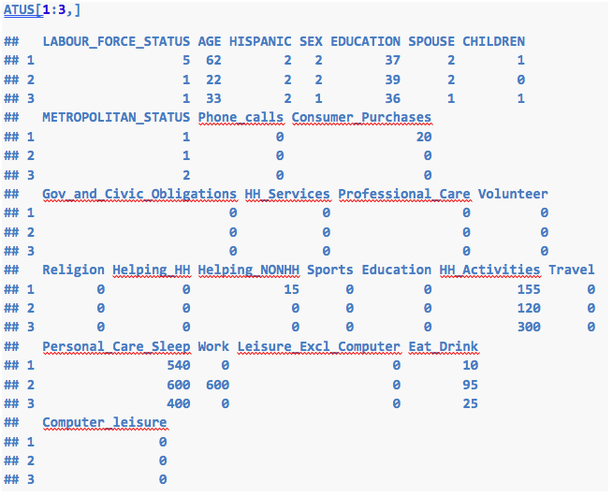
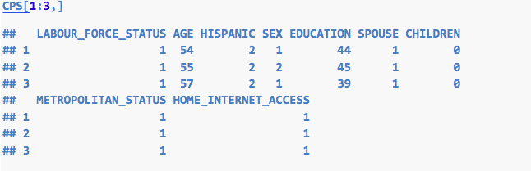
Phase 1 – Step 6 Final Datasets

Slide 33
PHASE 2

Slide 34
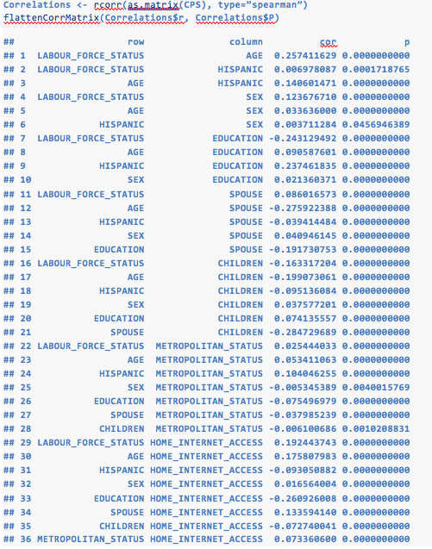
Phase 2 – Step 1 Correlation

Slide 35
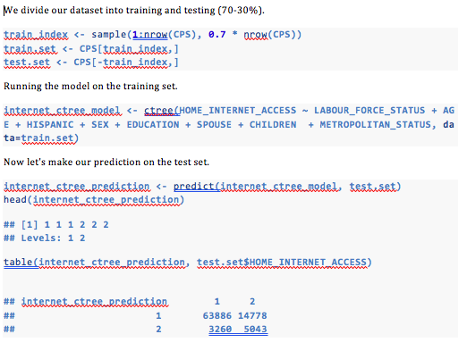
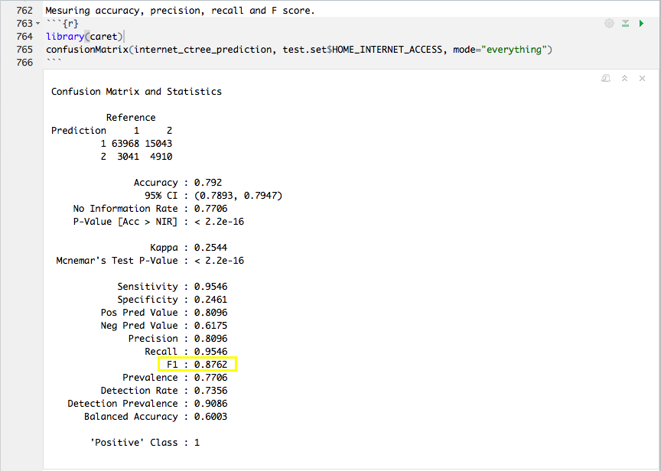
Phase 2 – Step 2 Conditional Inference Tree Building

Slide 36
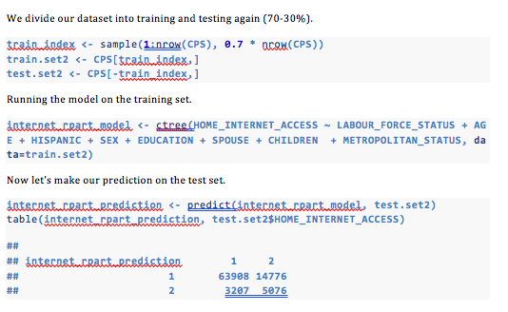
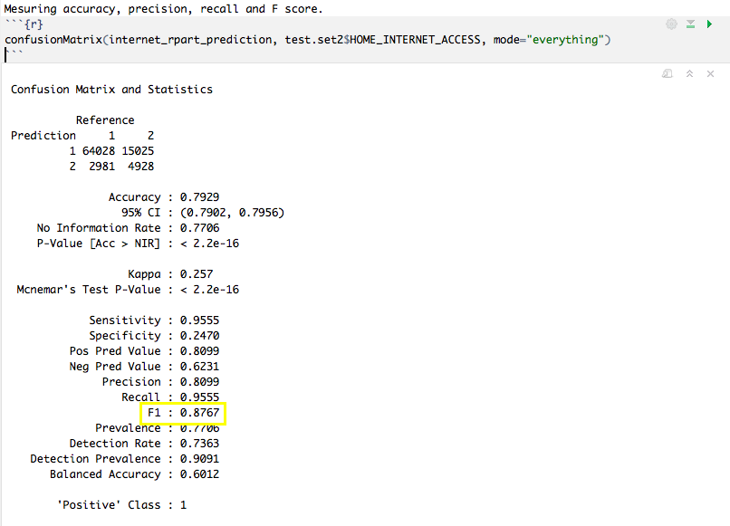
Phase 2 – Step 3 Traditional Decision Tree Building

Slide 37
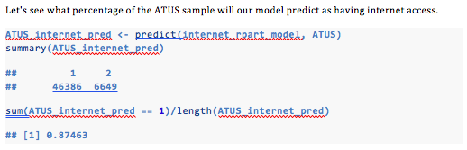
Phase 2 – Step 4 and Step 5 Decision Tree Application on the ATUS Dataset ‘Who has Internet’
Percentage Comparison
Our model estimates 87%
Note: we only took years 2011, 2013 and 2015 and averaged them
According to PEW Research Center: the averaged percentage of population using the Internet from 2011 to 2015 is 84%.

Slide 38
PHASE 3

Slide 39
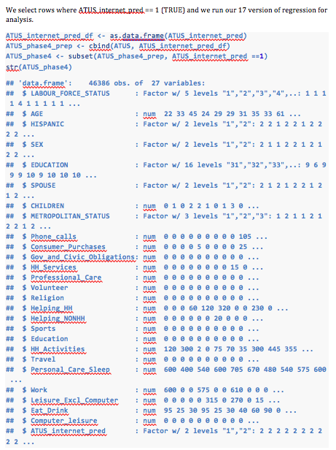
Phase 3 – Step 1 Linear Regression Analysis

Slide 40
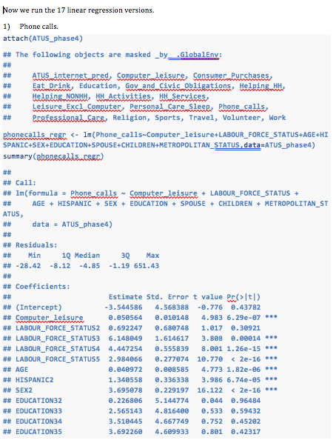
Phase 3 – Step 1 Linear Regression Analysis

Slide 41
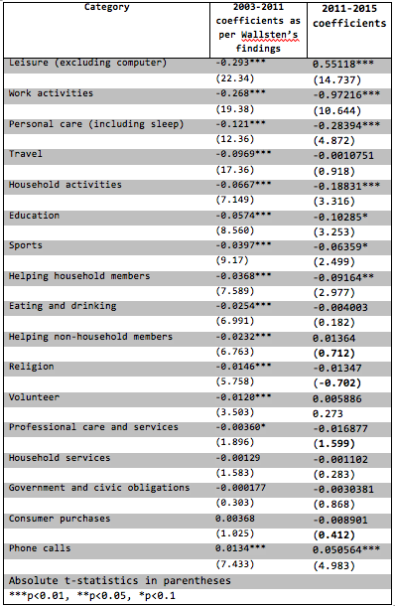
Phase 3 – Findings and Conclusions
Estimated Crowdout Effects of Computer Leisure on Major Categories

Slide 42
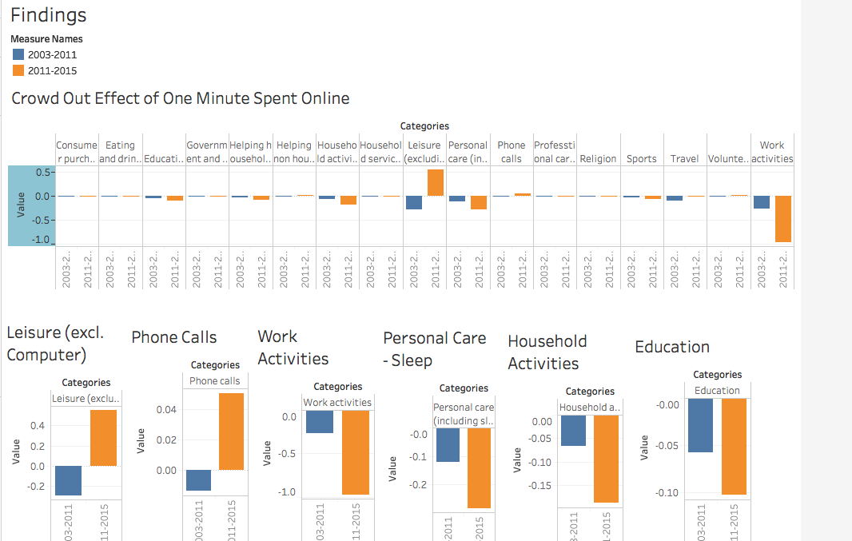
Findings Visualization Using Tableau
Notes:
Leisure offline – Listening to music, watching movies now done online
Leisure category includes social communication and hosting or attending social functions, watching television, reading, relaxing or thinking, playing or listening to music or other activies such as attending arts. We have not included leisure activities on the computer in this category (i.e. playing on the computer).
> From 2003 to 2011: 1 minute of online leisure activity translated into 0.29 fewer minutes spent on all other types of leisures
> From 2011 to 2015: 1 minute of online leisure activity translates into 0.55 more minutes spent on all other types of leisure.
An explanation of this positive correlation could be due to some of the subcategories, such as watching tv, reading or listening to music, are now activities being done through the internet. It would require further research in order for us to reach to a conclusion regarding this point.
Phone Calls - SKYPE
This category includes time spent in telephone communication, texting and Internet voice and video calling.
From 2003 to 2011: 1 minute of online leisure activity translated into 0.0134 more minutes spent on all other types of leisures
From 2011 to 2015: 1 minute of online leisure activity translates into 0.050564 more minutes spent on all other types of leisure.
Work Activities
This category includes time spent in working, doing activities as part of one’s job, engaging in income-generating activities not as part of one’s job, and job search activities.
From 2003 to 2011: 1 minute of online leisure activity translated into 0.268 fewer minutes spent on all other types of leisures
From 2011 to 2015: 1 minute of online leisure activity translates into 0.97216 fewer minutes spent on all other types of leisure.
PersonalCare and Sleep
This category includes time spent sleeping, grooming (bathing or dressing), health-related, self-care, and personal or private activities.
From 2003 to 2011: 1 minute of online leisure activity translated into 0.121 fewer minutes spent on all other types of leisures
From 2011 to 2015: 1 minute of online leisure activity translates into 0.28394 fewer minutes spent on all other types of leisure.
Household Activity
This category includes time spent by people to maintain their households. For example: housework, cooking, lawn and garden, pet care, vehicle maintenance and repair etc.
From 2003 to 2011: 1 minute of online leisure activity translated into 0.07 fewer minutes spent on all other types of leisures
From 2011 to 2015: 1 minute of online leisure activity translates into 0.18831 fewer minutes spent on all other types of leisure.
Education
This category includes time spent taking classes for a degree or for personal interest (including taking internet or other distance-learning courses), time spent doing research and homework, and time spent taking care of administrative tasks related to education.
From 2003 to 2011: 1 minute of online leisure activity translated into 0.0574 fewer minutes spent on all other types of leisures
From 2011 to 2015: 1 minute of online leisure activity translates into 0.10285 fewer minutes spent on all other types of leisure.

Slide 43
Challenges Faced and Lessons Learnt
Research Related
Technical Related
Qualitative Selection
Age Of Youngest Child and Marital Status
Data Cleaning and Formatting
‘Too good to be true’ Tree
Low F-Score at first
Issues:
Removing NAs rows and replacing those left with mean and mode
Lesson learnt:
It’s not enough to count NAs, it is important to visualize them

Slide 44
Continuity
Research
Technical
Research literature related to my findings and compare the accuracy of my findings to the literatures
Add the 2016 data
Add more graphics
Initial data exploration graphics
More findings such as: crowd-out effect by age and others
Use Wallsten’s Regression Methodology (Internet Prediction) and compare with DT
Notes:
Overfitting:
Visualize distribution prior to DT
Kappa
Randomized Lasso to overcome over-fitting

Slide 45
Packages and Tools
library("ggplot2")
library("lattice")
library("Formula")
library("survival")
library("Hmisc")
library(grid)
library(mvtnorm)
library(modeltools)
library(stats4)
library(strucchange)
library(zoo)
library(party)
library(sandwich)
library(caret)
library(rpart)
library(randomForest)
library(caTools)
library(sqldf)
library(RMySQL)

