Slide 1
Analyzing and Classifying Speech Emotions
Natural Language Processing (NLP)

Slide 2
Table of Content
01
02
03
04
Introduction
Dataset Description
Methodology
Results and Conclusion

Slide 3
01
Introduction

Slide 4
Introduction
This project is important as it enables real-time facial emotion recognition, which can enhance user experiences in fields like healthcare, marketing, and education. It helps systems better understand and respond to emotional states, making technology more human-centric.
Additionally, the project strengthens skills in machine learning and computer vision, offering valuable hands-on experience. It contributes to the development of smarter, more empathetic AI applications and provides data for future research in emotional intelligence.
What is the importance of facial-emotions detection?
ANGRY – CONTEMPT - DISGUSTED - AFRAID - HAPPY - NEUTRAL – SAD - SURPRIZED

Slide 5
02
Dataset Description

Slide 6
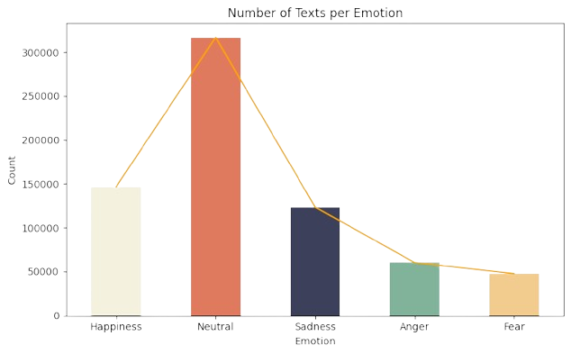
Dataset Description

Slide 7
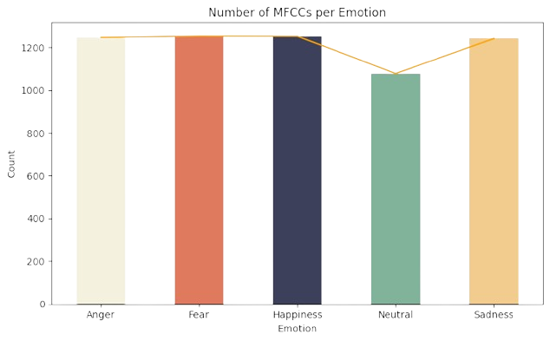
Dataset Description

Slide 8
03
Methodology

Slide 9
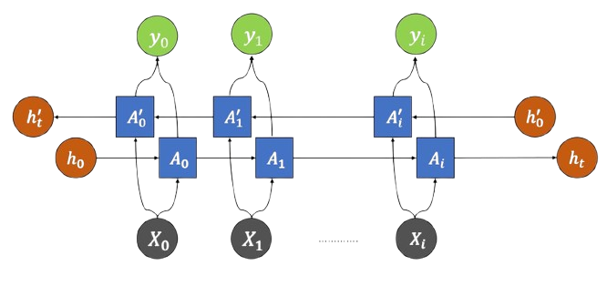
Models Architecture
SimpleRNN: A basic recurrent neural network that captures short-term
dependencies in sequences using a single hidden state updated at
each time step. It is lightweight and fast but less effective for long
sequences.
LSTM (Long Short-Term Memory): An advanced RNN designed to
capture long term dependencies with memory cells regulated by input,
forget, and output gates. It effectively handles vanishing gradients,
making it suitable for complex sequence tasks.
GRU (Gated Recurrent Unit): A simplified gated RNN variant that uses
update and reset gates to manage information flow without a separate
cell state. It balances efficiency and performance, making it ideal for
real-time applications like audio emotion recognition.
Bidirectional RNNs: These process sequences in both forward and backward directions, enabling the model to utilize context from past and future tokens simultaneously, enhancing performance in language and speech tasks.

Slide 10

Text Pipeline
Normalize text by expanding contractions and removing stop words
Generate lexicon-based emotion scores per sample
Perform POS tagging and encode POS sequences
Embed words with pre-trained Word2Vec vectors
Process word and POS embeddings through parallel bidirectional RNN layers
Concatenate RNN outputs with lexicon scores and apply dense layers with dropout
Train using Adam optimizer for 10 epochs
Select and save the best-performing model for final classification

Slide 11

Audio Pipeline
Extract MFCC features from raw audio
Apply zero-padding to standardize sequence length
Use Conv2D and MaxPooling layers to capture local audio patterns
Employ bidirectional RNNs (LSTM, GRU, SimpleRNN) with self-attention to highlight important time steps
Pass through dense layers with dropout for robust classification
Train using Adam optimizer for 20 epochs
Save the best-performing model for deployment

Slide 12
04
Results and Conclusion

Slide 13
Results
Type | Text | Audio
Best Model | BiLSTM | BiGRU
Accuracy | 72% | 68%
Strength | Captures contextual dependencies effectively | Strong temporal modeling with lower complexity
Insights:
Trade-off between dataset size and model generalization
Modular pipeline design supports flexible multimodal use

Slide 14
Conclusion
This study demonstrated the effectiveness of deep learning models for emotion classification using text and audio. The Bidirectional LSTM performed best for textual data, while the Bidirectional GRU excelled with audio inputs, both offering strong performance within resource-constrained environments. The modular design supports flexible deployment for real-time, mobile-friendly applications, making the system suitable for affective computing and intelligent agents.

Slide 15
Thank you !
Do you have any questions?

