Slide 1
Analyzing and Classifying Speech Emotions
Natural Language Processing (NLP)

Slide 2
Factors in Play
01
02
03
04
Emotions
Tools
Results
Demo

Slide 3
Introduction
This project is important as it enables real-time facial emotion recognition, which can enhance user experiences in fields like healthcare, marketing, and education. It helps systems better understand and respond to emotional states, making technology more human-centric.
Additionally, the project strengthens skills in machine learning and computer vision, offering valuable hands-on experience. It contributes to the development of smarter, more empathetic AI applications and provides data for future research in emotional intelligence.
What is the importance of facial-emotions detection?
ANGRY – CONTEMPT - DISGUSTED - AFRAID - HAPPY - NEUTRAL – SAD - SURPRIZED

Slide 4
01
The emotions
DATA SET DESCRIPTION

Slide 5
Data Description
The dataset consists of a total of 29,262 images
Training
=> 17,101 images
Validation
=> 5,406 images
Testing
=> 2,755 images

Slide 6
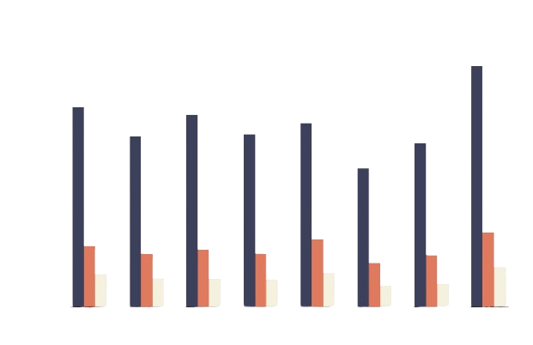
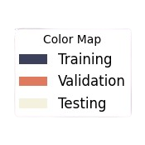
Data Description
ANGER
CONTEMPT
DISGUST
FEAR
HAPPY
NEUTRAL
SAD
SURPRISE

Slide 7
02
The tools
Classification and Detection Models

Slide 8
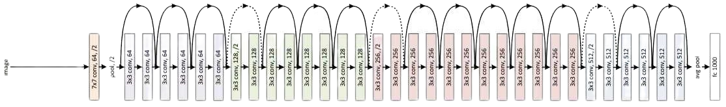
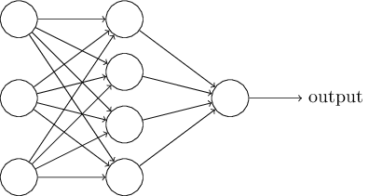
ResNETT 152
Fully Connected Layers
Dense | 256 | 524,544
Dense | 8 | 2,056
Architecture
Use OpenCV face Cascade to get frame
Add ResNet152 for feature extraction
Flatten the feature maps resulted from the resNet
Add 1 hidden ‘relu’ layer
Output Layer (8 Emotions)

Slide 9
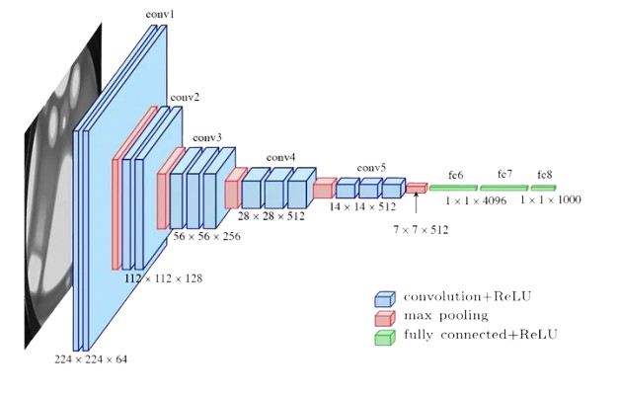
YOLO (you only learn once) v10
A real-time object detection algorithm that simultaneously predicts multiple bounding boxes and class probabilities for objects in an image, enabling fast and accurate detection.

Slide 10
03
The Results
Failure of Models

Slide 11
Results: FAILED
Both designs failed to create a well-fitted model and resulted in errors, primarily due to the insufficient image resolution of 96 x 96 pixels in the dataset. This resolution was too low to generate a generalized model with strong predictive capabilities, leading to performance issues and poor generalization on new, unseen data.

Slide 12
04
The DEMO
Not Working….?

Slide 13
Check Demo?

Slide 14
Thank you !
Do you have any questions?

