Slide 1
Task 5
Submitted by:
Mohamed Elshamy Omar Abdelwahab Saber Mohamed Naguib Elsayed Naguib

Slide 2
Introduction
This is a data for taxi rides to uncover patterns in fares, distances, and ride characteristics across New York City.

Slide 3
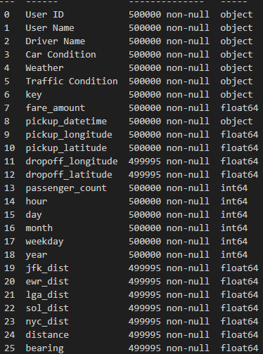
Data Loading & Initial Inspection

Slide 4

Renaming Columns for Clarity
jfk_dist = jfk_airport_distance
lga_dist = lga_airport_distance
ewr_dist = ewr_airport_distance
sol_dist = statue_of_liberty_distance
nyc_dist = nyc_center_distance

Slide 5
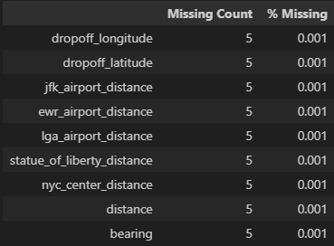
Missing value analysis

Slide 6
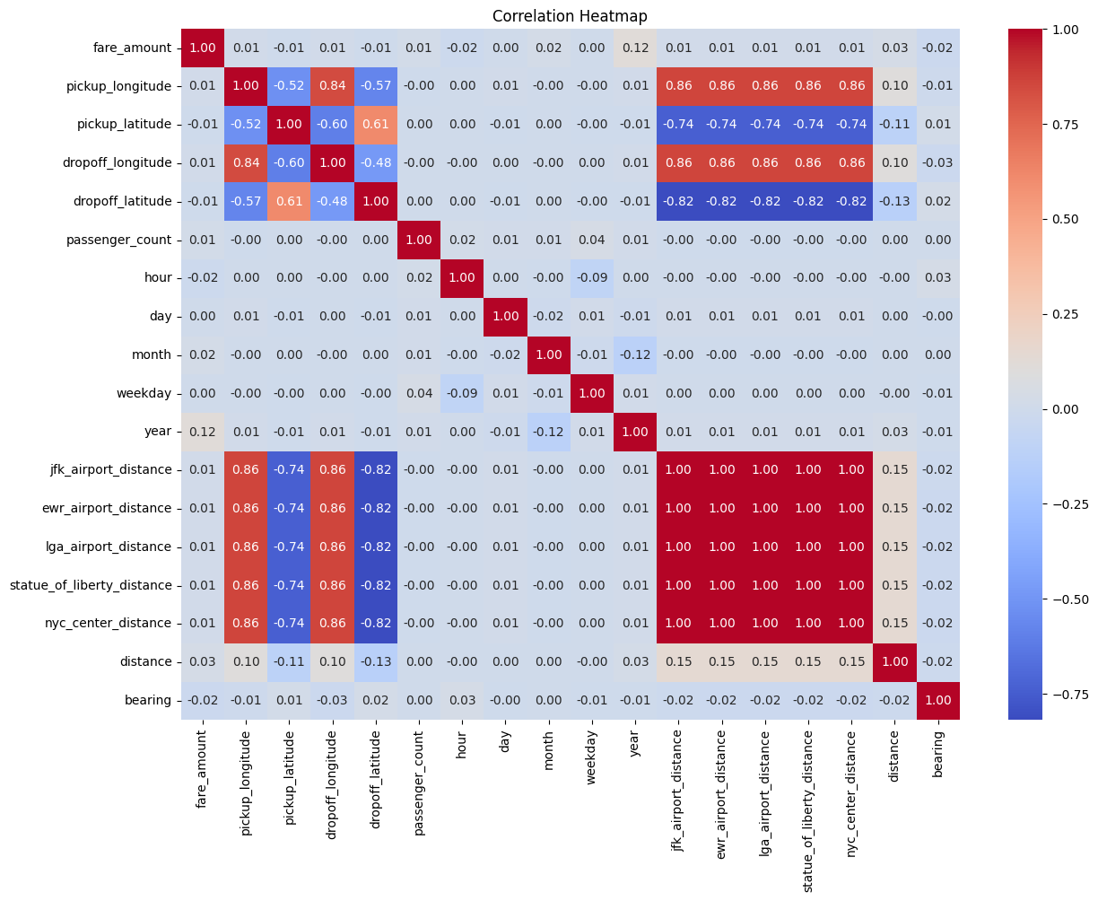
Multicollinearity check

Slide 7
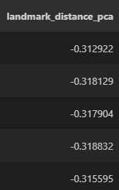
Using PCA to combine multiple distance features into a single representative feature

Slide 8
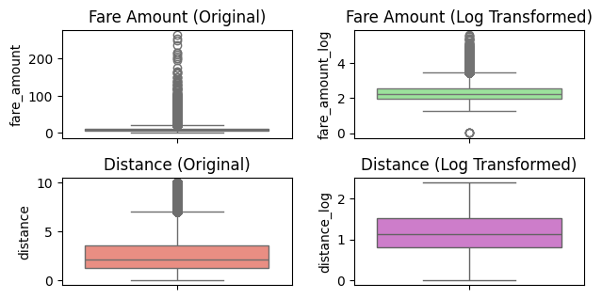
Removing zero/negative values
Setting reasonable value ranges
Log transformation for fare and distance

Slide 9
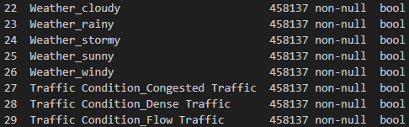
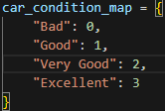
One hot encoding for the Whether and Traffic condition
Map The Car Condition From 0 to 3

Slide 10
Drop Unnecessary Columns

Slide 11
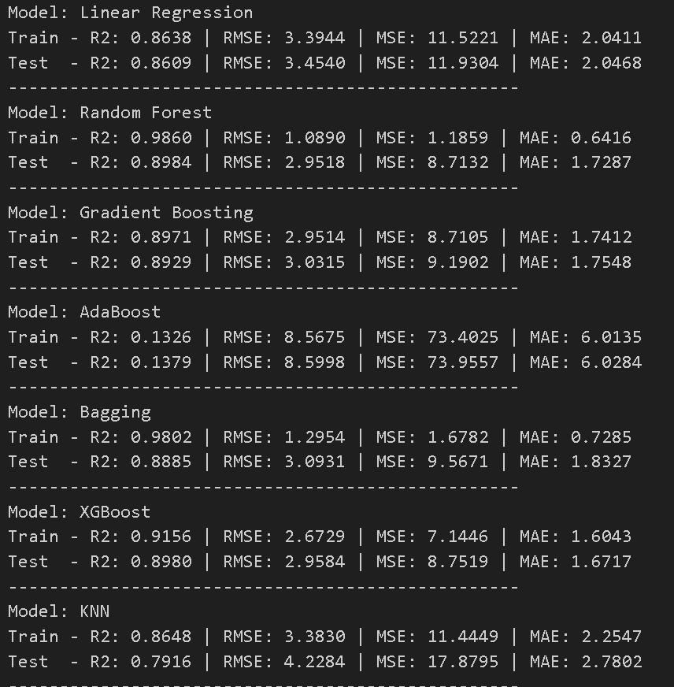
General Comparison For Different models

Slide 12
Select The best xgboost param using RandomizedSearchCV
Subsample = 0.8
N_estimator = 200
Max_depth = 5
Learing rate = 0.01
Colsample_bytree = 0.8

Slide 13
Performance Before and After Tuning
Before:
Mean Squared Error (MSE): 8.7519
Root Mean Squared Error (RMSE): 2.9584
Mean Absolute Error (MAE): 1.6717
R² Score: 0.8980
After:
Mean Squared Error (MSE): 8.6346
Root Mean Squared Error (RMSE): 2.9385
Mean Absolute Error (MAE): 1.6749
R² Score: 0.8993

Slide 14
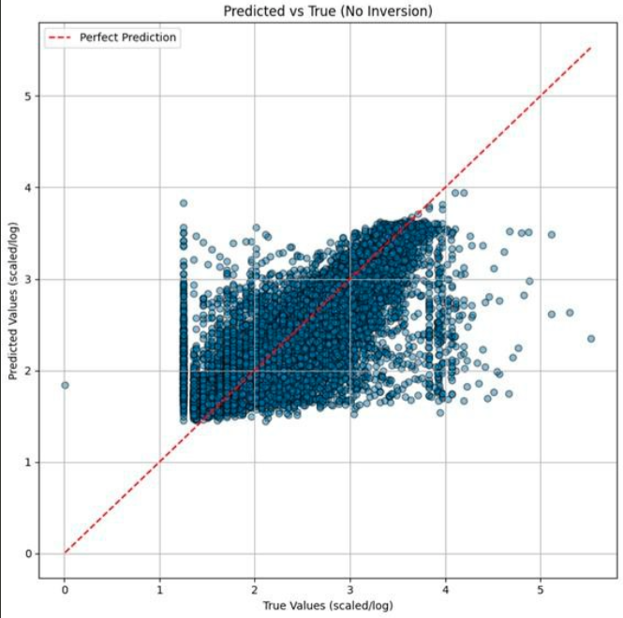
Approach 2

Slide 15
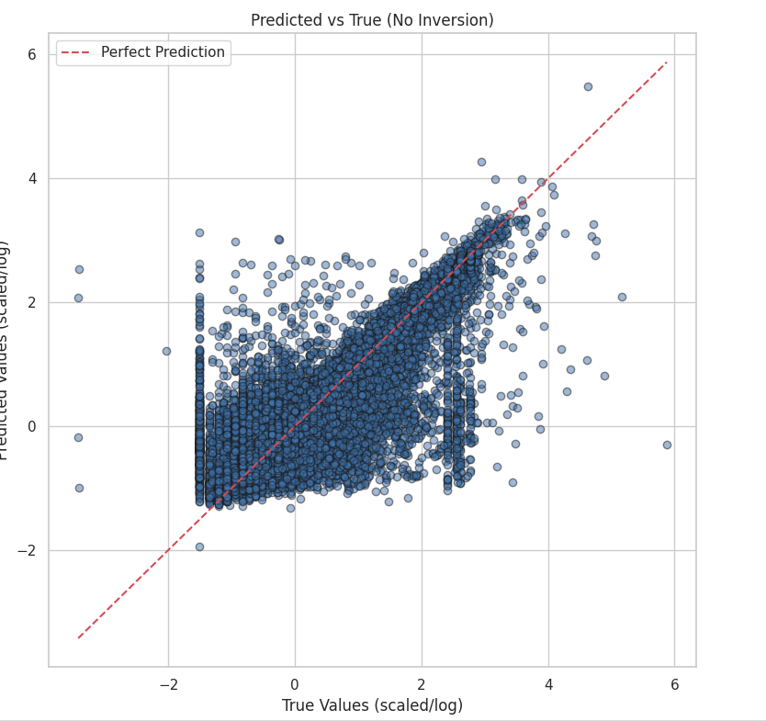
R2 SCORE= 0.83
MAE=0.198
MODEL= XGBOOST
Approach 3

Slide 16
Thank You
Notes:
<number>

