Slide 1
Hotel Booking Data Analysis
Exploratory Data Analysis Report
Key Insights and Recommendations

Slide 2
Executive Summary
• Dataset contains 36,285 hotel bookings with 16 features
• Overall cancellation rate: 32.8% (11,889 cancellations)
• Average booking price: $103.42 (range: $0 - $540)
• Key finding: Canceled bookings have 2.4x longer lead times
• Room Type 1 dominates bookings (75% of all reservations)
• Online market segment is most popular channel

Slide 3
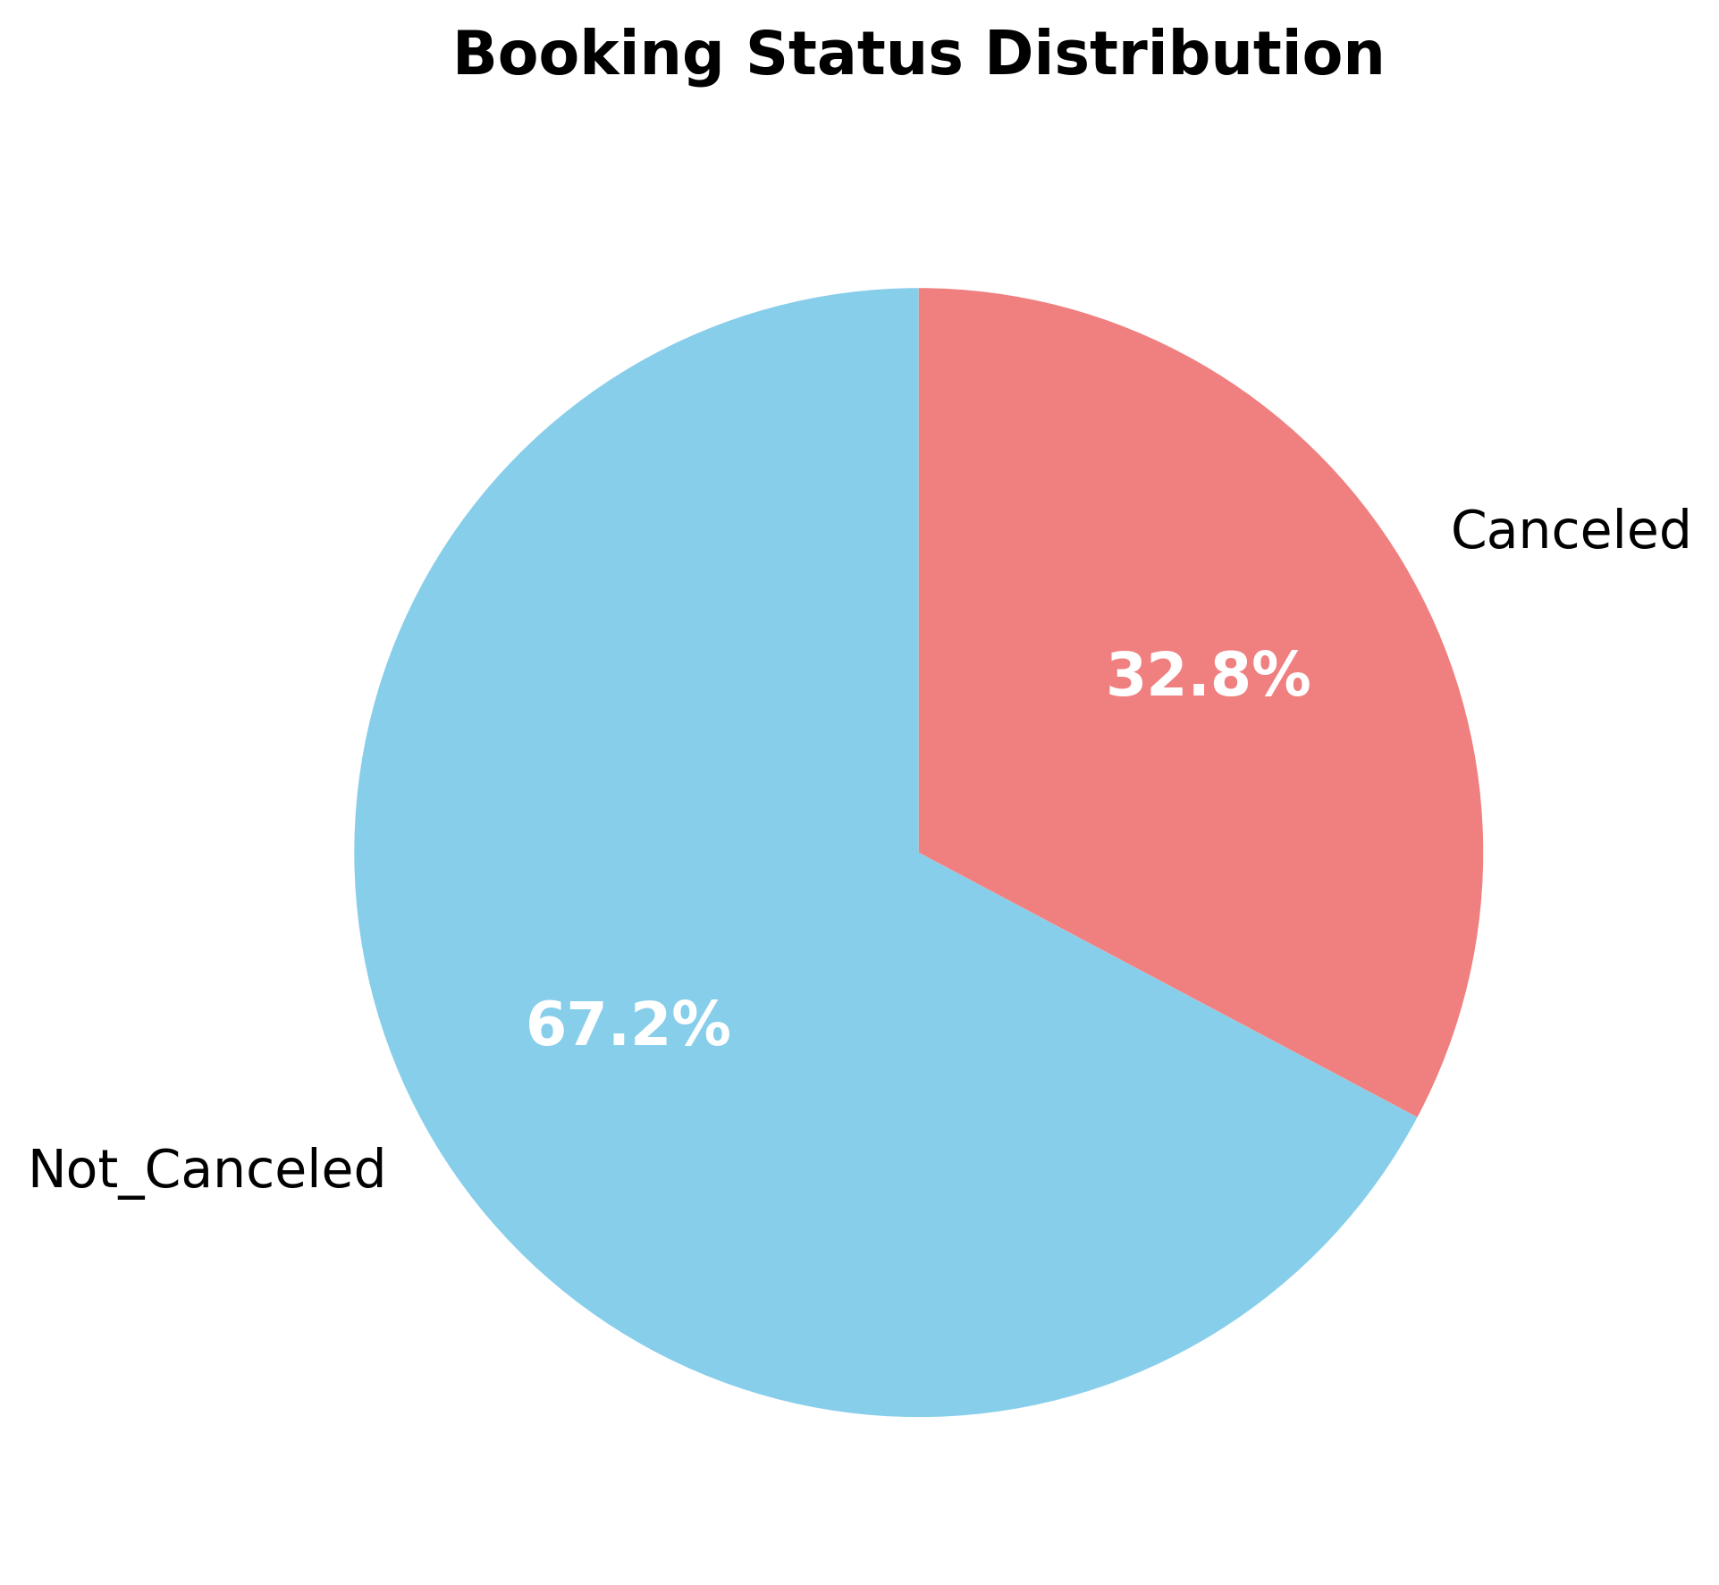
Booking Status Distribution
KEY INSIGHT: 67.2% of bookings are confirmed, while 32.8% are canceled

Slide 4
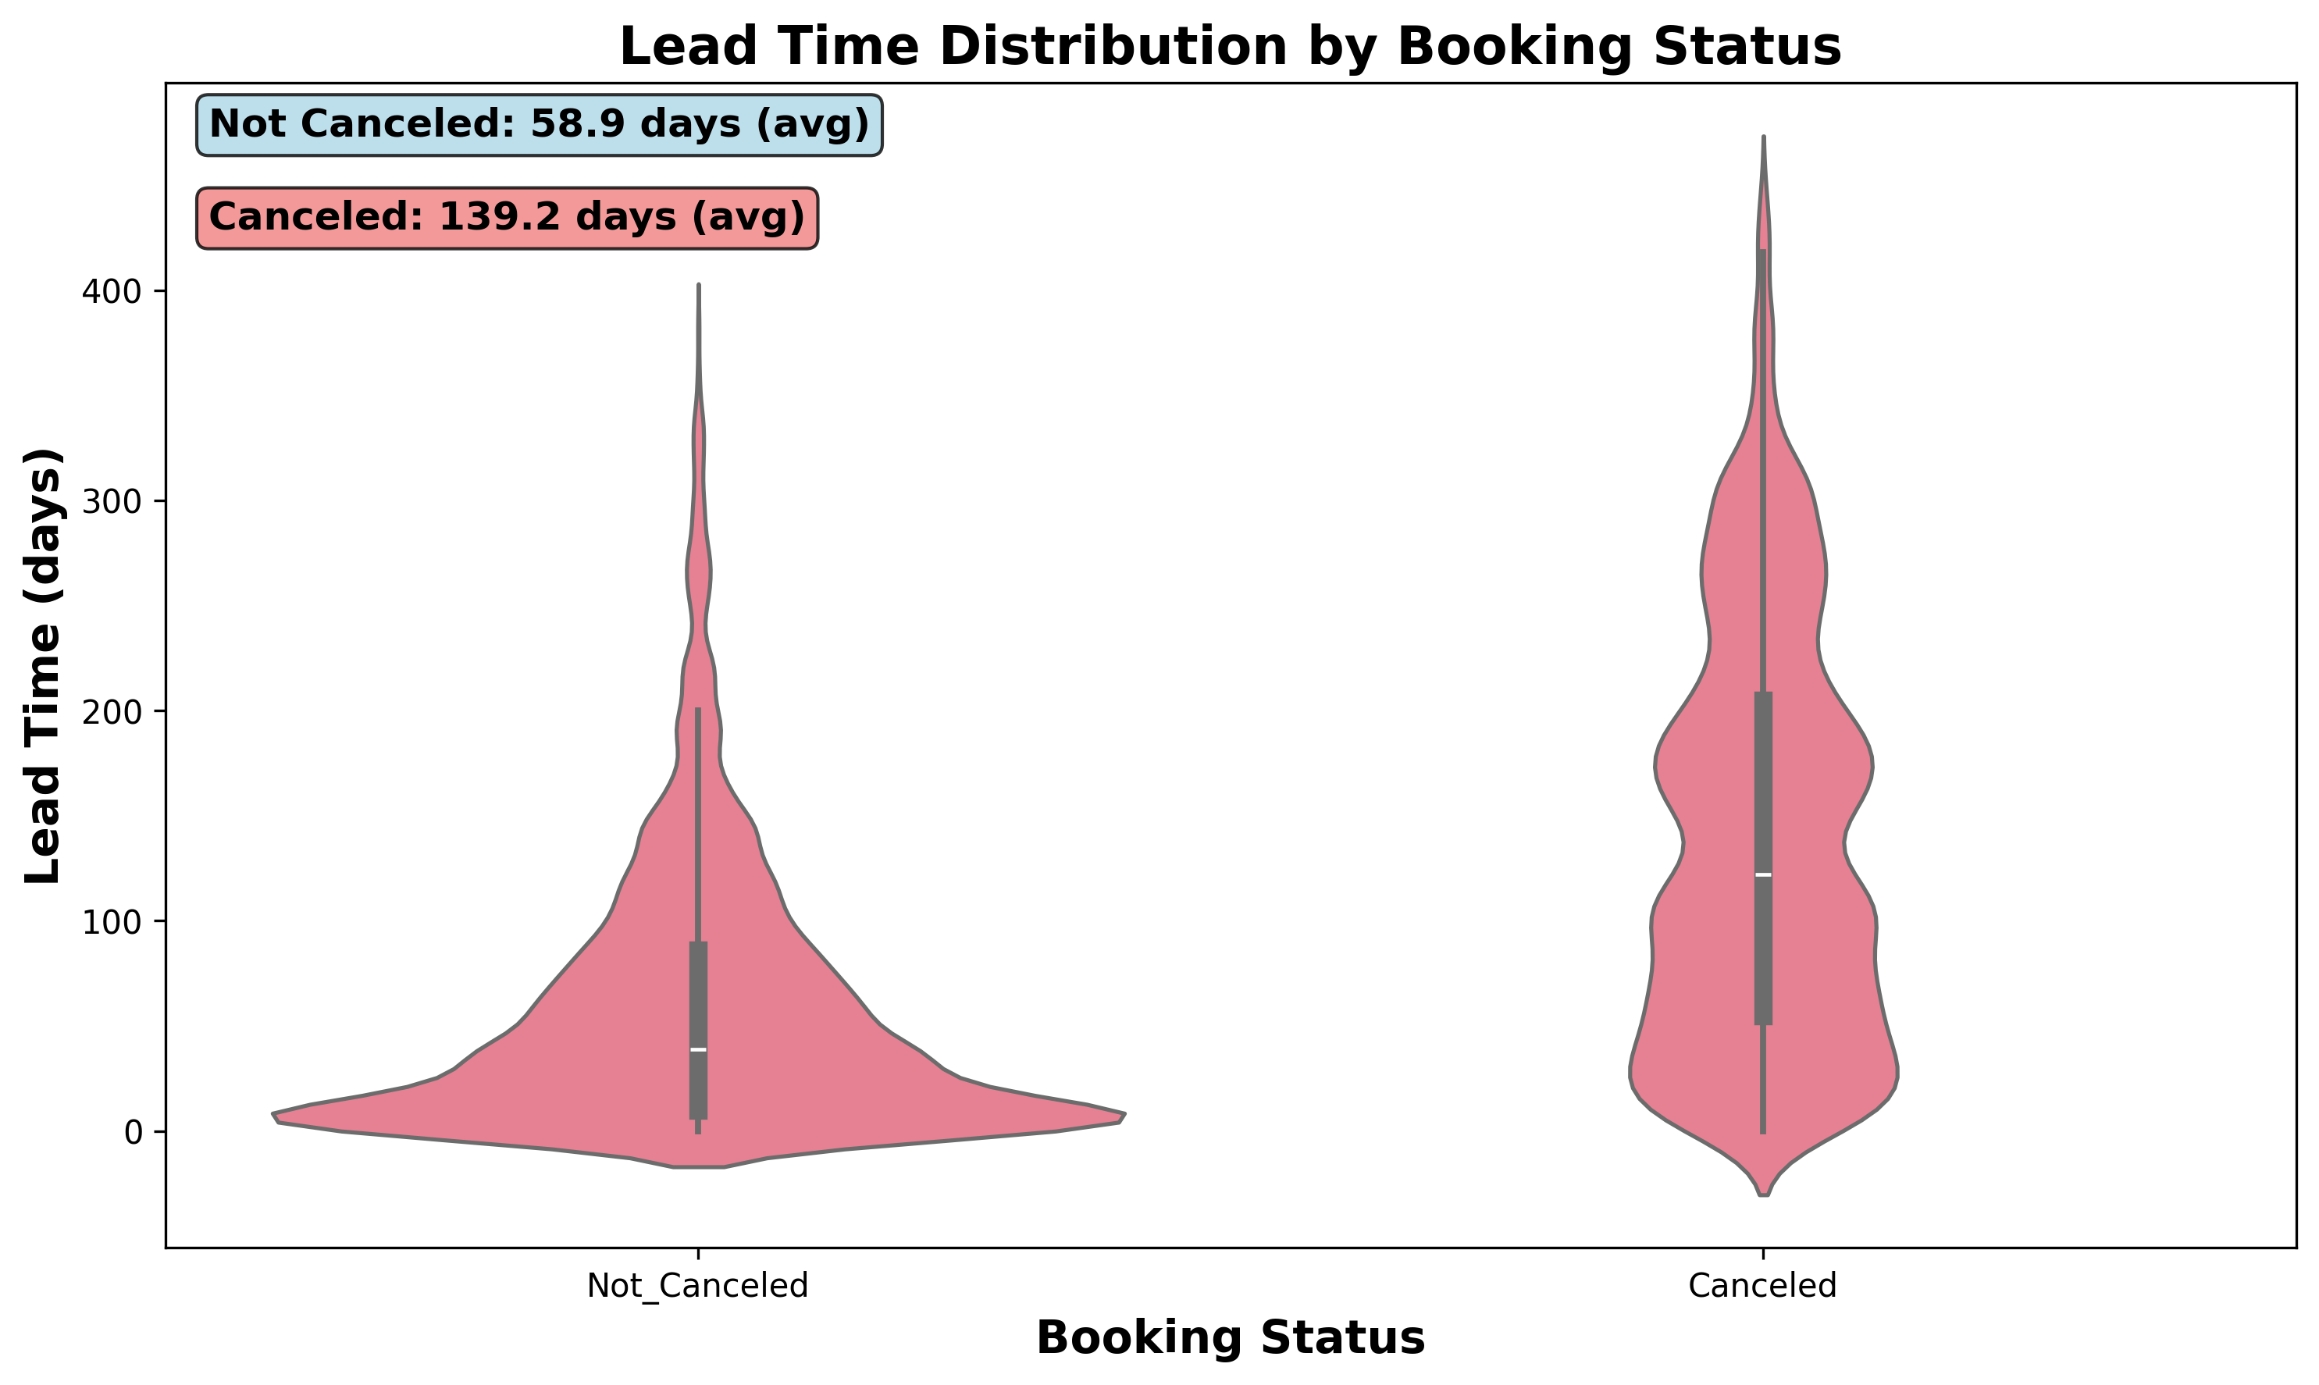
Lead Time Analysis: Key Predictor of Cancellations
CRITICAL FINDING: Canceled bookings have 2.4x longer lead times (139 vs 59 days)

Slide 5
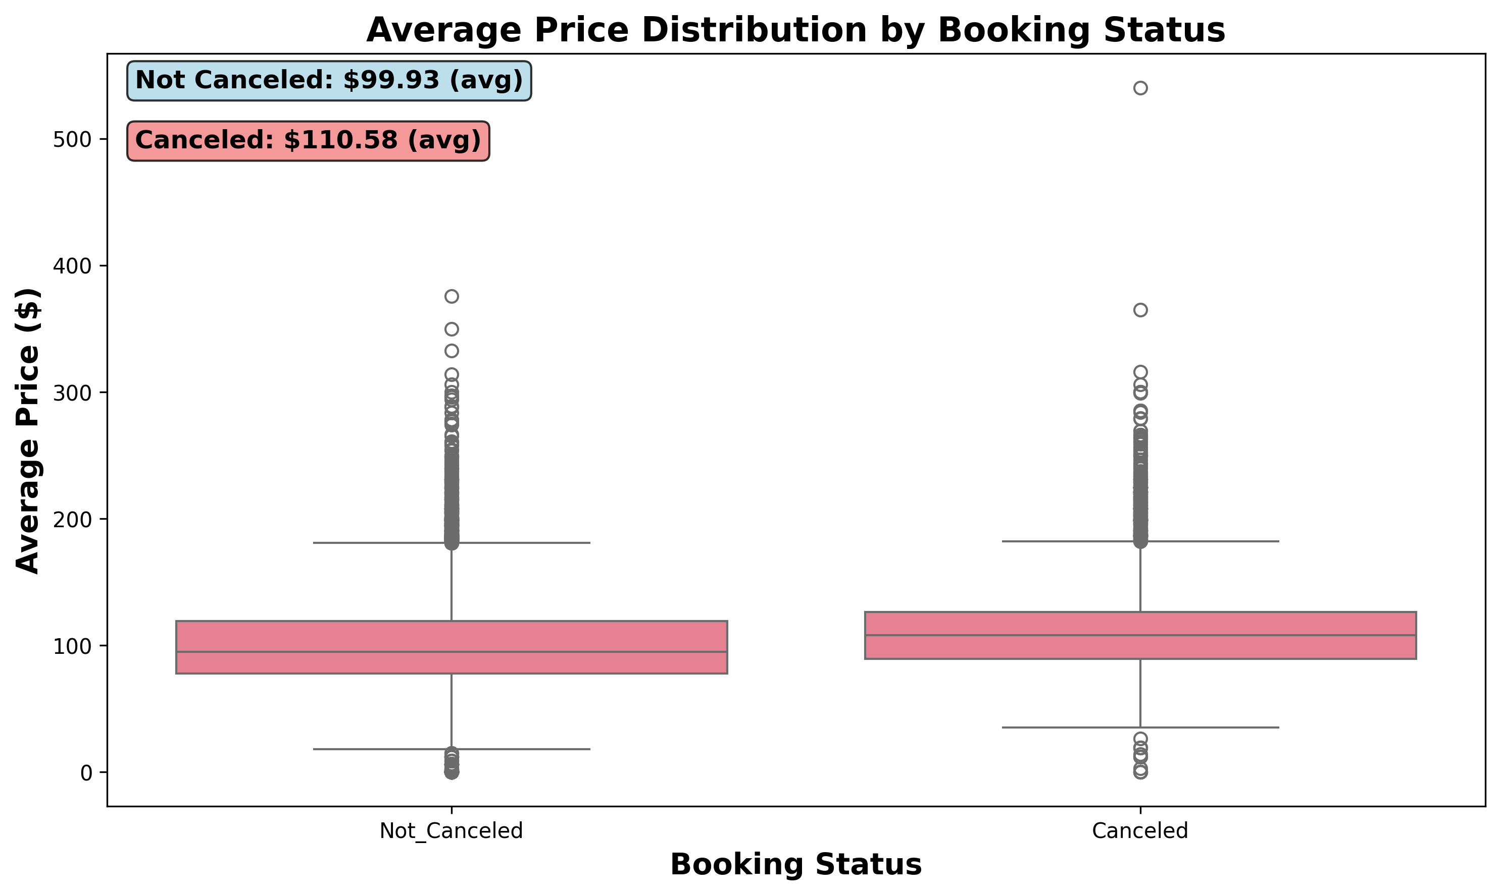
Price Analysis by Booking Status
Average price: $103.42 | Range: $0 - $540

Slide 6
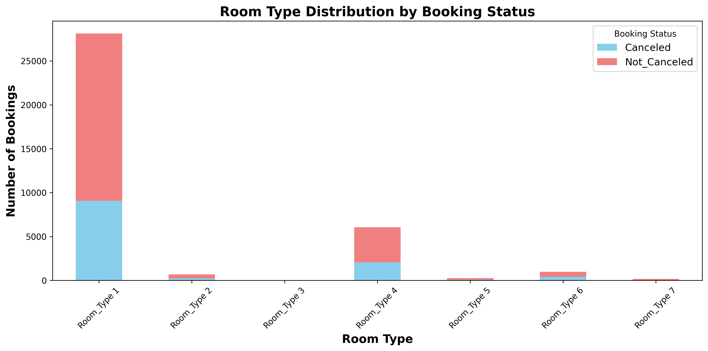
Room Type Distribution by Booking Status
Room Type 1 dominates with 77.5% of all bookings

Slide 7
Key Business Recommendations
🎯 REVENUE OPTIMIZATION
• Implement dynamic pricing for long lead-time bookings (>100 days)
• Offer early booking incentives to reduce cancellation risk
📊 OPERATIONAL IMPROVEMENTS
• Develop cancellation prediction model using lead time as primary feature
• Implement flexible booking policies for high-risk reservations
🏨 INVENTORY MANAGEMENT
• Optimize Room Type 1 availability and pricing (75% of demand)
• Consider overbooking strategies based on historical cancellation patterns
💼 MARKETING STRATEGY
• Focus retention efforts on online segment customers
• Target repeat customers with loyalty programs

Slide 8
Key Performance Metrics
Total Bookings
36,285
Cancellation Rate
32.8%
Avg. Price
$103
Avg. Lead Time
85 days
Most Popular Room
Room Type 1
Primary Channel
Online

Slide 9
Thank You
Questions & Discussion
Hotel Booking Data Analysis
Presented by: Data Analytics Team

