Slide 1


Task 1 – EDA
(before preprocessing)
Presentation

Slide 2

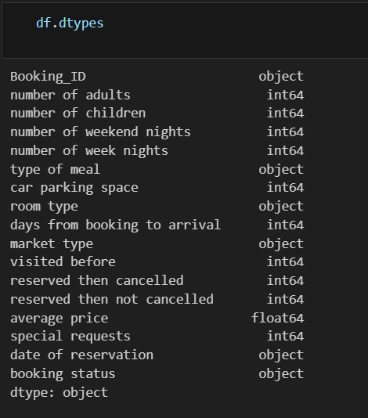
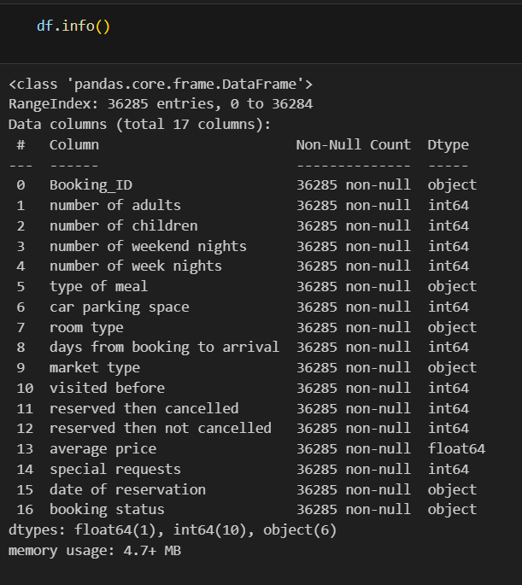

First we know the types of our features to have insight about which features will be encoded from string to integers
Then we check the info of null values and in our case there isn’t any null values

Slide 3
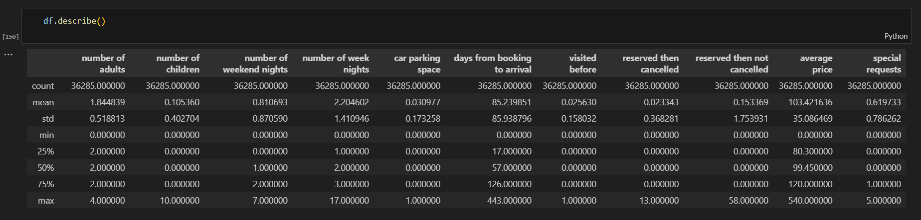
Then by checking the statestics of the data we can see if there exist outliers to handle by the quartiles and have more insights of the features

Slide 4

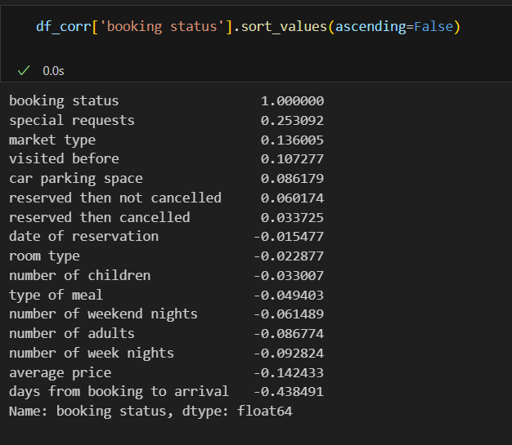
The correlation between features and booking status
most positive relation with special requests
most negative relation with days from booking to arrival (lead time)

Slide 5
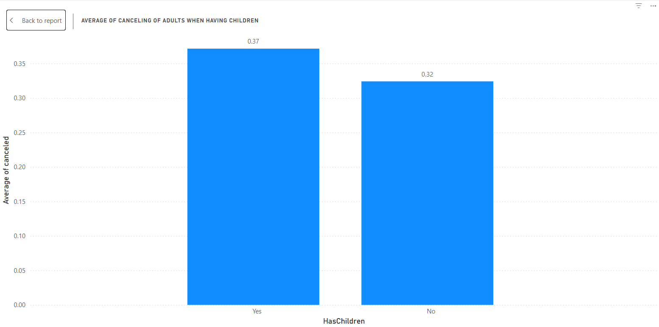
How having a children affects canceling?
Adults have children more likely to cancel with very small percentage effect (not very relevant)

Slide 6
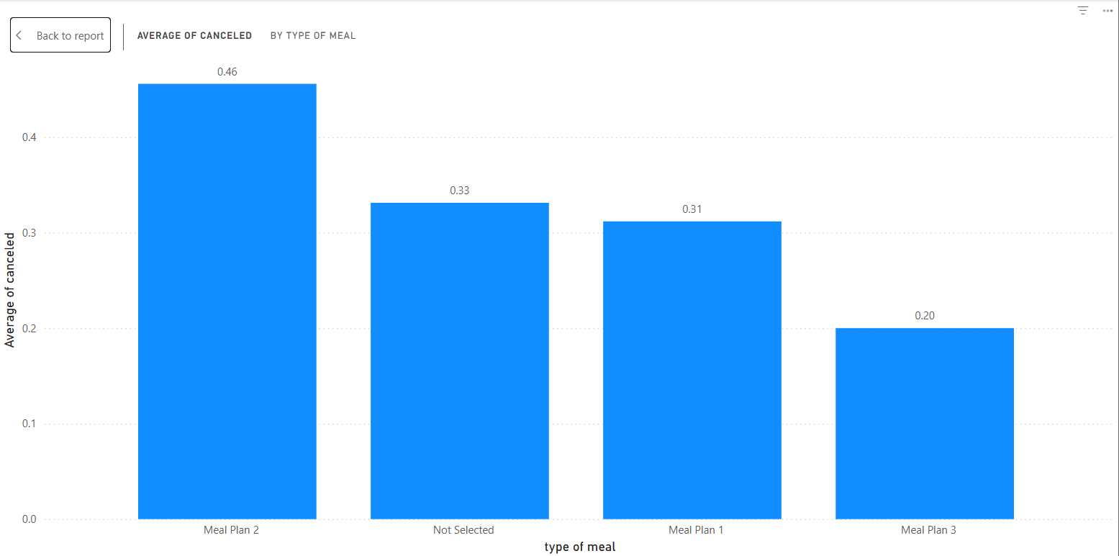
Which type of meal is more reserved when cancel?
Meal plan 2 is a bit higher frequency in canceled booking

Slide 7
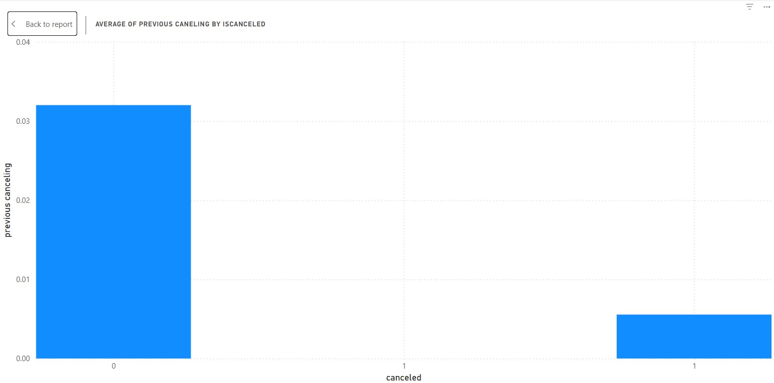
How person who previously canceled reservation
Is more likely to act?
Its more likely to not cancel the booking

Slide 8
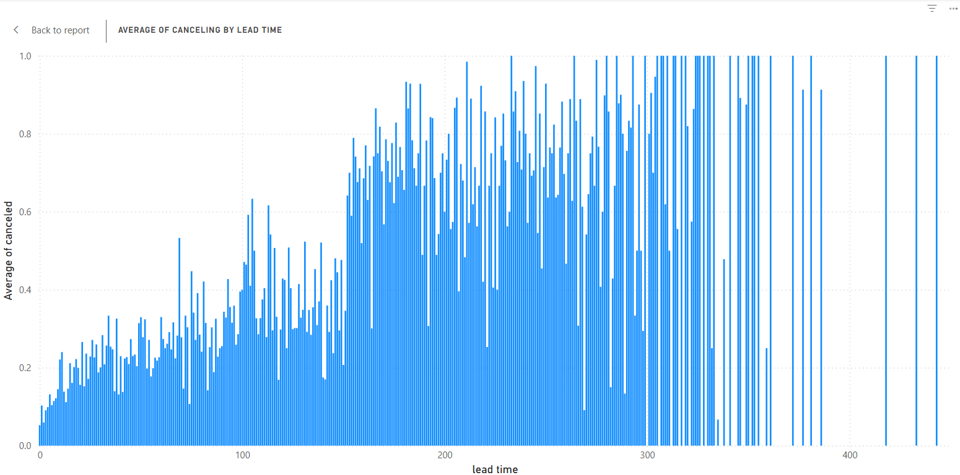
How lead time affects cancel average?
There is direct relation ship between them
Person more likely to cancel the higher the lead days are

Slide 9
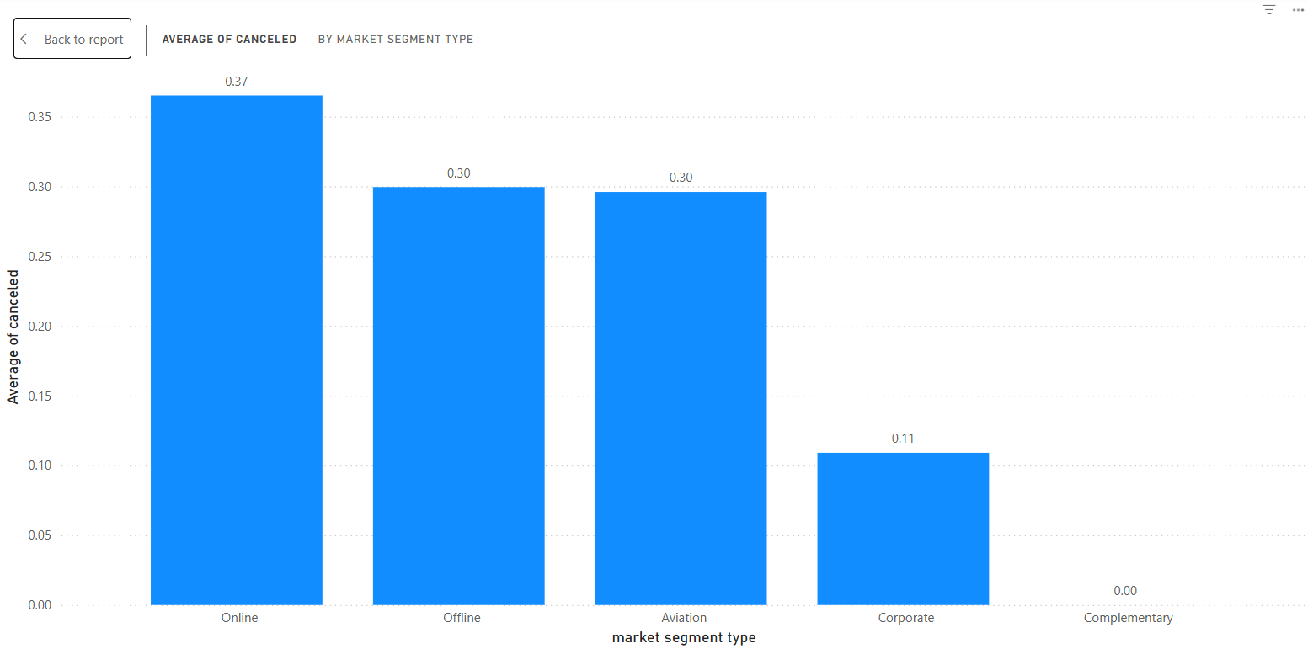
Which segment type are more likely to cancel?
Online are more likely to cancel
Offline and aviation are the same
Corporates are more committed to the reservations

Slide 10
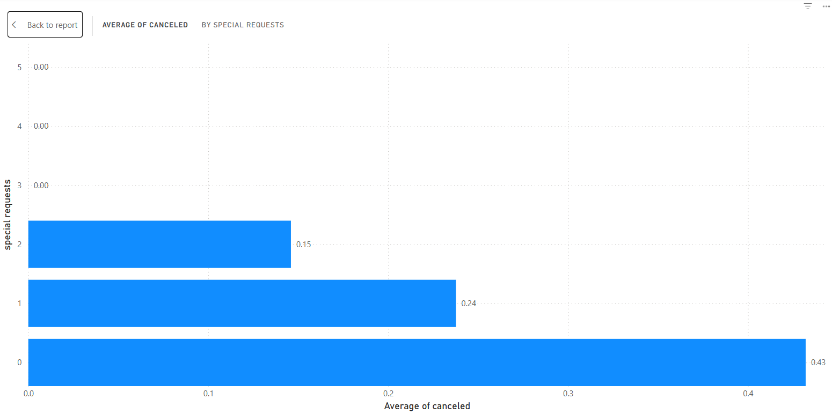
How special requests affects cancel average?
The higher the number of requests the more likely it won’t be canceled

Slide 11
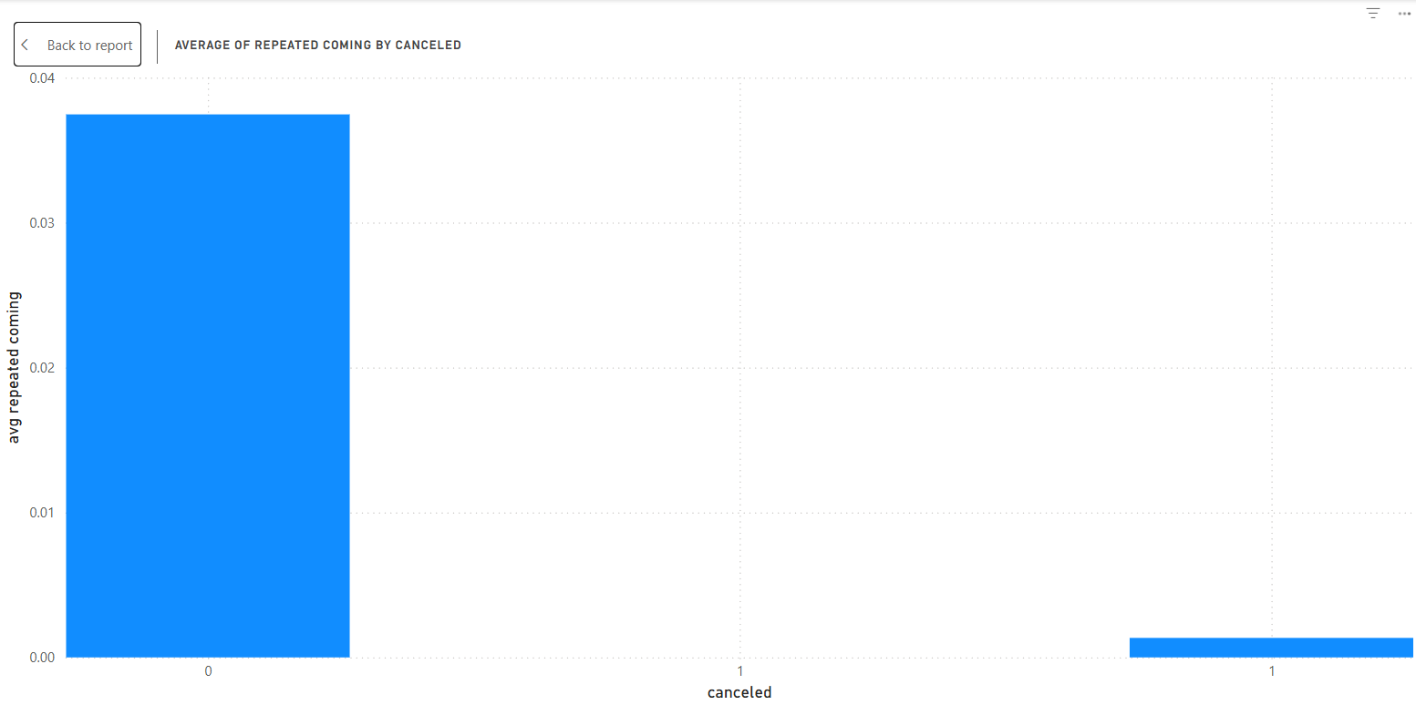
Does repeated visits affects the cancel avg?
Yes, people don’t cancel are mostly have repeated visits

Slide 12
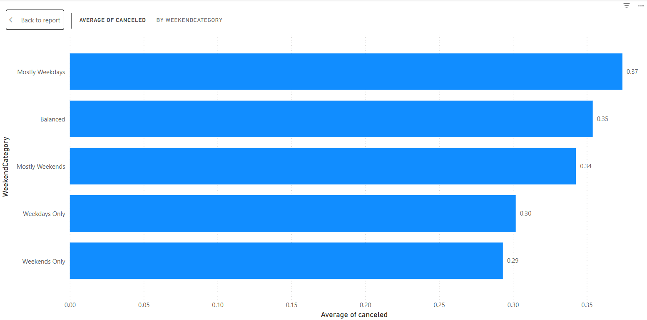
By calculating of weekend percentage of total days, how that affects cancel rate?
People reserve more weekend days are more likely to cancel

Slide 13
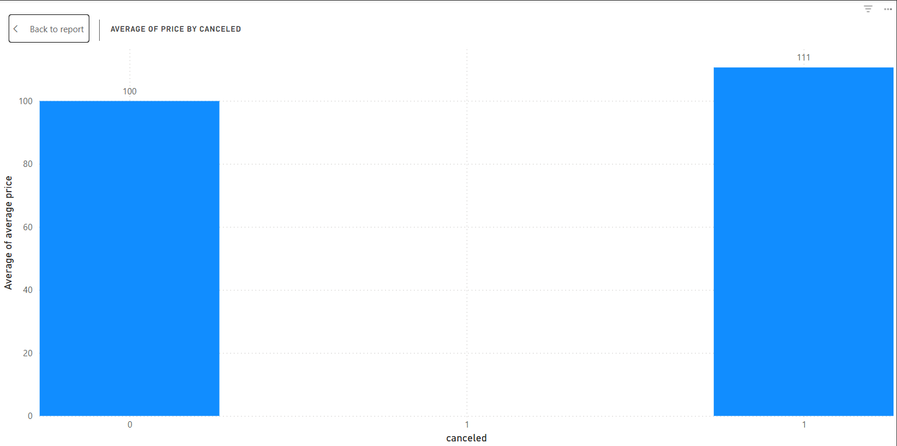
How avg of price affects canceling?
The difference is not very big but high average price has higher risk of canceling

