Slide 1













Hotel
EDA
Presented By
Mohamed Naguib

Slide 2

Description
Booking_ID – Unique identifier for each booking.
number of adults – Number of adults included in the booking.
number of children – Number of children included in the booking.
number of weekend nights – Nights stayed during weekends.
number of week nights – Nights stayed during weekdays.
type of meal – Type of meal plan selected .
car parking space – Indicates if a parking space was reserved.
room type – Category of room booked (e.g., Standard, Deluxe).
lead time – Days between reservation date and arrival.
market segment type – Source of the booking (e.g., Online, Corporate).
repeated – Indicates if the guest is a returning customer (1 = yes, 0 = no).
P-C – Number of previous cancellations.
P-not-C – Number of previous non-canceled bookings.
average price – Average price per night.
special requests – Count of special requests made
date of reservation – Date when the booking was made.
booking status – Final status of booking.

Slide 3
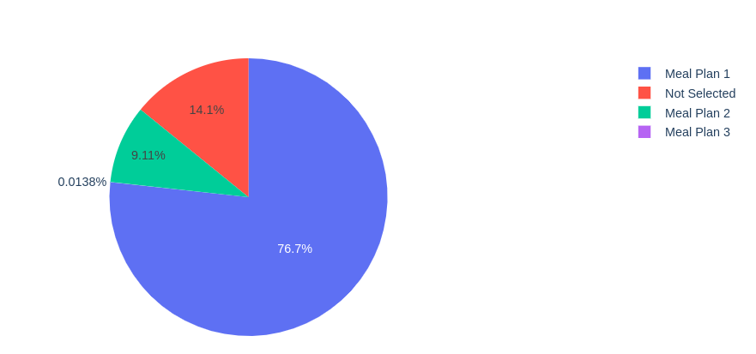
Distribution of Selected Meal Type
The graph shows that Meal plan 1 is more favoured

Slide 4
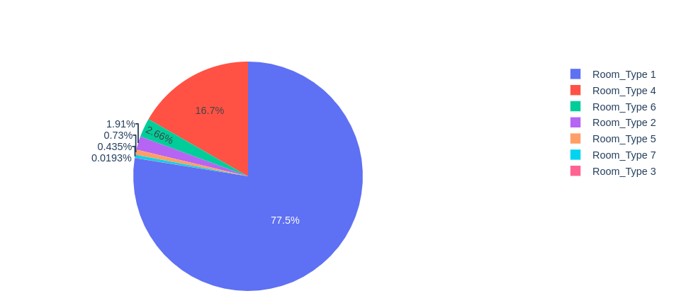
Distribution of Selected Room Type
The graph shows that Room type 1 is more favoured

Slide 5
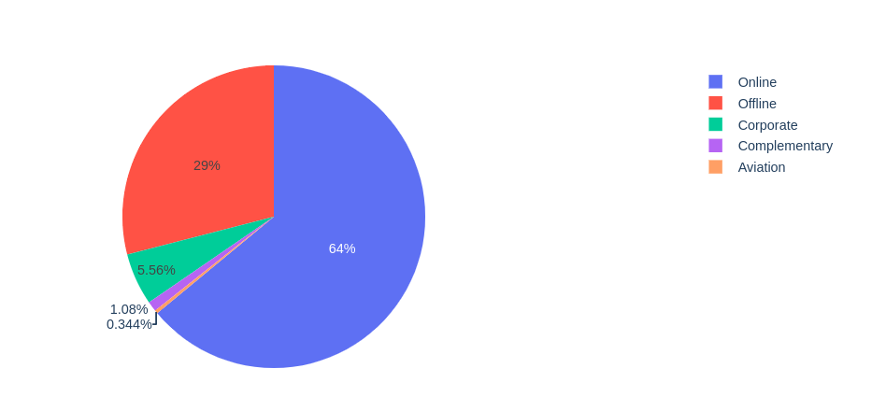
Distribution of Selected Payment Type
The graph shows that Online is most favoured payment type

Slide 6
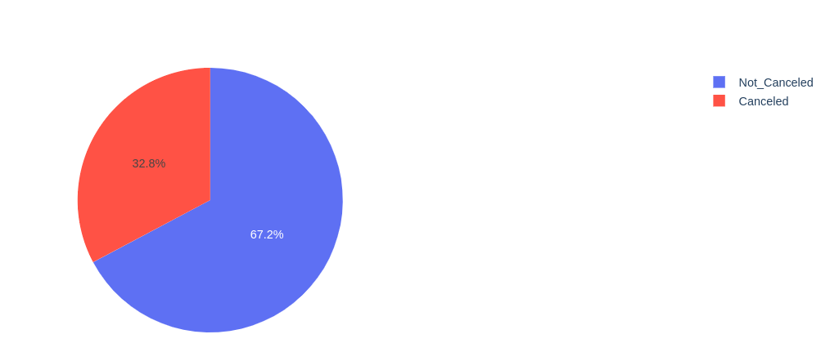
Distribution of Selected Payment Type
The graph shows
Most guests are likely to keep their reservations rather than cancel.

Slide 7
Family
Composition

Slide 8
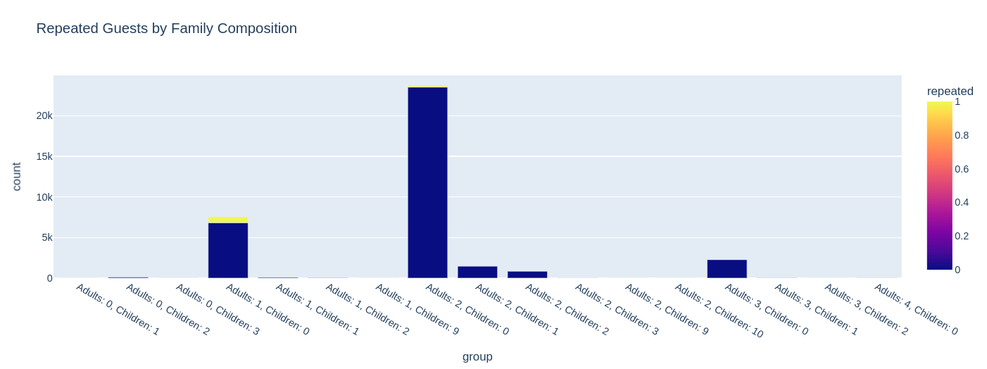
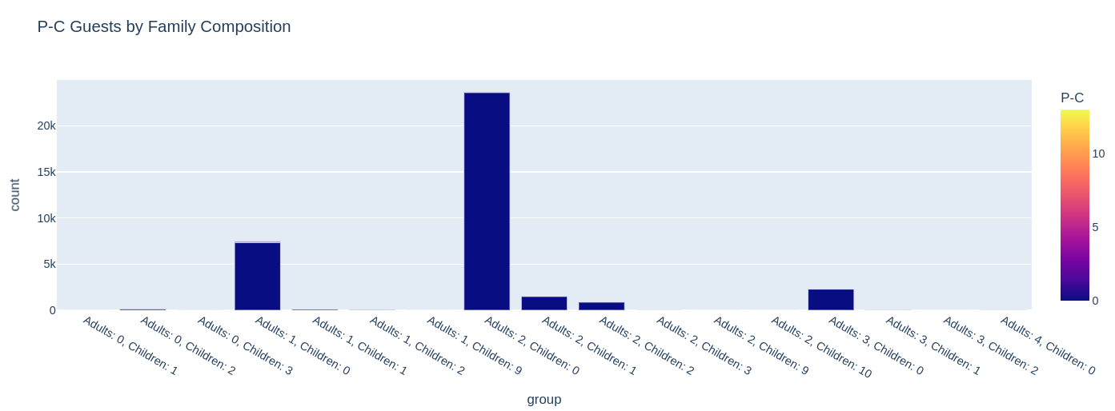
Family composition VS (Repeated , P_C)
Most of guests in dataset reserve for the first time
Most composition of guests is 2 adults

Slide 9
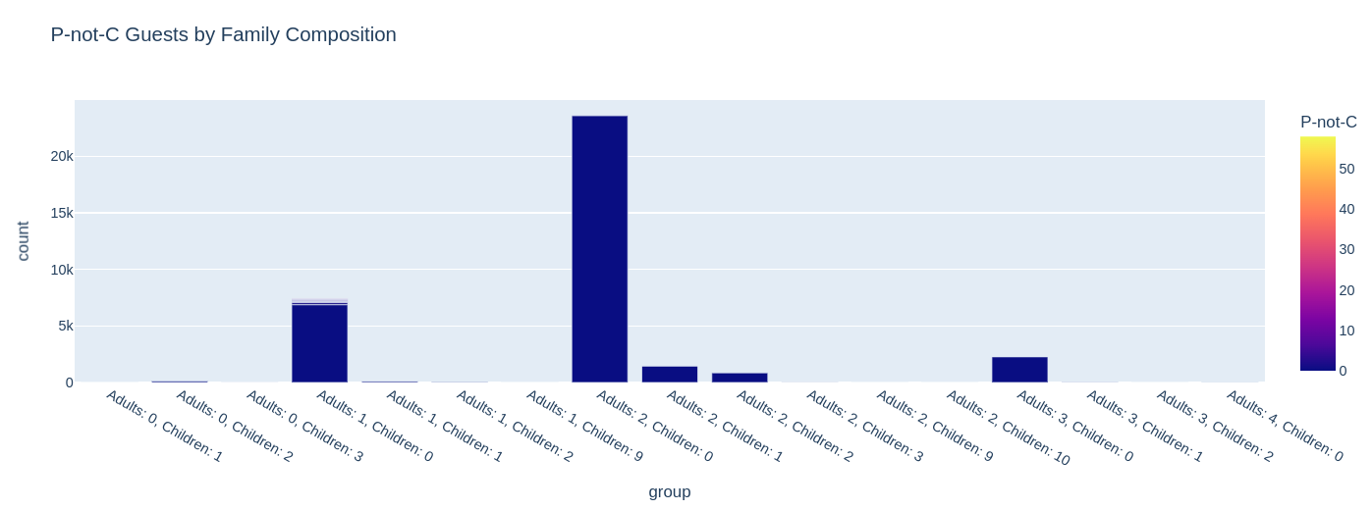
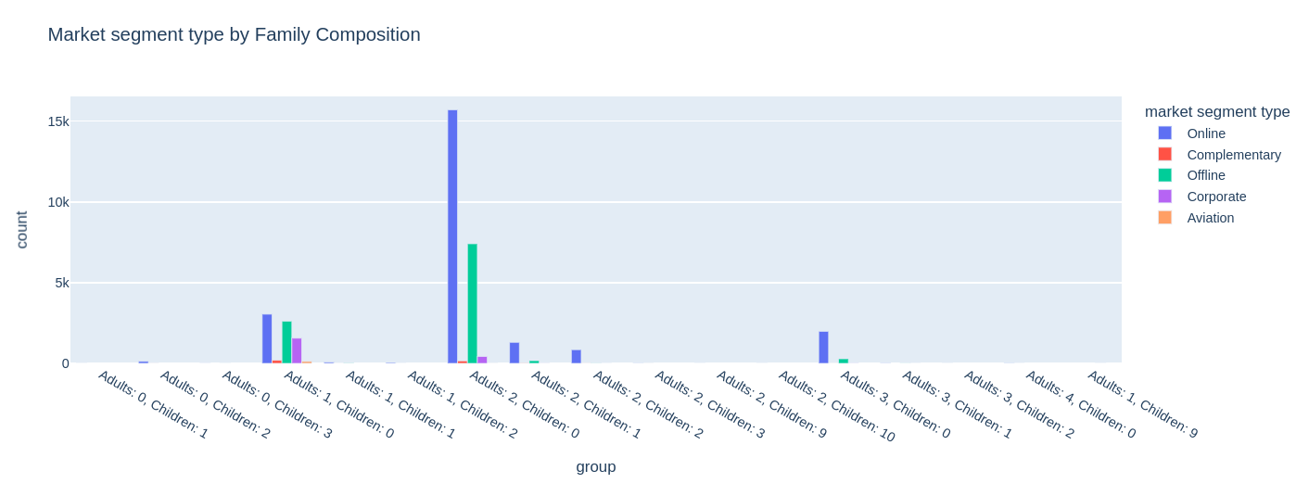
Family composition VS ( P_Not_C , Market Segment)

Slide 10
Booking
Status

Slide 11
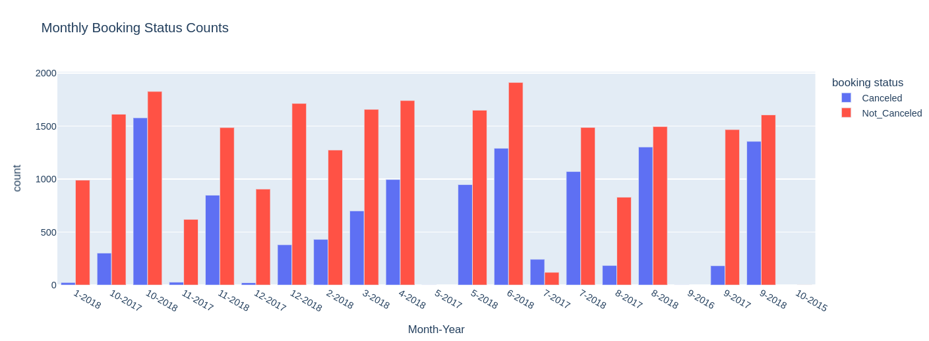
Monthly Booking Status
As shown in the graph the cancellation is high at the second half of 2018 especially and in the second half of a year generally

Slide 12
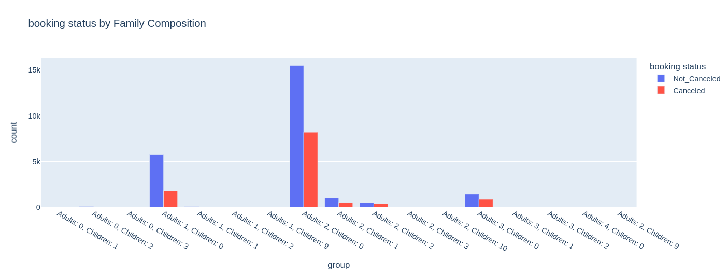
Booking Status Vs Family Composition
As shown in the graph the Precentage is nearly equal in each category except if there is a chilidren , there is a higher possibility of cancellation

Slide 13
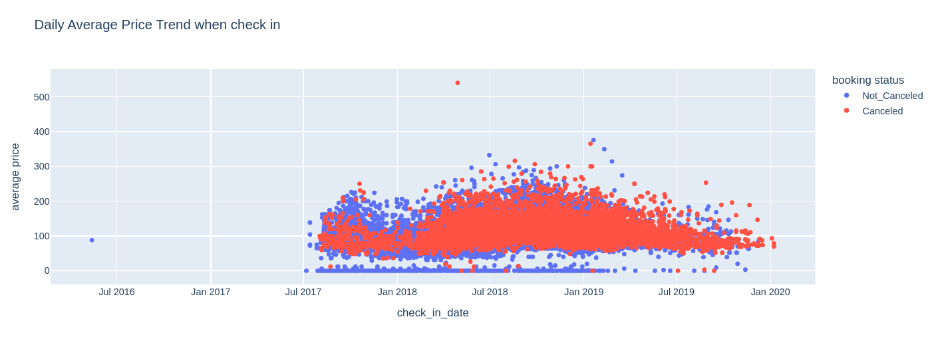
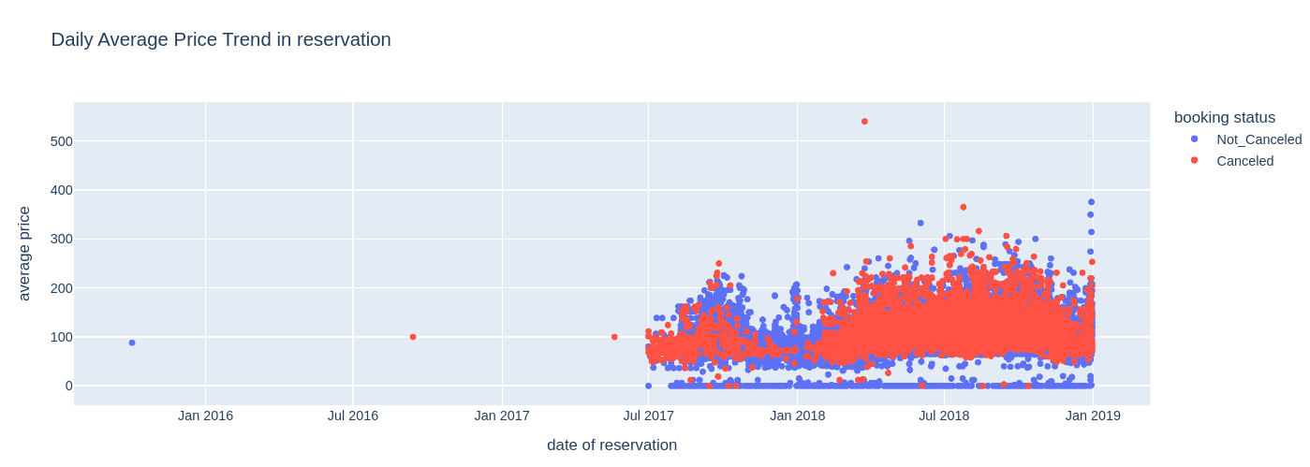
Daily Average Price Trend
Cancellations were more common for reservations made in 2018, as well as for check-ins during 2018 and 2019.
The probability of cancellation increases as the average booking price becomes higher.

Slide 14
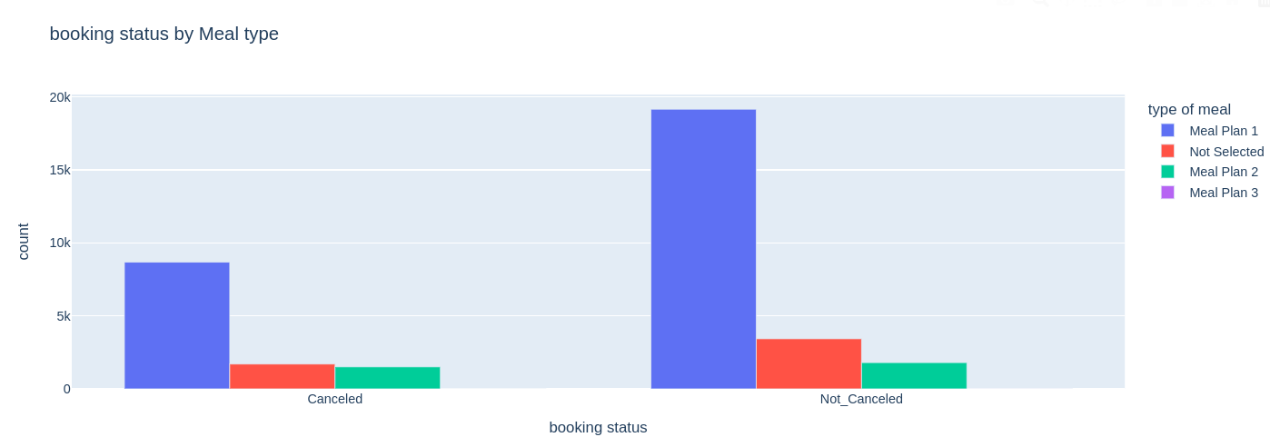
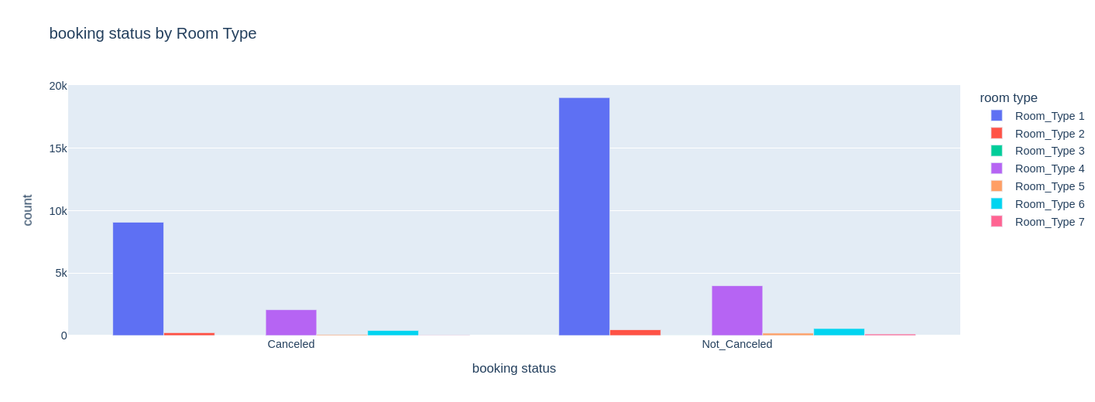
Booking Status by Meal type and Room type
As shown in the graph, the percentage distribution across categories is nearly equal.

Slide 15
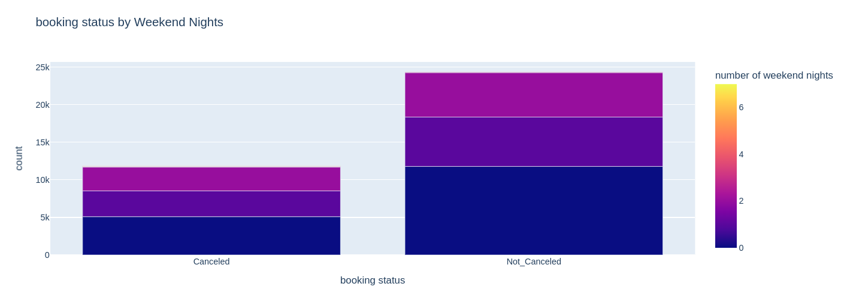
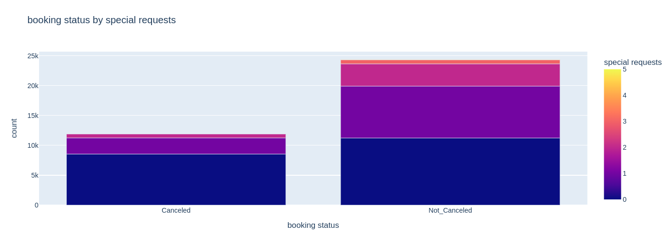
Booking Status by Weekend nights and Special Request
Guests with fewer weekend nights tend to have a lower probability of cancellation compared to the overall guest population.
Bookings with three or more special requests are rarely canceled, indicating strong commitment from these guests.

Slide 16
Thank you

