Slide 1

Exploratory Data Analysis: Ride-Sharing Trips
Data Preprocessing and EDA
Telling the Story Behind 500,000 Rides
Presented by:
Malak Ahmed Saber
Marawan Abbas Mohamed

Slide 2
Dataset Overview
500,000 ride records
26 features
Includes time, traffic, weather, and geo data
No Duplicated values

Slide 3
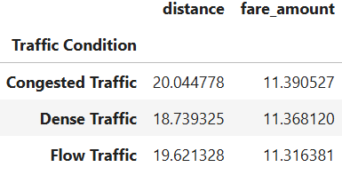
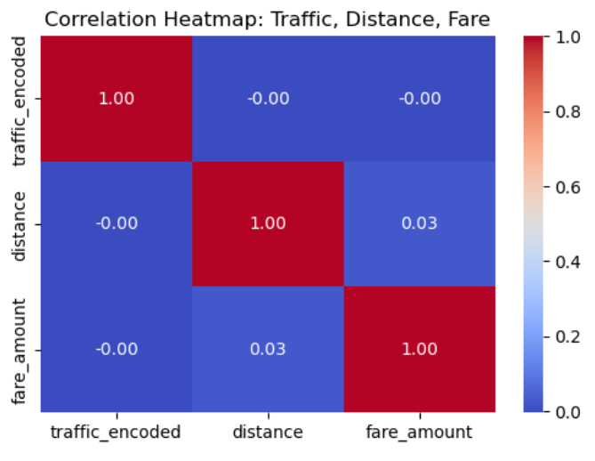
Data Preprocessing
Converted ‘pickup_date’ from object to date time
Null Values
Detected Nulls in 6 features (5 in each)
Displayed 5 nulls of first feature which appeared to affect all the other features to be null so only 5 records had 6 null features
Decided that the best way was to fill with mean of each feature
Converted Categorical Columns to ‘category’
Found Correlation between the most important features :
Traffic Condition
Fare Amount
Distance

Slide 4
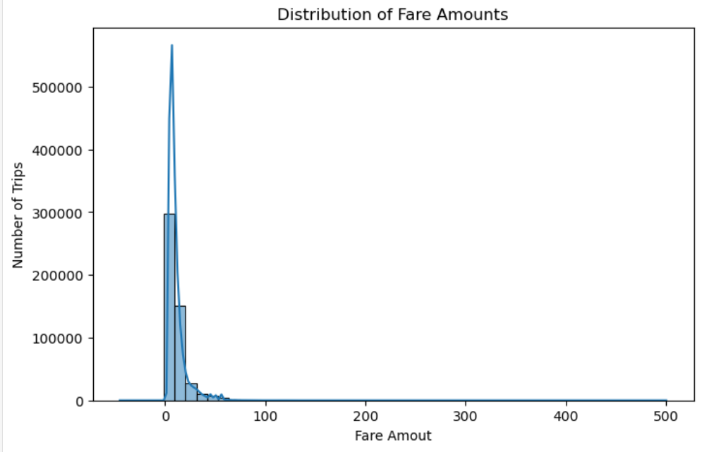
How much do we pay for a ride?
Insight : Most fares are under $20

Slide 5
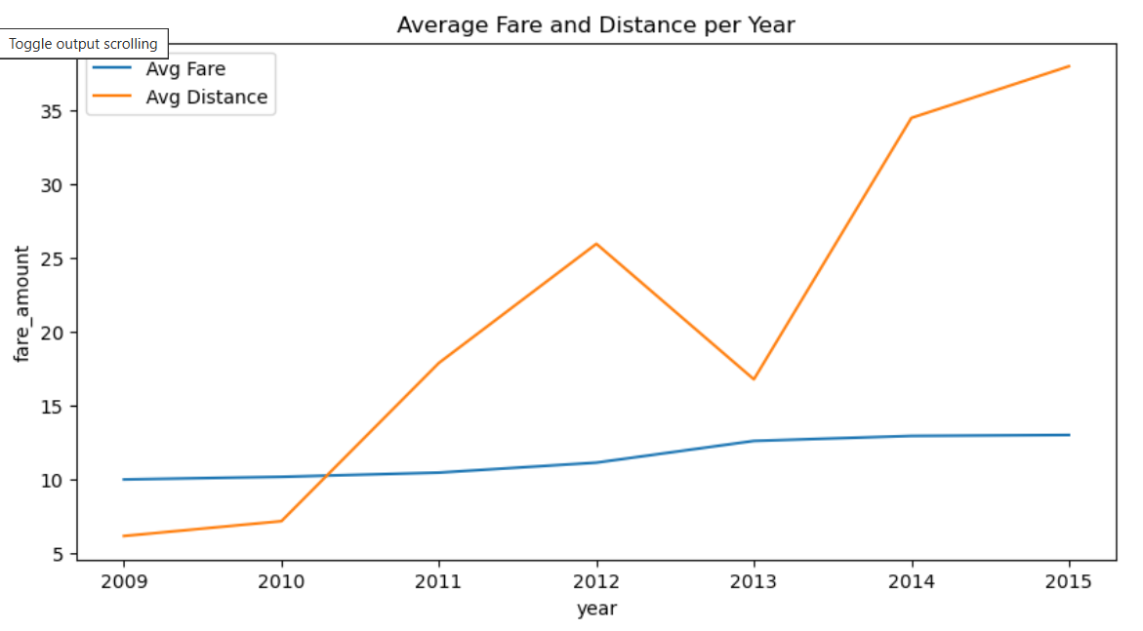
How is the fare affected along with distance among different years?
Insight : Average fare is very stable over time while distance increases or decreases.

Slide 6
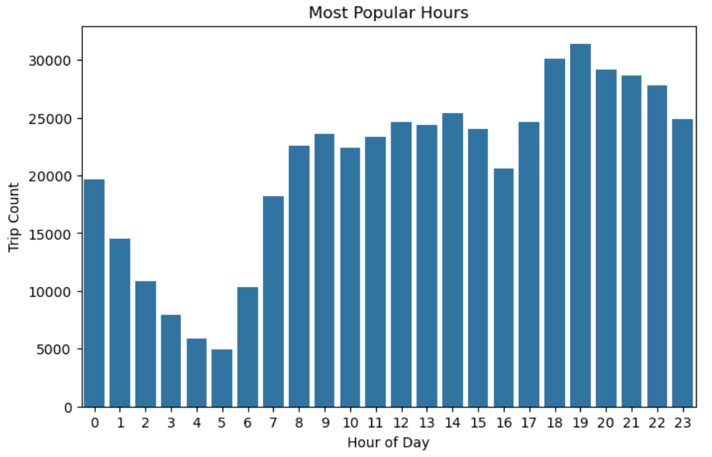
When Do we ride?
Insight : Riding is more active at night, very low at 5 morning

Slide 7
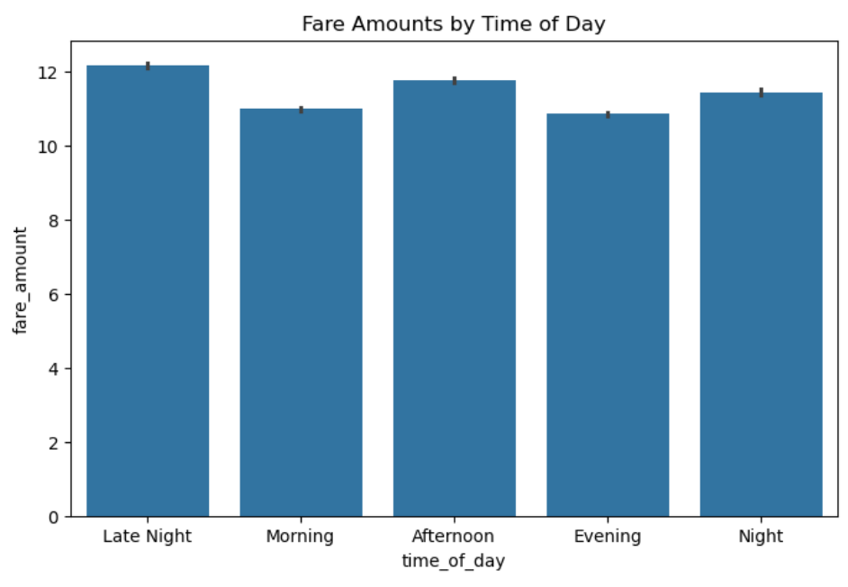
Does this timing affect Fares?
Insight : Late nights are the most paid, maybe as it is more non safe

Slide 8
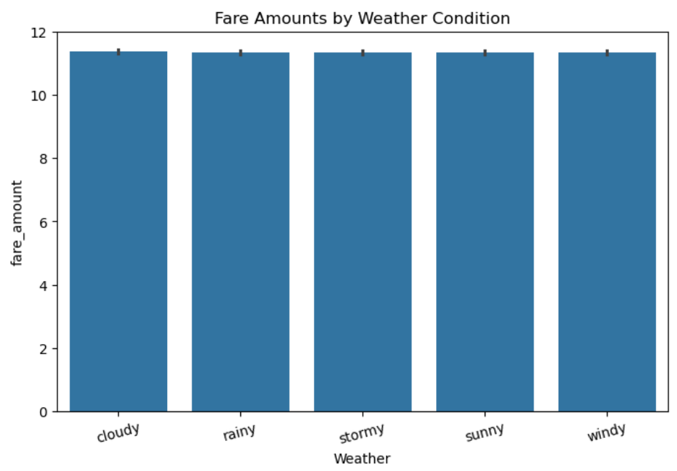
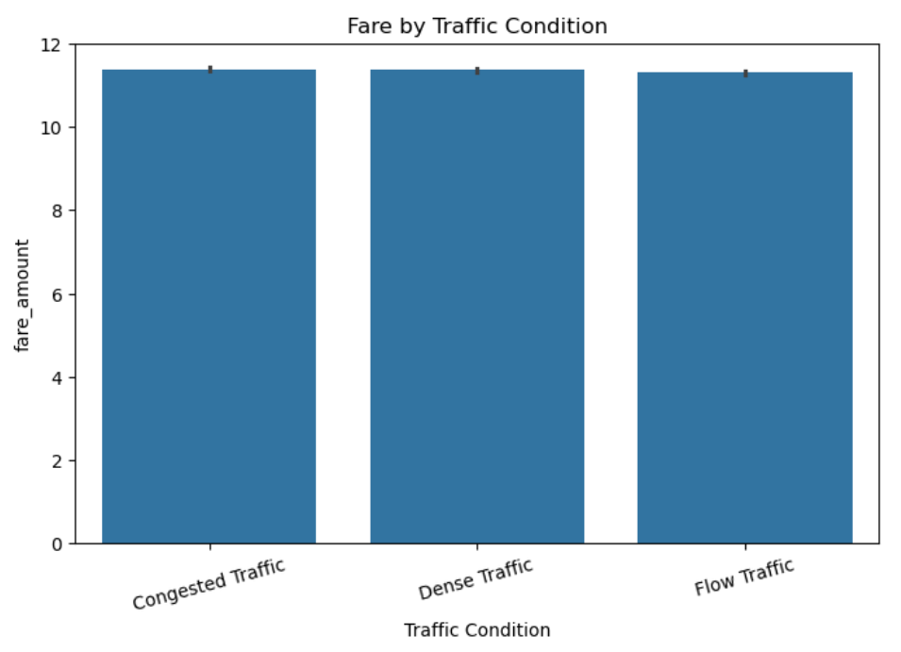
Do Conditions affect Fares?
Weather Condition
Traffic Conditions
Insight : Fares are almost equal for different weather conditions and traffic conditions

