Slide 1
Task 4
Submitted by:
Mohamed Elshamy Omar Abdelwahab Saber Mohamed Naguib Elsayed Naguib

Slide 2
Introduction
This is a data for taxi rides to uncover patterns in fares, distances, and ride characteristics across New York City.

Slide 3
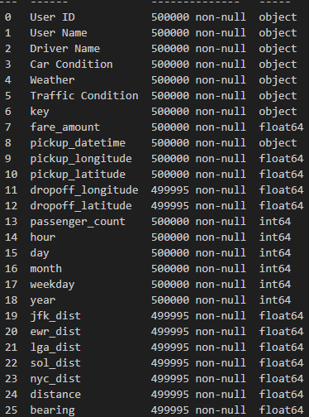
Data Loading & Initial Inspection

Slide 4

Renaming Columns for Clarity
jfk_dist = jfk_airport_distance
lga_dist = lga_airport_distance
ewr_dist = ewr_airport_distance
sol_dist = statue_of_liberty_distance
nyc_dist = nyc_center_distance

Slide 5
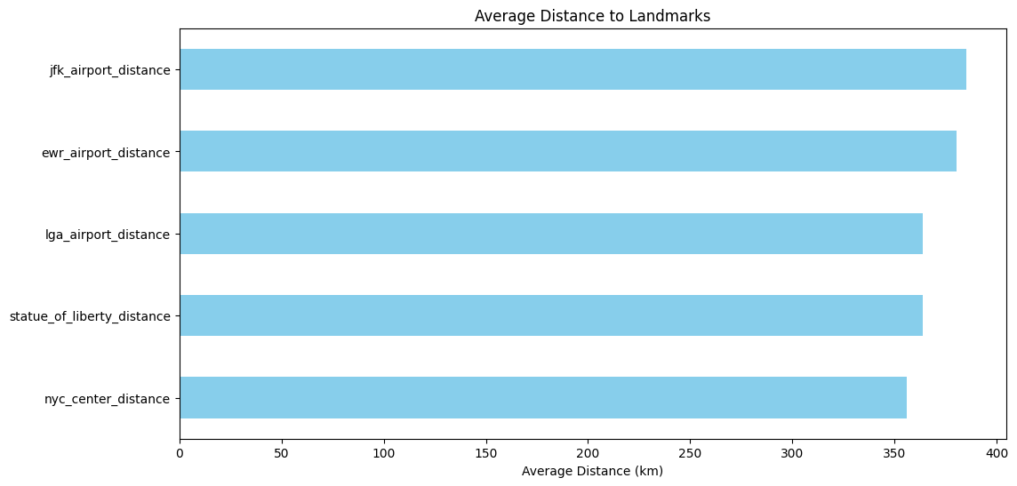
Average Distance to Landmarks

Slide 6
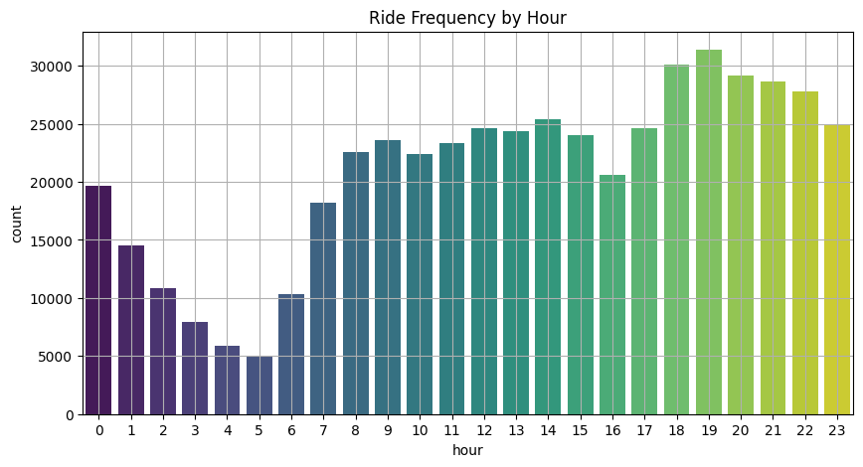
Ride Frequency By Hour

Slide 7
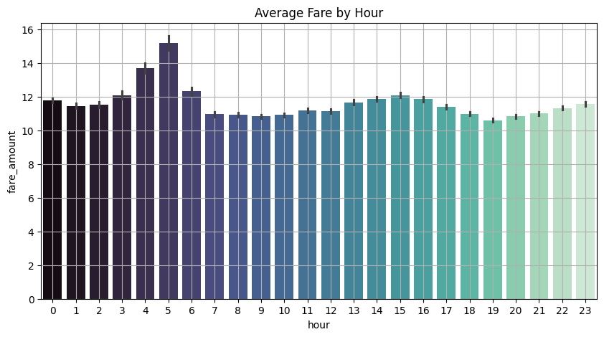
Average Fare by Hour

Slide 8
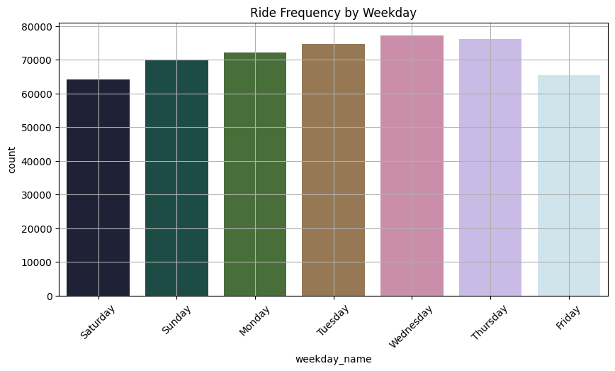
Ride Frequency By Weekday

Slide 9
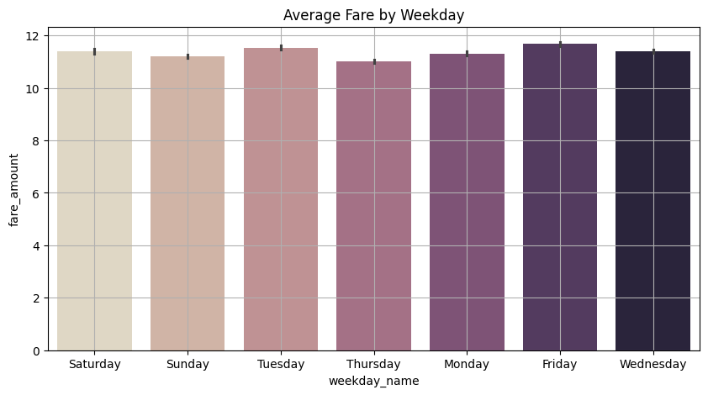
Average Fare by Weekday

Slide 10
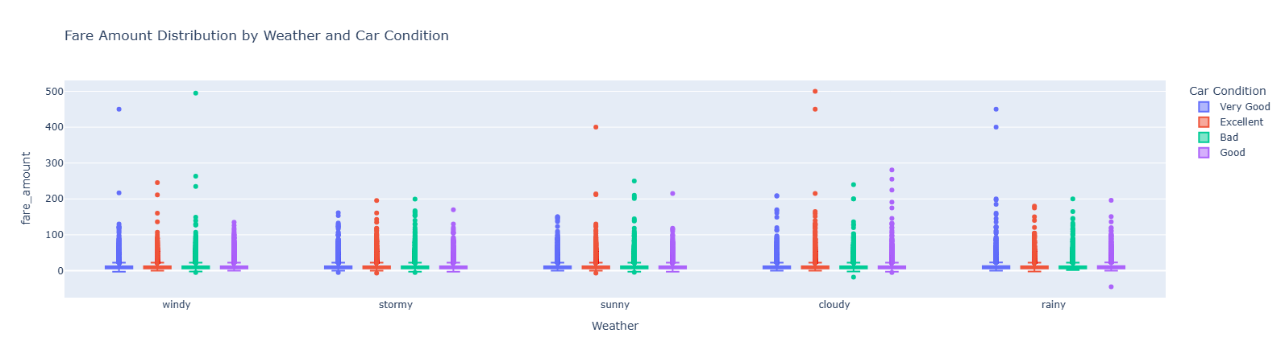
Fare Amount Distribution by Weather and Car Condition

Slide 11
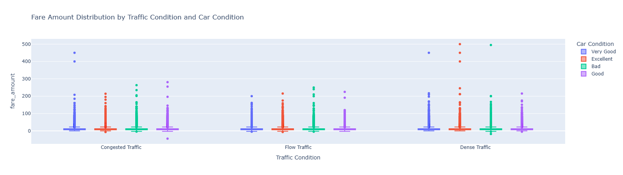
Fare Amount Distribution by Traffic Condition and Car Condition

Slide 12
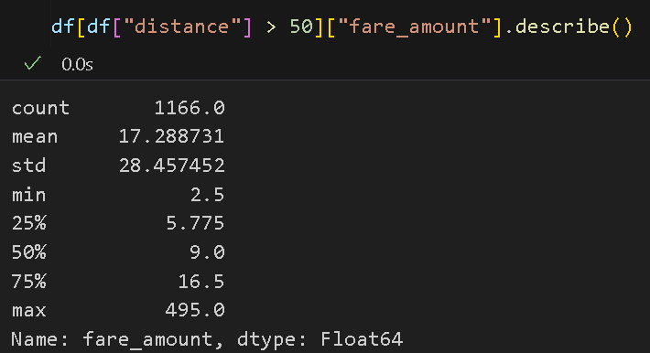
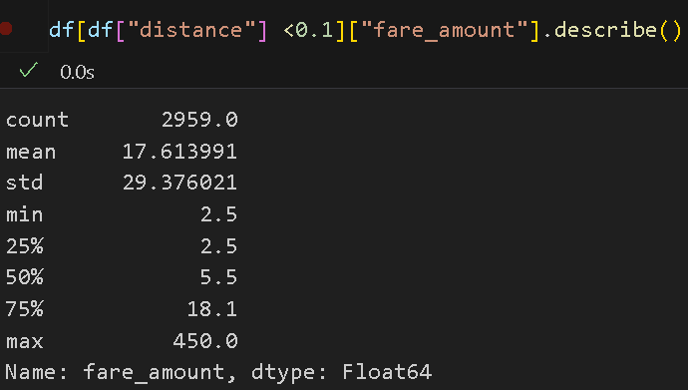
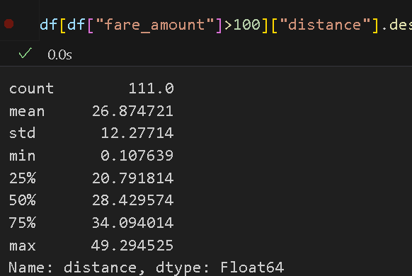
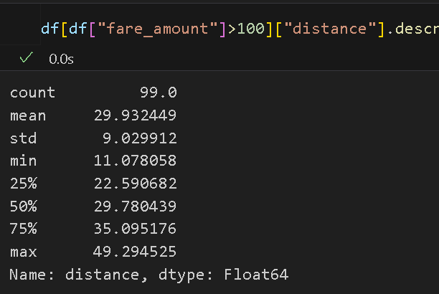
Some Data Preprocessing
Remove any rows where distance or fare amount is less than or equal to zero
Remove all rows where the distance is greater than 50 km or less than 0.1 km.

Slide 13
Some Data Preprocessing
Remove rows where the fare amount is greater than 100 while the distance is less than 10 km.

Slide 14
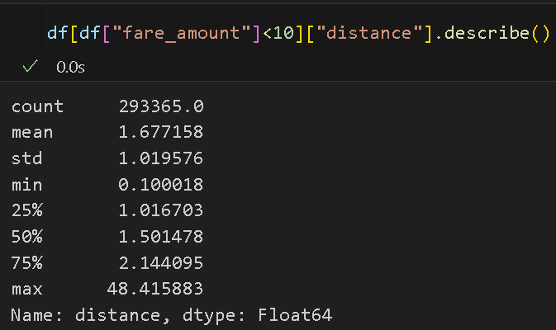
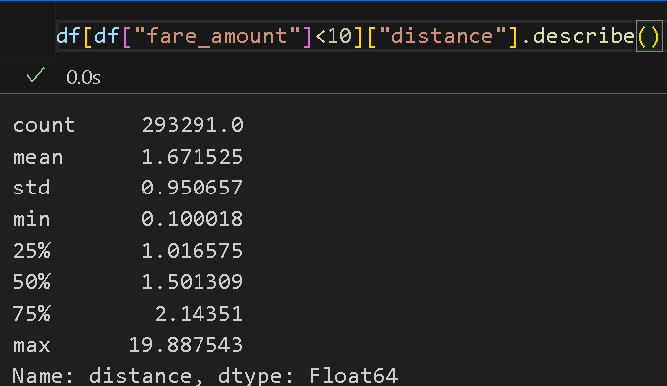
Some Data Preprocessing
Remove all rows where the fare amount is less than 10 while the distance is greater than 20 km

Slide 15
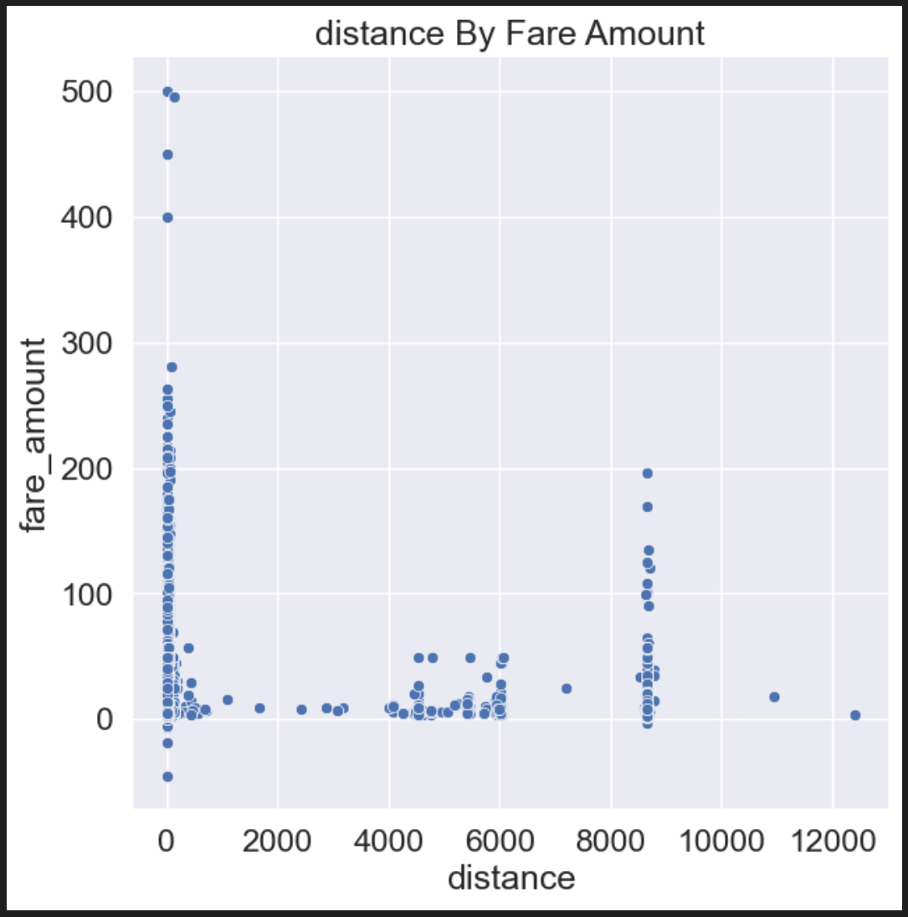
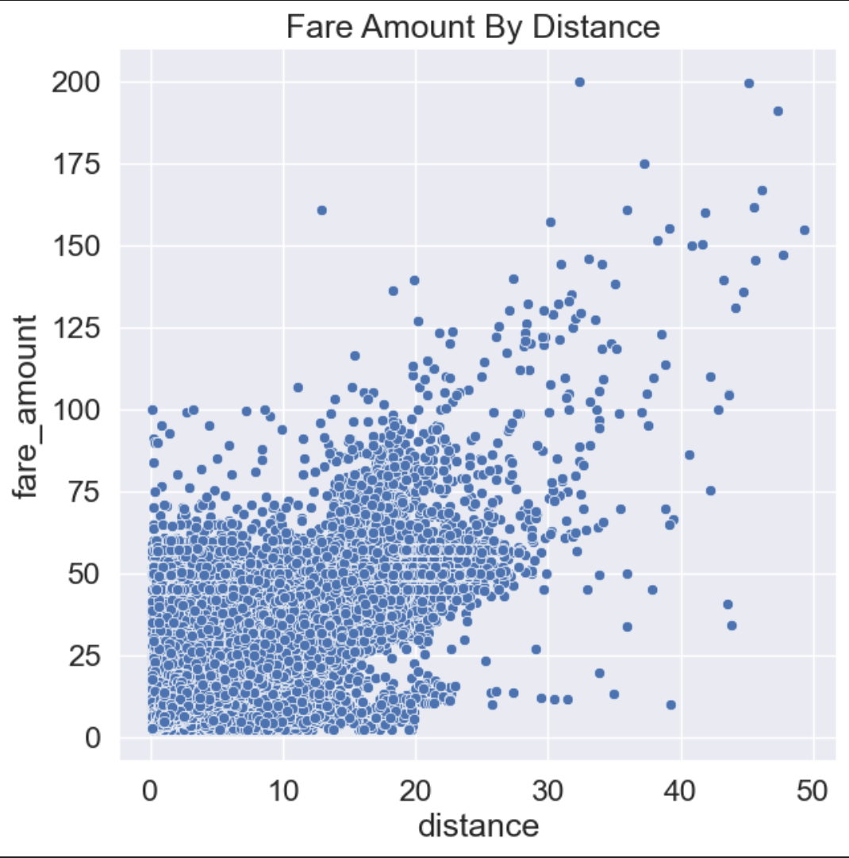
Fare Amount Distribution by Distance
Before Data Preprocessing
After Data Preprocessing

Slide 16
Thank You

