Slide 1


CELLULA
EDA
PROJECT

Slide 2

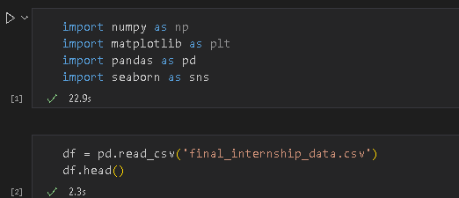
FIRST STEPS
Importing important libraries at first is the first step into creating a machine model
then we read the file and it’s components

Slide 3
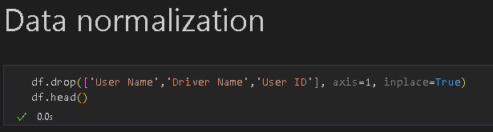
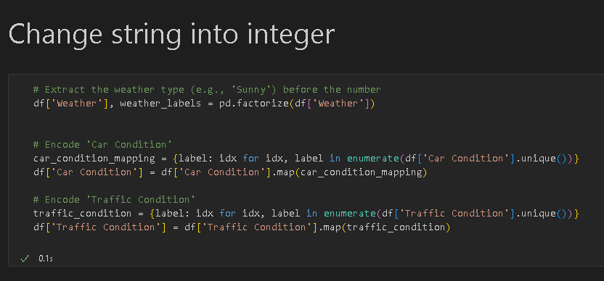
DATA NORMALIZATION
Then we start by dropping non important columns that might and recheck the data for comfirmation
Changing strings into integer is very important to not leave something out

Slide 4


DATA CLEANSING
We start by checking the null values which were 500000/column then we fill them
Checking for duplicates
Filling null values
(No duplicates)

Slide 5
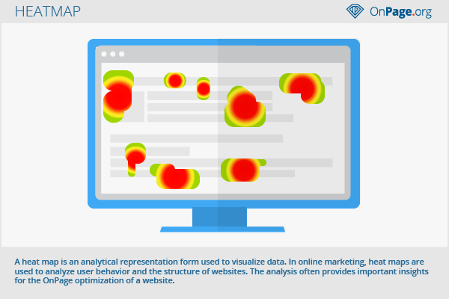
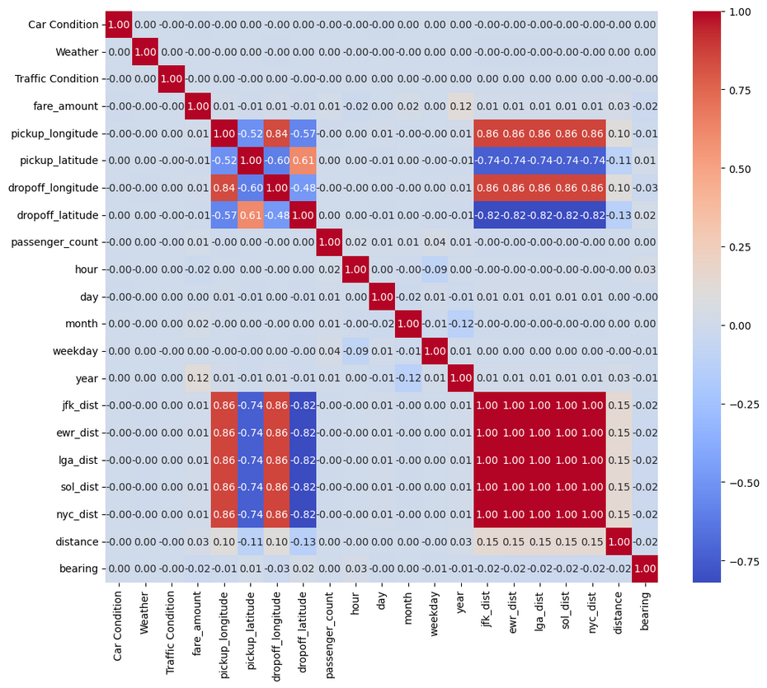
HEATMAP
Checking the heatmap is important for knowing which feature affects which

Slide 6

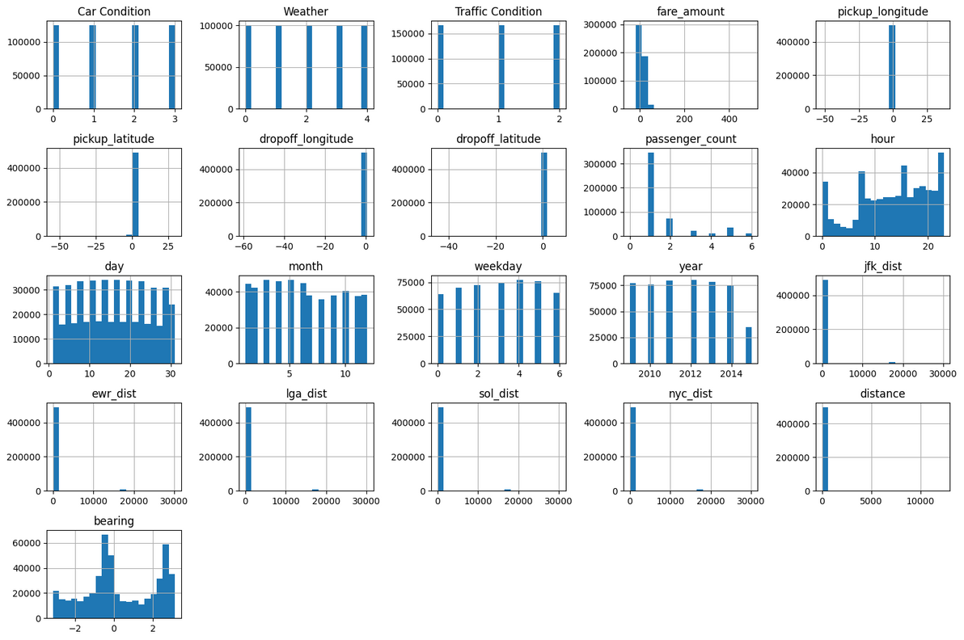
DATA VISUALIZATION
Now we visualize our data

Slide 7
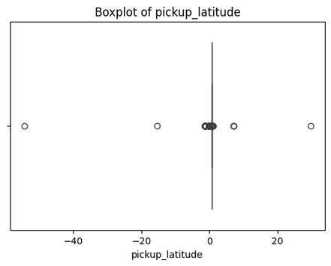
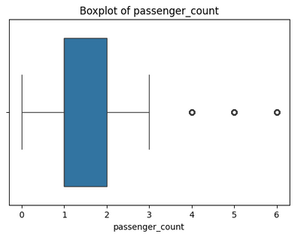
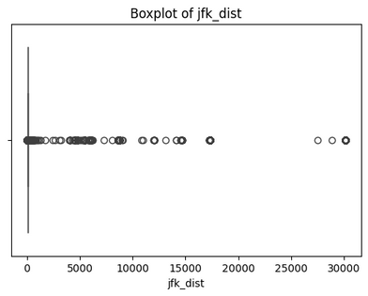

OUTLIER CHECKS
Then we checked for outliers
pass_count
Destinations
Latitude

Slide 8
CONCLUSION
Data cleaning,Visualization until the next step,Model training and deployment

