Slide 1
Preprocessing Report
By: Adham Saeed, Moaz Muhammad

Slide 2
Introduction
Good afternoon everyone. Today we will be presenting a comprehensive analysis of two distinct data preprocessing approaches implemented by our team for the taxi fare prediction project. This collaborative effort demonstrates how different methodologies can be applied to the same dataset, each with unique strengths and considerations.
**The Problem**: Predicting taxi fares based on various features including location coordinates, temporal data, weather conditions, traffic patterns, and vehicle characteristics.
**The Dataset**: 500,000 taxi trip records with 26 features including pickup/dropoff coordinates, datetime information, passenger count, distance metrics, and external conditions.
**Team Collaboration**: Two team members independently developed preprocessing pipelines, allowing us to compare methodologies and identify best practices.

Slide 3
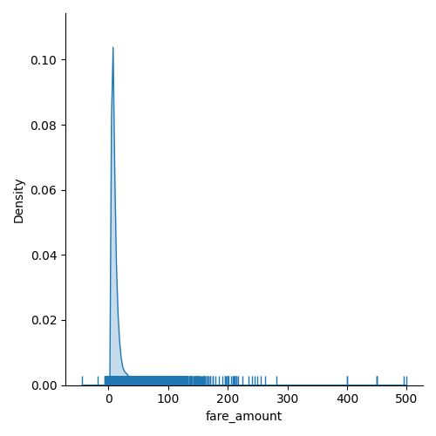
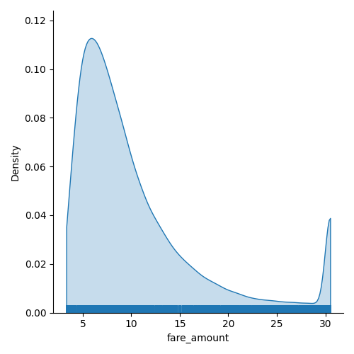
Dealing with outliers and errors

Slide 4
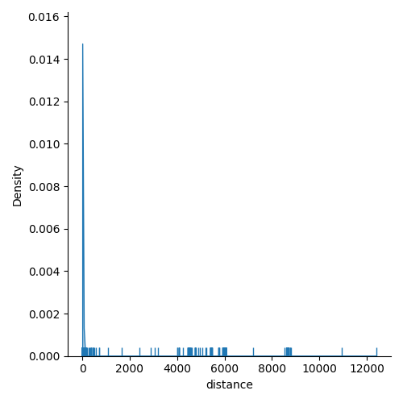
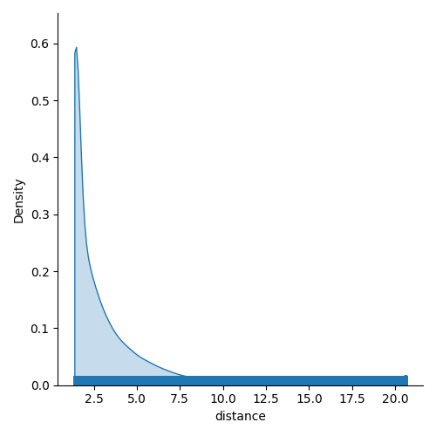
Dealing with outliers and errors

Slide 5
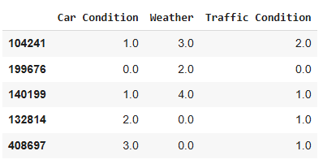
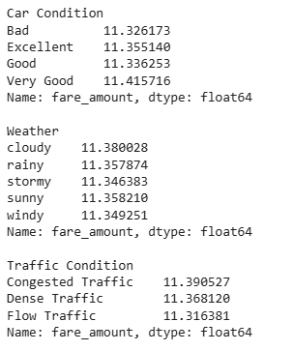
Encoding

Slide 6
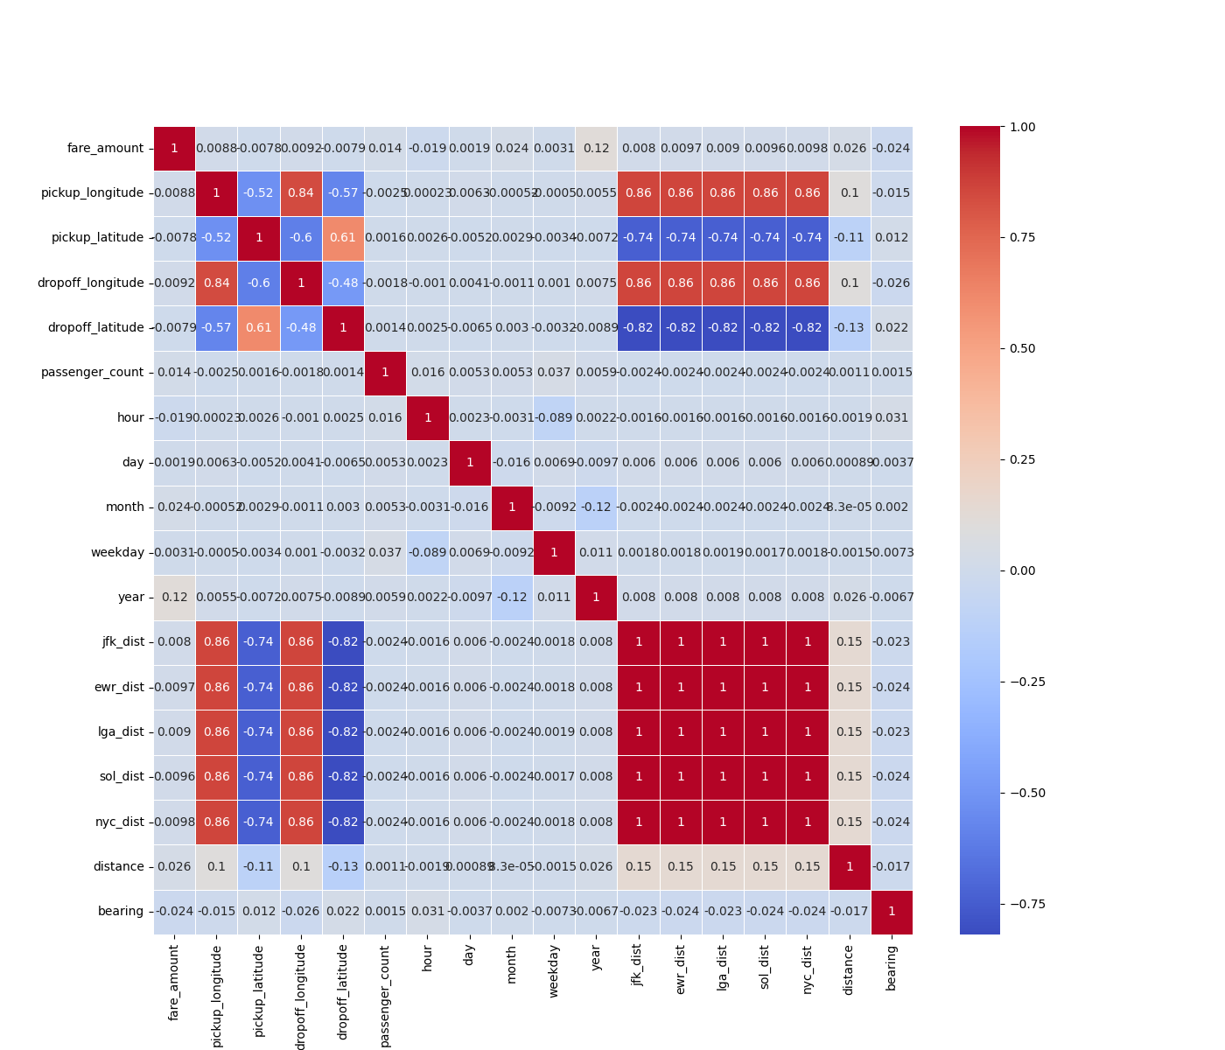
PCA for feature selection

Slide 7
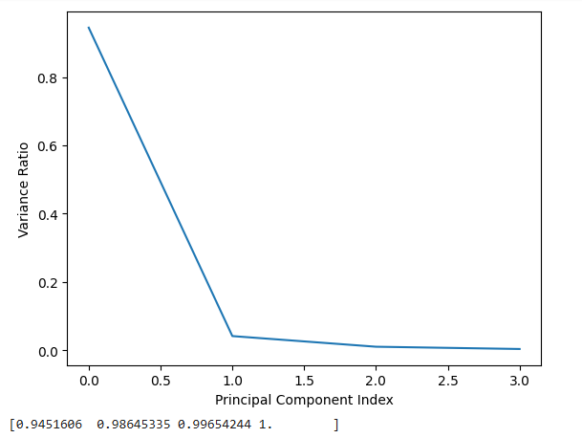
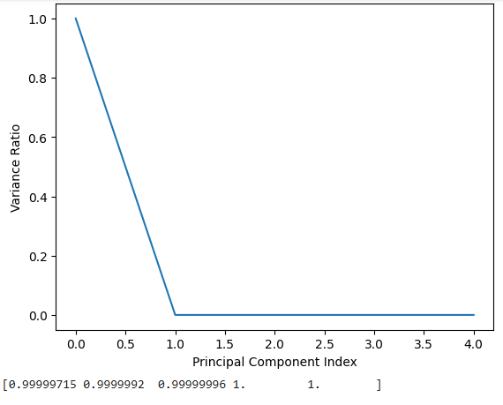
PCA for feature selection

Slide 8
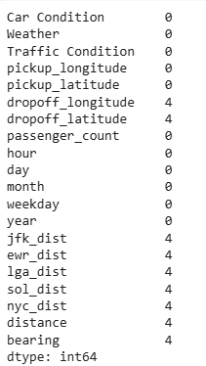
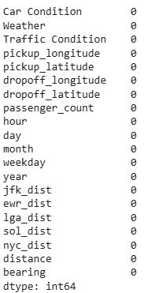
Handling missing values
The missing values were filled using the median, due to the presence of outliers.

Slide 9
Model Results
KNN:
MSE = 38.8
R2 score = 0.6
Decision Tree:
MSE = 42.74
R2 score = 0.56
Gradient Boosting:
MSE = 36.3
R2 score = 0.63
AdaBoost:
MSE = 46.18,
R2 score = 0.53.
Polynomial Regression of 2nd degree:
MSE = 38.8,
R2 score = 0.6

Slide 10
Hyper Parameter Tuning
Decision Tree:
Tuned Hyper Parameters: min_samples_split, max_depth
Best Hyper Parameters: min_samples_split:: (30), max_depth: (30)
R2 score: 0.73

