Slide 1
EDA of Trips Dataset
Soha Ashraf Eltokhy

Slide 2
Dataset Description:
User_ID: A unique number for each user.
User Name: The user's name.
Driver Name: The driver's name.
Car Condition: Whether the car is in good or bad condition.
Weather: The weather condition winter, windy, sunny.
Traffic Conditions: Whether traffic is congested or normal.
Key: A unique number for each trip
Fare Amount: The trip fare.
Pickup Datetime: The time when the passenger requested.
Pickup Longitude & Latitude: The (passenger’s location.
Drop-off Longitude & Latitude: The destination location, where the passenger was dropped off.
Passenger Count: The number of passengers in the car.
JFK, EWR, LGA Distance: The distance between the pickup location and these airports.
SOL Distance: The distance from the Statue of Liberty.
Distance: The trip distance.
Bearing: The trip direction from start to end, measured in angles.

Slide 3
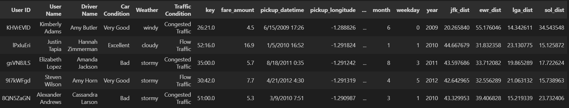
Dataset Overview:
Figure: Sample of the Dataset.

Slide 4
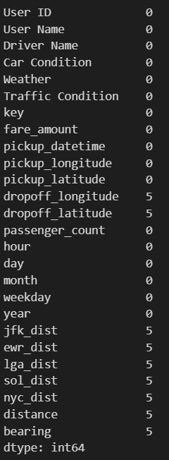
Data Cleaning and Preprocessing:
There is no duplicated values.
There is missing values in: ‘jfk_dist’, ‘ewr_dist’, ‘lga_dist’, ‘nyc_dist’, ‘distance’, ‘bearing’ columns.
Converting to ‘pickup_datetime’ to datetime data type.
Divide 'pickup_datetime’ to ‘month’, ‘day’, ‘weekday’, ‘hour’, and ‘year’.

Slide 5
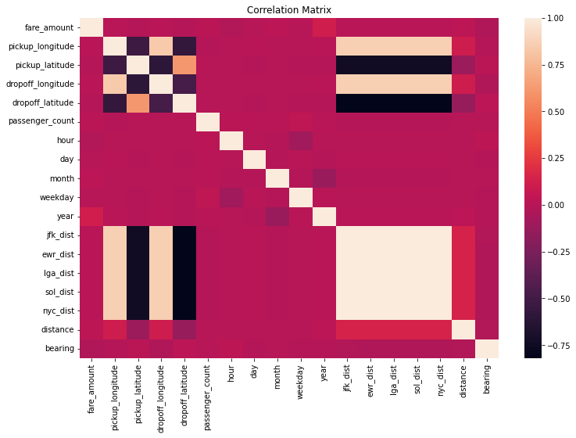
Data Cleaning and Preprocessing:

Slide 6
Data Visualization

Slide 7
Numerical Features Distribution

Slide 8
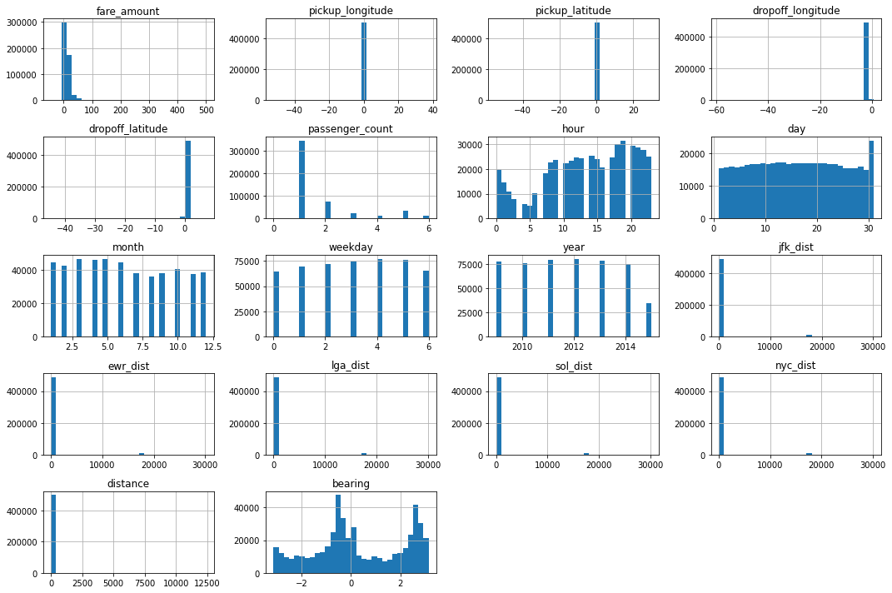

Slide 9
Categorical features Distribution

Slide 10
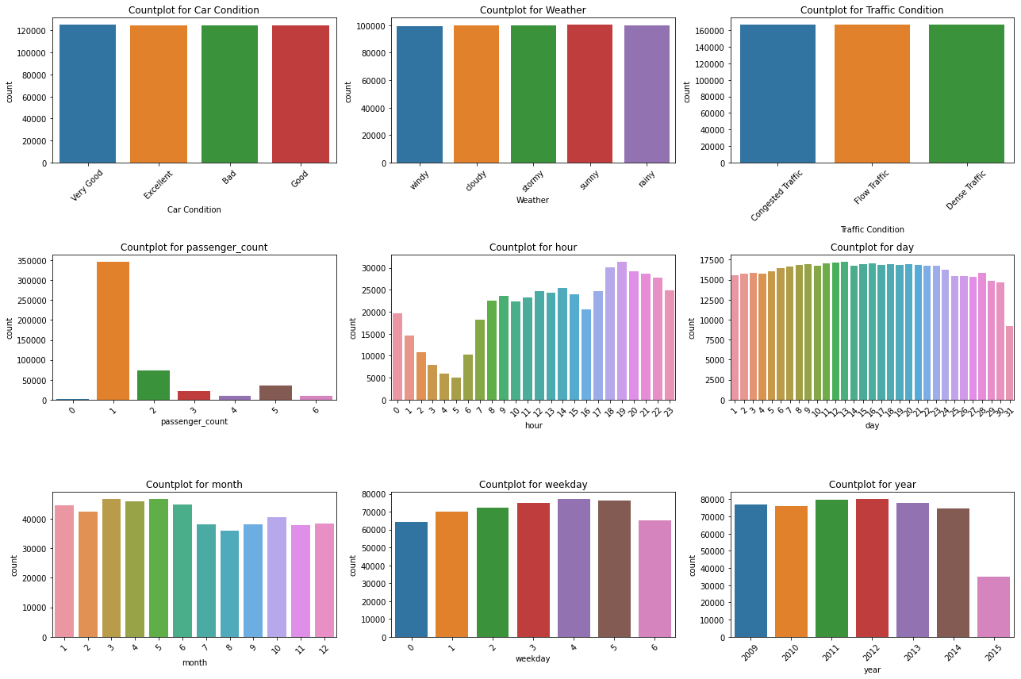

Slide 11
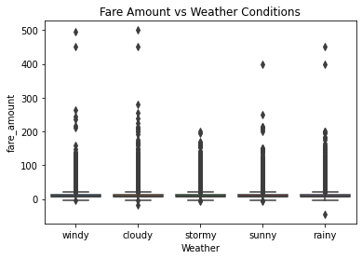
How does the fare amount vary with weather conditions?

Slide 12
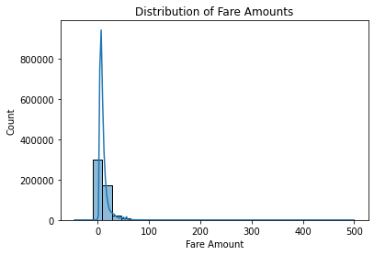
What is the distribution of fare amounts?

Slide 13
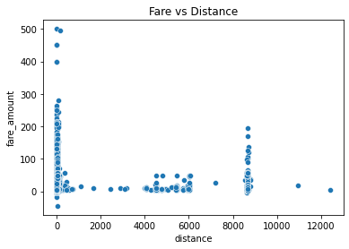
What is the relationship between distance and fare amount?

Slide 14
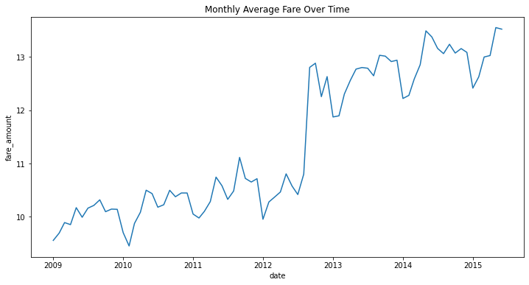
How do fares vary over months or years?

Slide 15
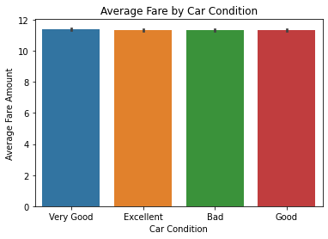
Do better car conditions lead to higher fares?

Slide 16
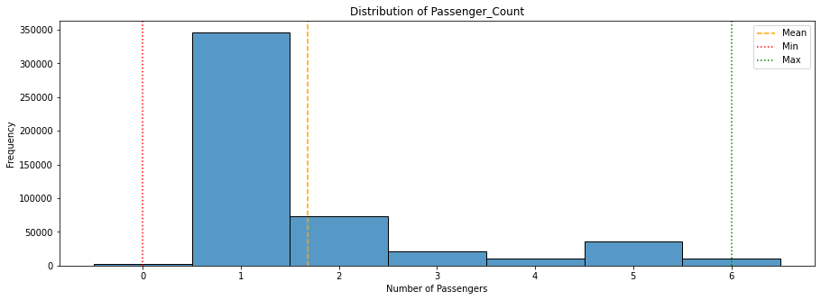
What is the most common number of passengers?

Slide 17
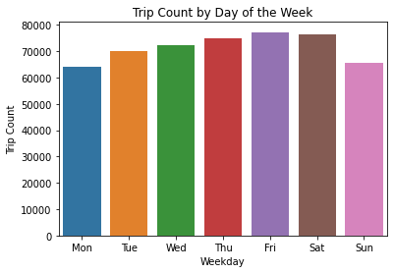
Which weekday has the most trips?

Slide 18
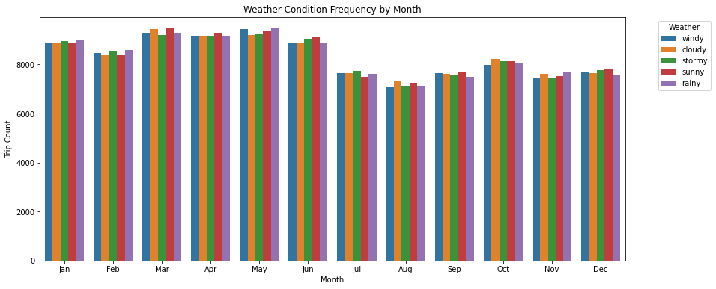
How does the distribution of weather conditions vary by month?

Slide 19
THANK YOU

