Slide 1
Data
3923 images
1000 classes
10 top predictions by probability : 39230 rows

Slide 2
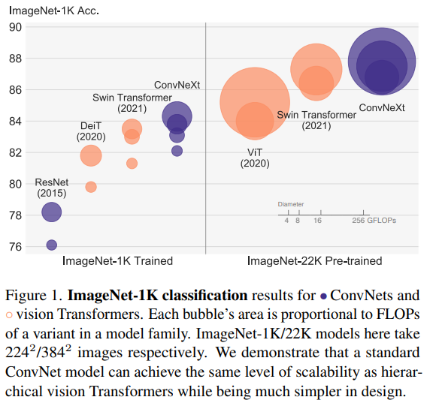
Does better accuaracy means better predictions?

Slide 3
Resnet50
2015
50 layers deep
Keras implantation: https://keras.io/api/applications/resnet/#resnet50-function

Slide 4
ConvneXt 2022
2022
Facebook research
constructed entirely from standard ConvNet modules
https://github.com/facebookresearch/ConvNeXt
Paper: https://arxiv.org/pdf/2201.03545v1.pdf

Slide 5
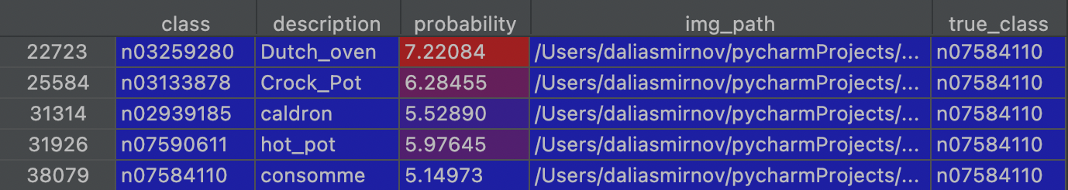
top_5_right_convnext
Model convnext got at least one right prediction of top 5 predictions it gave
3815 (97%) images got right prediction of top 5 preds

Slide 6
top_5_wrong_convnext
Model convnext did not got right prediction in the top 5 predictions it gave
108 (2%) images got no right prediction of the top 5 preds

Slide 7
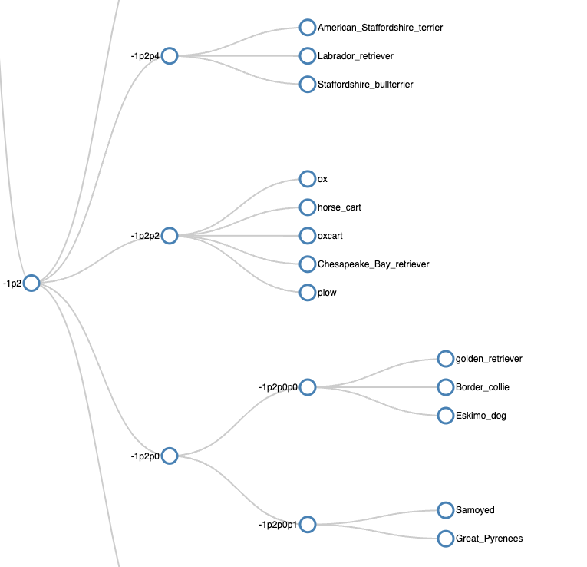
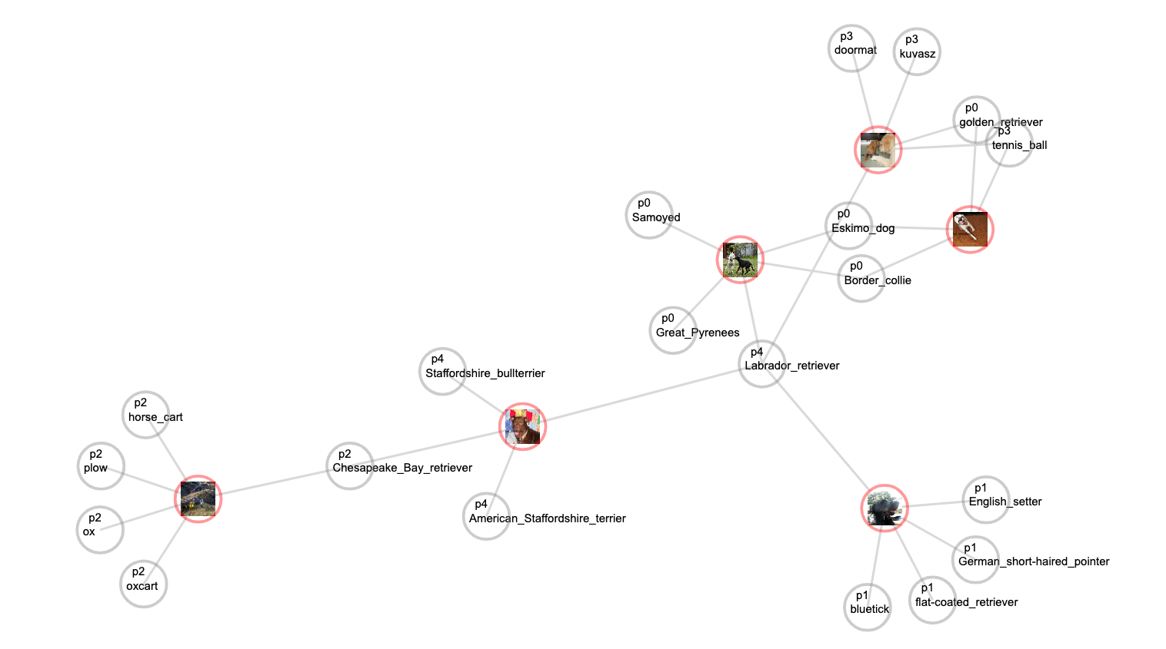
top_5_wrong_convnext

Slide 8
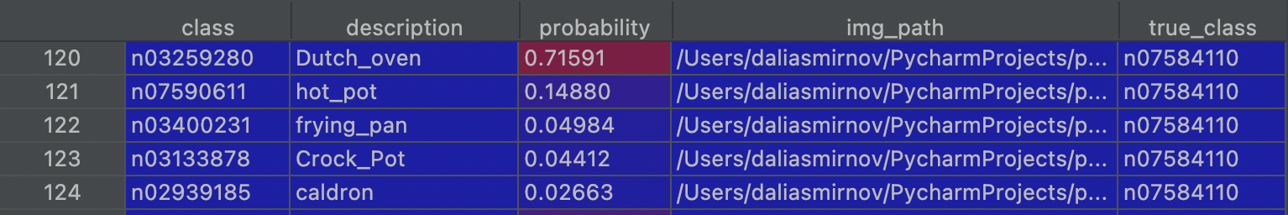
top_5_wrong_resnet50
Model resnet50 did not got right prediction in the top 5 predictions it gave
457 (11%) images got no right prediction of the top 5 preds

Slide 9
comparison
Lets try to be convinced that better accuracy means better predictions

Slide 10
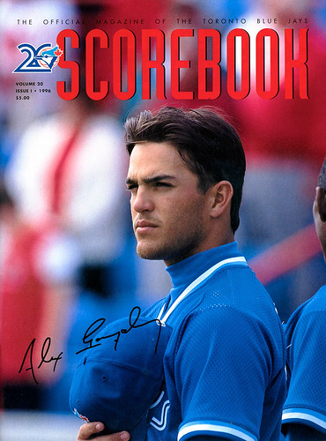
example – convnext wins
PRED RANK | CONVNECXT | RESNET50
1 | ballplayer | torch
2 | book_jacket | comic_book
3 | comic_book | web_site
4 | baseball | television
5 | football_helmet | book_jacket
6 | bow_tie | stage
7 | jersey | ballplayer
ballplayer
00014689

Slide 11
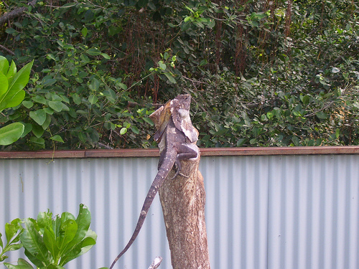
example – convnext (definitely) wins
PRED RANK | CONVNECXT | RESNET50
1 | frilled_lizard | koala
2 | common_iguana | banana
3 | agama | picket_fence
4 | American_chameleon | barracouta
5 | whiptail | birdhouse
6 | green_lizard | peacock
7 | green_lizard | mobile_home
frilled_lizard
00039831

Slide 12

example – Resnet50 wins
PRED RANK | CONVNECXT | RESNET50
1 | corn | menu
2 | plate | web_site
3 | meat_loaf | meat_loaf
4 | ear | book_jacket
5 | mashed_potato | bakery
6 | potpie | cheeseburger
7 | bakery | ice_cream
book_jacket
00036093

Slide 13
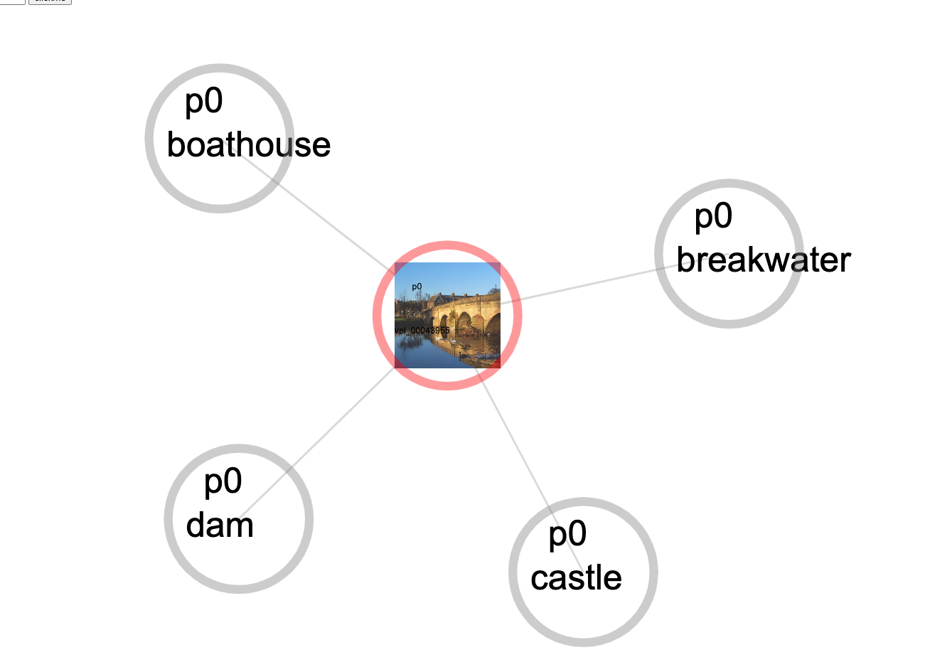
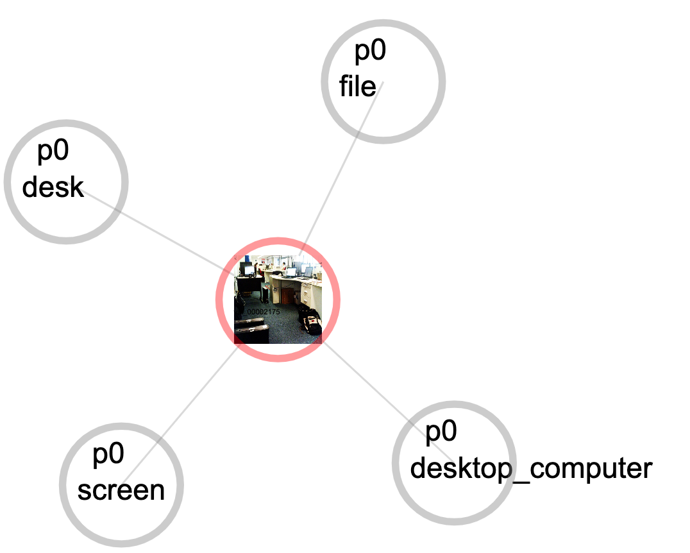
Conclusions
There is confusion when we have many items in one image

