Slide 1
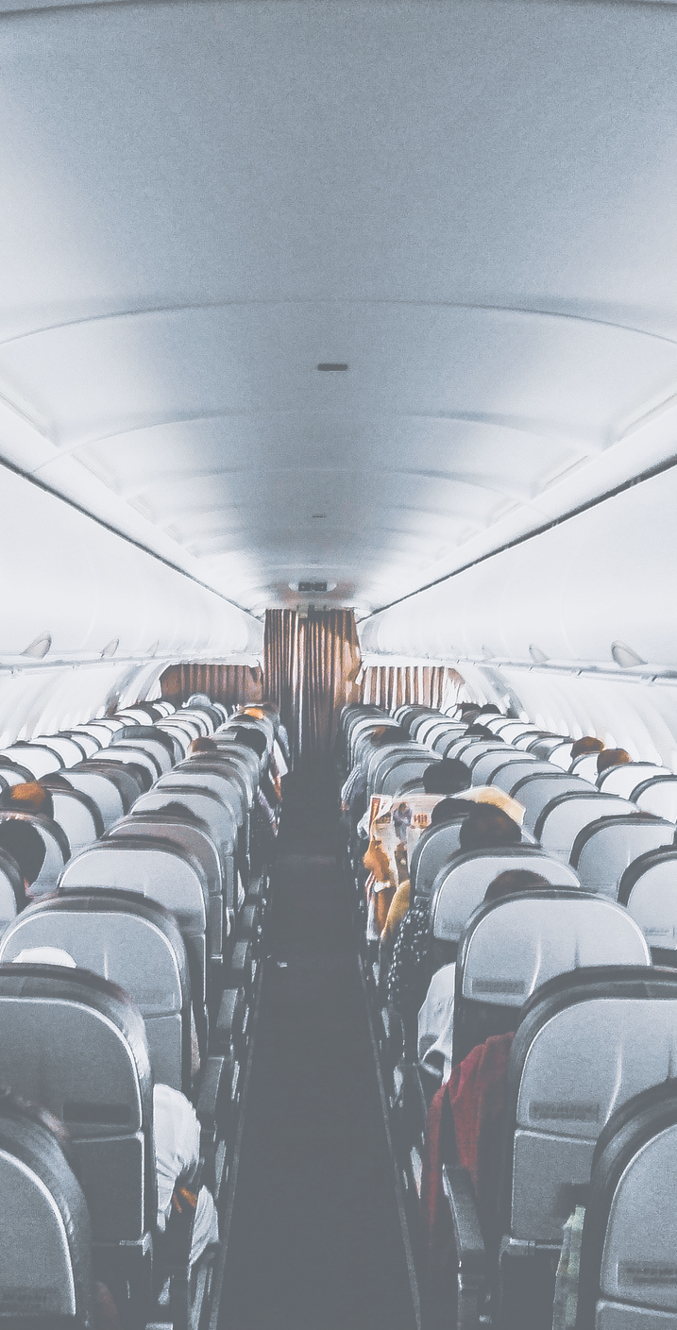

NOV 21 , 2021
Airline Passenger Satisfaction
Presented by
Dalya Alanazi

Slide 2



Introduction
There are factors that lead to a customer satisfaction for an Airline and this presentation it will show and anlayse
questions and figures that will explained the detailes of passengers and what they prefer the most. etc.
It will start with:
Data Structure
Data Cleaning
Data Analysis
Conclusion
2 0 2 1 | A I R L I N E P A S S E N G E R S A T I S F A C T I O N

Slide 3
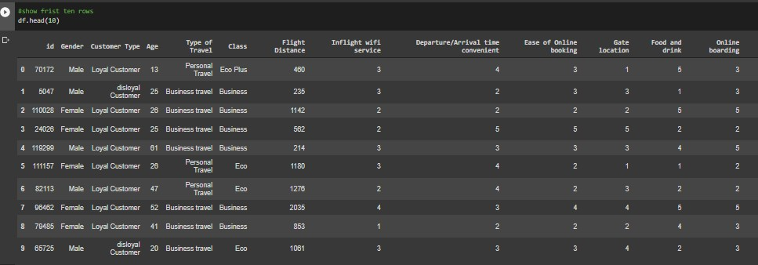
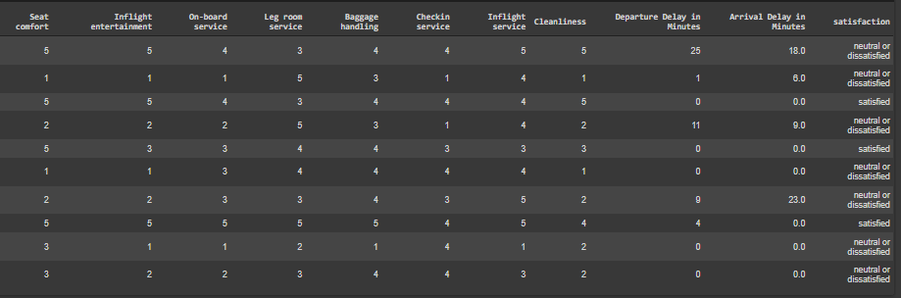
Data structure
Here is the top 10 of the dataset before the cleaning .
103904 rows and
24 columns.
2 0 2 0 | O O B E I N H O U S E H U N T E R S

Slide 4

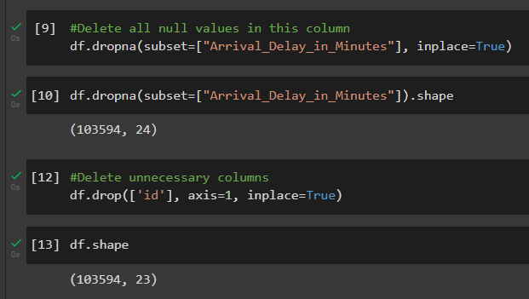
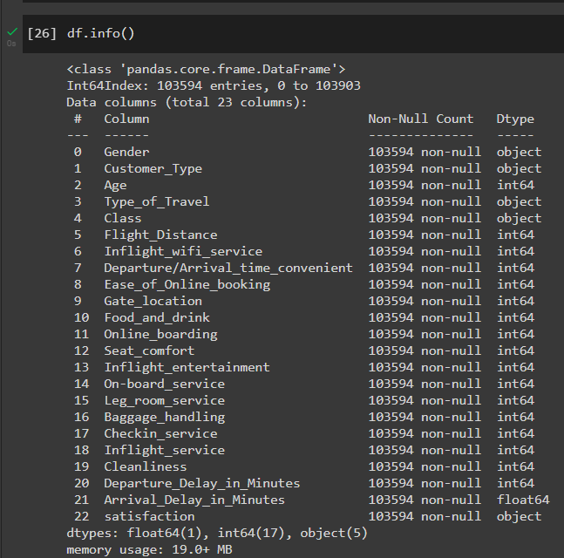
Data cleaning
I found missing values
and inconsistent data entry.
delete unnecessary columns and rows. delete outliers. after cleaning 103594 rows and
23 columns

Slide 5
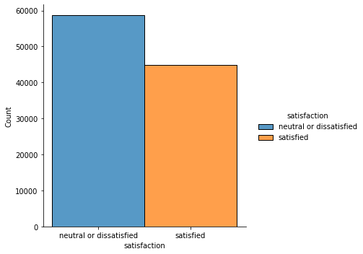
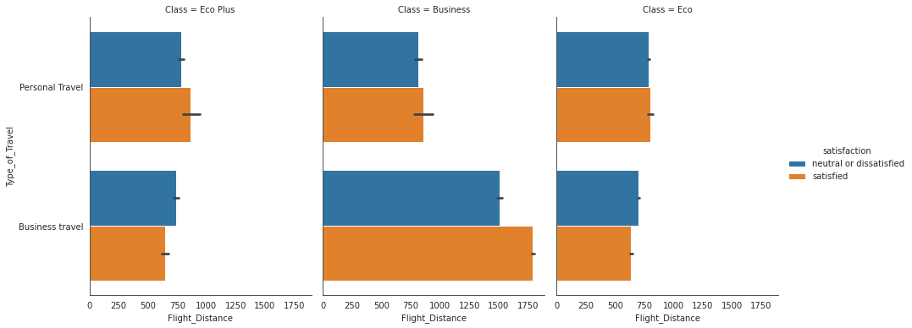
Data Analysis
Are most passengers satisfied or dissatisfied for the airline in general?
What type of class was more satisfied passengers?

Slide 6
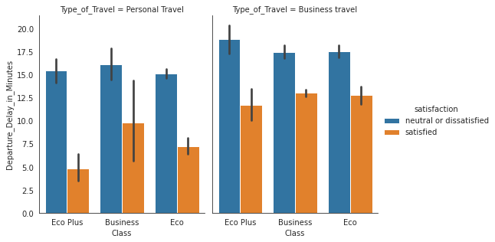
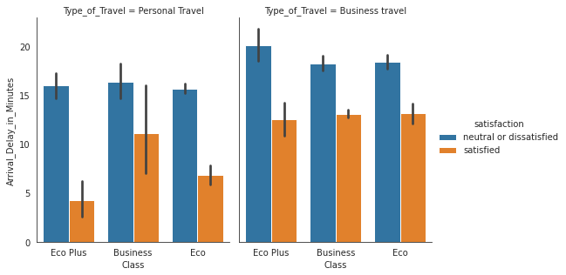
Data Analysis
For personal travel (specially Eco Plus and Eco), the no. of dissatisfied passengers are high when arrival delay in minutes is high. Now, this is obvious. By minute comparison, all combinations have higher no. of dissatisfied passengers compared to no. of satisfied passengers.

Slide 7
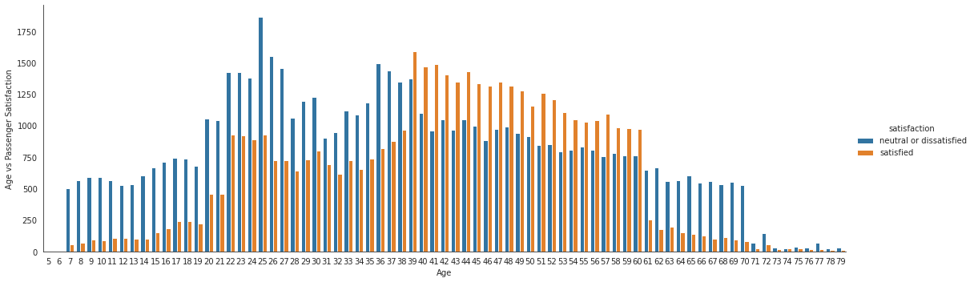
Data Analysis
3. What age group was more satisfied with the airline service?
To age 38 and age 61-to-79, quotient of dissatisfied passengers is very high compared to satisfied passengers. On the contrary, in age range 39-60, quotient of satisfied passengers is higher compared to dissatisfied passengers.

Slide 8
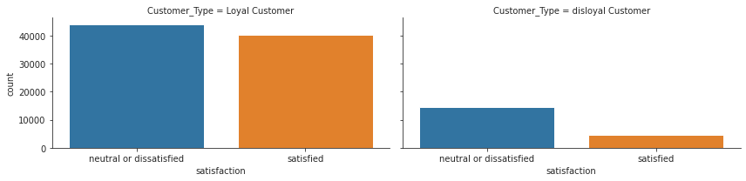
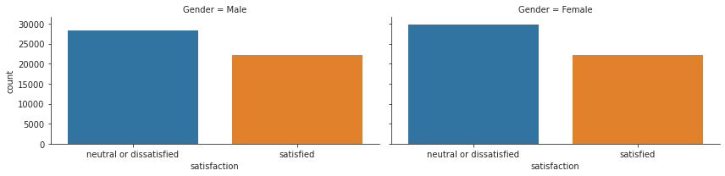
Data Analysis
4. What type of customer was more satisfied passengers?
5. Satisfaction depends on gender of passengers.

Slide 9
Conclusion
The sum up everything that has been stated so far, I reached the point of how to predict what people like and dislike and what they prefer the most so in future I can manage the services for an airline and reinforce the weak points and focusing on improvement always. in this project I tried to make customer’s experience visible for the new customers in a simple way and help the new customers to be aware about the airline service and how things work there .
2 0 2 1 | A I R L I N E P A S S E N G E R S A T I S F A C T I O N

Slide 10
Thank u all
<3

