Slide 1
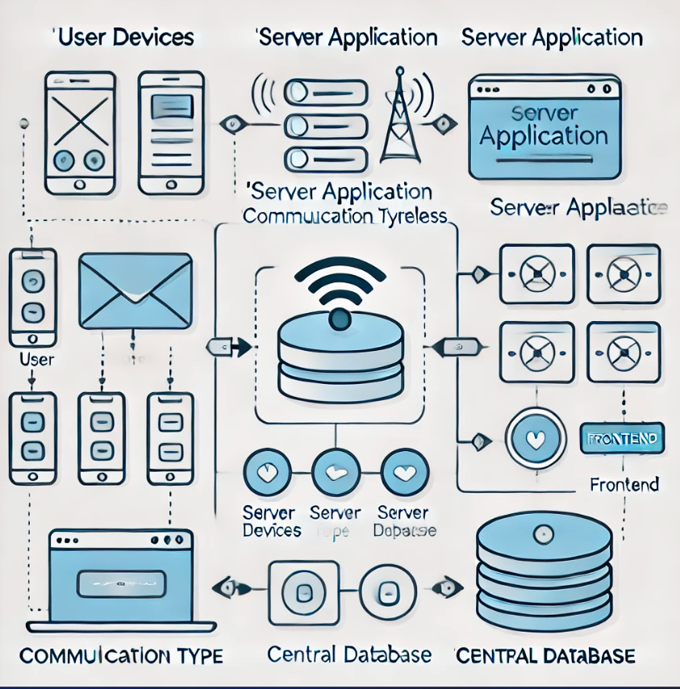
Messenger App
Team Members: Dalia Gogoașe, Nicoleta Ianoșiga

Slide 2

Project Overview
The Messenger Application is a real-time chat platform designed to facilitate seamless communication between users through instant messaging and multimedia sharing. The application allows users to send and receive messages in one-on-one and group chats, manage their contacts, and personalize their profiles. To ensure a safe and organized environment, administrators have the ability to moderate content, manage users, and review reports.

Slide 3
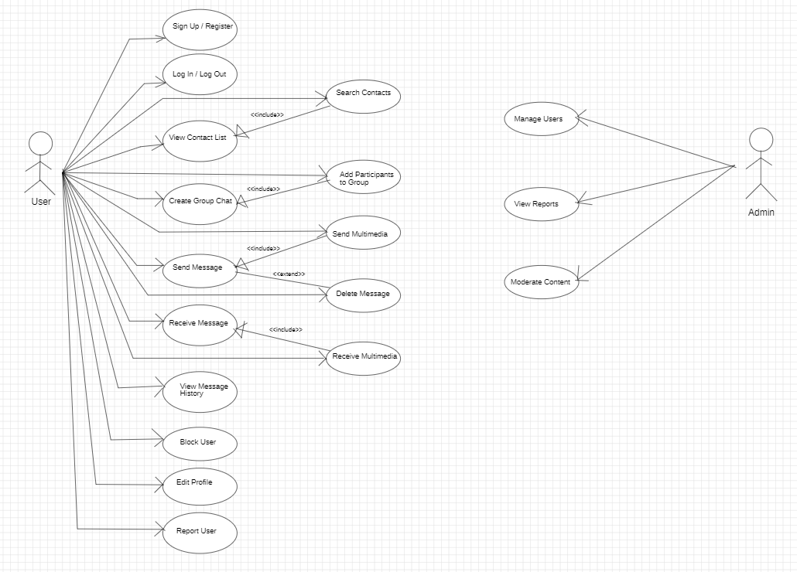
UML Use Case Diagram

Slide 4
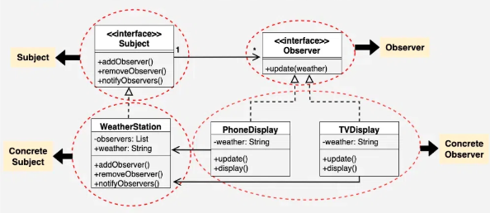
Design pattern: Observer
​

Slide 5
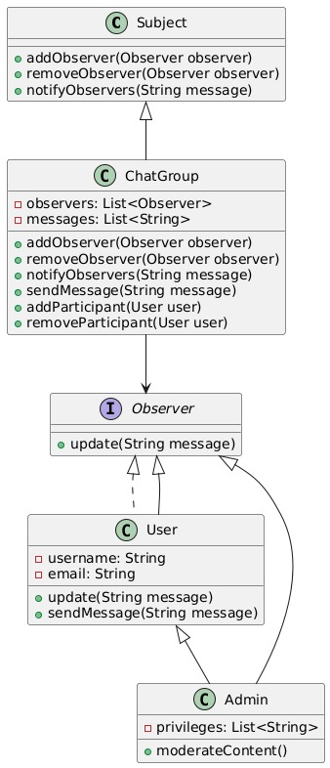
UML Class diagrams

Slide 6
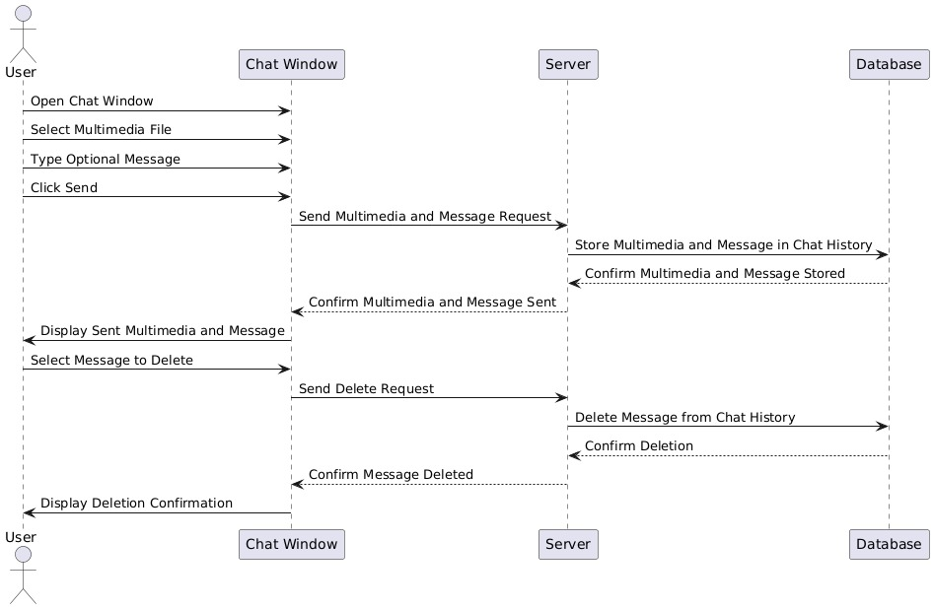
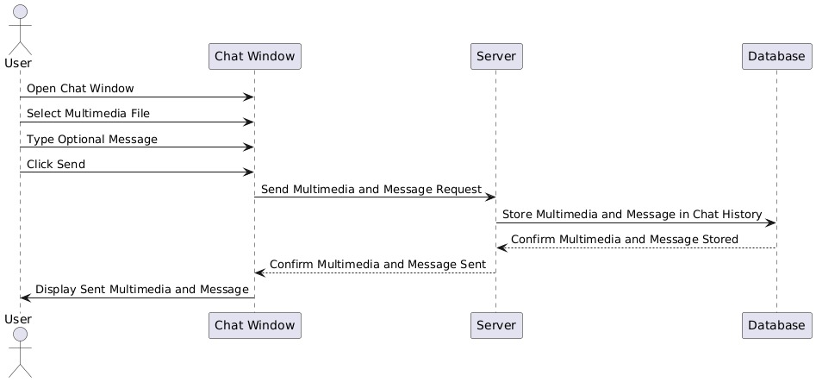
UML Sequence diagrams

Slide 7
UML Sequence diagrams

Slide 8
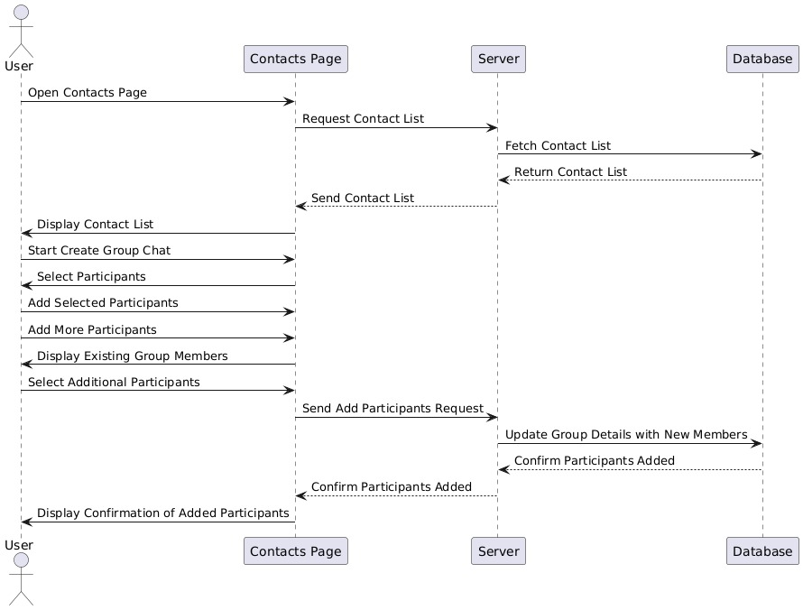
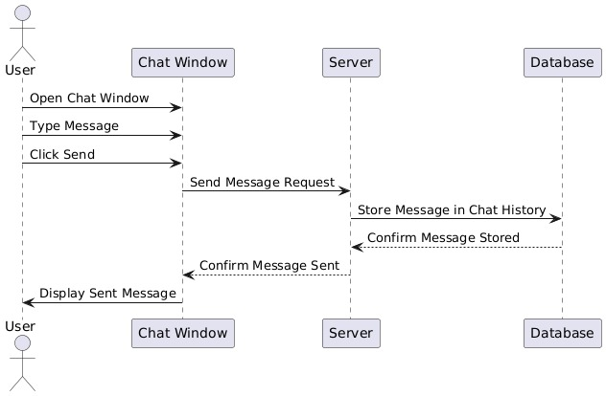
UML Sequence diagrams

Slide 9
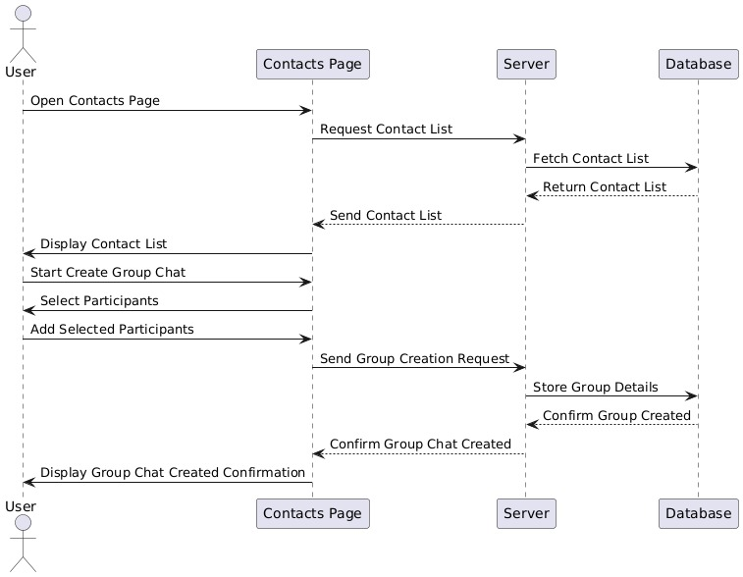
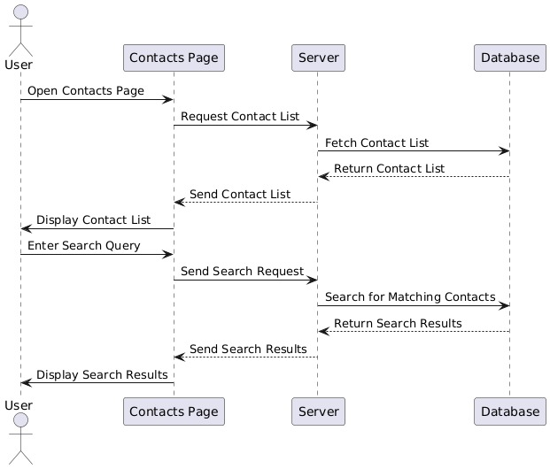
UML Sequence diagrams

Slide 10
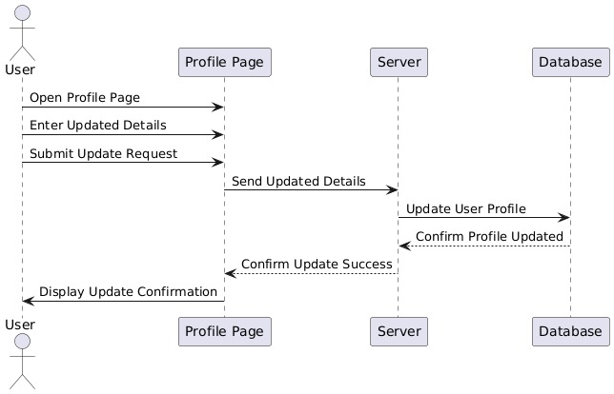
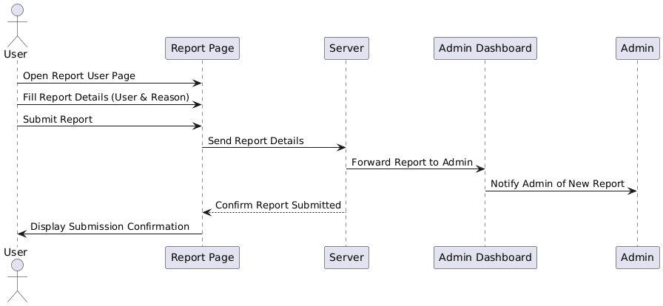
UML Sequence diagrams

Slide 11
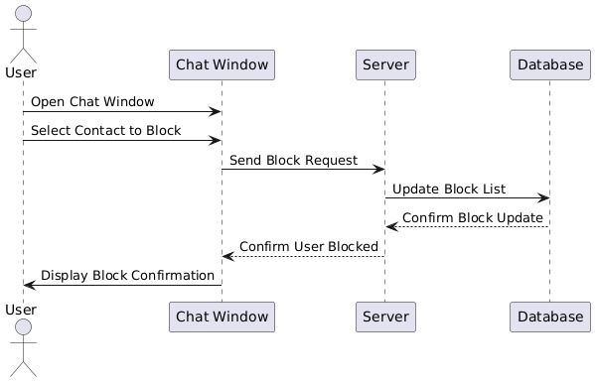
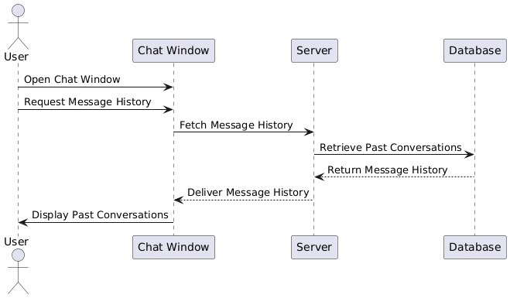
UML Sequence diagrams

Slide 12
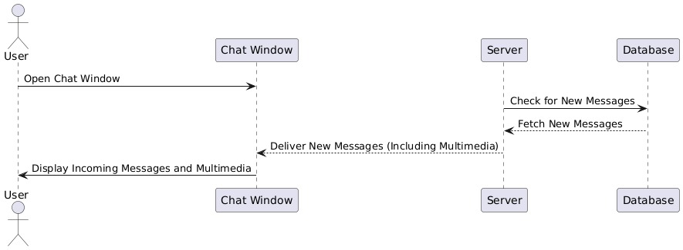
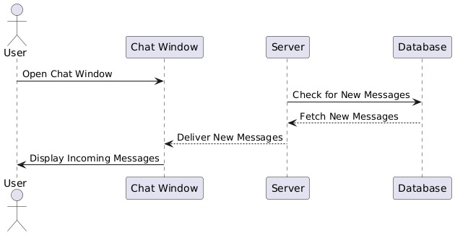
UML Sequence diagrams

Slide 13
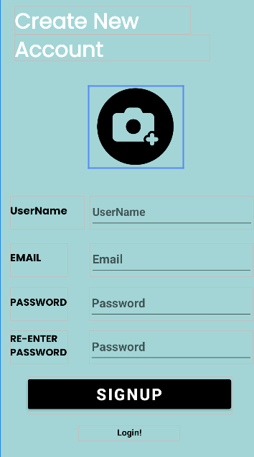
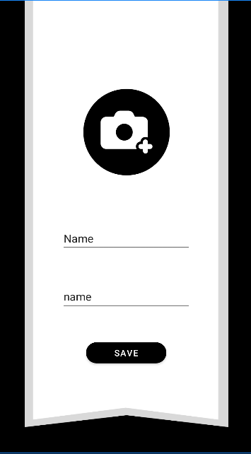
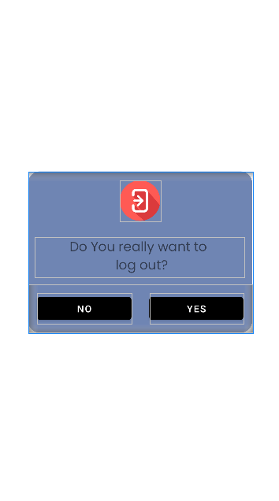
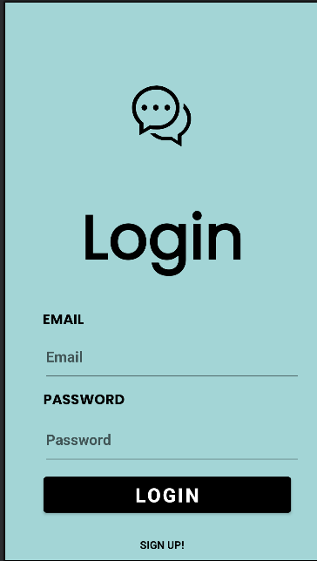
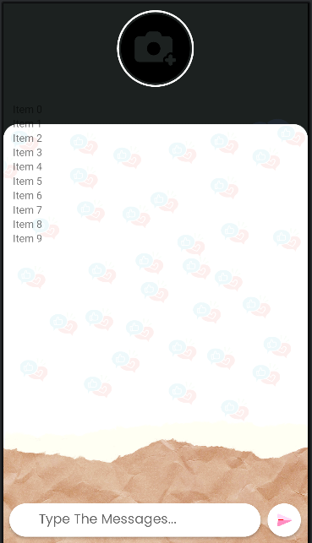
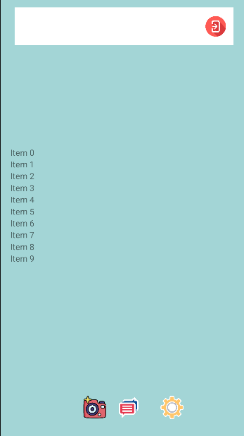
Application's interface

Slide 14


Technologies

