Slide 1
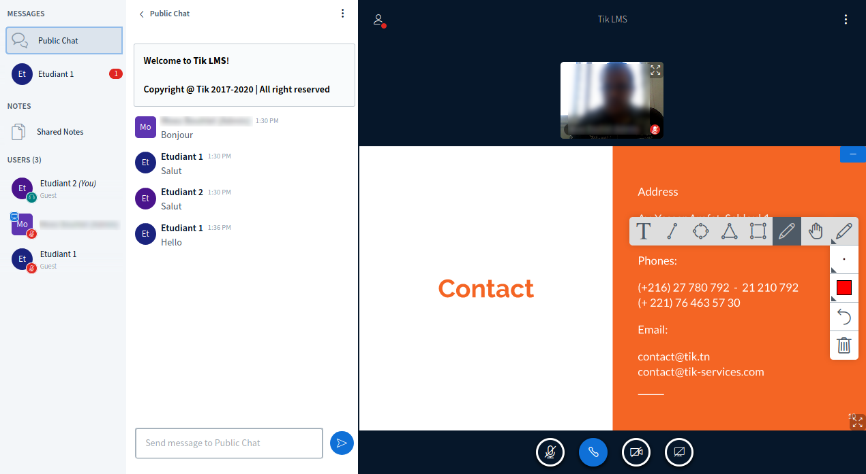
Minimiser l’interface
Public & Private Chat
Notebook Partagé
Outils Tableau Blanc
Partage Microphone
Partage Webcam
Partage Ecran
Solution provided by Technology Innovation Network ® SUARL 2017-2020 | contact@tik-services.com | https://tik-services.com/ | +216 27 780 792 | All rights reserved

Slide 2
Solution provided by Technology Innovation Network ® SUARL 2017-2020 | contact@tik-services.com | https://tik-services.com/ | +216 27 780 792 | All rights reserved

Slide 3
Solution provided by Technology Innovation Network ® SUARL 2017-2020 | contact@tik-services.com | https://tik-services.com/ | +216 27 780 792 | All rights reserved

Slide 4
Solution provided by Technology Innovation Network ® SUARL 2017-2020 | contact@tik-services.com | https://tik-services.com/ | +216 27 780 792 | All rights reserved

Slide 5
Solution provided by Technology Innovation Network ® SUARL 2017-2020 | contact@tik-services.com | https://tik-services.com/ | +216 27 780 792 | All rights reserved

Slide 6
Solution provided by Technology Innovation Network ® SUARL 2017-2020 | contact@tik-services.com | https://tik-services.com/ | +216 27 780 792 | All rights reserved

Slide 7
Solution provided by Technology Innovation Network ® SUARL 2017-2020 | contact@tik-services.com | https://tik-services.com/ | +216 27 780 792 | All rights reserved

Slide 8
Solution provided by Technology Innovation Network ® SUARL 2017-2020 | contact@tik-services.com | https://tik-services.com/ | +216 27 780 792 | All rights reserved

Slide 9
Solution provided by Technology Innovation Network ® SUARL 2017-2020 | contact@tik-services.com | https://tik-services.com/ | +216 27 780 792 | All rights reserved

Slide 10
Solution provided by Technology Innovation Network ® SUARL 2017-2020 | contact@tik-services.com | https://tik-services.com/ | +216 27 780 792 | All rights reserved

