Slide 1
IB Computer Science SL/HL
Year End Project Presentation
Project Name: Money Management Application
Student Names: Daniyal Osama and Saket

Slide 2
Project Background
Problem Statement: How to calculate net worth, income, expenses and budget for an induvial.
Success Criteria: Working Application which will calculate expenses, income. Net worth and budget.
Design: Application created out of OOP programing and Java
Demonstration: Application

Slide 3
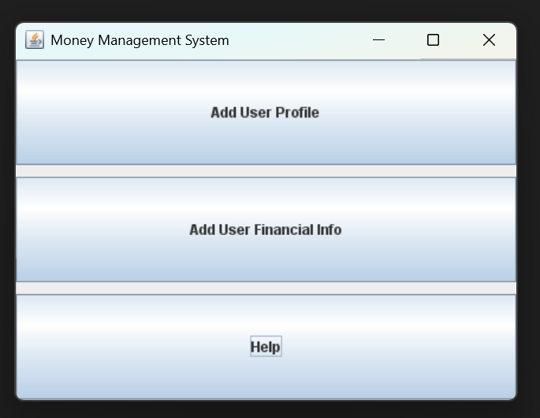
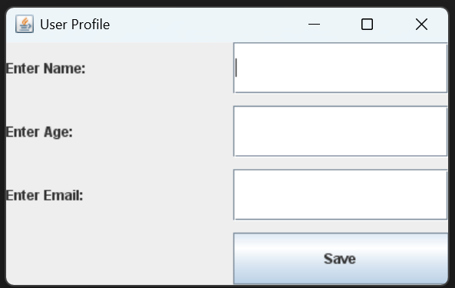
Project GUI (Home and Profile Page)
When the application is open, new users are directed to a create an account page. The user will then proceed to click on the “Add User Profile Button directing them to a page in which they fill out their info.

Slide 4
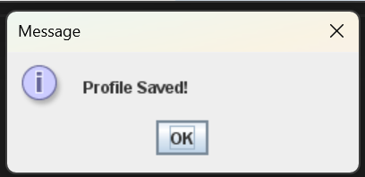
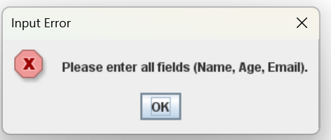
Project GUI (Home and Profile Page)
After entering their info, a pop up will appear stating that their info is saved, closing it will redirect the user back to the home page. However, if invalid info is placed in, then a pop up stating an error will appear.

Slide 5
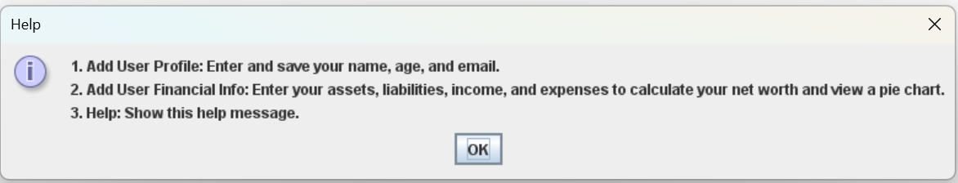
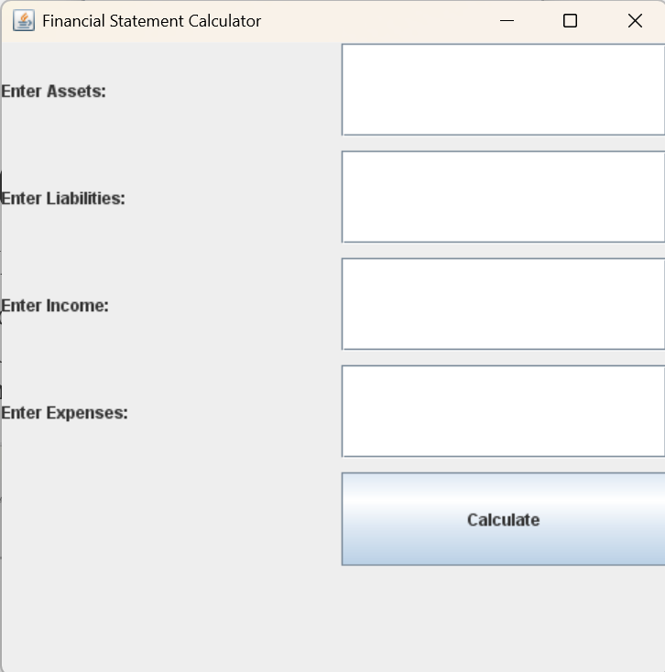
Project GUI (Home and Profile Page)
Going back to the home page, the user can either click on “Add User Finical Info” or the “Help” button. Clicking on the help button will direct the user to a help page. Clicking on the add finical info button will bring the user to a page which will allow them to fill in finical info.

Slide 6
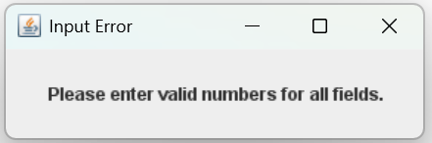
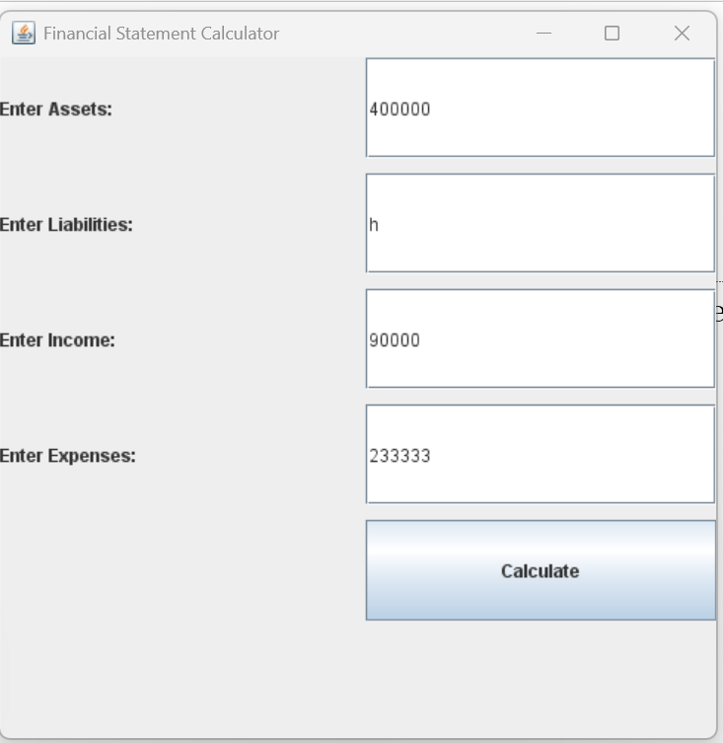
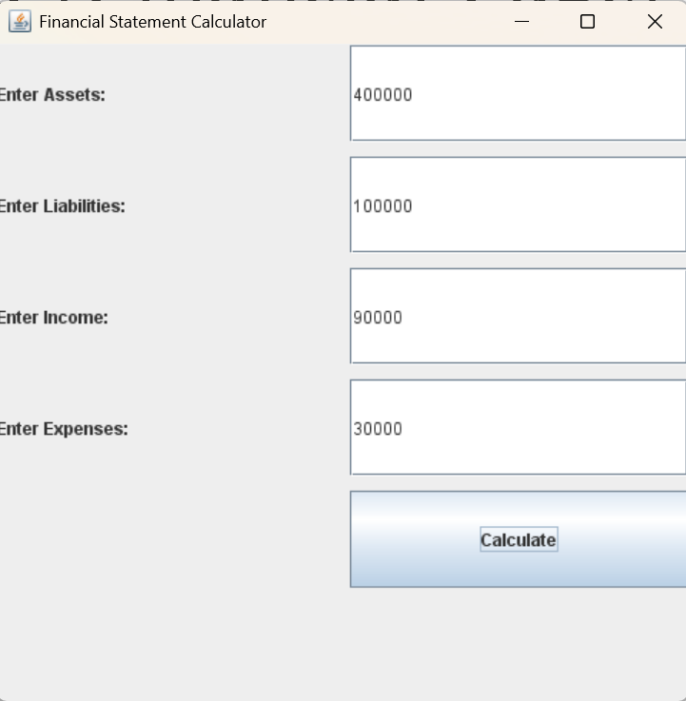
Project GUI (Financial Page)
The user can now enter their assets, labilities, income and expenses. If the user enters wrong data, then an error pop up will appear. Only digits can be entered.

Slide 7
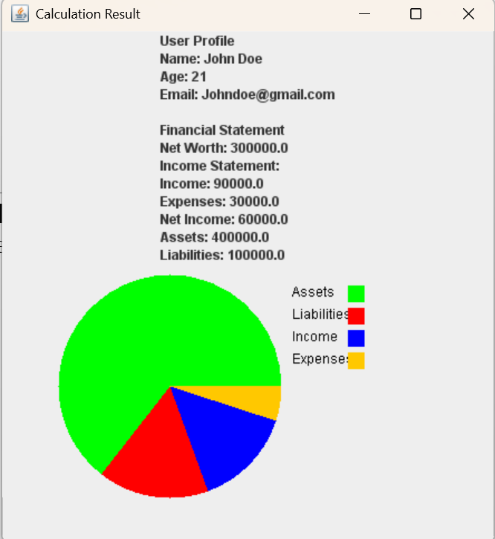
Project GUI (Financial Page)
On the previous page in which they entered their financial data, the user will click the “calculate” button. A pop up with their info, calculated data and a pie chart visual to make it easier for understand.

