Slide 1
Dalia Ahmed
Player Position Prediction

Slide 2
Introduction
Physical
Skills
Height
Weight
Speed
Shooting/Assisting
Intercepting / Tackling
Crossing
Technique
Overall Team
Aggressive
Acceleration

Slide 3
Data
Earth
71 countries
Brazil
England
45K
Leagues
Features
Premier league
La Liga
Serie A
14

Slide 4
Features
Goals
Fouls
Height
Goals Penalities
Cards Yellow
Crosses
Assists
Cards Red
Tackles won
Matches Played
Cards Yellow red
Interceptions
Minutes Played
Offsides

Slide 5
Target
Height/Intercepting/Tackling
Defender
Crossing/Assisting
Midfielder
Shooting
Forward

Slide 6
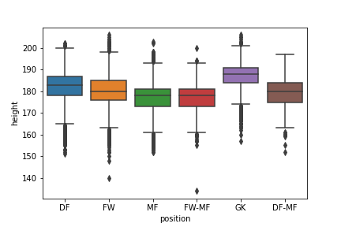
Questions
Does Height matter in specific position

Slide 7
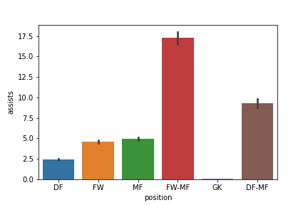
Questions
Which position requires assisting skill the most

Slide 8
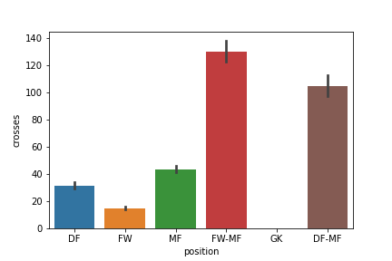
Questions
Which position requires crossing skill the most

Slide 9
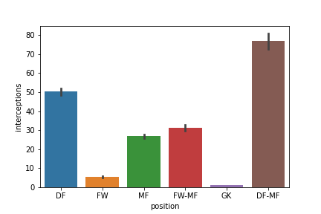
Questions
Which position requires Intercepting skill the most

Slide 10
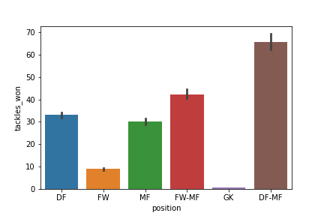
Questions
Which position requires Tackling skill the most

Slide 11
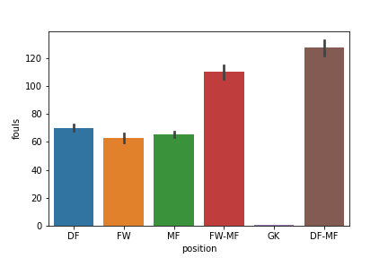
Questions
which position makes the biggest number of mistakes?

Slide 12
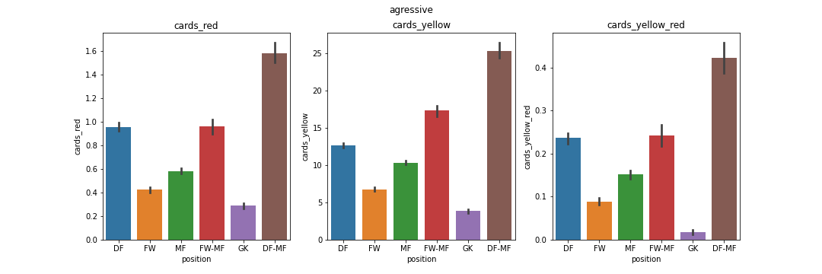
Questions
does position related to taking a card (yellow/red) and Aggressiveness?

Slide 13
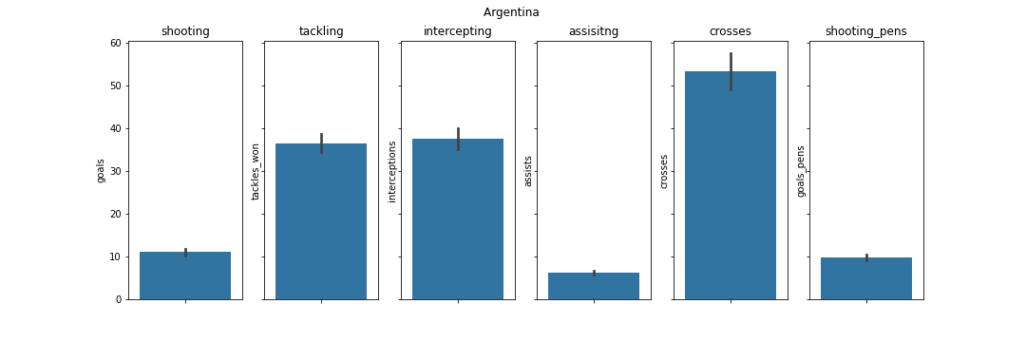
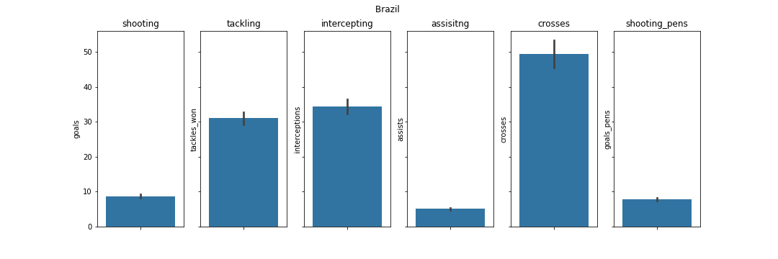
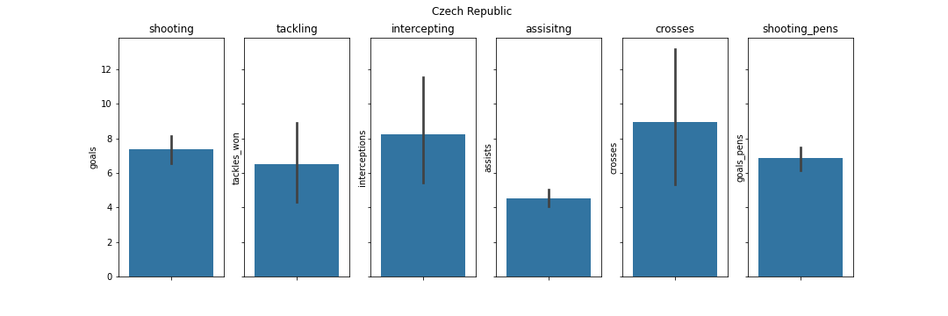
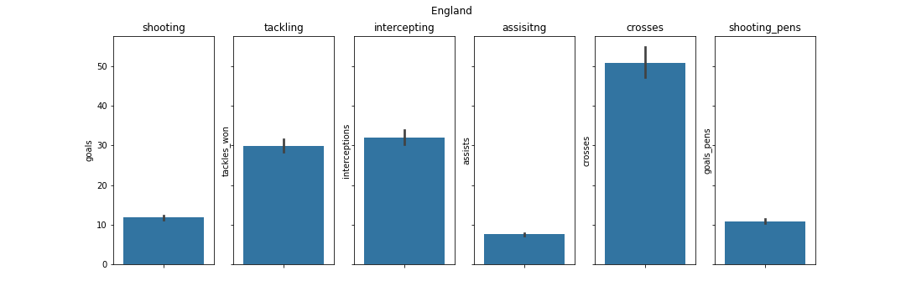
Questions
which skill that each country develops the most

Slide 14
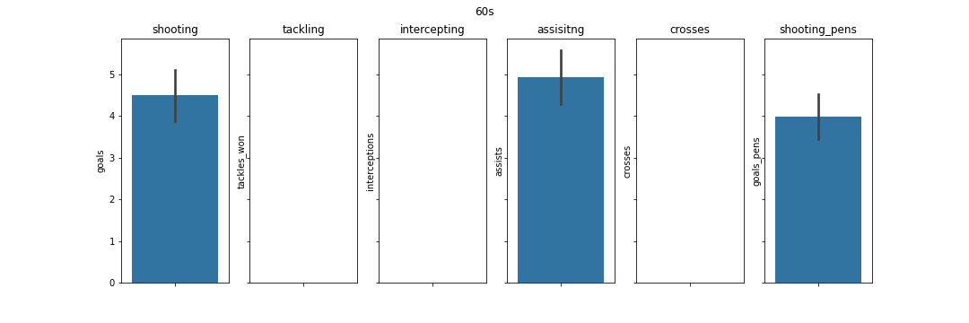
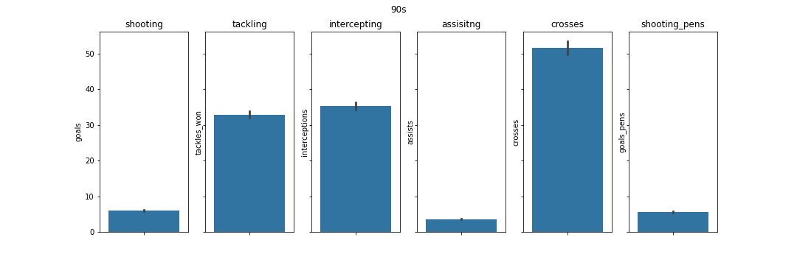
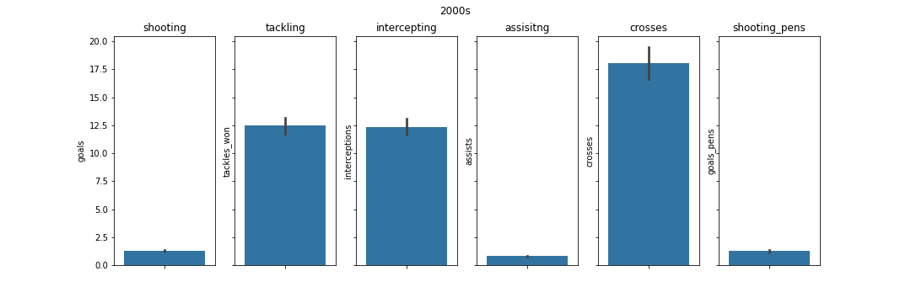
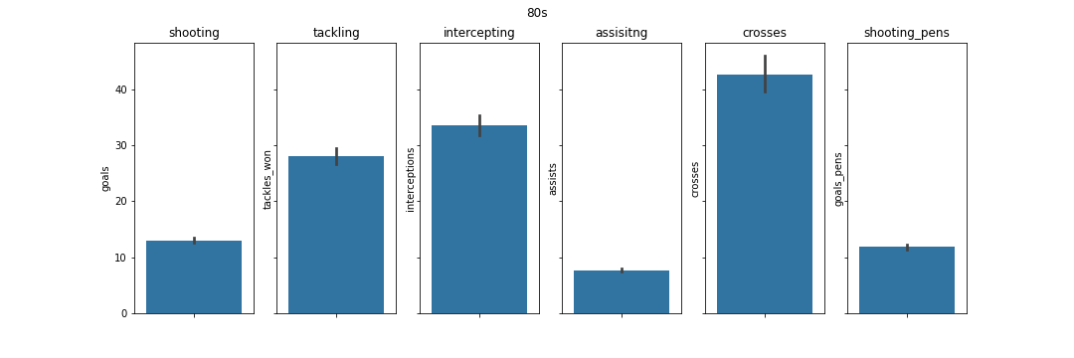
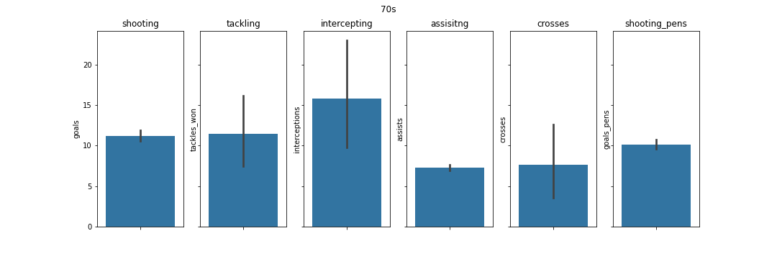
Questions
for each generation .. which skill that shines the most

Slide 15
Feature Engineering
2
Acceleration
1
Height
4
Aggressive
3
Assisting
6
Tackling
5
Shooting
8
Stamina
7
Intercepting
9
Crossing

Slide 16
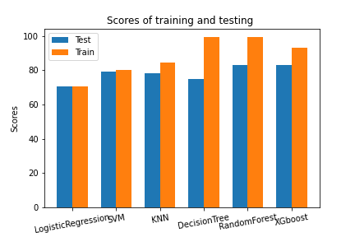
Model selection

Slide 17
Final Score and Model assessment
Test Data
Validation Data
VS
83
87

Slide 18
Future Work
Dashboard for all Countries
More Scraping
Plotly Dash
Embed Dash into Flask

