Slide 1
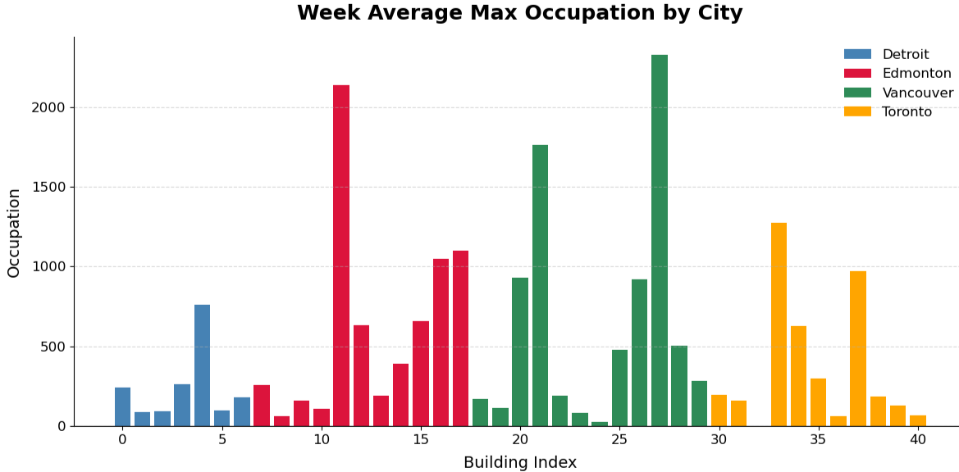
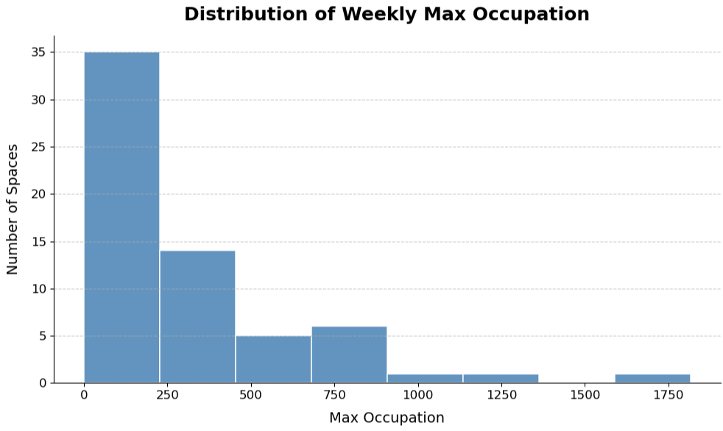
Occupancy Analysis - Trends and Anomalies

Slide 2
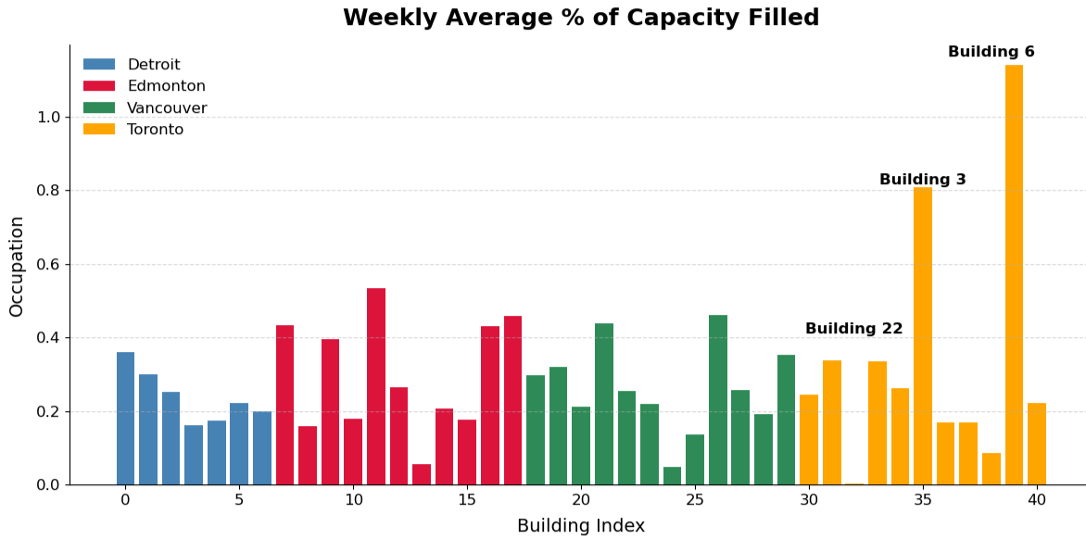
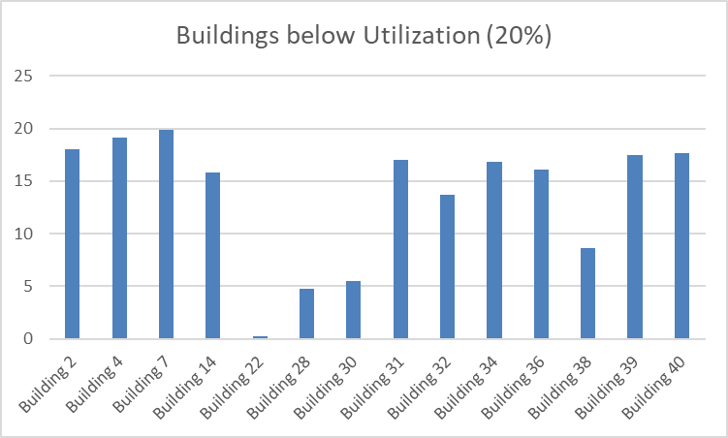
Building 22 is <1% occupied
34% of buildings running on less than
20% capacity

Slide 3
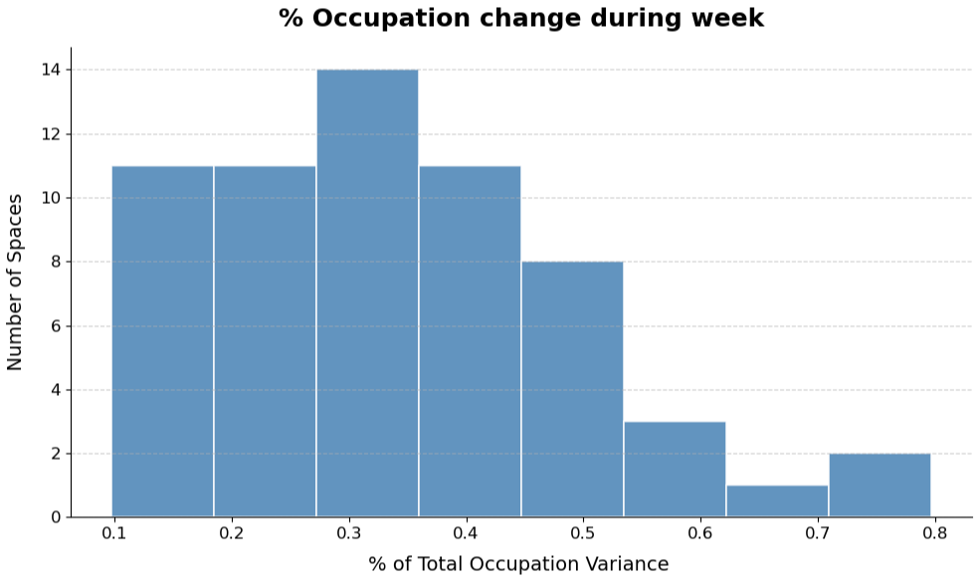
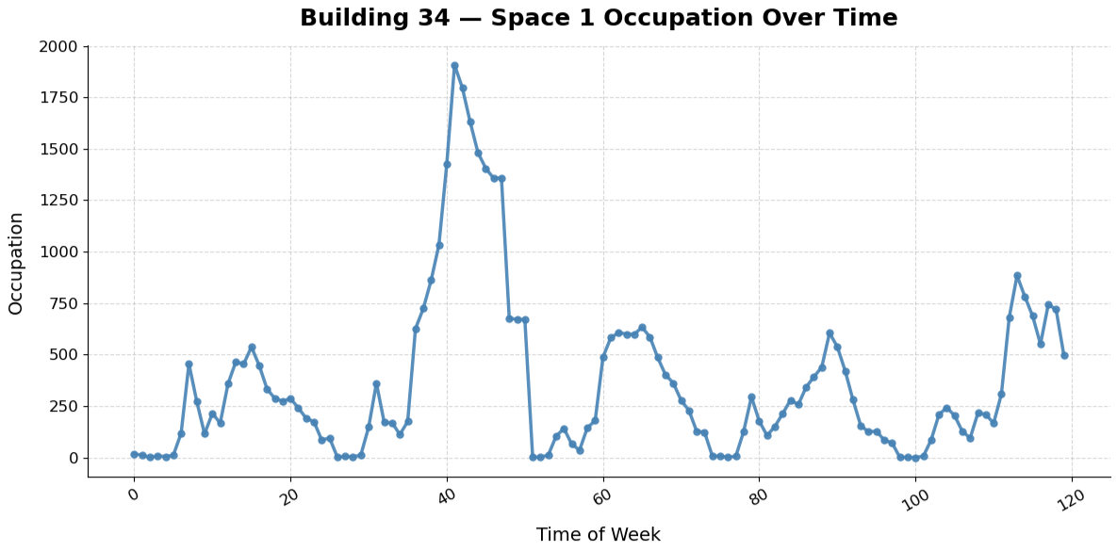
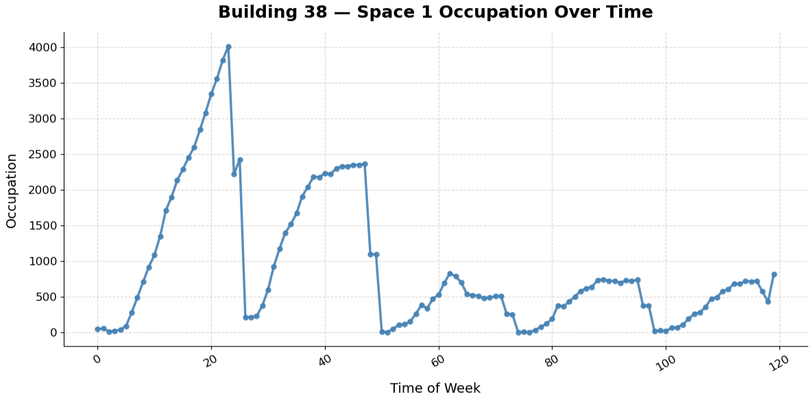
Inconsistent
Building Usage

Slide 4
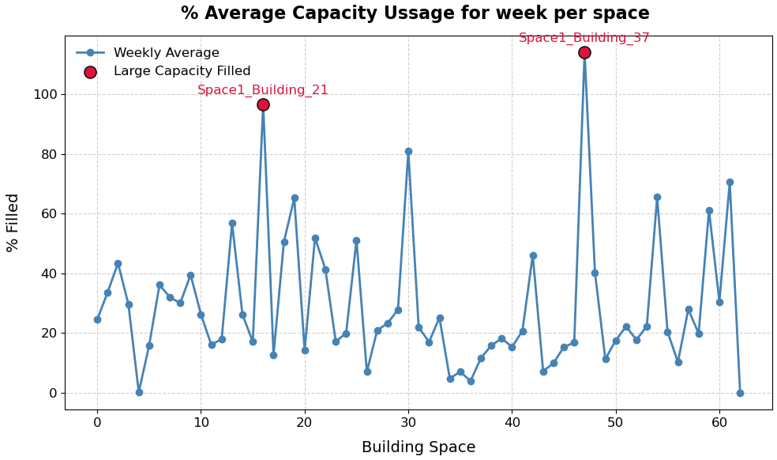
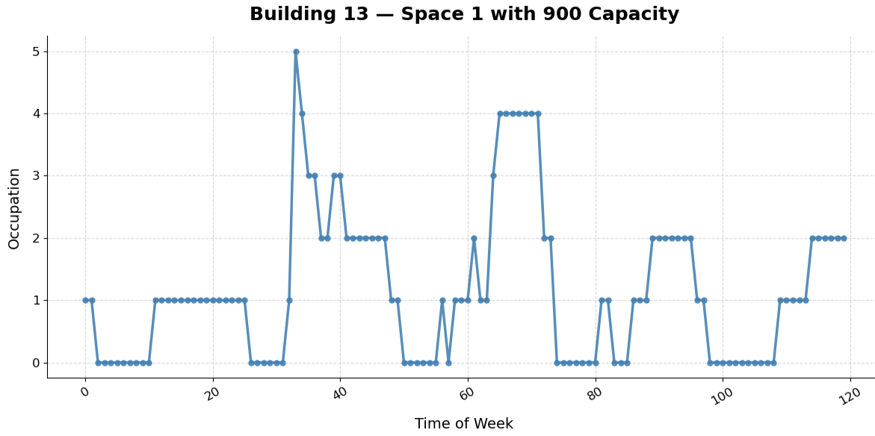
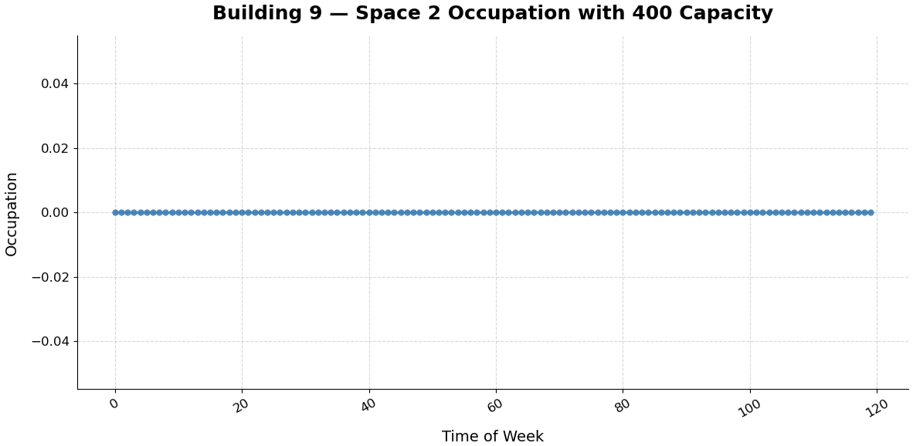
Extreme waste of spaces
Two examples
But many more
Two spaces operating at or over capacity

Slide 5
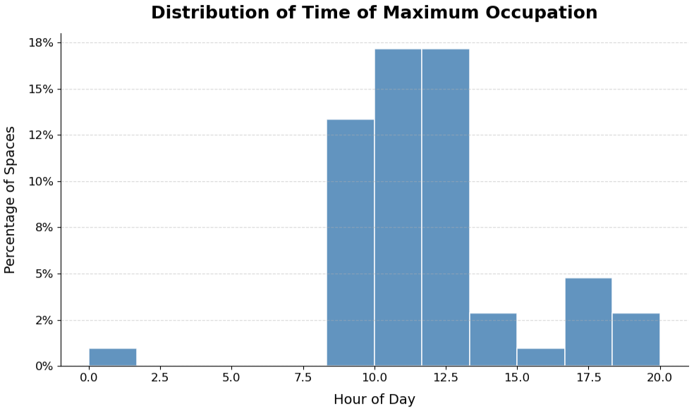
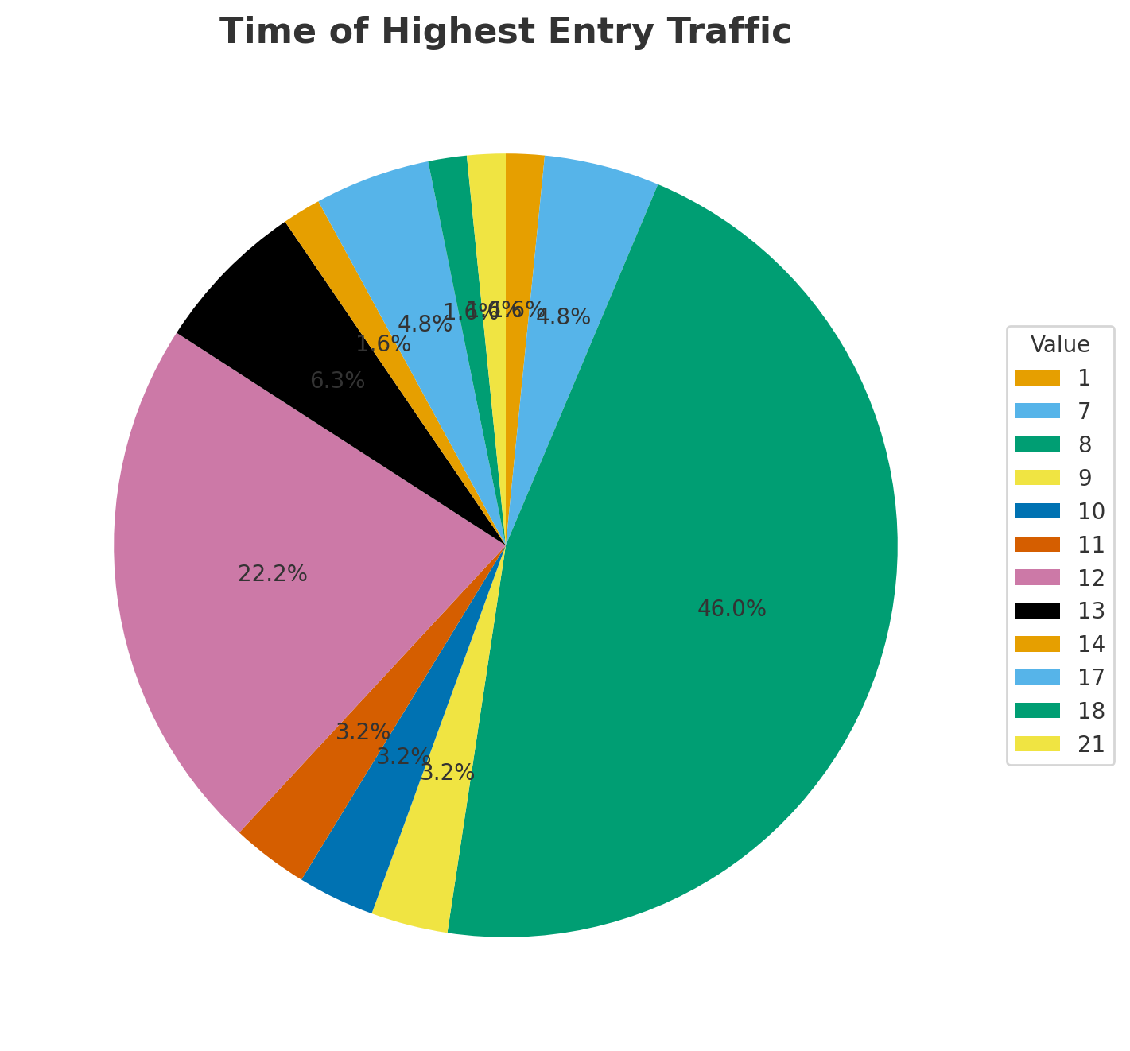
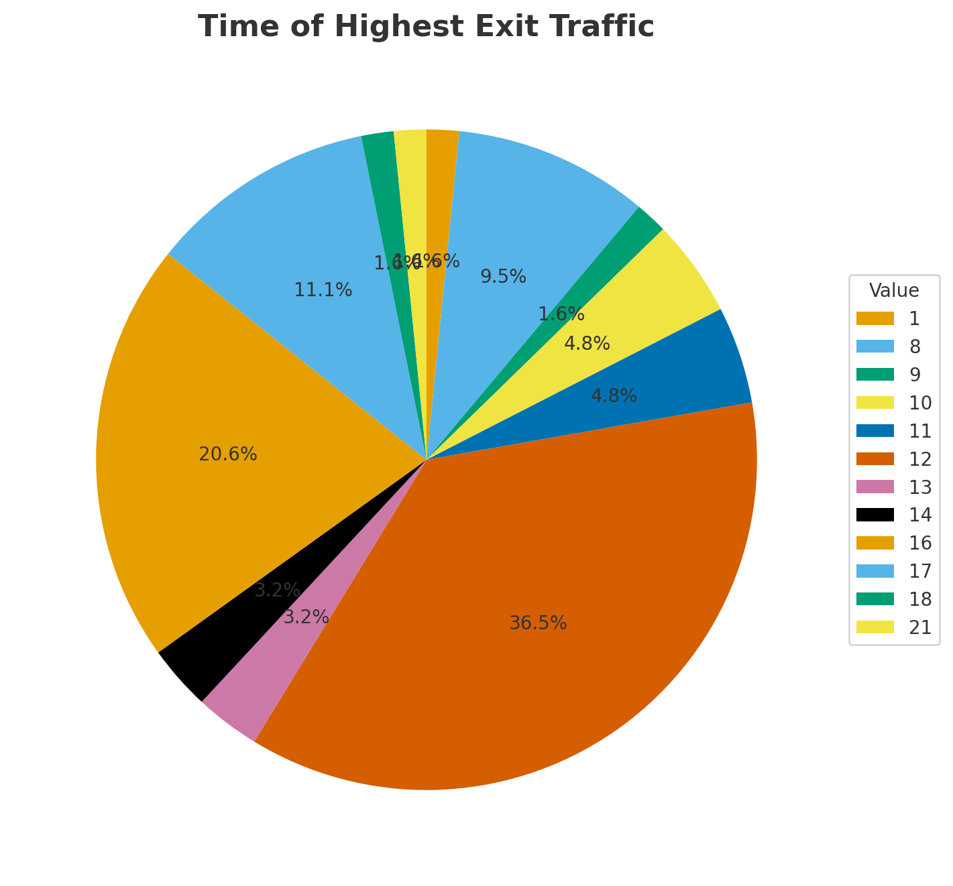
Noon (Lunch) sees highest exit traffic
Followed by
4pm
46% of buildings 8am peak entry traffic
22% of buildings 12pm peak entry traffic

Slide 6
Key Insights
Large share of buildings underutilized (<20%).
Some spaces unused or highly inconsistent.
Clear entry/exit peaks (8am, lunch, 5pm).

