Slide 1
General Notes
The occupation reading was reset to 0 at 02:00:00 everyday
We had data roughly each hour of the day and night from saturday to sunday
To simplify analysis I only looked at Monday - Friday. Good to separate work week trends vs weekend trends

Slide 2
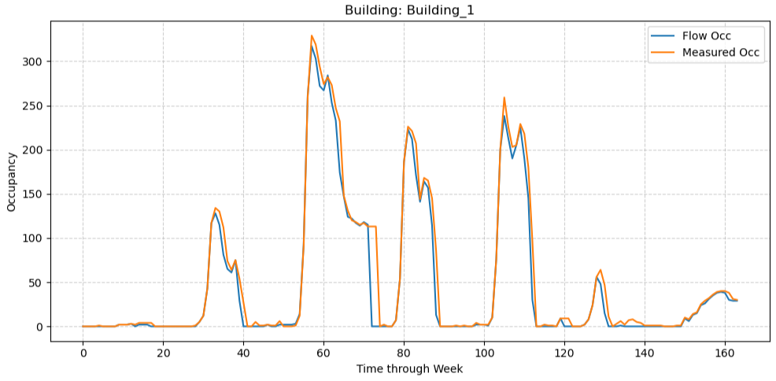
Unified Metric
Created a new metric called flow. flow = people_in - people_out.
Rolling sum through each day, and compared to occupation measurement.
Discrepancy is small compared to total occupations throughout week.

Slide 3
Unified Metric
Without further information I must speculate reasons
Multiple entrances flow sensors miss
Occupation sensors mis count when people are close or near irregular objects
Since we don’t have ground truth, the safest way to reduce bias from either system is to average them. This keeps us from overcommitting to one potentially flawed measurement
Best quick fix:
Average the two to try and limit the flaws of both.
Roundup to nearest integer so we don't miss people if only 1 person is present.
With more information could assign a weight to sensors depending on reliability

Slide 4
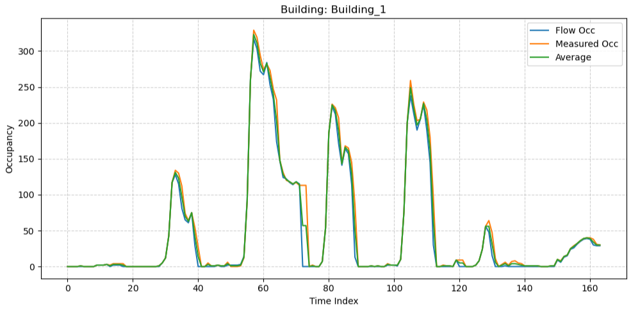
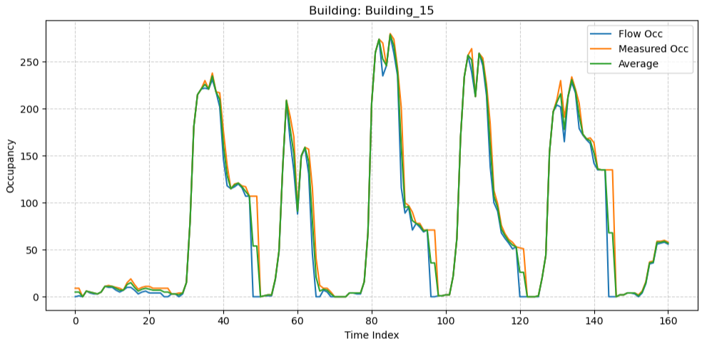
Unified Metric
The high traffic time zones are minimally affected, but improved.
Doesn’t completely erase anomalous readings in weird hours when flow sensors don’t catch anyone
Flow calculation resets at midnight (easier to code)
Occupation Sensors reset at 2
Systematic difference of why Flow Occ drops before measured occ
Dip in peak maximums likely due to lunch break

Slide 5
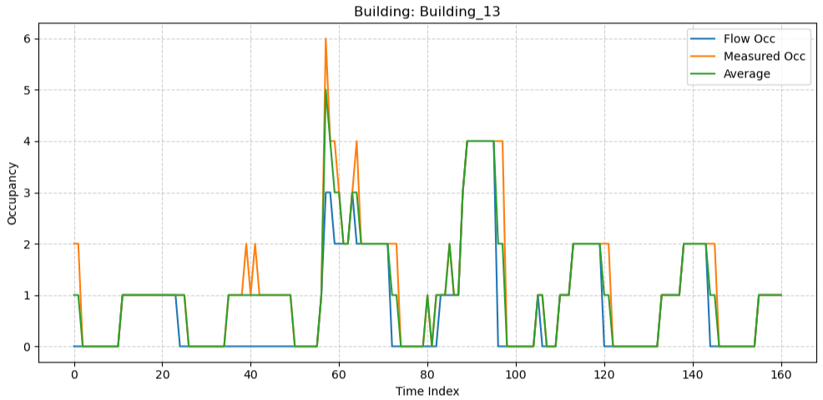
Small Occupations
This fix greatly improves readings in small buildings where one sensors mistake could be a difference in reading an empty room vs occupied

Slide 6
Summary
With this fix my analysis was straightforward working with one unified metric
A lot of fun analysis to do
But because asked for dashboard a thorough analysis is left in notebook
Will have a slide or two replicating interactive dashboard with big picture KPI, visual summaries and highlighting anomalies for problem 4.

