Slide 1
General Notes
Sensors ran on two cycles. Occupied and Unoccupied corresponding roughly to working hours in the office
The set point temperature was set higher at night presumably to save energy
The set point was lower during the day
More comfortable but more energy / money
All sensors stopped recording at 1:13, but would return a few minutes later. This might be due to a routine system reset. Or perhaps this was from an anomalous event.
Estimated the missing temperature reading by the average of the previous and next measurements

Slide 2
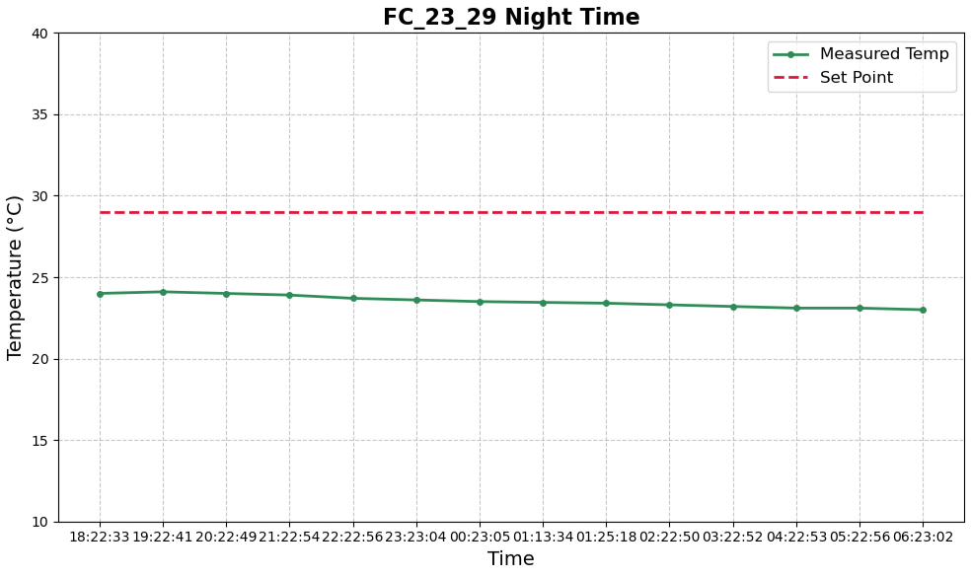
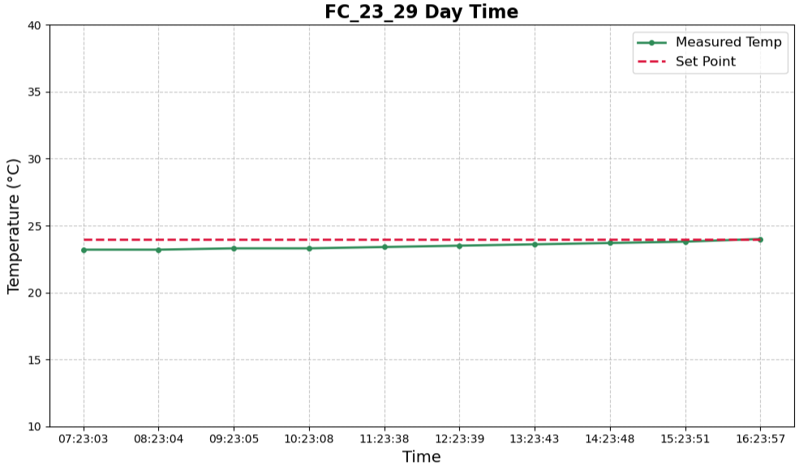
Sensor 0
Reached setpoint only at end of work day. Never hit equilibrium.
Average 0.5 °C below set point
Average rate of change: +0.09 °C/hour during the day. But steadily increased as day progressed
Temperatures rose more quickly in the afternoon, possibly due to poor insulation, window placement, or evening sun exposure

Slide 3
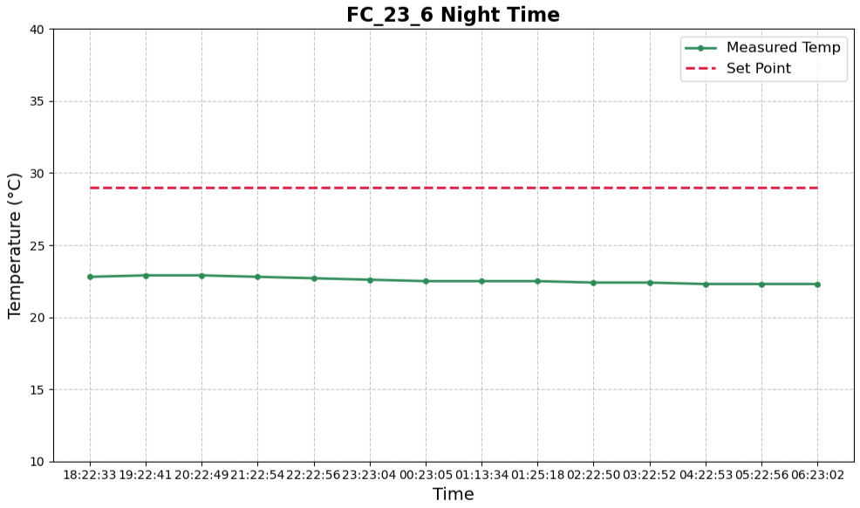
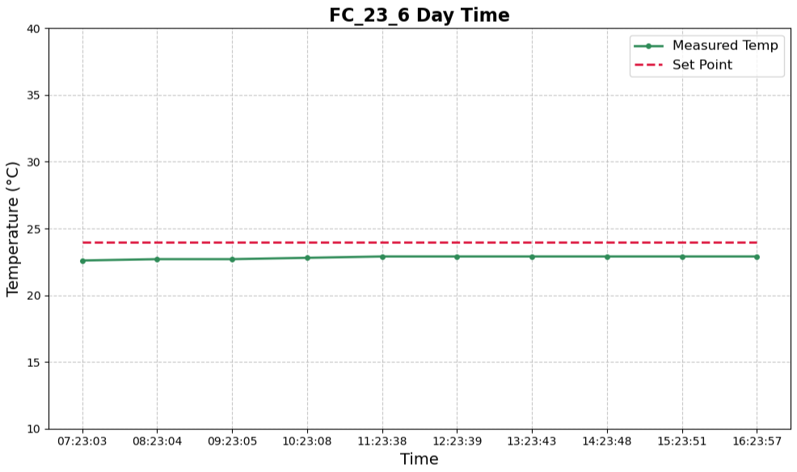
Sensor 1
Reached equilibrium 1.1 °C below set point 4 hours after occupant mode switch.
Average rate of change: +0.035 °C/hour during the day.
Suggests optimal insulation and HVAC performance

Slide 4
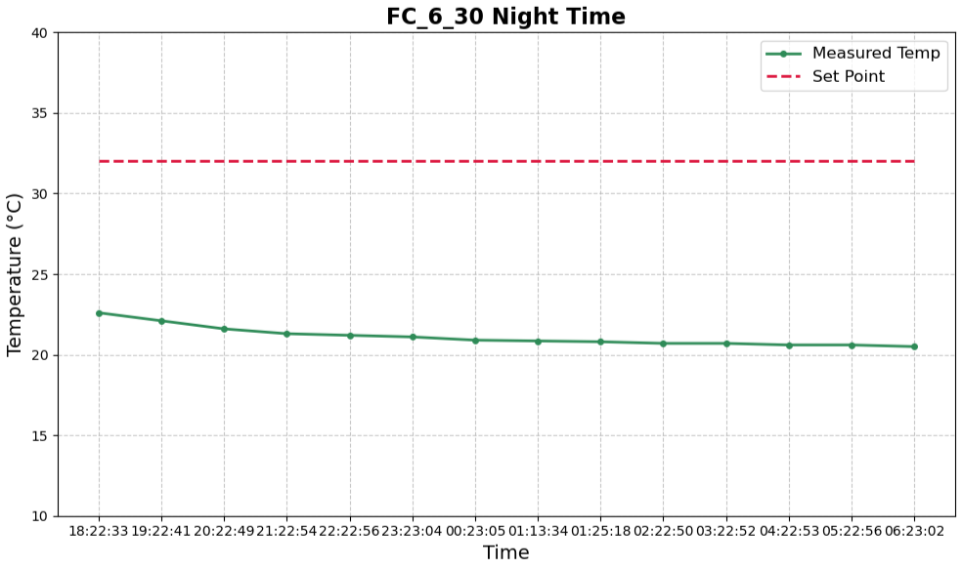
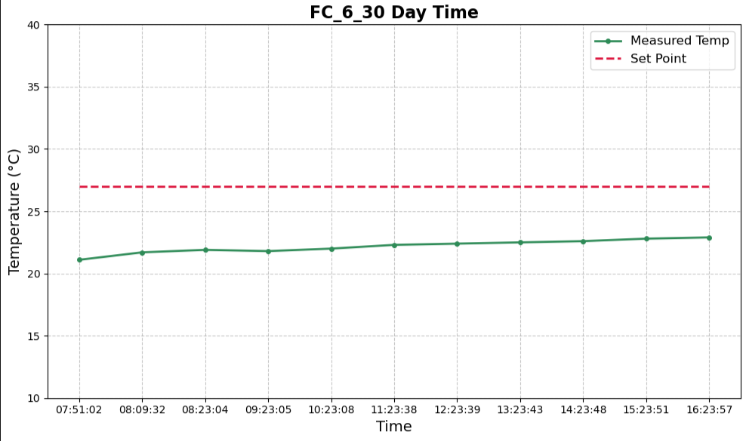
Sensor 2
Day time readings stayed below set point, but never reached equilibrium.
Rate of change decreased as day progressed, with an average of +0.2 °C/hour
Far faster rate than Sensor 0 & 1 & 3
Suggesting differences in insulation or HVAC responsiveness.
Average of 4.8 °C below set point during day.

Slide 5
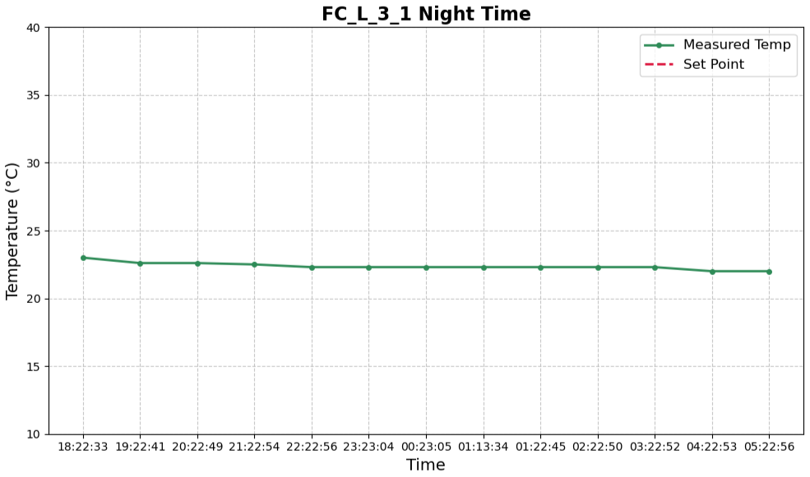
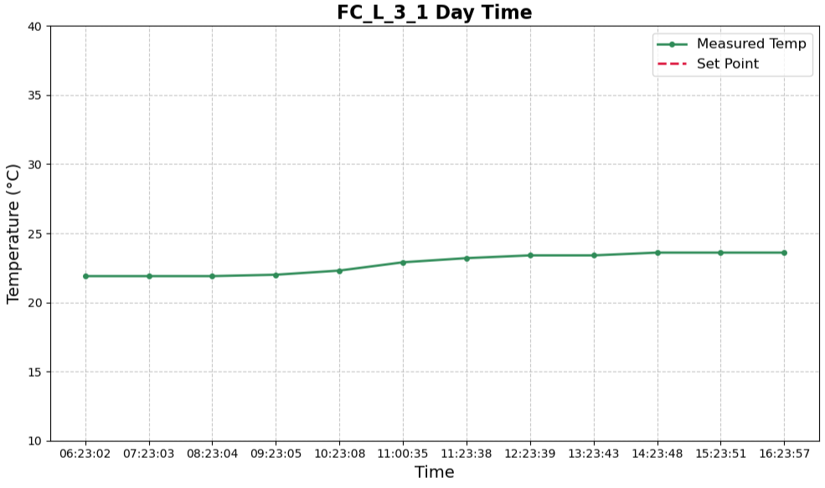
Sensor 3
Sensor 3 appears misconfigured (setpoint logged as 0°C). This likely indicates a calibration or repair need
Reached equilibrium 6 hours after occupant mode switch at 23.4°C
Rate of change averaged at +0.14°C/hour
Only increased between 9:23 to 12:23
Possibly due to small time interval of direct sunlight
Suggests optimal insulation and HVAC performance.

Slide 6
Summary
3 of 4 sensors show stable temperatures below setpoint.
Sensor 1 is optimal; Sensor 2 shows fastest swings; Sensor 0 did not stabilize fully; Sensor 3 misconfigured.
Recommend calibration of Sensor 3 and further investigation of Sensor 0 and 2 for possible improvements in efficiency.

