Slide 1
How to start with Containers
Robert McCaleb

Slide 2
Docker In Brief
Vision: Build, Ship, and Run Any App Anywhere
Both: a company and an open source ecosystem (under the Apache license V2.0 since 2013)
Docker is a tool chain written in Go that simplifies the creation and management of containers.
Paradigm shift: “new” packaging model for deploying applications and services
Containers: A self-contained portable environment for packaging, deploying, and executing applications and services. Contains all execution dependencies for a service (one process == one container)
Better resource utilization: VMs virtualize the CPU, containers virtualize process(es) (lightweight) (launch in ms vs s, doesn't consume OS memory)
Application Lifecycle Management impact:
  Build and configure once (integrated DevOps), and rebuild often ;-)
  Deploy anywhere (laptop, server, cloud, …)

Slide 3
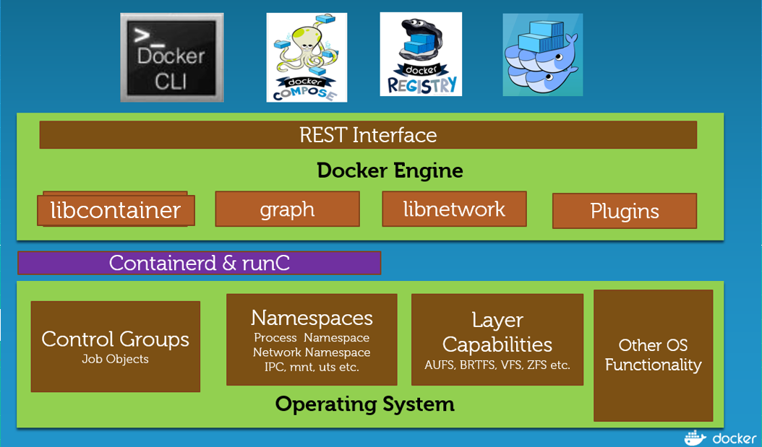
Docker CE on Linux
CE Engine
Docker Compose
Docker Swarm
Docker Registry (container)
http://collabnix.com/a-comparative-study-of-docker-engine-on-windows-server-vs-linux-platform/

Slide 4
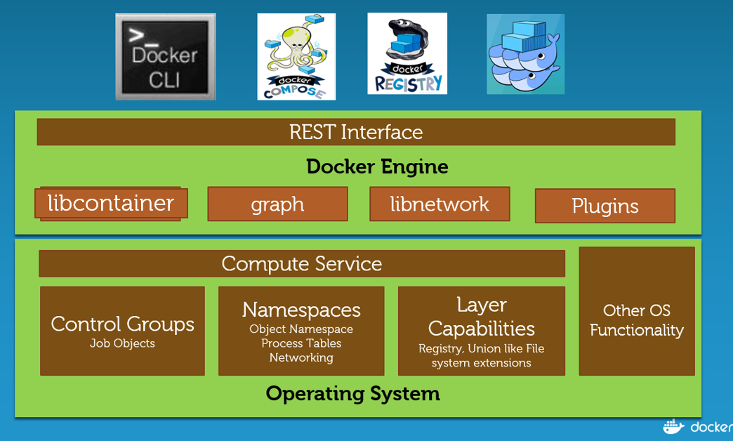
Docker CE on Windows
CE Engine
Docker Compose
Docker Swarm
Docker Registry (container)

Slide 5
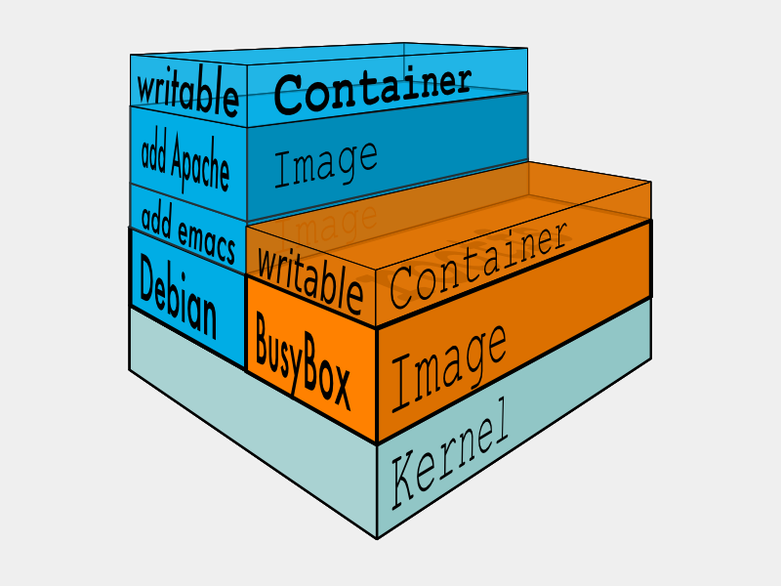
A layered approach
Images
  Local or remote reference content to initiate a container
  Multiple images can be layered adding content at each time using Copy on Write FS
  Cache to speed up repeated operations
Containers
  Last layer providing rw access to the cumulated set of images

Slide 6
Security
CTN Apps are more secured vs BM Apps
Docker has least privileged principle
Different security isolation than VMs (Combine containers & VMs for improved security)
Uses cgroups, seccomp, namespaces, capabilities. Benefit from SELinux, apparmor, Grsecurity, PAX
Depends on choices and practices
  Use of root privilege (only when necessary)
  Disable SUID
  Fine-grained privileges
  Use advanced Docker configuration options
Trusted images / container secrets
  Official images / Signed images
  Vault –open source project to managing secrets
Container delivery pipeline can/should include security testing
Management of images and containers wrt security updates
Container security continues to improve while its Understandably a hot topic

Slide 7
Docker Engine
Docker CE
  CLI Linux and Windows are the same
  Docker Engine, Docker Registry, Swarm (Orchestration)
Windows Native (EE)
  W/HyperV Linux and Windows
  W/O HyperV Windows only
Docker EE
  Engine, Docker Trusted Reg, UCP (Swarm)

Slide 8
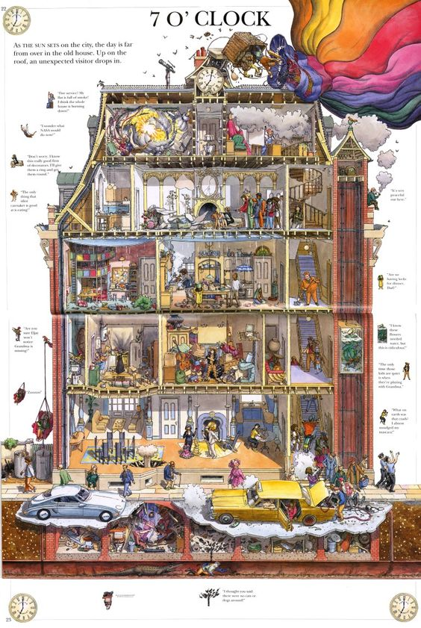
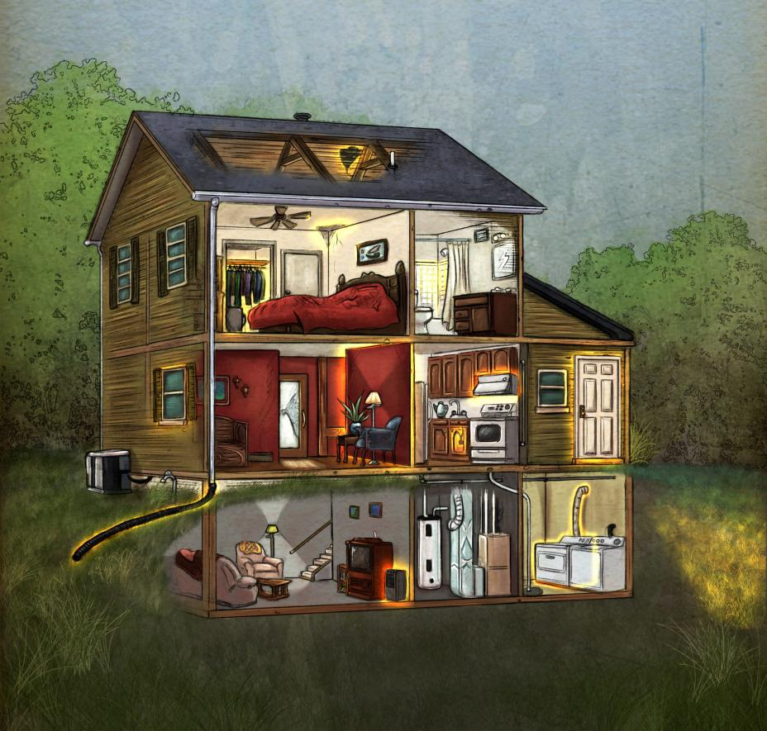
Containers are Apartments and VM’s are houses

Slide 9
How to containers
Layers
Tweaky
Dockerfile
Docker build yer versions

Slide 10
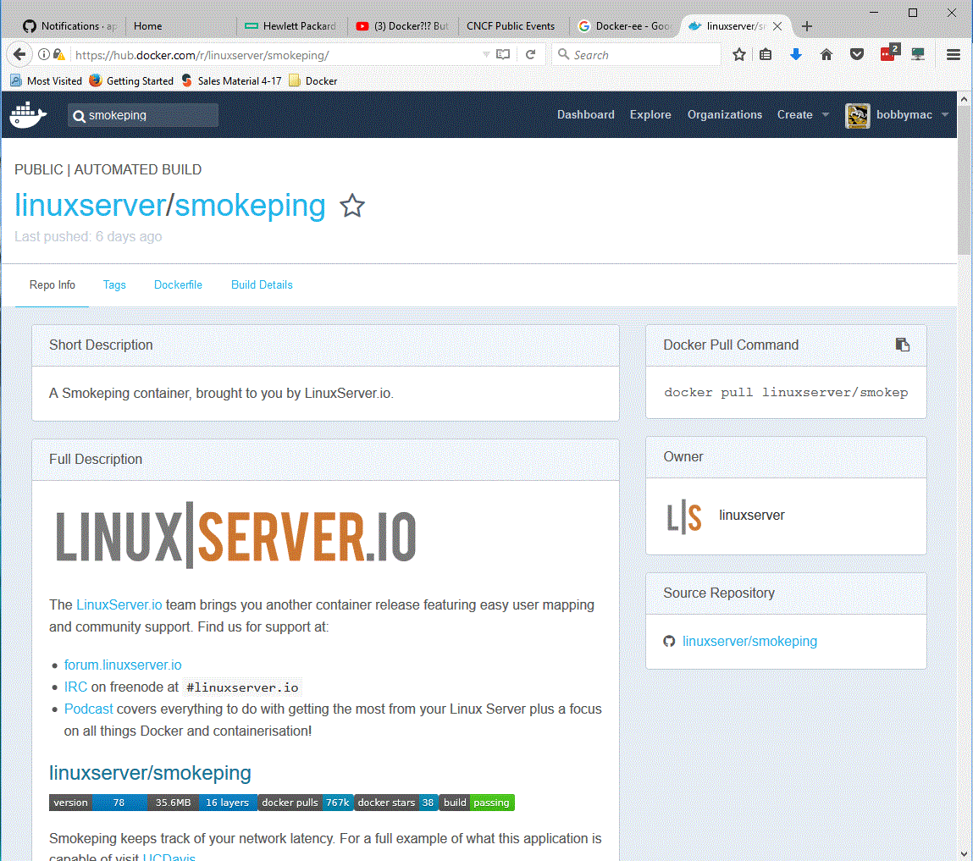
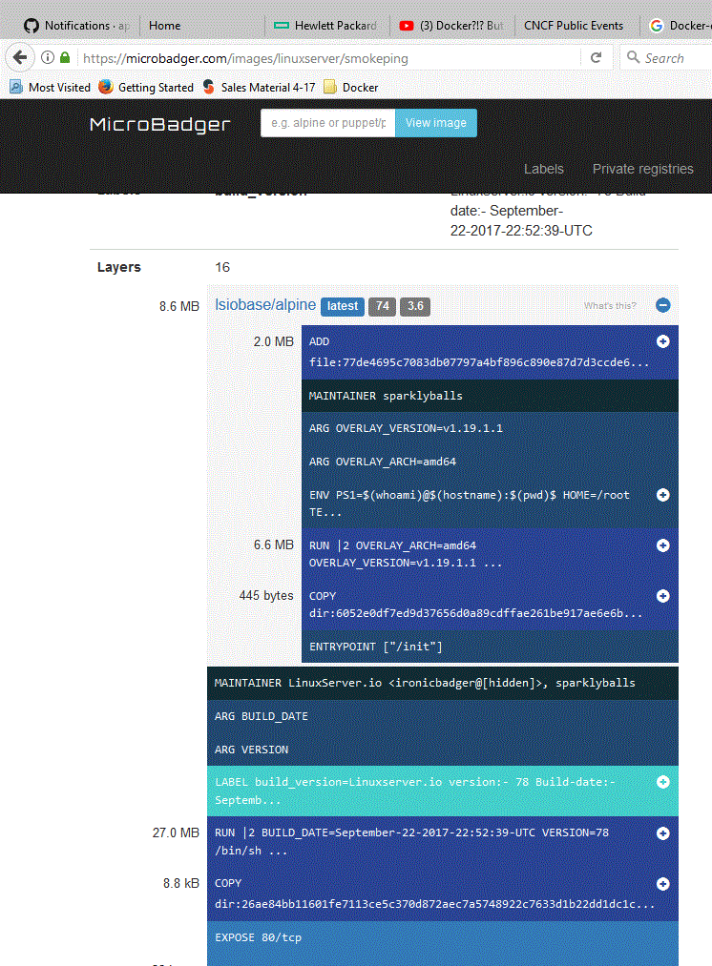
SmokePing Layers

Slide 11
Dockerfile

