Slide 1
New Vision Chat Analysis App
Project Team(group 3)
Name | Registration Number | Student Number
Mutungi Denis Sharp | 16/X/2340/PS | 216002239
Kalema Arnold | 16/U/5256/PS | 216003529
Asingwire Dallington | 16/U/127 | 216000708
Nanjuki Saidat | 16/U/9715/PS | 216017634

Slide 2
Description of the Application
The New Vision Analysis App is a chat analysis application whose
Main functionality is to analyze chat data and outputs identified insights in the chat data that human beings can’t figure out.
Clients
New Vision company a media company in Uganda

Slide 3
Application users
Clients of New Vision Chat Analysis App is the New Vision company
Specific Users
Top level management of New Vision such as the CEO, CTO, System Administrators etc
Purpose: to analyze the chat data using the application
Developers
Purpose: to enhance the application

Slide 4
why use the application
Save time
results are produced quickly
Accurate results
Application was fully tested i.e modular test and integration test hence correct results.
Secure
it involves authentication of the user preventing unauthorized people from accessing personal data
Easy to use and understand
use of clearly named buttons and tabs

Slide 5
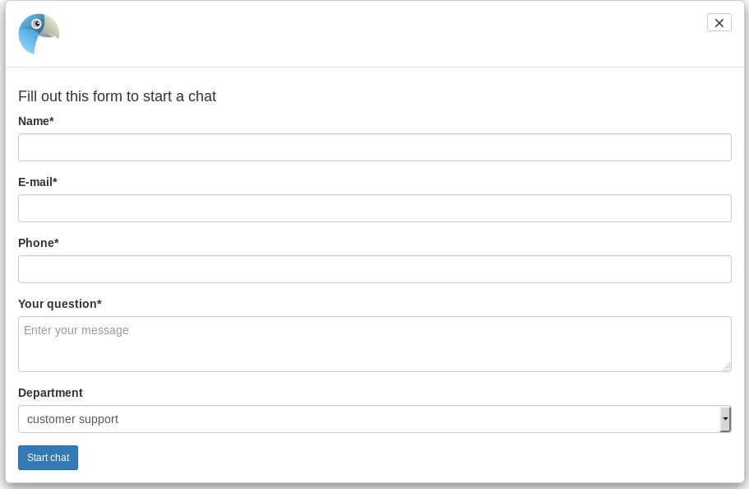
Origin of the data set
The data in the data set which was analyzed was generated from the chat section on the new vision web site. (https://www.newvision.co.ug/)

Slide 6
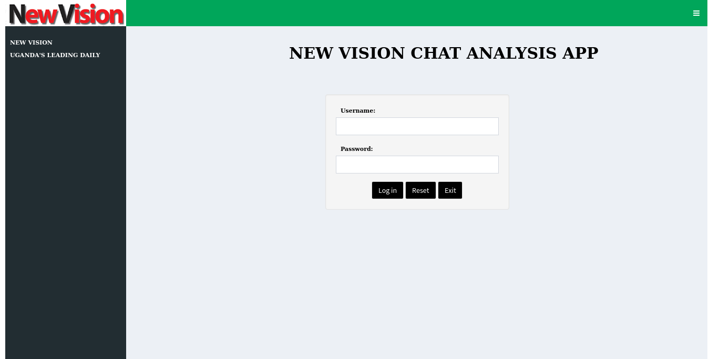
Operations and features of app
1. Login
Allow only authorized users access the app.
This is the first step, requires users credentials i.e username and password

Slide 7
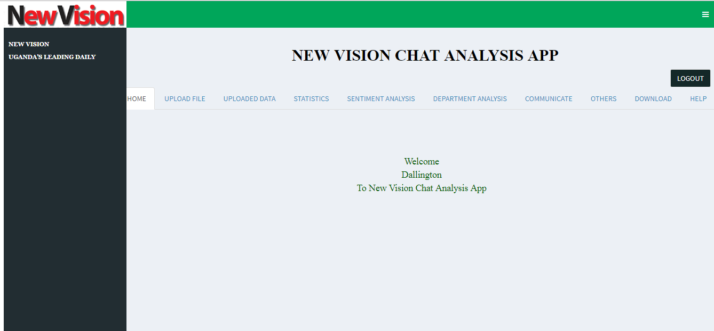
Operations and features of app
Home Page after a successful login

Slide 8
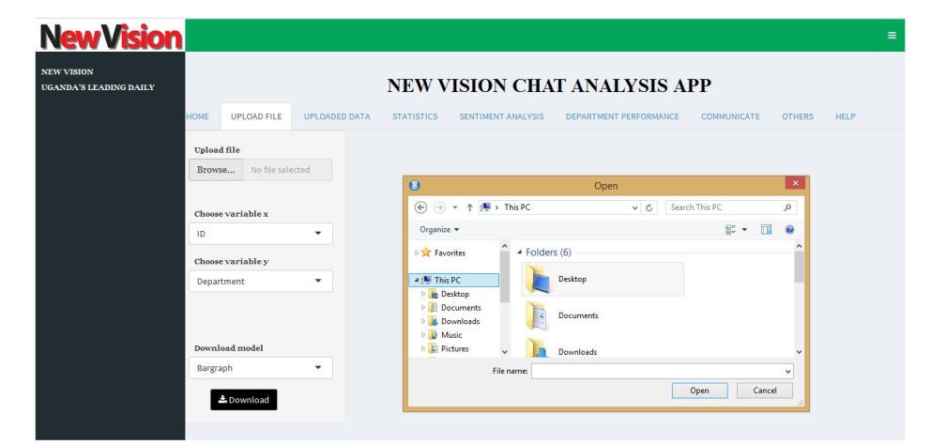
Operations and features of app
2. Upload data set
Allow the user upload the chat data(csv file) to be analyzed

Slide 9
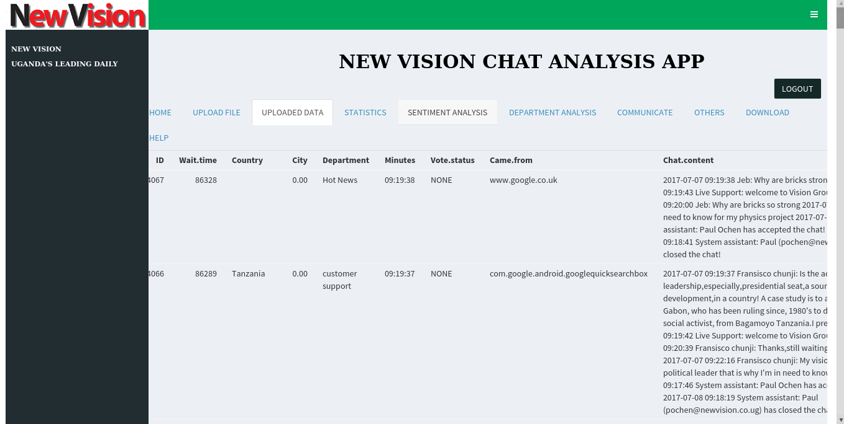
Operations and features of app
3. Uploaded Data

Slide 10
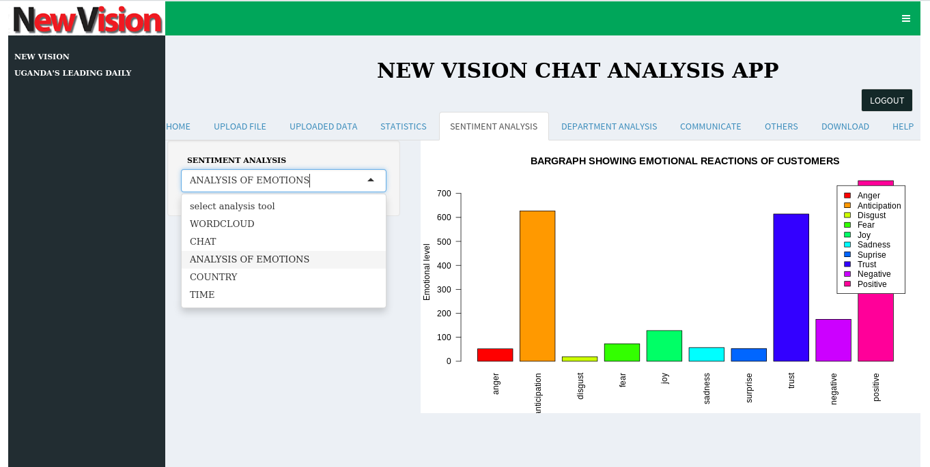
Operations and features of app
4.Select any tab to accomplish a given data analysis

Slide 11
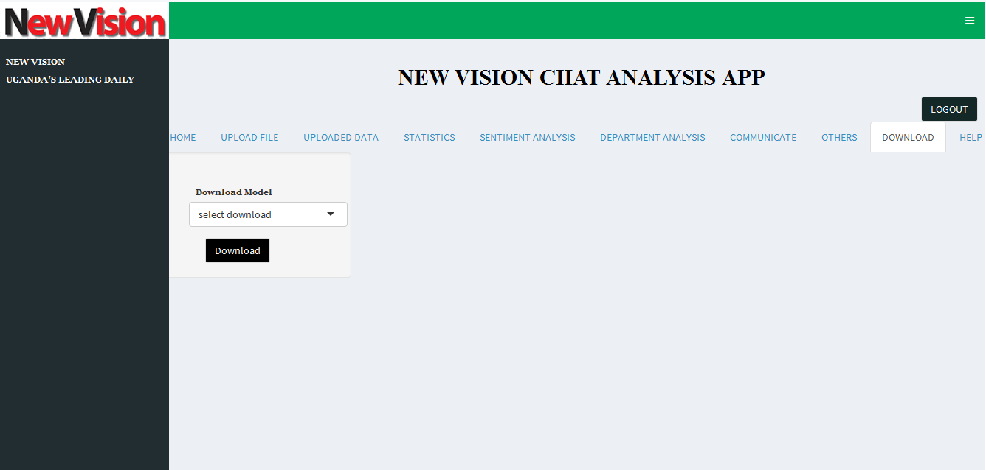
Operations and features of app
5.Download the data or any model
select any model to download

Slide 12
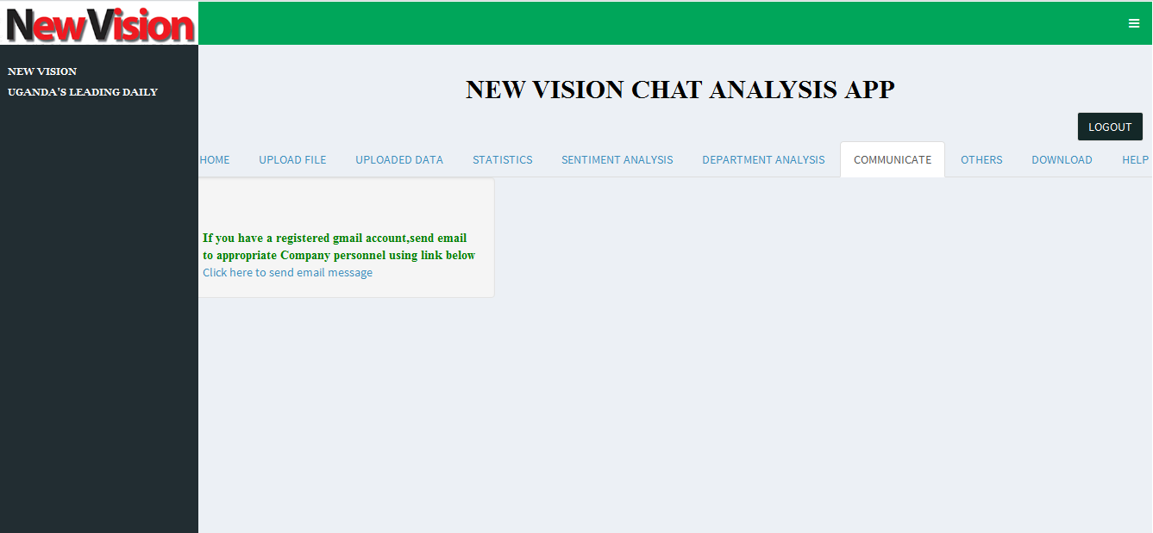
Operations and features of app
6.Communication
send communication to required authorities after identifying some info about the chat data after analysis

Slide 13
Findings
Uganda has most participants(customers)
japan foreign country with highest participants
No chatting involved between 20:00 and 20:59
Time range with the most chat sessions being 04:00 to 04:59
Most selected department being Customer support
Employee involved in most chats being Joseph
Less data obtained from Came.from column
Column City with no data
Most people start chat around 05:00 to 05:59

Slide 14
Findings
Most word involved in chat data is welcome(positive communication)
Most of waiting time between 09:00 and 09:59

Slide 15
Recommendations
Addition of one system assistant between 02:00 to 11:59
Adjustment of the New Vision web site to capture city
Appreciation of most hard working system assistant with an award

Slide 16
Predictions
Graph of chat starting time almost same as graph of chat sessions
Ability to analyze more data from Came.from column
Ability to analyze city data
Increase in worker's morale hence more productivity
More customers

