Slide 1
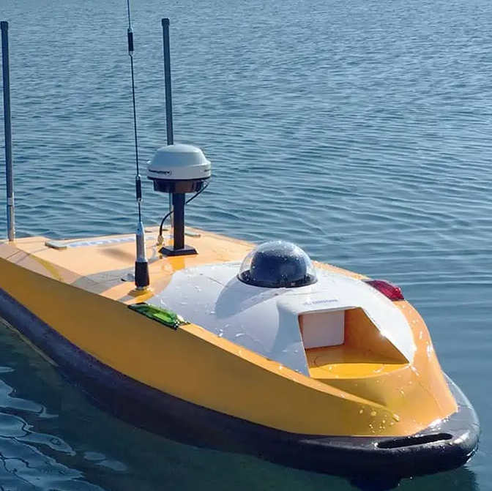
Robot design challenge 4: Small boat with manipulator for picking plastic
Bendik, Lars, Lars & Sebastian

Slide 2
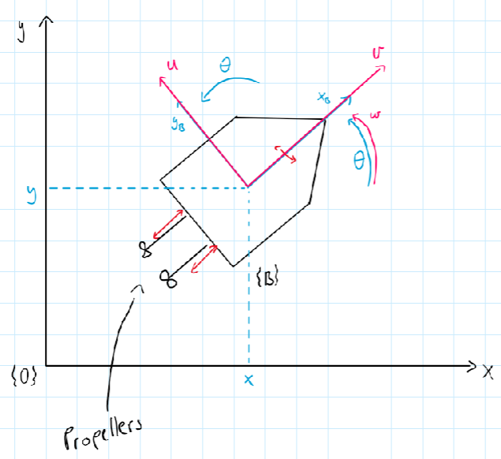
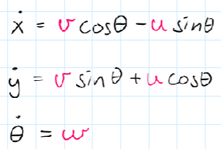
Kinematic equations

Slide 3
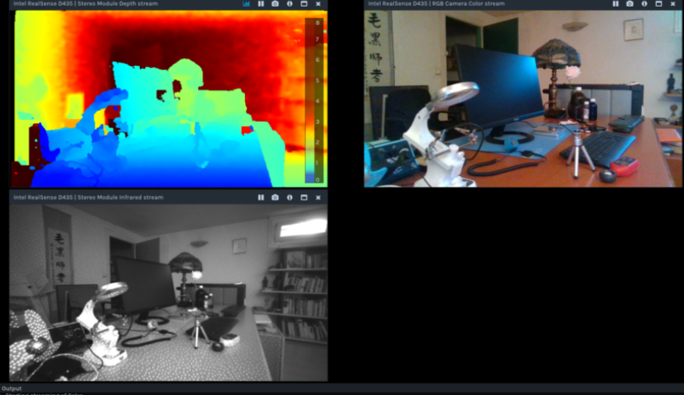
Sensors and navigation
Sensors
  IMU (accelerometer, gyroscope, magnetometer)
  3D-camera
  GPS
Navigation
  Lattice Planner
  Line of sight
Intel RealSense D435 review – Maurice's Musings

Slide 4
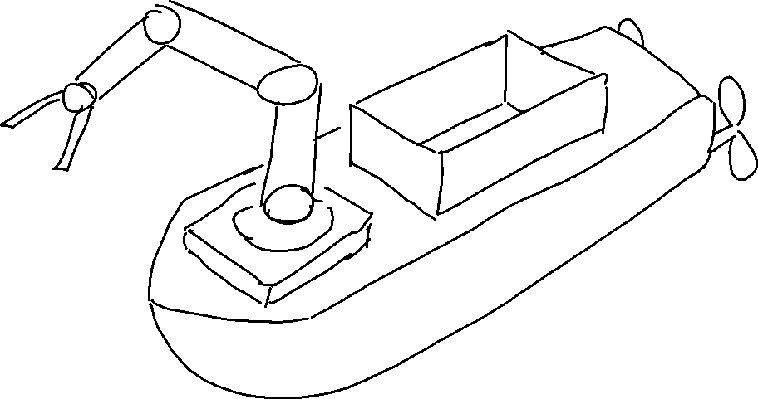
Sketch

Slide 5
Further plans
Simulations (MatLAB, Gazebo)
Different equations for simulations
Table of DH parameters
Intel RealSense D435 review – Maurice's Musings

