Slide 1
Lightweight Scene Understanding and Synthetic Data-Driven Damage Inspection for Martian Rovers
Faculty of Information Engineering, Informatics, and Statistics
Master’s Degree in Computer Science
Venturini Daniele 1991255
Academic Year 2025/2026
Advisor
Prof. Marco Raoul Marini
Notes:
Suggested duration: 0:15. Talk interval: 0:00–0:15.
This thesis investigates two visual tasks for Martian rovers: semantic understanding of the surrounding scene and inspection of visible wheel damage. The common question is how much useful information different methods can provide for the computational resources they require.
Internal source: Frontespizio and abstract.

Slide 2




Communication delays motivate local perception
4–22 min
Earth
one-way communication
Mars
Local perception supports decisions during a drive
[1] [4] [5]
Daniele Venturini
27 October 2026
2 / 33
Notes:
Suggested duration: 0:35. Talk interval: 0:15–0:50.
Communication with Earth does not allow immediate intervention during a drive: a signal takes approximately four to twenty-two minutes in one direction. This motivates visual processing performed locally. A rover needs information about the terrain and exposed components while working within computational constraints. This thesis studies visual methods that could support such future perception modules, rather than an autonomous driving system already deployed on a rover.
Internal source: Chapter 1, Problem Statement; cap. 2, Task Definition.
[1] NASA Jet Propulsion Laboratory. How to Drive a Mars Rover. On a Mission, Season 4, Episode 8, 25 August 2022. https://www.jpl.nasa.gov/podcasts/on-a-mission-season-1/season-4-mars-rovers/episode-8-how-to-drive-a-mars-rover/
[4] J. Zhang et al.. S⁵Mars: Semi-Supervised Learning for Mars Semantic Segmentation. IEEE Transactions on Geoscience and Remote Sensing, vol. 62, 2024. https://doi.org/10.1109/TGRS.2024.3386756
[5] M. Purohit et al.. Mars-Bench: A Benchmark for Evaluating Foundation Models for Mars Science Tasks. NeurIPS, Datasets and Benchmarks Track, 2025. https://doi.org/10.52202/085713-4098
Icons8 artwork (Color style, PNG):
https://img.icons8.com/color/96/earth-planet.png
https://img.icons8.com/color/96/mars-planet.png
https://img.icons8.com/color/96/satellite-sending-signal.png
Attribution and terms: https://icons8.com/license

Slide 3
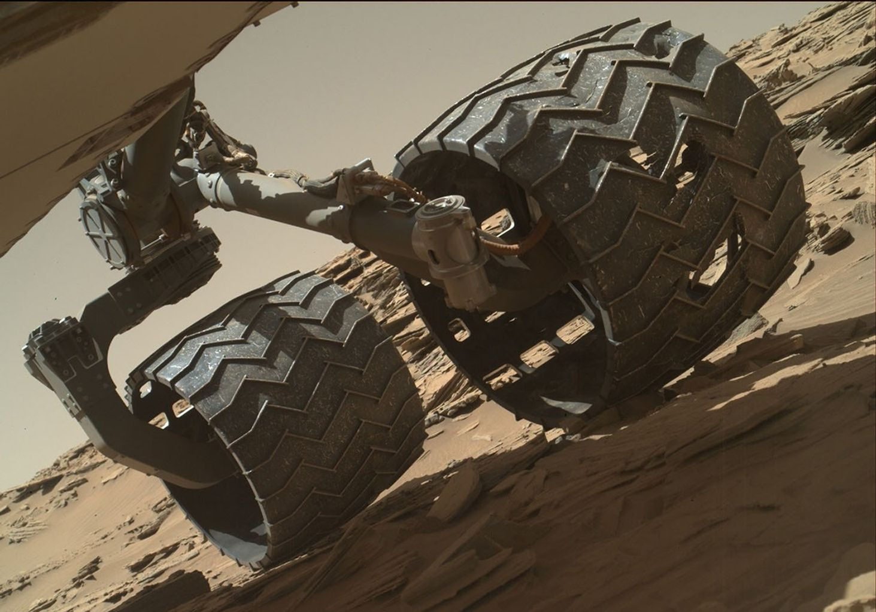


Wheel damage motivates visual inspection
Detect damage
Locate the defect
NASA/JPL-Caltech/MSSS, sol 1315
[2] [3]
Daniele Venturini
27 October 2026
3 / 33
Notes:
Suggested duration: 0:35. Talk interval: 0:50–1:25.
The second motivation is the condition of the wheels. Real inspection images of Curiosity show visible tears and perforations in the wheel skin. Detecting suspicious observations and highlighting their location could support image review. Here the modeled anomaly is restricted to visible perforations. Shadows, dust and scratches without a perforation remain part of normal appearance, so the detector must distinguish actual openings from benign visual changes.
Internal source: Chapter 1, Problem Statement and fig. curiosity-wheel-damage.
[2] A. Rankin et al.. Assessing Mars Curiosity Rover Wheel Damage. IEEE Aerospace Conference, 2022, pp. 1–19. https://robotics.jpl.nasa.gov/media/documents/fmwi-rankin-2022-0225-final.pdf
[3] NASA. Routine Inspection of Rover Wheel Wear and Tear. NASA Science, 27 April 2016. Image PIA20334. https://science.nasa.gov/resource/routine-inspection-of-rover-wheel-wear-and-tear/
Icons8 artwork (Color style, PNG):
https://img.icons8.com/color/96/search.png
https://img.icons8.com/color/96/inspection.png
Attribution and terms: https://icons8.com/license

Slide 4

Thesis objective and research branches
Scene understanding
Wheel inspection
Semantic segmentation
Synthetic data + anomaly detection
Real Martian scenes
Independent datasets and evaluations
Shared objective: quality at a manageable inference cost
Thesis results and methods
Daniele Venturini
27 October 2026
4 / 33
Notes:
Suggested duration: 0:35. Talk interval: 1:25–2:00.
The research has two complementary branches. Scene understanding compares segmentation models on real rover imagery. Wheel inspection first requires an annotated synthetic dataset and then compares anomaly detection methods. Both branches examine prediction quality together with inference cost. They use separate datasets and evaluation procedures. Integrating them into a complete rover perception pipeline is future work, and a semantic Rover label alone does not identify individual wheels.
Internal source: Chapter 1, Proposed Research Framework and Main Contributions.
Icons8 artwork (Color style, PNG):
https://img.icons8.com/color/96/road.png
https://img.icons8.com/color/96/inspection.png
Attribution and terms: https://icons8.com/license

Slide 5
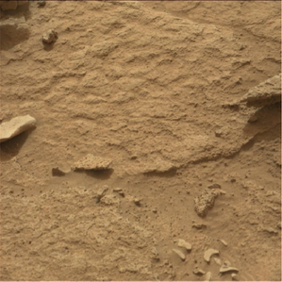
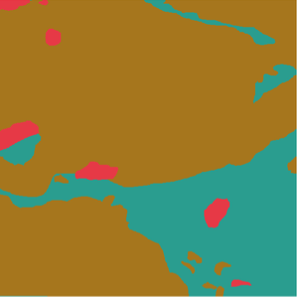
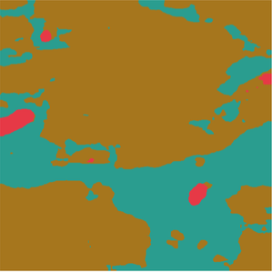
Semantic labels describe the scene
RGB observation
Ground truth
SegFormer-B0
Bedrock
Sand / Soil
Rock
[4] [5]
Daniele Venturini
27 October 2026
5 / 33
Notes:
Suggested duration: 0:30. Talk interval: 2:00–2:30.
Semantic segmentation assigns a category to every image pixel. Here the same observation is shown as an RGB image, its annotation and a SegFormer prediction. The colors identify materials and scene elements such as bedrock, rocks and sand or soil. This spatial representation could inform downstream terrain interpretation. The experiments evaluate the quality and cost of producing semantic labels, rather than implementing a navigation planner.
Internal source: Chapter 2, Task Definition; cap. 5, fig. s5mars-model-prediction-comparison.
[4] J. Zhang et al.. S⁵Mars: Semi-Supervised Learning for Mars Semantic Segmentation. IEEE Transactions on Geoscience and Remote Sensing, vol. 62, 2024. https://doi.org/10.1109/TGRS.2024.3386756
[5] M. Purohit et al.. Mars-Bench: A Benchmark for Evaluating Foundation Models for Mars Science Tasks. NeurIPS, Datasets and Benchmarks Track, 2025. https://doi.org/10.52202/085713-4098

Slide 6

S⁵Mars provides real rover imagery
Curiosity / Mastcam
Training | Validation | Test
4,997 | 200 | 800
8 target categories, including Rover
Sparse annotations and predefined partitions
[4] [5]
Daniele Venturini
27 October 2026
6 / 33
Notes:
Suggested duration: 0:30. Talk interval: 2:30–3:00.
The primary task uses the Mars-Bench adaptation of S5Mars, with RGB Mastcam observations from Curiosity. The release provides predefined training, validation and test splits containing 4,997, 200 and 800 images. Its annotations are sparse and confidence-based. Eight target categories include both terrain and Rover. The implementation also retains the Background identifier exposed by the released masks. Standardized partitions support consistent comparisons between the selected models.
Internal source: Chapter 2, Dataset and tab. mars-bench-datasets.
[4] J. Zhang et al.. S⁵Mars: Semi-Supervised Learning for Mars Semantic Segmentation. IEEE Transactions on Geoscience and Remote Sensing, vol. 62, 2024. https://doi.org/10.1109/TGRS.2024.3386756
[5] M. Purohit et al.. Mars-Bench: A Benchmark for Evaluating Foundation Models for Mars Science Tasks. NeurIPS, Datasets and Benchmarks Track, 2025. https://doi.org/10.52202/085713-4098
Icons8 artwork (Color style, PNG):
https://img.icons8.com/color/96/stack-of-photos.png
Attribution and terms: https://icons8.com/license

Slide 7



Seven segmentation configurations
U-Net
DeepLab
SegFormer
LCNet
ResNet34
MobileNetV2
V3 / ResNet34
V3+ / MobileNetV2
B0
3,7 and 3,11
A common task, with different capacity and resource requirements
[6] [7] [8] [9] [10]
Daniele Venturini
27 October 2026
7 / 33
Notes:
Suggested duration: 0:35. Talk interval: 3:00–3:35.
Seven configurations cover several design principles. U-Net uses encoder–decoder connections, DeepLab incorporates context through atrous convolutions, SegFormer uses a hierarchical Transformer encoder, and LCNet explores compact configurations. The U-Net and DeepLab models use ResNet34 or MobileNetV2 backbones. These are complete experimental candidates with different initialization and training budgets, as documented in the thesis, rather than a controlled comparison of architecture alone.
Internal source: Chapter 2, Segmentation Architectures and Architectural Comparison.
[6] O. Ronneberger, P. Fischer and T. Brox. U-Net: Convolutional Networks for Biomedical Image Segmentation. MICCAI, 2015, pp. 234–241. https://doi.org/10.1007/978-3-319-24574-4_28
[7] L.-C. Chen et al.. Rethinking Atrous Convolution for Semantic Image Segmentation. arXiv:1706.05587, 2017. https://arxiv.org/abs/1706.05587
[8] L.-C. Chen et al.. Encoder-Decoder with Atrous Separable Convolution for Semantic Image Segmentation. ECCV, 2018, pp. 833–851. https://doi.org/10.1007/978-3-030-01234-2_49
[9] E. Xie et al.. SegFormer: Simple and Efficient Design for Semantic Segmentation with Transformers. NeurIPS, vol. 34, 2021, pp. 12077–12090. https://arxiv.org/abs/2105.15203
[10] M. Shi et al.. Lightweight Context-Aware Network Using Partial-Channel Transformation for Real-Time Semantic Segmentation. IEEE Transactions on Intelligent Transportation Systems, 25(7), 2024. https://doi.org/10.1109/TITS.2023.3348631
Icons8 artwork (Color style, PNG):
https://img.icons8.com/color/96/layers.png
https://img.icons8.com/color/96/search.png
https://img.icons8.com/color/96/artificial-intelligence.png
https://img.icons8.com/color/96/processor.png
Attribution and terms: https://icons8.com/license

Slide 8


Reduced-precision deployment
FP16
PTQ
QAT
Reduced floating-point
precision
Calibrate after
training
Fine-tune with
quantization effects
Selective INT8 deployment retains some floating-point operations
[11]
Daniele Venturini
27 October 2026
8 / 33
Notes:
Suggested duration: 0:40. Talk interval: 3:35–4:15.
Deployment also depends on numerical precision. FP16 reduces floating-point precision. Post-training quantization, or PTQ, calibrates a model after training. Quantization-aware training, or QAT, includes further optimization while simulating quantization effects. In this thesis INT8 is selective: some computations remain in floating point. The QAT procedure also includes fine-tuning and distillation. Therefore its results describe the complete optimization and deployment procedure, not the isolated effect of changing precision.
Internal source: Chapter 2, Optimization and Quantization; cap. 5, Quantization Results.
[11] B. Jacob et al.. Quantization and Training of Neural Networks for Efficient Integer-Arithmetic-Only Inference. CVPR, 2018, pp. 2704–2713. https://arxiv.org/abs/1712.05877
Icons8 artwork (Color style, PNG):
https://img.icons8.com/color/96/processor.png
https://img.icons8.com/color/96/compress.png
https://img.icons8.com/color/96/learning.png
Attribution and terms: https://icons8.com/license

Slide 9


Perforation masks require dedicated data
Wheel views
Damage masks
Controlled variation
The reviewed resources did not provide a ready-to-use
perforation benchmark with pixel annotations
[2]
Daniele Venturini
27 October 2026
9 / 33
Notes:
Suggested duration: 0:25. Talk interval: 4:15–4:40.
Wheel inspection requires task-specific annotations of visible perforations. Among the resources examined for this work, no ready-to-use benchmark provided the required damage masks and experimental setting. Synthetic generation supplies wheel observations, automatic pixel masks and controlled variation. It avoids manually annotating every generated image and makes the comparison reproducible. Its role is to establish a synthetic experimental setting whose transfer to real imagery still needs to be tested.
Internal source: Chapter 1, Wheel Damage Inspection and Available Imagery; cap. 3, Design Requirements.
[2] A. Rankin et al.. Assessing Mars Curiosity Rover Wheel Damage. IEEE Aerospace Conference, 2022, pp. 1–19. https://robotics.jpl.nasa.gov/media/documents/fmwi-rankin-2022-0225-final.pdf
Icons8 artwork (Color style, PNG):
https://img.icons8.com/color/96/stack-of-photos.png
https://img.icons8.com/color/96/image-file.png
https://img.icons8.com/color/96/settings.png
Attribution and terms: https://icons8.com/license

Slide 10
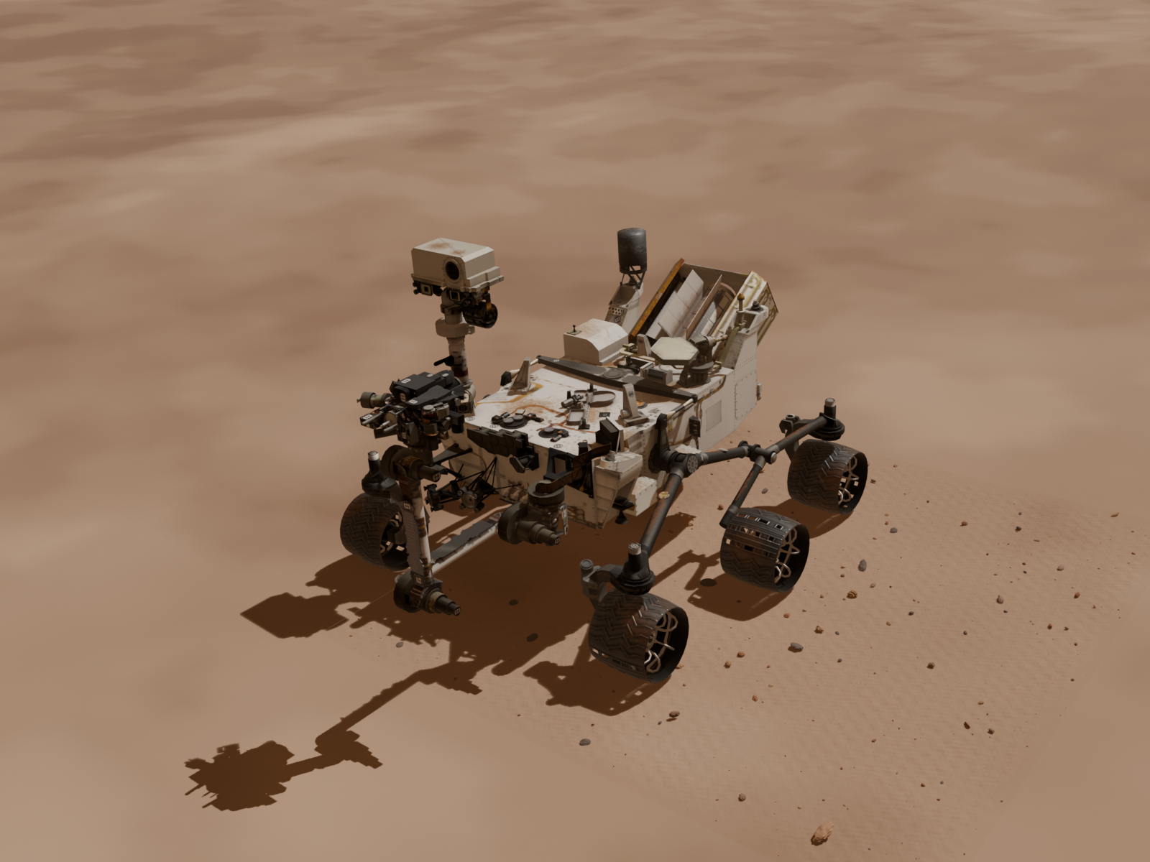

The Blender generation scene
NASA Curiosity asset
HiRISE terrain
and local detail
[12] [13]
Daniele Venturini
27 October 2026
10 / 33
Notes:
Suggested duration: 0:35. Talk interval: 4:40–5:15.
The scene is built in Blender around the NASA Curiosity asset. The six wheels are independently addressable for rotation, damage injection and annotation. The environment combines HiRISE terrain and orthoimagery from Gale Crater with procedural close-range detail such as grains and rocks. The asset supports visual image generation. It is not an engineering model of mechanical wheel behavior, so the generated damage levels describe geometry rather than a physical health assessment.
Internal source: Chapter 3, Asset Preparation and fig. rover-terrain-scene.
[12] NASA Visualization Technology Applications and Development. Curiosity 3D Model. NASA Science, 22 April 2019. https://science.nasa.gov/resource/curiosity-3d-model/
[13] HiRISE. Possible MSL Landing Site in Gale Crater. DTM and orthoimage, PSP_010573_1755 and PSP_010639_1755. https://hirise.lpl.arizona.edu/dtm/dtm.php?ID=PSP_010573_1755
Icons8 artwork (Color style, PNG):
https://img.icons8.com/color/96/settings.png
https://img.icons8.com/color/96/globe.png
Attribution and terms: https://icons8.com/license

Slide 11
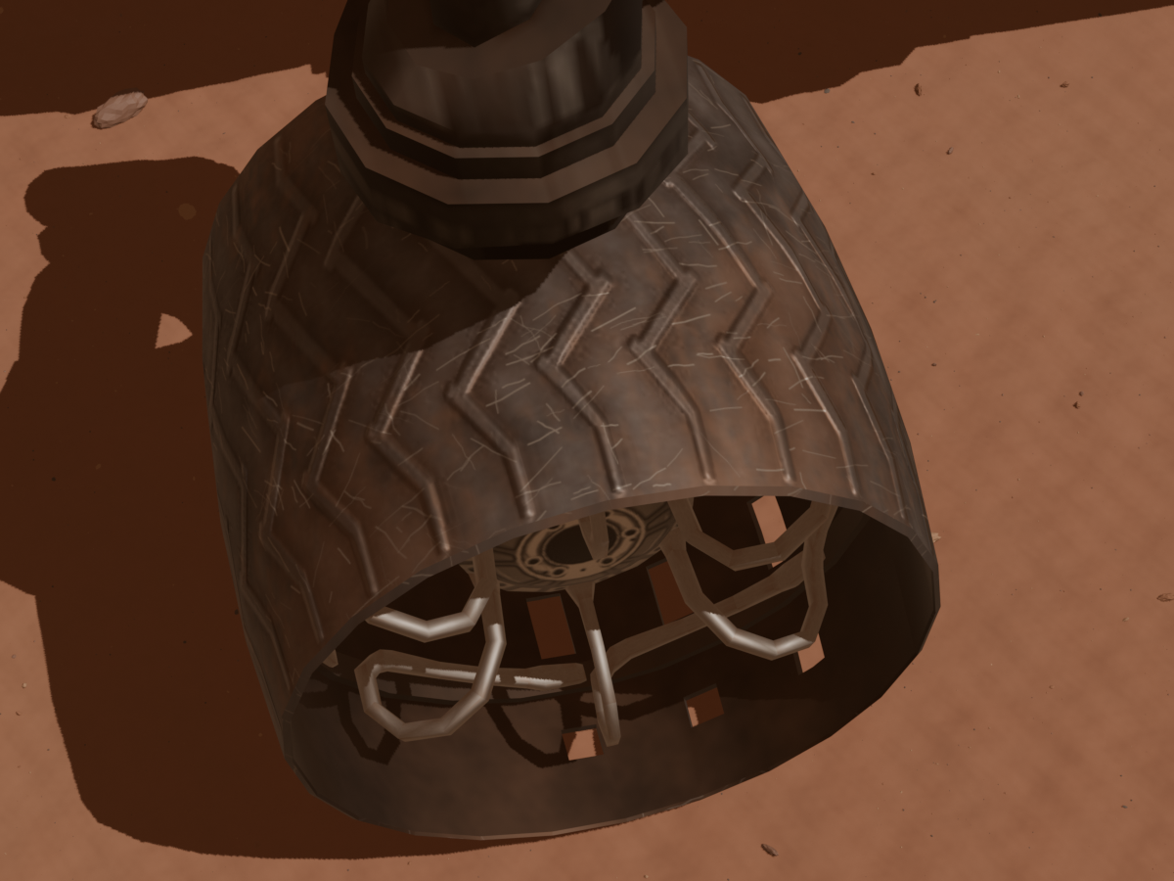



Matched views isolate the injected damage
Normal
Perforated
Damage mask
Matched camera, lighting, pose and wear
Thesis results and methods
Daniele Venturini
27 October 2026
11 / 33
Notes:
Suggested duration: 0:40. Talk interval: 5:15–5:55.
Each anomalous observation contains an injected through-hole on the target wheel. The generation process also produces a binary mask of the visible damage. This example shows a recorded normal view, its perforated counterpart and the corresponding mask. Camera, lighting, wheel pose and surface wear are shared within the pair. The intended visual difference is the injected hole, which permits a controlled comparison of normal and damaged observations.
Internal source: Chapter 3, Synthetic Damage Generation; final dataset, pair_dr_200008.
Icons8 artwork (Color style, PNG):
https://img.icons8.com/color/96/camera.png
Attribution and terms: https://icons8.com/license

Slide 12

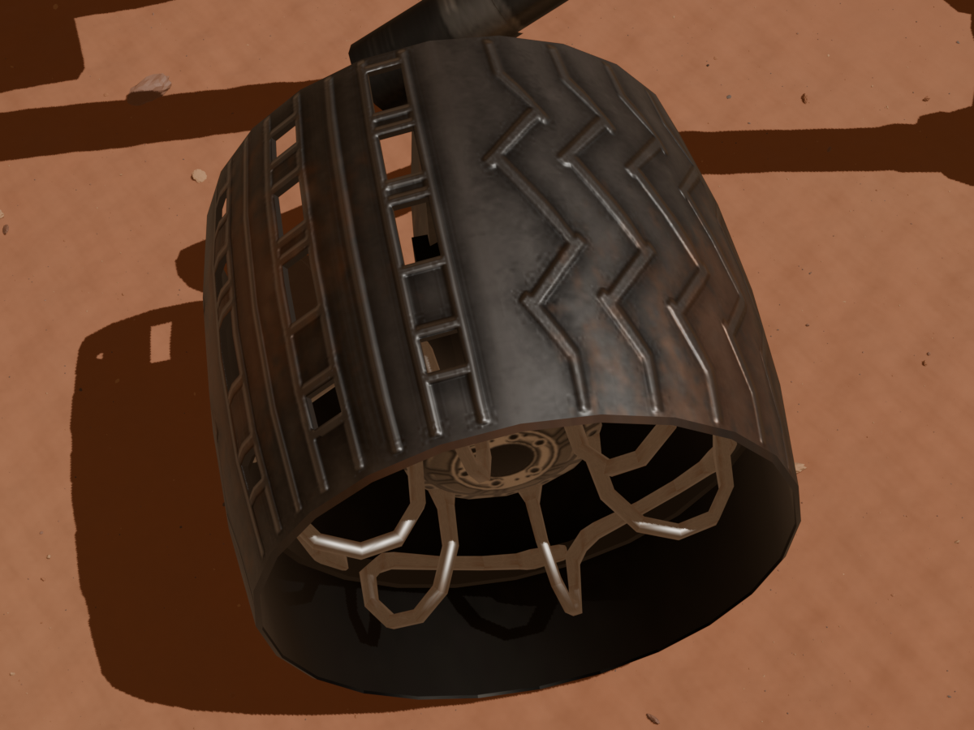
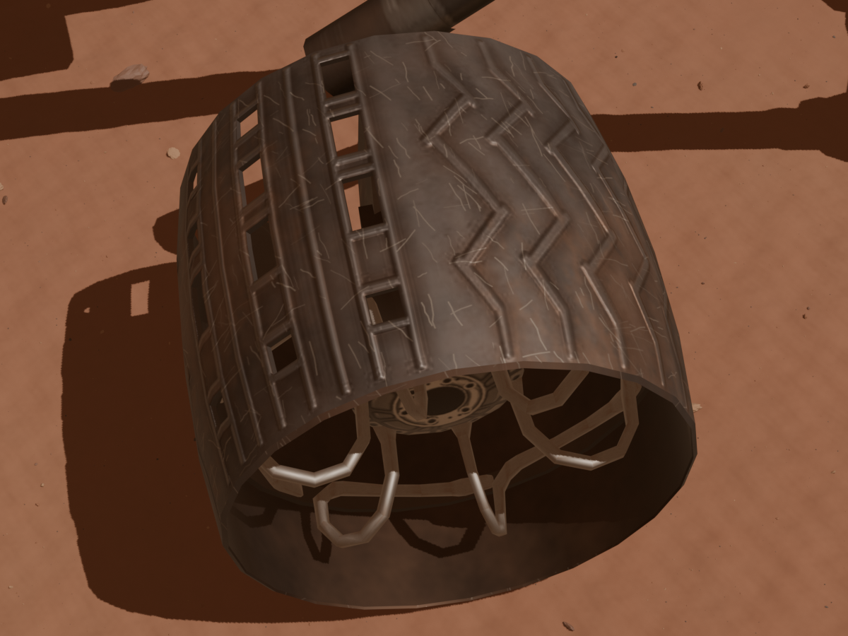
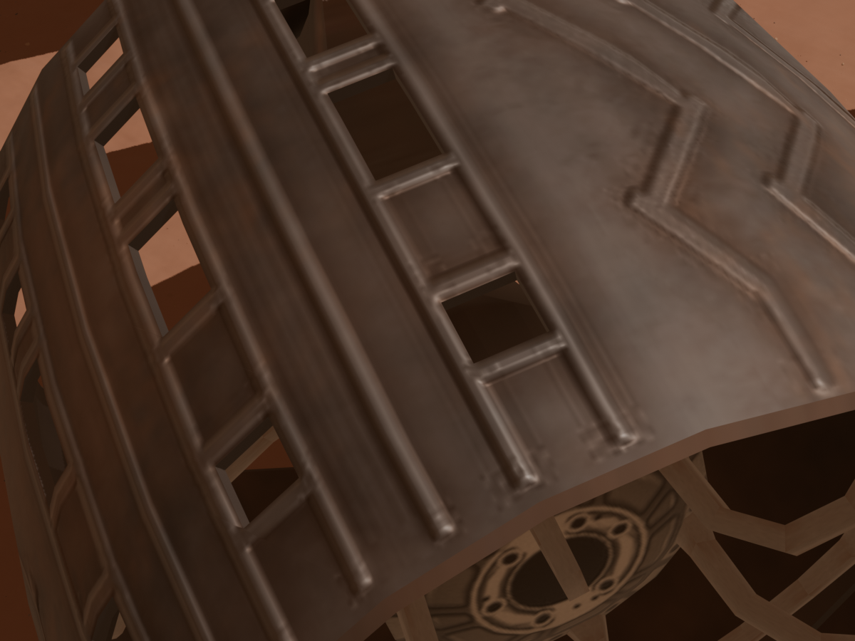
Normal appearance varies across observations
Lighting & dust
Benign wear
Viewpoint
Dusty
75%
No extra wear
20%
A: Overhead
40%
Clear
25%
Light wear
45%
C1: Leading
27.5%
Evident wear
35%
C2: Trailing
27.5%
D: Upper detail
5%
Shares of all 10,000 images. Variation is independent of the anomaly label.
[14]
Daniele Venturini
27 October 2026
12 / 33
Notes:
Suggested duration: 0:40. Talk interval: 5:55–6:35.
The generated observations vary in illumination, camera viewpoint, wheel rotation and benign surface wear. These examples illustrate changes in lighting, scratches and framing. The aim is to expose the methods to a range of normal appearances instead of one fixed visual reference. The variation remains controlled and reproducible. Domain randomization broadens the synthetic setting, while successful transfer to real wheel imagery remains an empirical question.
Internal source: Chapter 3, Domain Randomization.
[14] J. Tobin et al.. Domain Randomization for Transferring Deep Neural Networks from Simulation to the Real World. IEEE/RSJ IROS, 2017, pp. 23–30. https://doi.org/10.1109/IROS.2017.8202133
Icons8 artwork (Color style, PNG):
https://img.icons8.com/color/96/sun.png
https://img.icons8.com/color/96/settings.png
https://img.icons8.com/color/96/camera.png
Attribution and terms: https://icons8.com/license
Final dataset distributions (all 10,000 images): dusty 7,500 (75%), clear 2,500 (25%). No added wear 2,000 (20%), light wear 4,500 (45%), evident wear 3,500 (35%). Camera A overhead 4,000 (40%), C1 leading three-quarter 2,750 (27.5%), C2 trailing three-quarter 2,750 (27.5%), D upper detail 500 (5%). Frequencies were checked directly against the final samples.csv and the thesis Chapter 3 category-distribution table. The clear/dusty presets also change deposited dust and camera response. Small continuous lighting and camera jitter is applied within categories; the percentages describe categorical frequencies, not jitter magnitudes.

Slide 13

10,000 annotated synthetic images
Training | Validation | Test
7,000 | 1,000 | 2,000
Normal only | 750 normal 250 perforated | 1,000 normal 1,000 perforated
Every matched pair stays within one split
Thesis results and methods
Daniele Venturini
27 October 2026
13 / 33
Notes:
Suggested duration: 0:35. Talk interval: 6:35–7:10.
The final dataset contains ten thousand images. Training uses seven thousand normal observations. Validation contains 750 normal images and 250 perforated images, while test contains one thousand of each. Every image has a target-wheel mask, and anomalous images have a damage mask. Normal and damaged counterparts remain within the same split. This prevents paired versions of the same scene from leaking across the experimental partitions.
Internal source: Chapter 3, Final Dataset Composition; docs/generation/final_dataset_assembly.md.
Icons8 artwork (Color style, PNG):
https://img.icons8.com/color/96/split.png
Attribution and terms: https://icons8.com/license

Slide 14


Anomaly detection learns normal appearance
Normal-only training
Image anomaly score
Spatial anomaly map
Dust and scratches can still be normal
[15]
Daniele Venturini
27 October 2026
14 / 33
Notes:
Suggested duration: 0:35. Talk interval: 7:10–7:45.
The inspection models learn or store a reference for normal wheel appearance from normal renders. Perforated Blender observations are reserved for validation and test. Each method produces an image anomaly score and a spatial anomaly map. These outputs answer different questions: whether an observation is suspicious and where the suspicious region lies. Normality is defined by the absence of the modeled perforation, so dust and scratches can still be present in normal training images.
Internal source: Chapter 4, Task Definition.
[15] P. Bergmann et al.. MVTec AD: A Comprehensive Real-World Dataset for Unsupervised Anomaly Detection. CVPR, 2019, pp. 9584–9592. https://doi.org/10.1109/CVPR.2019.00982
Icons8 artwork (Color style, PNG):
https://img.icons8.com/color/96/learning.png
https://img.icons8.com/color/96/inspection.png
https://img.icons8.com/color/96/image.png
Attribution and terms: https://icons8.com/license

Slide 15



Normality through memory or feature matching
PatchCore
Normal features
Memory bank
Feature distance
EfficientAD-S
Teacher
Student
Anomaly evidence from feature disagreement
[16] [17]
Daniele Venturini
27 October 2026
15 / 33
Notes:
Suggested duration: 0:35. Talk interval: 7:45–8:20.
PatchCore stores a representative memory of local features extracted from normal images. At inference, feature distances from that memory indicate abnormality. EfficientAD-S instead uses a pretrained teacher and a student optimized to reproduce normal features, together with an autoencoder and calibration. Feature disagreement provides anomaly evidence. These methods therefore contrast memory search with learned feature matching, with different resource requirements and responses to normal visual variation.
Internal source: Chapter 4, PatchCore and EAD-S.
[16] K. Roth et al.. Towards Total Recall in Industrial Anomaly Detection. CVPR, 2022, pp. 14318–14328. https://arxiv.org/abs/2106.08265
[17] K. Batzner, L. Heckler and R. König. EfficientAD: Accurate Visual Anomaly Detection at Millisecond-Level Latencies. WACV, 2024, pp. 128–138. https://arxiv.org/abs/2303.14535
Icons8 artwork (Color style, PNG):
https://img.icons8.com/color/96/layers.png
https://img.icons8.com/color/96/database.png
https://img.icons8.com/color/96/search.png
https://img.icons8.com/color/96/teacher.png
https://img.icons8.com/color/96/student-male.png
Attribution and terms: https://icons8.com/license

Slide 16
Synthetic perturbations support training
SuperSimpleNet
TinyGLASS
Noise in feature space
Image + feature perturbations
Compact ResNet-18 backbone
Perforated Blender renders remain held out
[18] [19] [20]
Daniele Venturini
27 October 2026
16 / 33
Notes:
Suggested duration: 0:35. Talk interval: 8:20–8:55.
SuperSimpleNet and TinyGLASS introduce artificial anomalies while learning from normal data. SuperSimpleNet perturbs localized regions in feature space. TinyGLASS combines image and feature perturbations with a compact backbone. The thesis adapts its local image alterations to irregular darkened regions resembling perforations and investigates spatial resolution. These training perturbations are generated from normal inputs and remain distinct from the damaged Blender images and masks reserved for validation and test.
Internal source: Chapter 4, SSN and TinyGLASS; fig. tinyglass_architecture.
[18] B. Rolih, M. Fučka and D. Skočaj. SuperSimpleNet: Unifying Unsupervised and Supervised Learning for Fast and Reliable Surface Defect Detection. ICPR 2024, LNCS 15310, Springer, 2025, pp. 47–65. https://doi.org/10.1007/978-3-031-78192-6_4
[19] B. Rolih, M. Fučka and D. Skočaj. No Label Left Behind: A Unified Surface Defect Detection Model for All Supervision Regimes. Journal of Intelligent Manufacturing, vol. 37, 2026, pp. 3189–3209. https://doi.org/10.1007/s10845-025-02680-8
[20] P. Bonazzi et al.. TinyGLASS: Real-Time Self-Supervised In-Sensor Anomaly Detection. arXiv:2603.16451v3, 2026. Accepted at AICAS 2026. https://arxiv.org/abs/2603.16451v3
Icons8 artwork (Color style, PNG):
https://img.icons8.com/color/96/layers.png
https://img.icons8.com/color/96/image.png
https://img.icons8.com/color/96/processor.png
Attribution and terms: https://icons8.com/license

Slide 17
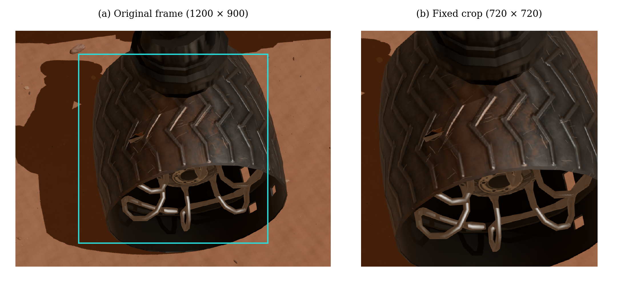
A controlled wheel-focused evaluation
Pose A: 2,800 normal training images and 808 test images
Thesis results and methods
Daniele Venturini
27 October 2026
17 / 33
Notes:
Suggested duration: 0:35. Talk interval: 8:55–9:30.
The main comparison uses pose A, a controlled acquisition setting that still varies wheel identity, lighting and surface wear. A fixed 720-by-720 crop concentrates image detail on the target wheel before model-specific preprocessing. This subset contains 2,800 normal training images and 808 test images. Validation informs configuration selection or calibration. The compared models share the image population, but their input resolutions and spatial coverage differ as documented in the thesis.
Internal source: Chapter 4, Preprocessing; cap. 6, Experimental Setup.
Icons8 artwork (Color style, PNG):
https://img.icons8.com/color/96/camera.png
Attribution and terms: https://icons8.com/license

Slide 18
SegFormer-B0 leads the FP32 comparison
75.55%
SegFormer-B0
3.72M parameters
S⁵Mars test mIoU (%), FP32 configurations
Thesis results and methods
Daniele Venturini
27 October 2026
18 / 33
Notes:
Suggested duration: 0:40. Talk interval: 9:30–10:10.
Mean Intersection over Union, or mIoU, summarizes overlap between predicted and annotated semantic categories. In the FP32 comparison, SegFormer-B0 reaches the highest test mIoU at 75.55%, followed by DeepLabV3 with ResNet34. SegFormer uses 3.72 million parameters. LCNet configurations use fewer than one million parameters but reach about 58–59% mIoU. The comparison shows different positions in the quality–resource trade-off before the reduced-precision deployment study.
Internal source: Chapter 5, tab. s5mars-reference-accuracy.
Icons8 artwork (Color style, PNG):
https://img.icons8.com/color/96/artificial-intelligence.png
Attribution and terms: https://icons8.com/license

Slide 19
Cross-mission generalization on MarsSeg
MSL: Curiosity MER: Spirit / Opportunity
Model | MSL training |  | MER training
 | MSL test | MER test | MER test | MSL test
SegFormer-B0 | 70.63 | 52.06 | 66.75 | 48.11
U-Net R34 | 71.80 | 27.43 | 67.76 | 13.82
DeepLabV3+ MV2 | 68.98 | 38.27 | 65.10 | 12.86
SegFormer-B0 transfers best in both directions
Test mIoU (%). Separate training runs, shared labels, no target fine-tuning.
Thesis, Section 5.5. [5] [9]
Daniele Venturini
27 October 2026
19 / 33
Notes:
Suggested duration: 0:40. Talk interval: 10:10–10:50.
This is a separate experiment from S5Mars. The MarsSeg MSL and MER releases share a taxonomy, so the same categories can be evaluated across missions. Each configuration is trained independently on MSL and on MER, using its source-validation checkpoint. Cross-mission evaluation uses no target-domain fine-tuning. U-Net has the highest in-domain mIoU, but SegFormer-B0 transfers best in both directions: 52.06% from MSL to MER and 48.11% from MER to MSL. Both remain below its target-trained references, 66.75% on MER and 70.63% on MSL. Different pretraining and acquisition conditions prevent attributing this difference to architecture alone.
Internal source: thesis/latex/Chapters/5 Evaluation of Lightweight Scene Understanding.tex, Section 5.5, table label tab:marsseg-cross-mission-accuracy. All 12 values are transcribed from that table.
[5] M. Purohit et al. Mars-Bench: A Benchmark for Evaluating Foundation Models for Mars Science Tasks. NeurIPS Datasets and Benchmarks, 2025. https://doi.org/10.52202/085713-4098
[9] E. Xie et al. SegFormer: Simple and Efficient Design for Semantic Segmentation with Transformers. NeurIPS, 2021. https://arxiv.org/abs/2105.15203

Slide 20
Quantization: accuracy, latency and energy
Model | Variant | Test mIoU (%) | Latency (ms) | Energy (mJ/image)
DeepLabV3+ MobileNetV2 | FP32 | 64.07 | 8.84 | 653.72
 | FP16 | 64.07 | 6.03 | 377.88
 | PTQ INT8 | 59.14 | 4.02 | 159.19
 | QAT INT8 | 65.63 | 3.01 | 115.34
SegFormer-B0 | FP32 | 75.55 | 11.88 | 835.72
 | FP16 | 75.55 | 7.17 | 432.07
 | PTQ INT8 | 75.60 | 5.92 | 327.99
 | QAT INT8 | 76.93 | 5.66 | 291.76
NVIDIA T4, batch 1, 512 × 512. Forward pass only; preprocessing excluded.
Selective INT8. QAT includes fine-tuning and distillation; runtimes differ.
Thesis, Section 5.3. Selected deployments from the quantization comparison.
Daniele Venturini
27 October 2026
20 / 33
Notes:
Suggested duration: 0:40. Talk interval: 10:50–11:30.
This table retains the two selected models from the previous slide and expands the comparison to FP32, FP16, PTQ INT8 and QAT INT8. For DeepLabV3+ with MobileNetV2, PTQ reduces latency to 4.02 milliseconds but lowers test mIoU to 59.14%. QAT reaches 65.63% at 3.01 milliseconds and 115.34 millijoules per image. SegFormer-B0 retains 75.60% mIoU with PTQ, while QAT reaches 76.93% at 5.66 milliseconds. The choice remains between lower inference cost and higher semantic accuracy.
Measurement scope: test mIoU on the 800-image S5Mars test split. Mean forward-pass latency and GPU energy were measured separately on NVIDIA T4, batch size 1, 512 by 512 inputs already on the GPU, excluding preprocessing. FP32 and FP16 use ONNX Runtime CUDA. PTQ uses ONNX Runtime TensorRT with fallback, and QAT uses TensorRT directly. INT8 denotes selective mixed precision, with Conv-only quantization for SegFormer-B0. QAT includes supervised fine-tuning and teacher distillation. Energy includes device idle consumption and excludes CPU energy. These results compare complete deployment configurations, not bit width in isolation, and do not establish equivalent savings on rover hardware.
Internal source: thesis/latex/Chapters/5 Evaluation of Lightweight Scene Understanding.tex, Section 5.3, table tab:s5mars-quantization-accuracy-efficiency. All 24 metric values are transcribed at the precision reported in the thesis. The full thesis comparison contains five models; this slide retains the two selected models from the existing presentation.

Slide 21
PatchCore-L gives the highest Image AUROC
86.43%
PatchCore-L
Synthetic pose-A test
Image AUROC (%) measures ranking, without an operational threshold
Thesis results and methods
Daniele Venturini
27 October 2026
21 / 33
Notes:
Suggested duration: 0:40. Talk interval: 11:30–12:10.
Image AUROC measures how well anomaly scores rank damaged observations above normal ones, without selecting an operational threshold. On the synthetic pose-A test subset, PatchCore-L achieves the highest value at 86.43%, followed by SuperSimpleNet at 82.72%. TinyGLASS configurations are around 77%. These results apply to the tested configurations and their preprocessing contracts. They do not directly establish false-alarm or missed-defect rates at a chosen operational decision threshold.
Internal source: Chapter 6, tab. damage-reference-test-results.
Icons8 artwork (Color style, PNG):
https://img.icons8.com/color/96/inspection.png
Attribution and terms: https://icons8.com/license

Slide 22



TinyGLASS-384 has the lowest inference cost
Model | Latency (ms) | GPU energy (J/image) | Peak memory (MiB)
TinyGLASS-384 | 5.13 | 0.239 | 38.72
TinyGLASS-512 | 6.29 | 0.369 | 55.03
SuperSimpleNet | 27.54 | 1.939 | 219.69
EfficientAD-S | 57.72 | 4.032 | 878.45
PatchCore-L | 62.89 | 4.116 | 385.25
PatchCore-S | 101.21 | 6.849 | 277.53
NVIDIA T4, batch 1. Inputs already on GPU; preprocessing and transfer excluded.
Whole-GPU energy includes idle consumption and excludes CPU energy.
Thesis, Chapter 6, Table 6.3. Pose-A configurations with model-specific preprocessing.
Daniele Venturini
27 October 2026
22 / 33
Notes:
Suggested duration: 0:40. Talk interval: 12:10–12:50.
The table compares all six configurations using latency, GPU energy per image and peak allocated GPU memory. TinyGLASS-384 has the lowest measured values in every column: 5.13 milliseconds, 0.239 joules and 38.72 MiB. TinyGLASS-512 remains inexpensive at 6.29 milliseconds and 0.369 joules. SuperSimpleNet lies between these compact models and PatchCore or EfficientAD. PatchCore-L provides the strongest image discrimination on the preceding slide but requires 62.89 milliseconds and 4.116 joules per image. This makes the accuracy–resource choice explicit for all configurations.
Measurement scope: NVIDIA T4 on Kaggle, batch size one, with preprocessed input already in GPU memory. Latency averages 50 synchronized predictions after 10 warm-up runs. GPU energy is a separate measurement using a five-second warm-up and three 30-second windows, divided by the total number of predictions. It covers the whole GPU, including idle consumption, and excludes CPU processing and transfer. Memory is peak allocated GPU memory reported by the PyTorch allocator, including the model and other live tensors. Configurations share the pose-A image population but differ in input resolution and spatial coverage; these are complete deployment configurations rather than a controlled comparison at identical input resolution. Results do not establish end-to-end or flight-hardware performance.
Internal source: thesis/latex/Chapters/6 Evaluation of Synthetic Damage Inspection.tex, Section 6.2, Table 6.3, label tab:damage-reference-efficiency. All 18 measurements match the table. Latency and memory retain two decimal places and energy three.
Icons8 Color artwork: https://img.icons8.com/color/96/clock.png, https://img.icons8.com/color/96/lightning-bolt.png, https://img.icons8.com/color/96/memory-slot.png. Attribution and terms: https://icons8.com/license

Slide 23
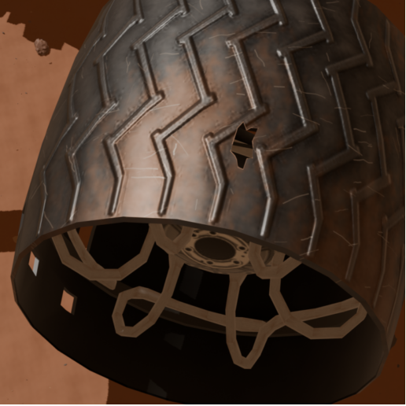
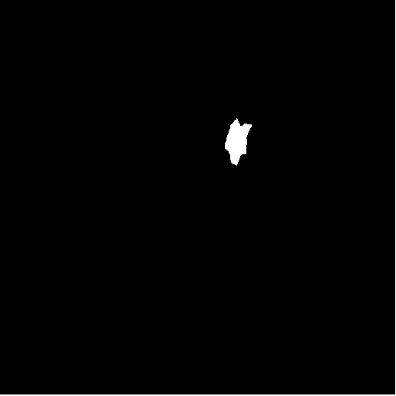
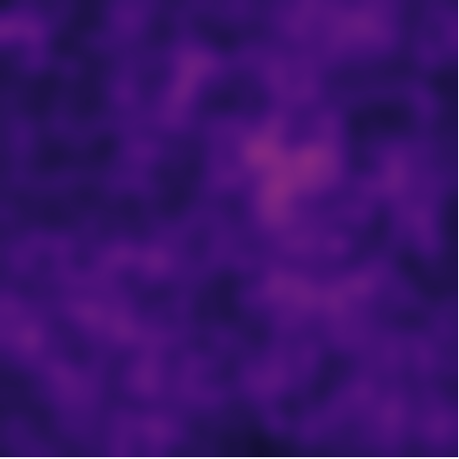
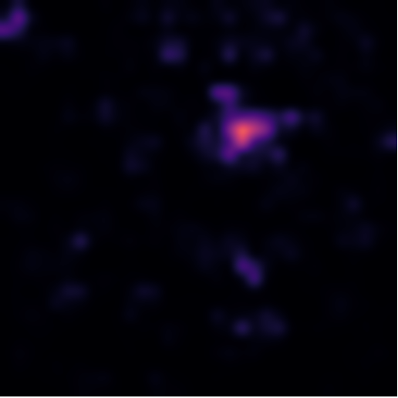
Localization maps and pixel precision
Observation
Ground truth
SuperSimpleNet
TinyGLASS-512
19.10%
27.59%
Normalized maps illustrate one observation
Pixel AP, full pose-A test
Thesis results and methods
Daniele Venturini
27 October 2026
23 / 33
Notes:
Suggested duration: 0:40. Talk interval: 12:50–13:30.
The anomaly maps show why detection and localization need separate evaluation. A response around the perforation can coexist with responses on normal wheel regions. SuperSimpleNet has higher Image AUROC than TinyGLASS-512, but lower aggregate test Pixel Average Precision: 19.10% versus 27.59%. The displayed maps are one qualitative example, while the percentages summarize the full test split. Small perforations remain difficult, and a useful image ranking does not guarantee a precise defect outline.
Internal source: Chapter 6, fig. damage-model-map-comparison and tab. damage-reference-test-results.

Slide 24
Real-image and hardware validation come next
Real wheel imagery
Representative hardware
Validate synthetic-to-real transfer
and adaptation
Measure the complete pipeline,
including preprocessing and transfer
Current inspection scope: one asset, one damage class, controlled pose A
Thesis results and methods
Daniele Venturini
27 October 2026
24 / 33
Notes:
Suggested duration: 0:35. Talk interval: 13:30–14:05.
The inspection findings concern one Curiosity asset, one modeled anomaly class and a main comparison on a controlled pose. The next step is independent validation on annotated real wheel images, potentially with domain adaptation. Hardware evaluation should then include the complete pipeline on a representative platform, including preprocessing and data transfer. Broader damage coverage and integration with semantic perception also require further implementation and experiments before operational conclusions can be drawn.
Internal source: Chapter 7, Discussion and Limitations; cap. 8, Future Work.
Icons8 artwork (Color style, PNG):
https://img.icons8.com/color/96/camera.png
https://img.icons8.com/color/96/processor.png
Attribution and terms: https://icons8.com/license

Slide 25
Contributions to future rover perception
Scene understanding
Synthetic data
Wheel inspection
76.93%
10,000
86.43%
S⁵Mars test mIoU
annotated wheel images
Image AUROC
Synthetic pose A
Thesis results and methods
Daniele Venturini
27 October 2026
25 / 33
Notes:
Suggested duration: 0:35. Talk interval: 14:05–14:40.
The thesis contributes a comparison of lightweight segmentation and reduced-precision deployments, an automated dataset of ten thousand annotated synthetic wheel images, and an adaptation and evaluation of four anomaly detection families. The headline results summarize the tested settings: 76.93% segmentation mIoU and 86.43% image-level anomaly AUROC. The work identifies useful quality–cost choices and distinguishes image detection from localization, providing an experimental basis for future rover perception research.
Internal source: Chapter 8, Conclusions.
Icons8 artwork (Color style, PNG):
https://img.icons8.com/color/96/artificial-intelligence.png
https://img.icons8.com/color/96/database.png
https://img.icons8.com/color/96/inspection.png
Attribution and terms: https://icons8.com/license

Slide 26
References 1 / 4
[1]
NASA Jet Propulsion Laboratory. How to Drive a Mars Rover.
On a Mission, Season 4, Episode 8, 25 August 2022.
jpl.nasa.gov, On a Mission, S4 E8
[2]
A. Rankin et al. Assessing Mars Curiosity Rover Wheel Damage.
IEEE Aerospace Conference, 2022, pp. 1–19.
robotics.jpl.nasa.gov, fmwi-rankin-2022-0225-final.pdf
[3]
NASA. Routine Inspection of Rover Wheel Wear and Tear.
NASA Science, 27 April 2016. Image PIA20334.
science.nasa.gov/resource/routine-inspection-of-rover-wheel-wear-and-tear/
[4]
J. Zhang et al. S⁵Mars: Semi-Supervised Learning for Mars Semantic Segmentation.
IEEE Transactions on Geoscience and Remote Sensing, vol. 62, 2024.
doi: 10.1109/TGRS.2024.3386756
[5]
M. Purohit et al. Mars-Bench: A Benchmark for Evaluating Foundation Models for Mars Science Tasks.
NeurIPS, Datasets and Benchmarks Track, 2025.
doi: 10.52202/085713-4098
Daniele Venturini
27 October 2026
26 / 33
Notes:
References cited in the main slides. Consultation material after the conclusion.
[1] NASA Jet Propulsion Laboratory. How to Drive a Mars Rover. On a Mission, Season 4, Episode 8, 25 August 2022. https://www.jpl.nasa.gov/podcasts/on-a-mission-season-1/season-4-mars-rovers/episode-8-how-to-drive-a-mars-rover/
[2] A. Rankin et al.. Assessing Mars Curiosity Rover Wheel Damage. IEEE Aerospace Conference, 2022, pp. 1–19. https://robotics.jpl.nasa.gov/media/documents/fmwi-rankin-2022-0225-final.pdf
[3] NASA. Routine Inspection of Rover Wheel Wear and Tear. NASA Science, 27 April 2016. Image PIA20334. https://science.nasa.gov/resource/routine-inspection-of-rover-wheel-wear-and-tear/
[4] J. Zhang et al.. S⁵Mars: Semi-Supervised Learning for Mars Semantic Segmentation. IEEE Transactions on Geoscience and Remote Sensing, vol. 62, 2024. https://doi.org/10.1109/TGRS.2024.3386756
[5] M. Purohit et al.. Mars-Bench: A Benchmark for Evaluating Foundation Models for Mars Science Tasks. NeurIPS, Datasets and Benchmarks Track, 2025. https://doi.org/10.52202/085713-4098

Slide 27
References 2 / 4
[6]
O. Ronneberger, P. Fischer and T. Brox. U-Net: Convolutional Networks for Biomedical Image Segmentation.
MICCAI, 2015, pp. 234–241.
doi: 10.1007/978-3-319-24574-4_28
[7]
L.-C. Chen et al. Rethinking Atrous Convolution for Semantic Image Segmentation.
arXiv:1706.05587, 2017.
arxiv.org/abs/1706.05587
[8]
L.-C. Chen et al. Encoder-Decoder with Atrous Separable Convolution for Semantic Image Segmentation.
ECCV, 2018, pp. 833–851.
doi: 10.1007/978-3-030-01234-2_49
[9]
E. Xie et al. SegFormer: Simple and Efficient Design for Semantic Segmentation with Transformers.
NeurIPS, vol. 34, 2021, pp. 12077–12090.
arxiv.org/abs/2105.15203
[10]
M. Shi et al. Lightweight Context-Aware Network Using Partial-Channel Transformation for Real-Time Semantic Segmentation.
IEEE Transactions on Intelligent Transportation Systems, 25(7), 2024.
doi: 10.1109/TITS.2023.3348631
Daniele Venturini
27 October 2026
27 / 33
Notes:
References cited in the main slides. Consultation material after the conclusion.
[6] O. Ronneberger, P. Fischer and T. Brox. U-Net: Convolutional Networks for Biomedical Image Segmentation. MICCAI, 2015, pp. 234–241. https://doi.org/10.1007/978-3-319-24574-4_28
[7] L.-C. Chen et al.. Rethinking Atrous Convolution for Semantic Image Segmentation. arXiv:1706.05587, 2017. https://arxiv.org/abs/1706.05587
[8] L.-C. Chen et al.. Encoder-Decoder with Atrous Separable Convolution for Semantic Image Segmentation. ECCV, 2018, pp. 833–851. https://doi.org/10.1007/978-3-030-01234-2_49
[9] E. Xie et al.. SegFormer: Simple and Efficient Design for Semantic Segmentation with Transformers. NeurIPS, vol. 34, 2021, pp. 12077–12090. https://arxiv.org/abs/2105.15203
[10] M. Shi et al.. Lightweight Context-Aware Network Using Partial-Channel Transformation for Real-Time Semantic Segmentation. IEEE Transactions on Intelligent Transportation Systems, 25(7), 2024. https://doi.org/10.1109/TITS.2023.3348631

Slide 28
References 3 / 4
[11]
B. Jacob et al. Quantization and Training of Neural Networks for Efficient Integer-Arithmetic-Only Inference.
CVPR, 2018, pp. 2704–2713.
arxiv.org/abs/1712.05877
[12]
NASA Visualization Technology Applications and Development. Curiosity 3D Model.
NASA Science, 22 April 2019.
science.nasa.gov/resource/curiosity-3d-model/
[13]
HiRISE. Possible MSL Landing Site in Gale Crater.
DTM and orthoimage, PSP_010573_1755 and PSP_010639_1755.
hirise.lpl.arizona.edu/dtm/dtm.php?ID=PSP_010573_1755
[14]
J. Tobin et al. Domain Randomization for Transferring Deep Neural Networks from Simulation to the Real World.
IEEE/RSJ IROS, 2017, pp. 23–30.
doi: 10.1109/IROS.2017.8202133
[15]
P. Bergmann et al. MVTec AD: A Comprehensive Real-World Dataset for Unsupervised Anomaly Detection.
CVPR, 2019, pp. 9584–9592.
doi: 10.1109/CVPR.2019.00982
Daniele Venturini
27 October 2026
28 / 33
Notes:
References cited in the main slides. Consultation material after the conclusion.
[11] B. Jacob et al.. Quantization and Training of Neural Networks for Efficient Integer-Arithmetic-Only Inference. CVPR, 2018, pp. 2704–2713. https://arxiv.org/abs/1712.05877
[12] NASA Visualization Technology Applications and Development. Curiosity 3D Model. NASA Science, 22 April 2019. https://science.nasa.gov/resource/curiosity-3d-model/
[13] HiRISE. Possible MSL Landing Site in Gale Crater. DTM and orthoimage, PSP_010573_1755 and PSP_010639_1755. https://hirise.lpl.arizona.edu/dtm/dtm.php?ID=PSP_010573_1755
[14] J. Tobin et al.. Domain Randomization for Transferring Deep Neural Networks from Simulation to the Real World. IEEE/RSJ IROS, 2017, pp. 23–30. https://doi.org/10.1109/IROS.2017.8202133
[15] P. Bergmann et al.. MVTec AD: A Comprehensive Real-World Dataset for Unsupervised Anomaly Detection. CVPR, 2019, pp. 9584–9592. https://doi.org/10.1109/CVPR.2019.00982

Slide 29
References 4 / 4
[16]
K. Roth et al. Towards Total Recall in Industrial Anomaly Detection.
CVPR, 2022, pp. 14318–14328.
arxiv.org/abs/2106.08265
[17]
K. Batzner, L. Heckler and R. König. EfficientAD: Accurate Visual Anomaly Detection at Millisecond-Level Latencies.
WACV, 2024, pp. 128–138.
arxiv.org/abs/2303.14535
[18]
B. Rolih, M. Fučka and D. Skočaj. SuperSimpleNet: Unifying Unsupervised and Supervised Learning for Fast and Reliable Surface Defect Detection.
ICPR 2024, LNCS 15310, Springer, 2025, pp. 47–65.
doi: 10.1007/978-3-031-78192-6_4
[19]
B. Rolih, M. Fučka and D. Skočaj. No Label Left Behind: A Unified Surface Defect Detection Model for All Supervision Regimes.
Journal of Intelligent Manufacturing, vol. 37, 2026, pp. 3189–3209.
doi: 10.1007/s10845-025-02680-8
[20]
P. Bonazzi et al. TinyGLASS: Real-Time Self-Supervised In-Sensor Anomaly Detection.
arXiv:2603.16451v3, 2026. Accepted at AICAS 2026.
arxiv.org/abs/2603.16451v3
Daniele Venturini
27 October 2026
29 / 33
Notes:
References cited in the main slides. Consultation material after the conclusion.
[16] K. Roth et al.. Towards Total Recall in Industrial Anomaly Detection. CVPR, 2022, pp. 14318–14328. https://arxiv.org/abs/2106.08265
[17] K. Batzner, L. Heckler and R. König. EfficientAD: Accurate Visual Anomaly Detection at Millisecond-Level Latencies. WACV, 2024, pp. 128–138. https://arxiv.org/abs/2303.14535
[18] B. Rolih, M. Fučka and D. Skočaj. SuperSimpleNet: Unifying Unsupervised and Supervised Learning for Fast and Reliable Surface Defect Detection. ICPR 2024, LNCS 15310, Springer, 2025, pp. 47–65. https://doi.org/10.1007/978-3-031-78192-6_4
[19] B. Rolih, M. Fučka and D. Skočaj. No Label Left Behind: A Unified Surface Defect Detection Model for All Supervision Regimes. Journal of Intelligent Manufacturing, vol. 37, 2026, pp. 3189–3209. https://doi.org/10.1007/s10845-025-02680-8
[20] P. Bonazzi et al.. TinyGLASS: Real-Time Self-Supervised In-Sensor Anomaly Detection. arXiv:2603.16451v3, 2026. Accepted at AICAS 2026. https://arxiv.org/abs/2603.16451v3

Slide 30
Visual credits
Icons by Icons8
icons8.com
Color-style PNG icons, used with attribution
icons8.com/license
Daniele Venturini
27 October 2026
30 / 33
Notes:
Icons by Icons8: https://icons8.com. Color-style PNG assets. Attribution follows https://icons8.com/license. Photographs, rendered observations, annotations and results are sourced from the thesis and the references cited on the relevant slides. The VisionLab logo and cover come from the user-provided presentation.
Icons8 artwork (Color style, PNG):
https://img.icons8.com/color/96/earth-planet.png
https://img.icons8.com/color/96/camera.png
https://img.icons8.com/color/96/processor.png
https://img.icons8.com/color/96/database.png
https://img.icons8.com/color/96/inspection.png
Attribution and terms: https://icons8.com/license

Slide 31

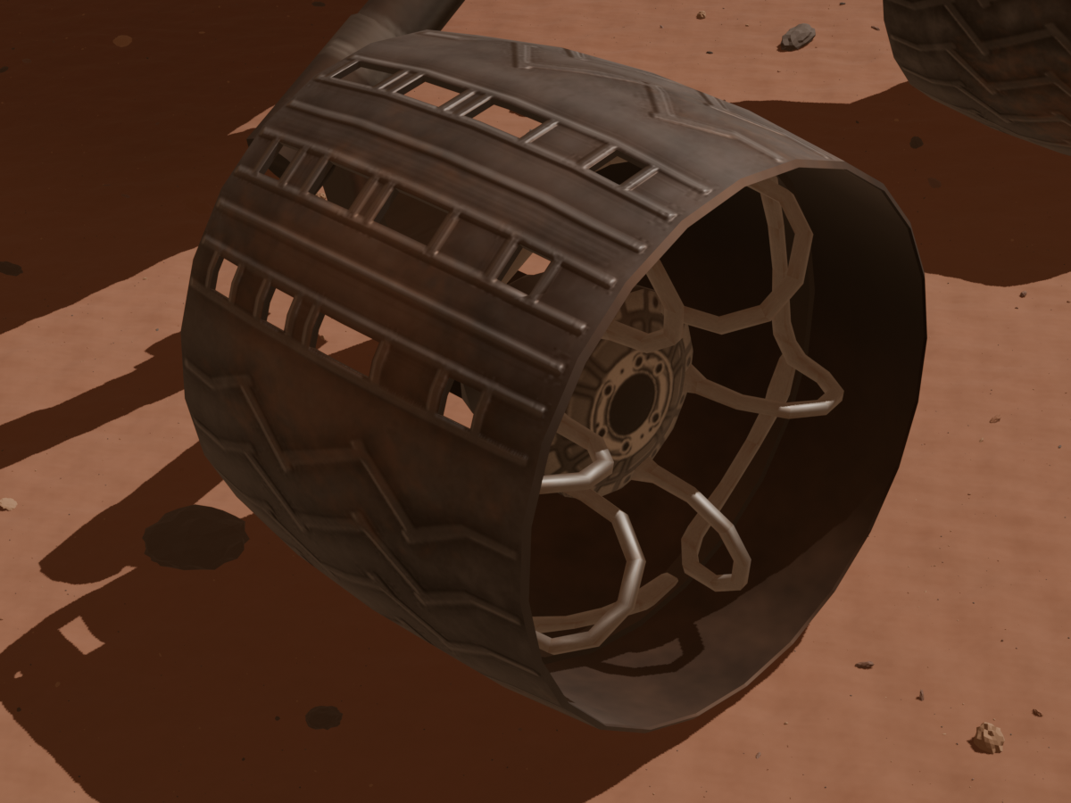
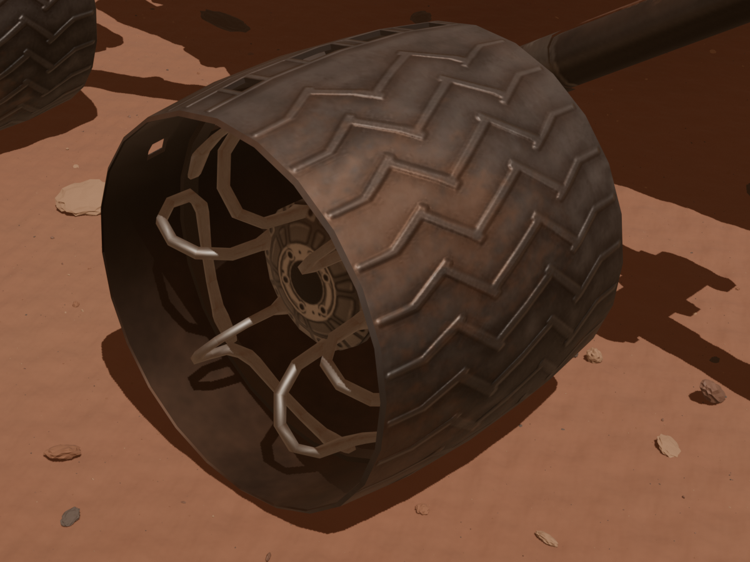
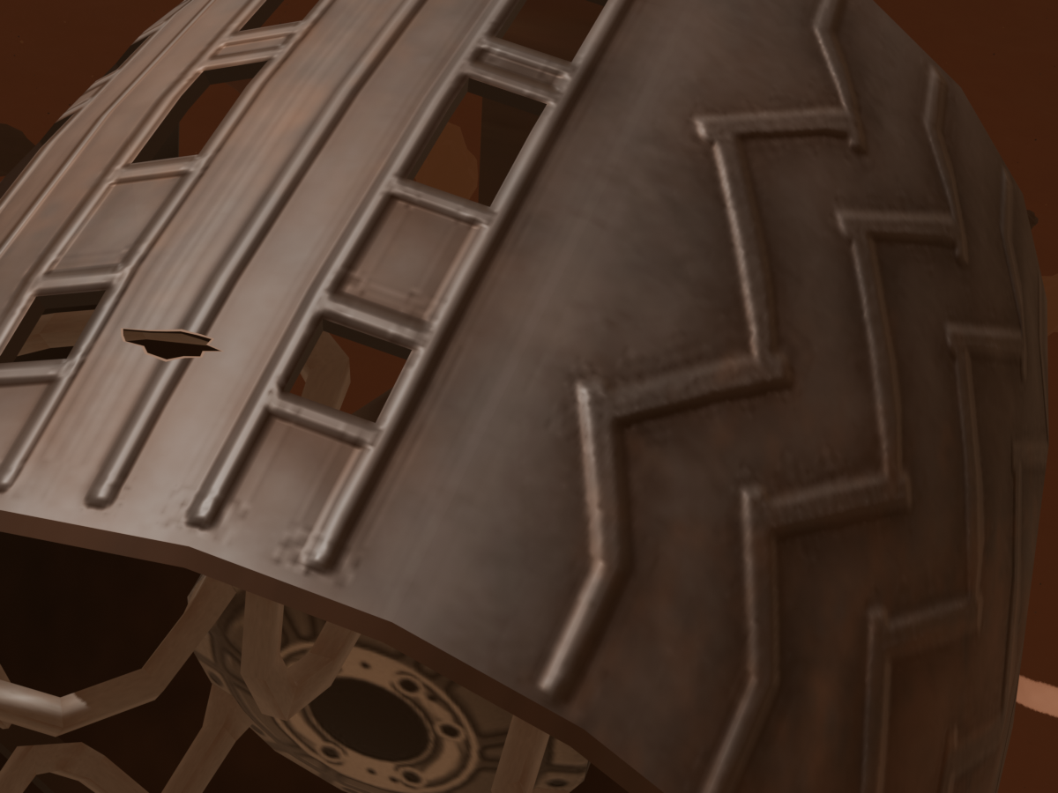
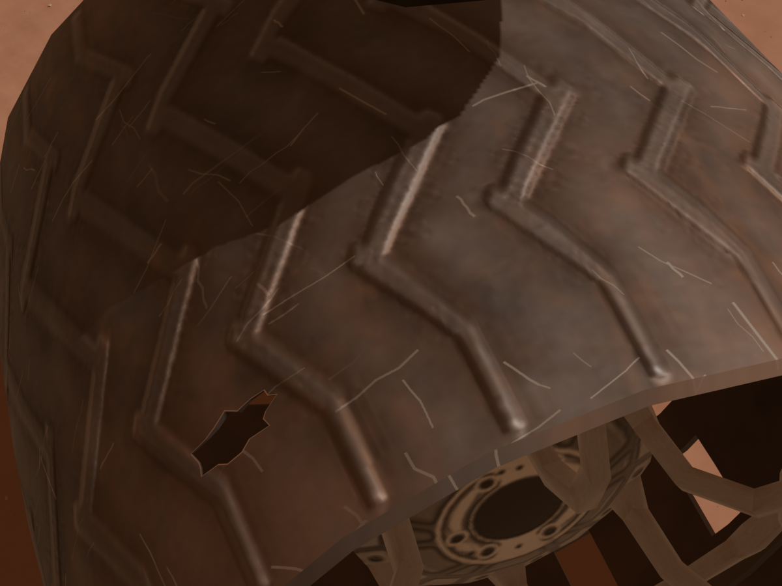
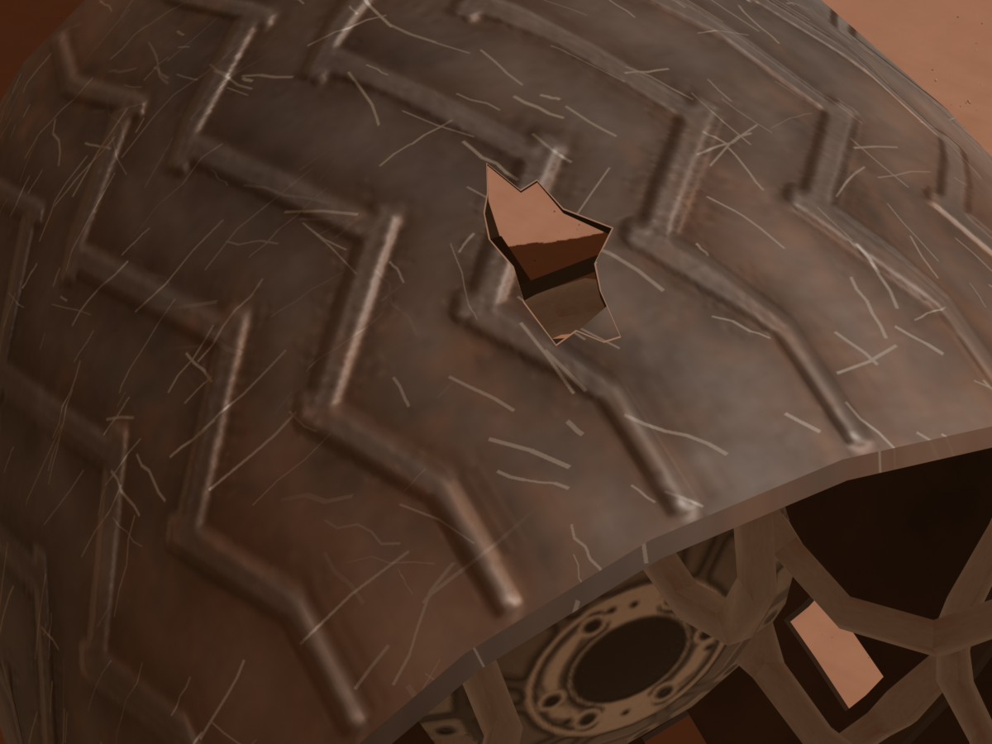
Extra: Variations and hole sizes
Lighting: Dusty (75%)
Lighting: Clear (25%)
Wear: None added (20%)
Wear: Light (45%)
Wear: Evident (35%)
View A: Overhead (40%)
View C1: Leading (27.5%)
View C2: Trailing (27.5%)
View D: Upper detail (5%)
Small hole: 50%*
2.7–4.1 cm
Medium hole: 40%*
4.4–6.8 cm
Large hole: 10%*
7.3–11.6 cm
Lighting, wear and views: all 10,000 images. *Hole sizes: 1,250 anomalous images only.
Daniele Venturini
27 October 2026
Extra
Notes:
Q&A reference slide, outside the main spoken presentation. All twelve pictures are original thesis renders from Chapter 3. The repeated normal baseline is intentional: it represents the dusty lighting preset, no additional wear and overhead pose A. Lighting and wear figure comparisons keep camera and wheel orientation fixed; the camera figure changes viewpoint with the same wheel orientation. Hole pictures illustrate generated geometry categories, not mechanical health. Hole-length ranges are small 2.7–4.1 cm, medium 4.4–6.8 cm, large 7.3–11.6 cm. Their 50/40/10% shares refer to the 1,250 anomalous images (625/500/125), while lighting, wear and camera shares refer to all 10,000 images. Apparent image size also depends on viewpoint. Source figures: thesis Chapter 3, Domain Randomization and Synthetic Damage Generation. Final dataset distributions (all 10,000 images): dusty 7,500 (75%), clear 2,500 (25%). No added wear 2,000 (20%), light wear 4,500 (45%), evident wear 3,500 (35%). Camera A overhead 4,000 (40%), C1 leading three-quarter 2,750 (27.5%), C2 trailing three-quarter 2,750 (27.5%), D upper detail 500 (5%). Frequencies were checked directly against the final samples.csv and the thesis Chapter 3 category-distribution table. The clear/dusty presets also change deposited dust and camera response. Small continuous lighting and camera jitter is applied within categories; the percentages describe categorical frequencies, not jitter magnitudes.

Slide 32
Extra: Loss-function comparison
0.5 CE
+ 0.5 GDL
SegFormer: +6.3 pp
U-Net R34: +5.0 pp
U-Net R34: Dice weighting within CE + GDL
Inverse square | Inverse volume | Uniform
64.5 | 57.2 | 62.2
Thesis, Section 5.4.1. Exploratory test mIoU (%), approximate values.
Daniele Venturini
27 October 2026
Extra 2 / 3
Notes:
Backup material. Optional explanation: approximately 45 seconds, outside the main 15-minute talk.
The exploratory loss comparison uses the highest-validation-mIoU checkpoint from each run. Adding Generalized Dice Loss to cross-entropy increases approximate test mIoU from 69.2 to 75.5% for SegFormer-B0 and from 59.5 to 64.5% for U-Net ResNet34. The combined objective gives equal coefficients to CE and GDL and uses inverse-square Dice weights. A separate U-Net comparison reaches 64.5% with inverse-square weights, 57.2% with inverse-volume weights and 62.2% with uniform weights. These approximate preliminary results motivated the default configuration. Standalone GDL was unstable and has no reported numerical result. No repeated-run uncertainty is reported in these exploratory tables.
Internal source: thesis/latex/Chapters/5 Evaluation of Lightweight Scene Understanding.tex, Section 5.4.1, tables tab:s5mars-exploratory-loss-ablation and tab:s5mars-exploratory-dice-weighting. Values intentionally retain the one-decimal precision of the thesis.
Icons8 Color artwork: https://img.icons8.com/color/96/learning.png. Attribution and terms: https://icons8.com/license

Slide 33
Extra: Augmentation and oversampling
75.55%
Default test mIoU
SegFormer-B0
CE + GDL
Flips and 90° rotations, training only. Validation/test images unchanged.
Thesis, Section 5.4.3.
Daniele Venturini
27 October 2026
Extra 3 / 3
Notes:
Backup material. Optional explanation: approximately 45 seconds, outside the main 15-minute talk.
All four SegFormer-B0 runs use CE + GDL and choose the checkpoint with highest validation mIoU. The default uses standard sampling, inverse-square Dice weights and no augmentation, reaching 80.28% validation and 75.55% test mIoU. Horizontal and vertical flips with random right-angle rotations reduce the scores to 73.99% and 66.86%. Oversampling with inverse-square weights reaches 70.64% and 71.02%. Uniform Dice weights partly recover the oversampled run to 79.28% and 72.90%, still below the default on both splits. Augmentation is disabled in both oversampling runs. The tests support the selected default for these policies and runs, rather than a general conclusion about augmentation or class balancing. Validation and test distributions remain unchanged.
Internal source: thesis/latex/Chapters/5 Evaluation of Lightweight Scene Understanding.tex, Section 5.4.3, table tab:s5mars-segformer-training-ablation. The chart transcribes all eight validation/test values and retains their two-decimal precision.
Icons8 Color artwork: https://img.icons8.com/color/96/settings.png. Attribution and terms: https://icons8.com/license

