Slide 1
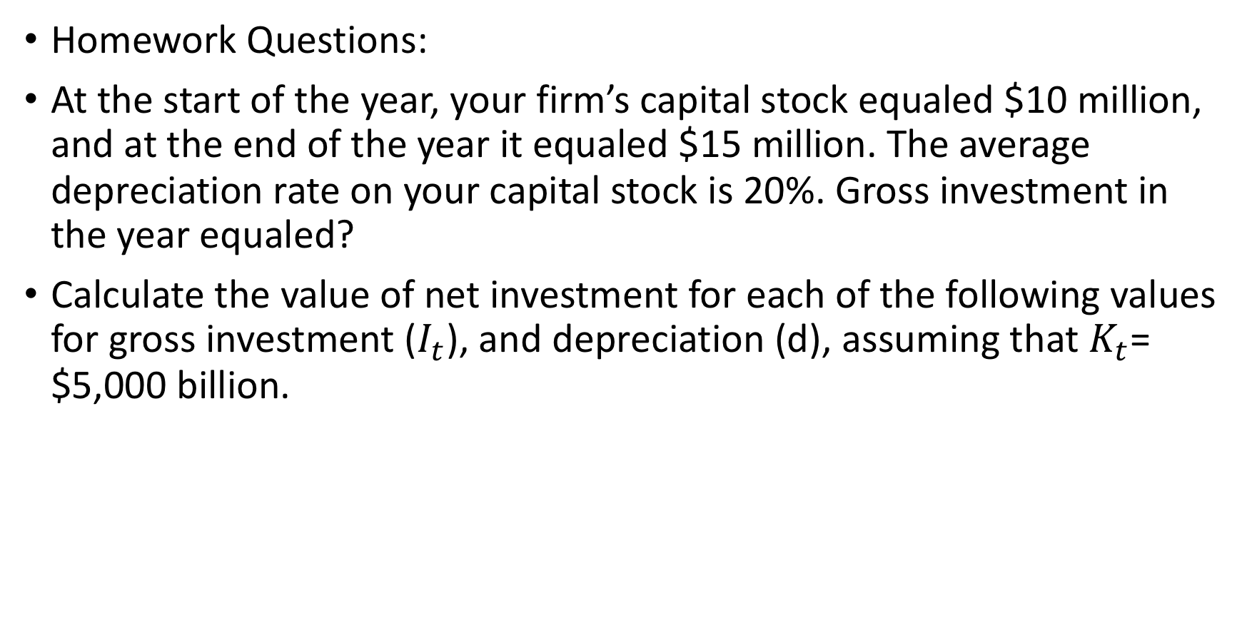
Gross & Net Investment
Homework Questions:
At the start of the year, your firm’s capital stock equaled $10 million, and at the end of the year it equaled $15 million. The average depreciation rate on your capital stock is 20%. Gross investment in the year equaled?
Calculate the value of net investment for each of the following values for gross investment ($I_{t}$), and depreciation (d), assuming that $K_{t}$= $5,000 billion.

Slide 2
Investment and the stock market
Firms change investment in the same direction as the stock market: Tobin’s q theory of investment
If market value > replacement cost, then firm should invest more
Tobin’s q = capital’s market value divided by its replacement cost
If q < 1, don’t invest
If q > 1, invest more
Stock price times number of shares equals firm’s market value, which equals value of firm’s capital
Formula: q = V/(p_{K}K), where V is stock market value of firm, K is firm’s capital, p_{K} is price of new capital
So p_{K}K is the replacement cost of firm’s capital stock
Stock market boom raises V, causing q to rise, increasing investment

Slide 3
Tobin’s q Example
Homework Question:
If the stock market value of a firm is $8 million and the firm owns $12 million of capital, then Tobin’s q equals?

Slide 4
Investment and the stock market cont’d.
Higher MPK^{f} increases future earnings of firm, so V rises
A falling real interest rate also raises V as people buy stocks instead of bonds
A decrease in the cost of capital, p_{K}, raises q
Homework Questions:
Calculate the user cost of a machine that costs $10,000 & depreciates at a 10% rate, when the nominal interest rate is 6% & the expected inflation rate is 3%
Calculate the after-tax user cost of capital of a machine that costs $5,000 and depreciates at a 25% rate, when the real interest rate is 5% and the tax rate on revenue is 25%

Slide 5
Goods Market Equilibrium
The real interest rate adjusts to bring the goods market into equilibrium
Y = C^{d} + I^{d} + G goods market equilibrium condition
Differs from income-expenditure identity, as goods market equilibrium condition need not hold; undesired goods may be produced, so goods market won’t be in equilibrium
Alternative representation: since
S^{d} = Y - C^{d} - G,
S^{d} = I^{d}

Slide 6
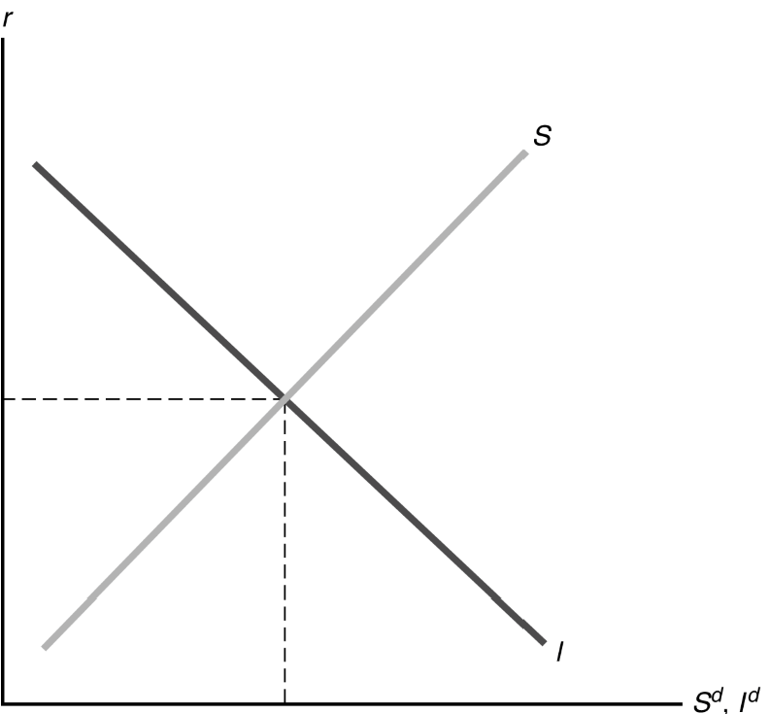
The Saving-Investment Diagram

Slide 7
The Saving and Investment Diagram Cont’d.
Equilibrium where S^{d} = I^{d}
How to reach equilibrium? Adjustment of r
Shifts of the saving curve
Saving curve shifts right due to a rise in current output, a fall in expected future output, a fall in wealth, a fall in government purchases, a rise in taxes (unless Ricardian equivalence holds, in which case tax changes have no effect)
Example: Temporary increase in government purchases shifts S left
Result of lower savings: higher r, causing crowding out of I

Slide 8
Shifts of the investment curve
Investment curve shifts right due to a fall in the effective tax rate or a rise in expected future marginal productivity of capital
Result of increased investment: higher r, higher S and I

Slide 9
Present & Future Value
Example: At an interest rate of 10%, $12,000 today invested for one year is worth $13,200 ($12,000 x 1.10); so the present value of $13,200 in one year is $12,000.
General Formula: Present Value = Future Value/(1+i), where amounts are in dollar terms and i is the nominal interest rate.
Alternatively, if amounts are in real terms, use the real interest rate r instead of the nominal interest rate.
Homework Problems:
Future Value of $10,000, i = 5%, n = 30
Present Value of $1,000,000, i = 10%, n = 10

Slide 10
Present value and the budget constraint
Present value of lifetime consumption:
PVLC = c + c ^{f}/(1 + r)
Homework Questions:
Thomas consumes 140 in the current period and 210 in the future period. The real interest rate is 5% per period. David’s present value of lifetime consumption is?
Thomas consumes 140 in the current period and 220 in the future period. David’s present value of lifetime consumption is 340. The real interest rate is?

Slide 11
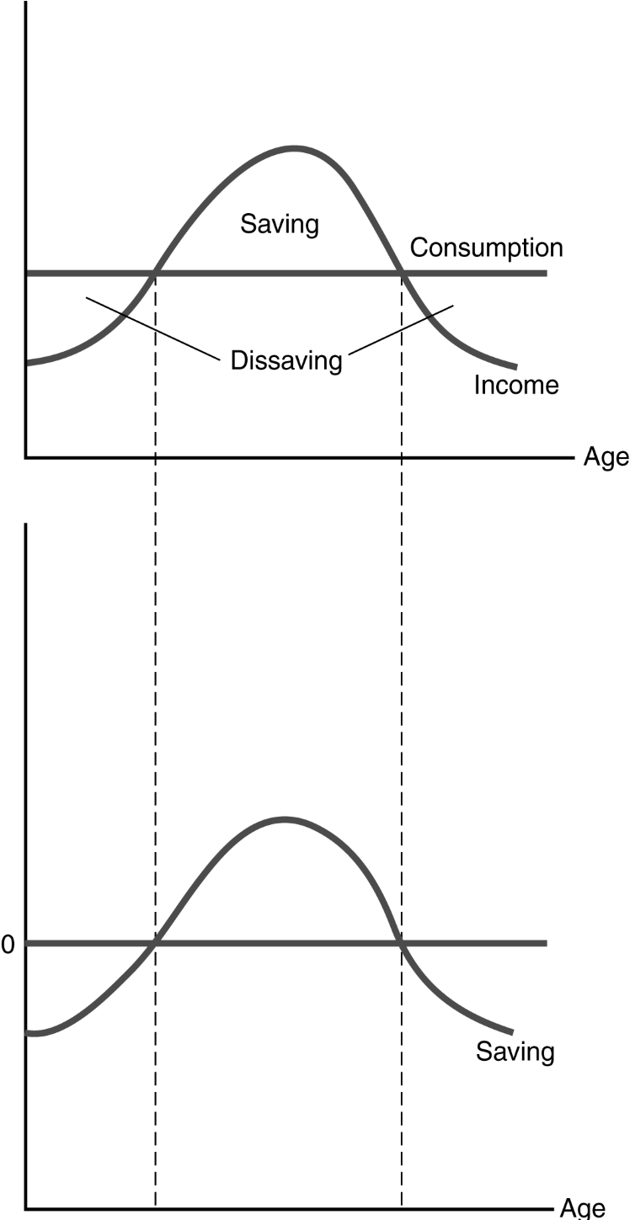
Consumption Smoothing

Slide 12
Consumption Smoothing Cont’d.
Real income steadily rises over time until near retirement; at retirement, income drops sharply
Lifetime pattern of consumption is much smoother than the income pattern
In reality, consumption varies somewhat by age
For example, when raising children, household consumption is higher than average
Saving has the following lifetime pattern
Saving is low or negative early in working life
Maximum saving occurs when income is highest (ages 50 to 60)
Dissaving occurs in retirement

Slide 13
Alternative Motives to Consumption Smoothing
There seems to be excess sensitivity of consumption to changes in current income
This could be due to shortsighted behavior
Or it could be due to borrowing constraints
Borrowing constraints mean people cannot borrow as much as they want Lenders may worry that a consumer won’t pay back the loan, so they won’t lend
If a person would not borrow anyway, the borrowing constraint is said to be nonbinding
But if a person wants to borrow and can’t, the borrowing constraint is binding
A consumer with a binding borrowing constraint spends all income and wealth on consumption
So an increase in income or wealth will be entirely spent on consumption as well
This causes consumption to be excessively sensitive to current income changes
How prevalent are borrowing constraints? Perhaps 20% to 50% of the U.S. population faces binding borrowing constraints

