Slide 1
Topics for the Rest of the Semester
Consumption, Saving, & Investment
The Money Market
Monetary Policy
Fiscal Policy

Slide 2
Consumption, Saving, and Investment

Slide 3
Learning Objectives
Describe the factors that affect consumption and saving decisions
Discuss the factors that affect the investment of firms
Explain the factors affecting goods market equilibrium

Slide 4
The importance of consumption and saving
Desired consumption: consumption amount desired by households
Desired national saving: level of national saving when consumption is at its desired level
S^{d} = Y - C^{d} - G

Slide 5
The consumption and saving decision of an individual
A person can consume less than current income (saving is positive)
A person can consume more than current income (saving is negative)
Trade-off between current consumption and future consumption
The price of 1 unit of current consumption is 1 + r units of future consumption, where r is the real interest rate
Consumption-smoothing motive: the desire to have a relatively even pattern of consumption over time

Slide 6
Effect of changes in current income
Increase in current income: both consumption and saving increase (vice versa for decrease in current income)
Marginal propensity to consume (MPC) = fraction of additional current income consumed in current period; between 0 and 1
Aggregate level: When current income (Y) rises, C^{d} rises, but not by as much as Y, so S^{d} rises
Example: MPC = 0.4, Increase in Current Income, $6,000
$6,000(0.4) = $2,400 increase in consumption.
Saving also increase by $6,000-$2,400= $3,600.
Assuming an MPC of 0.4 for all households, the Money Multiplier in the economy = 1/(1-MPC) or 1.67. This means that for every dollar injected into the economy generates $1.67 of demand for goods and services.

Slide 7
Effect of changes in expected future income
Higher expected future income leads to more consumption today, so saving falls

Slide 8
Effect of changes in wealth
Increase in wealth raises current consumption, so lowers current saving

Slide 9
Effect of changes in real interest rate
Increased real interest rate has two opposing effects
Substitution effect: Positive effect on saving, since rate of return is higher; greater reward for saving elicits more saving
Income effect
For a saver: Negative effect on saving, since it takes less saving to obtain a given amount in the future (target saving)
For a borrower: Positive effect on saving, since the higher real interest rate means a loss of wealth
Empirical studies have mixed results; probably a slight increase in aggregate saving

Slide 10
Taxes and the real return to saving
Expected real after-tax interest rate:
r_{a–t} = (1 - t)i - π^{e}
Homework Question: i = 5%, π^{e} = 2%; if t = 30%, r_{a–t} = ?; if t = 20%, r_{a–t} = ?

Slide 11
Fiscal policy
Affects desired consumption through changes in current and expected future income
Directly affects desired national saving, S^{d} = Y - C^{d} - G
Government purchases (temporary increase)
Higher G financed by higher current taxes reduces after-tax income, lowering desired consumption
Even true if financed by higher future taxes, if people realize how future incomes are affected
Since C^{d} declines less than G rises, national saving (S^{d} = Y - C^{d} - G) declines
Thus, government purchases reduce both desired consumption and desired national saving

Slide 12
Taxes
Lump-sum tax cut today, financed by higher future taxes
Decline in future income may offset increase in current income; desired consumption could rise or fall
Ricardian equivalence proposition
If future income loss exactly offsets current income gain, no change in consumption
Tax change affects only the timing of taxes, not their ultimate amount (present value)
In practice, people may not see that future taxes will rise if taxes are cut today; then a
tax cut leads to increased desired consumption and reduced desired national saving

Slide 13
Investment
Why is investment important?
Investment fluctuates sharply over the business cycle, so we need to understand investment to understand the business cycle
Investment plays a crucial role in economic growth
The desired capital stock
Desired capital stock is the amount of capital that allows firms to earn the largest expected profit
Desired capital stock depends on costs and benefits of additional capital
Since investment becomes capital stock with a lag, the benefit of investment is the future marginal product of capital (MPK^{f} )
The user cost of capital
Example of Kyle’s Bakery: cost of capital, depreciation rate, and expected real interest rate
User cost of capital = real cost of using a unit of capital for a specified period of time = real interest cost + depreciation
uc = rp_{K} + dp_{K} = (r + d)p_{K}

Slide 14
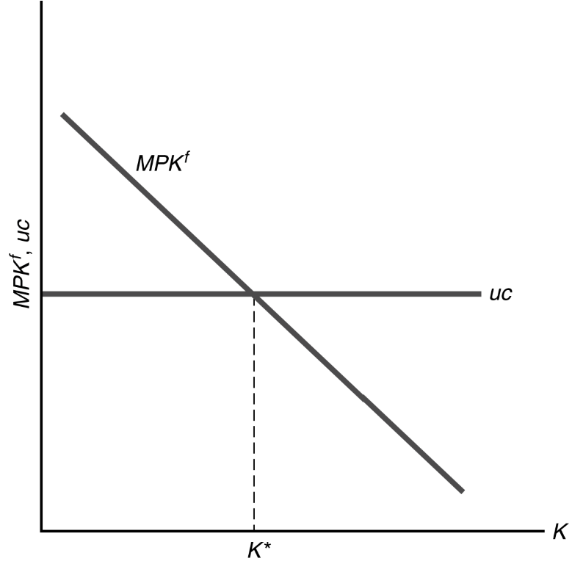
Investment- Cont’d.
Determining the desired capital stock

Slide 15
Investment Cont’d.
Desired capital stock is the level of capital stock at which MPK^{f} = uc
MPK^{f} falls as K rises due to diminishing marginal productivity
uc doesn’t vary with K, so is a horizontal line
If MPK^{f} > uc, profits rise as K is added (marginal benefits > marginal costs)
If MPK^{f} < uc, profits rise as K is reduced (marginal benefits < marginal costs)
Profits are maximized where MPK^{f} = uc

Slide 16
Changes in the desired capital stock
Factors that shift the MPK^{f} curve or change the user cost of capital cause the desired capital stock to change
These factors are changes in the real interest rate, depreciation rate, price of capital, or technological changes that affect the MPK^{f}
Taxes and the desired capital stock
With taxes, the return to capital is only (1 - t)MPK^{f}
A firm chooses its desired capital stock so that the return equals the user cost, so (1 - t)MPK^{f} = uc, which means:
MPK^{f} = uc/(1 - t) = (r + d)p_{K}/(1 - t)
Tax-adjusted user cost of capital is uc/(1 - t)
An increase in t raises the tax-adjusted user cost and reduces the desired capital stock

Slide 17
From the desired capital stock to investment
The capital stock changes from two opposing channels
New capital increases the capital stock; this is gross investment
The capital stock depreciates, which reduces the capital stock
Net investment = gross investment (I) minus depreciation:
K_{t+1} - K_{t} = I_{t} - dK_{t} where net investment equals the change in the capital stock
Rewriting gives I_{t} = K_{t+1} - K_{t} + dK_{t}
If firms can change their capital stocks in one period, then the desired capital stock
(K*) = K_{t+1}
So I_{t} = K* - K_{t} + dK_{t} (4.6) c. Thus investment has two parts
Desired net increase in the capital stock over the year (K* - K_{t})
Investment needed to replace depreciated capital (dK_{t})

